Slide 1

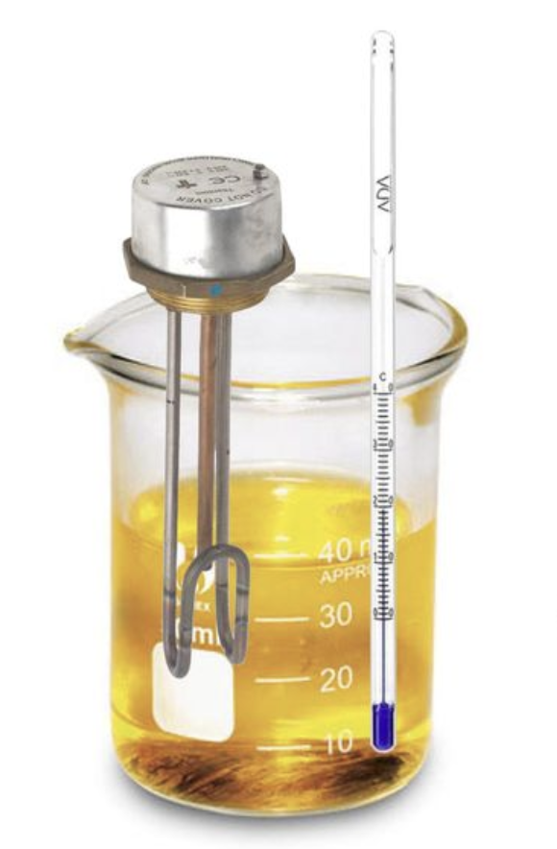
0001.01
Mission Assignment
Task | Complete the required practical for specific heat capacity.
Developing skills | Concentrate on the skills of planning, organising, data collection, analysis and reporting
Think about… | How to improve your experiment to increase the reliability and validity of your data.
KS4-18-08:
Required Practical

