Slide 1
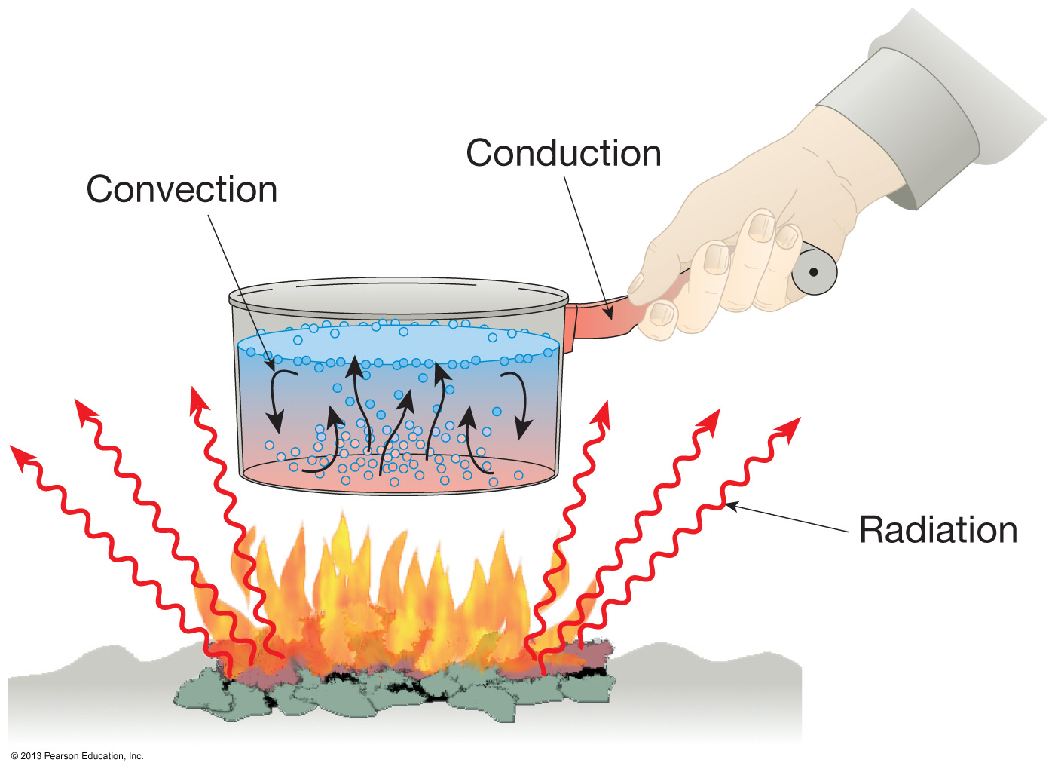
Developing Experts All rights reserved © 2021

Slide 2
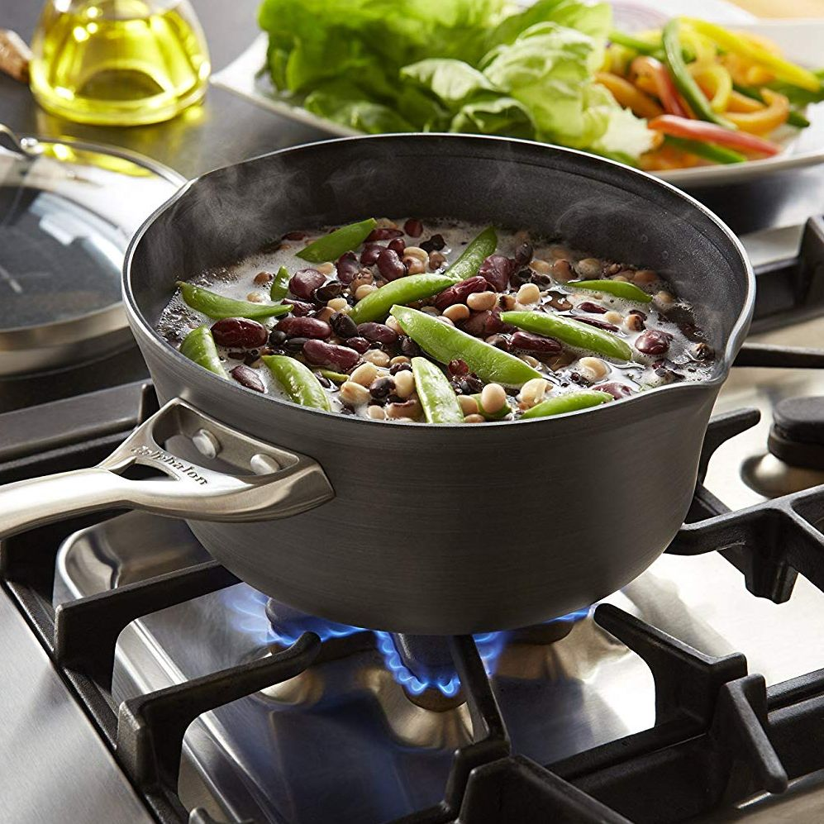
Explore specific heat capacity
Define specific heat capacity
Calculate specific heat capacity using the equation
Compare values for specific heat capacity ad explain how this information can be useful
Developing Experts All rights reserved © 2021

Slide 3
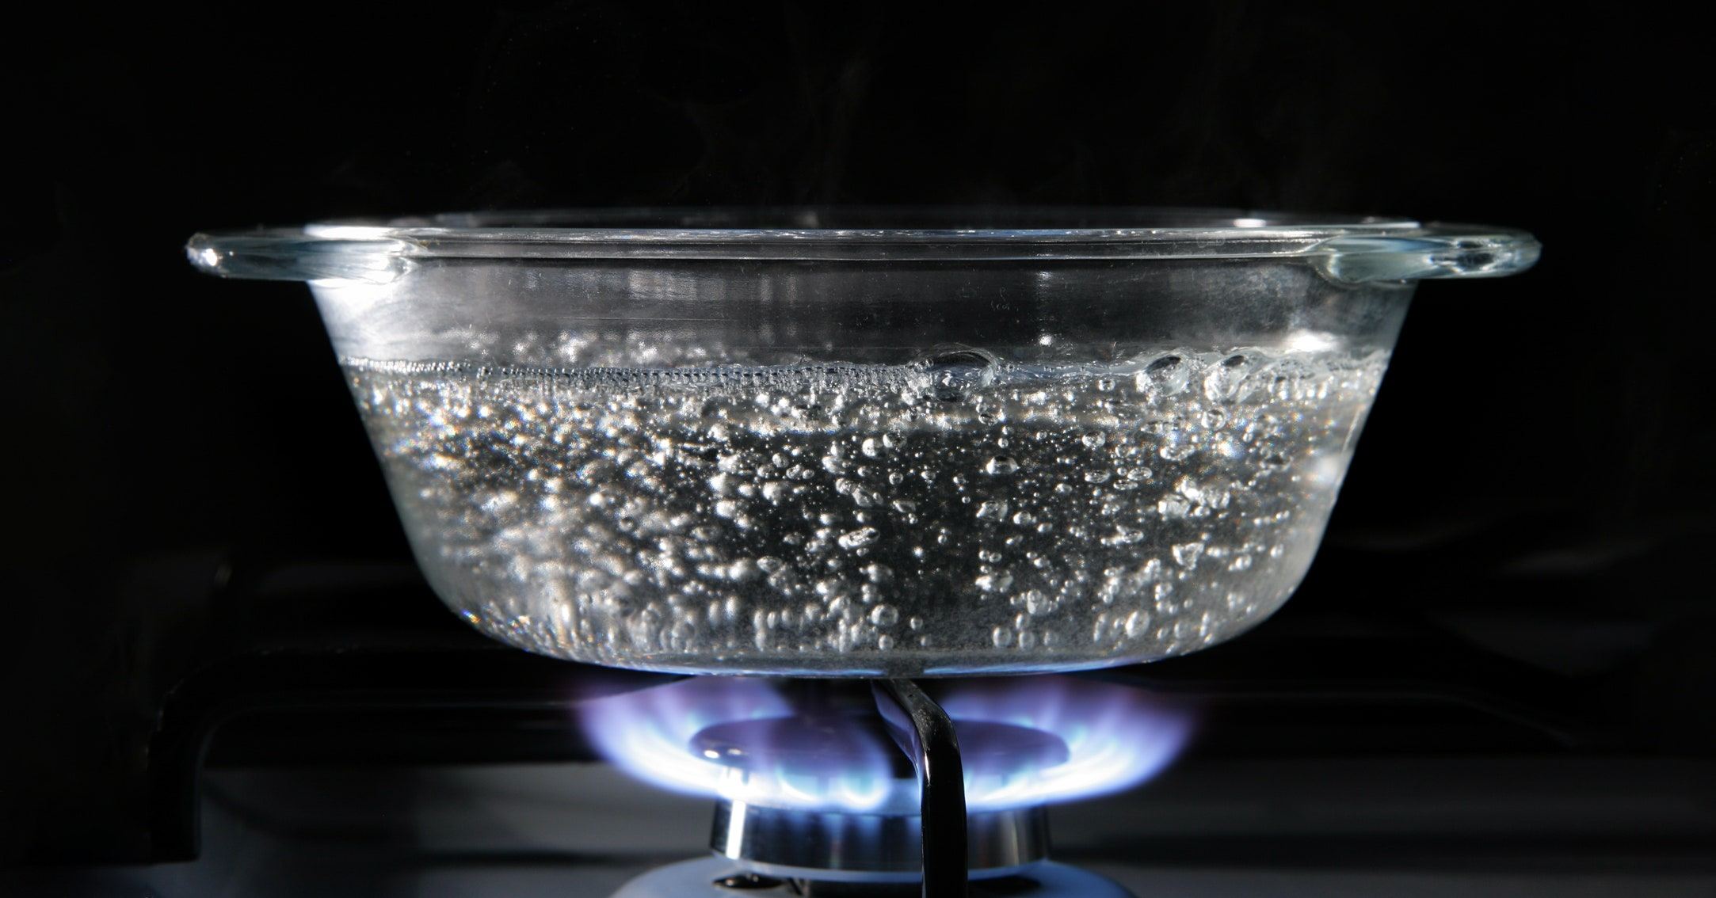
How much energy is stored in hot water?
Developing Experts All rights reserved © 2021

Slide 4
Calculate the energy required to increase the temperature of two kilograms of water, from 20 degrees Celsius to 100 degrees Celsius. The specific heat capacity of water is 4200 joules per kilogram per degree Celsius.
Developing Experts All rights reserved © 2021vv

Slide 5
ΔE
= m × c ×
Δθ
change in thermal energy (J)
mass
(kg)
specific heat capacity (J/kg/°C)
temperature change (°C)
Developing Experts All rights reserved © 2021

Slide 6
Calculate the energy required to increase the temperature of two kilograms of water, from 20 degrees Celsius to 100 degrees Celsius. The specific heat capacity of water is 4200 joules per kilogram per degree Celsius.
ΔE
= m × c ×
Δθ
change in thermal energy (J)
mass
(kg)
specific heat capacity (J/kg/°C)
Temperature change (°C)
Developing Experts All rights reserved © 2021

Slide 7
ΔE
= m × c ×
Δθ
ΔE
= 2 × 4200 ×
(100 − 20)
ΔE
= 2 × 4200 ×
80
ΔE
= 672000 J
ΔE
= 672 kJ
Developing Experts All rights reserved © 2021

Slide 8
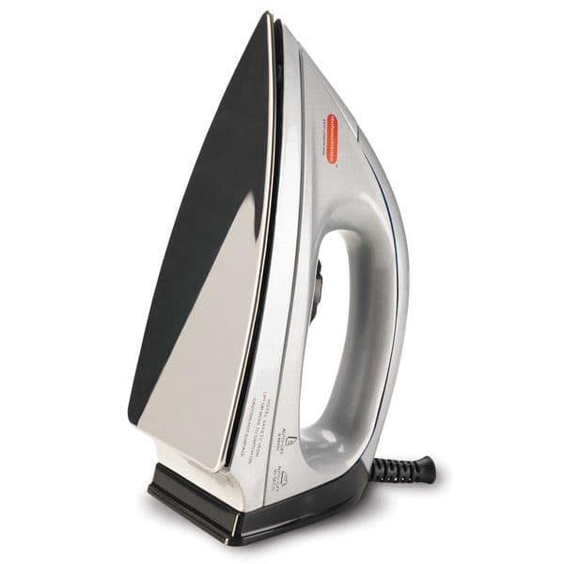
An iron has an aluminium plate with a mass of
1.5 kilograms.
Calculate the change in thermal energy in the plate when the temperature rises from 20 degrees Celsius to 200 degrees Celsius. The specific heat capacity of aluminium is 913 joules per kilogram per degree Celsius.
aluminum plate
ΔE
= m × c ×
Δθ
Developing Experts All rights reserved © 2021

Slide 9
An iron has an aluminium plate with a mass of 1.5 kilograms. Calculate the change in thermal energy in the plate when the temperature rises from 20 degrees Celsius to 200 degrees Celsius. The specific heat capacity of aluminium is 913 joules per kilogram per degree Celsius.
ΔE
= m × c ×
Δθ
ΔE
= 1.5 × 913 ×
(200 − 20)
ΔE
= 1.5 × 913 ×
180
ΔE
=
246,510 J
ΔE
=
246.51 kJ
Developing Experts All rights reserved © 2021

Slide 10
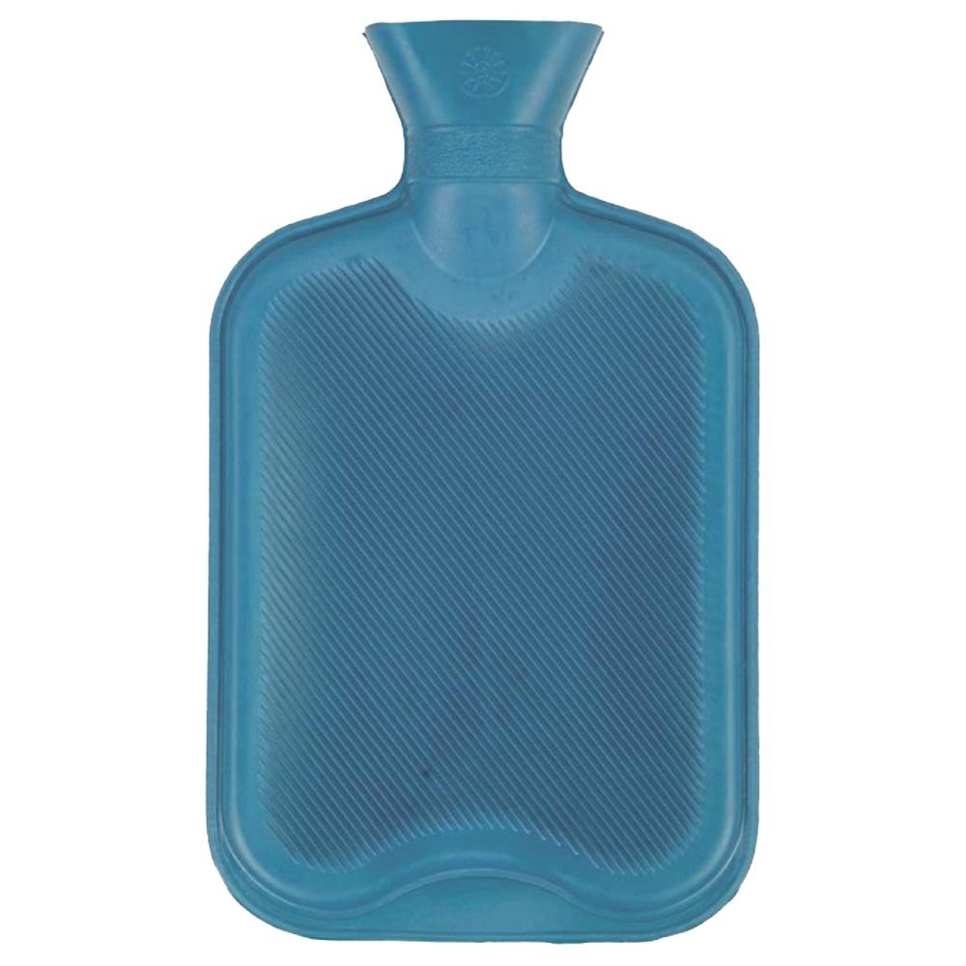
ΔE
= m × c ×
Δθ
A hot water bottle cools down from 80 degrees Celsius to 20 degrees Celsius, releasing 756,000 joules of thermal energy.
Calculate the mass of water in the hot water bottle. The specific heat capacity of water is 4,200 joules per kilogram per degree Celsius.
Developing Experts All rights reserved © 2021

Slide 11
ΔE
= m × c ×
Δθ
(first, rearrange the equation to make m (mass) the subject)
ΔE
m
=
c × Δθ
756000
m
=
4200 × 60
m
=
3 kg
Developing Experts All rights reserved © 2021

