Slide 1
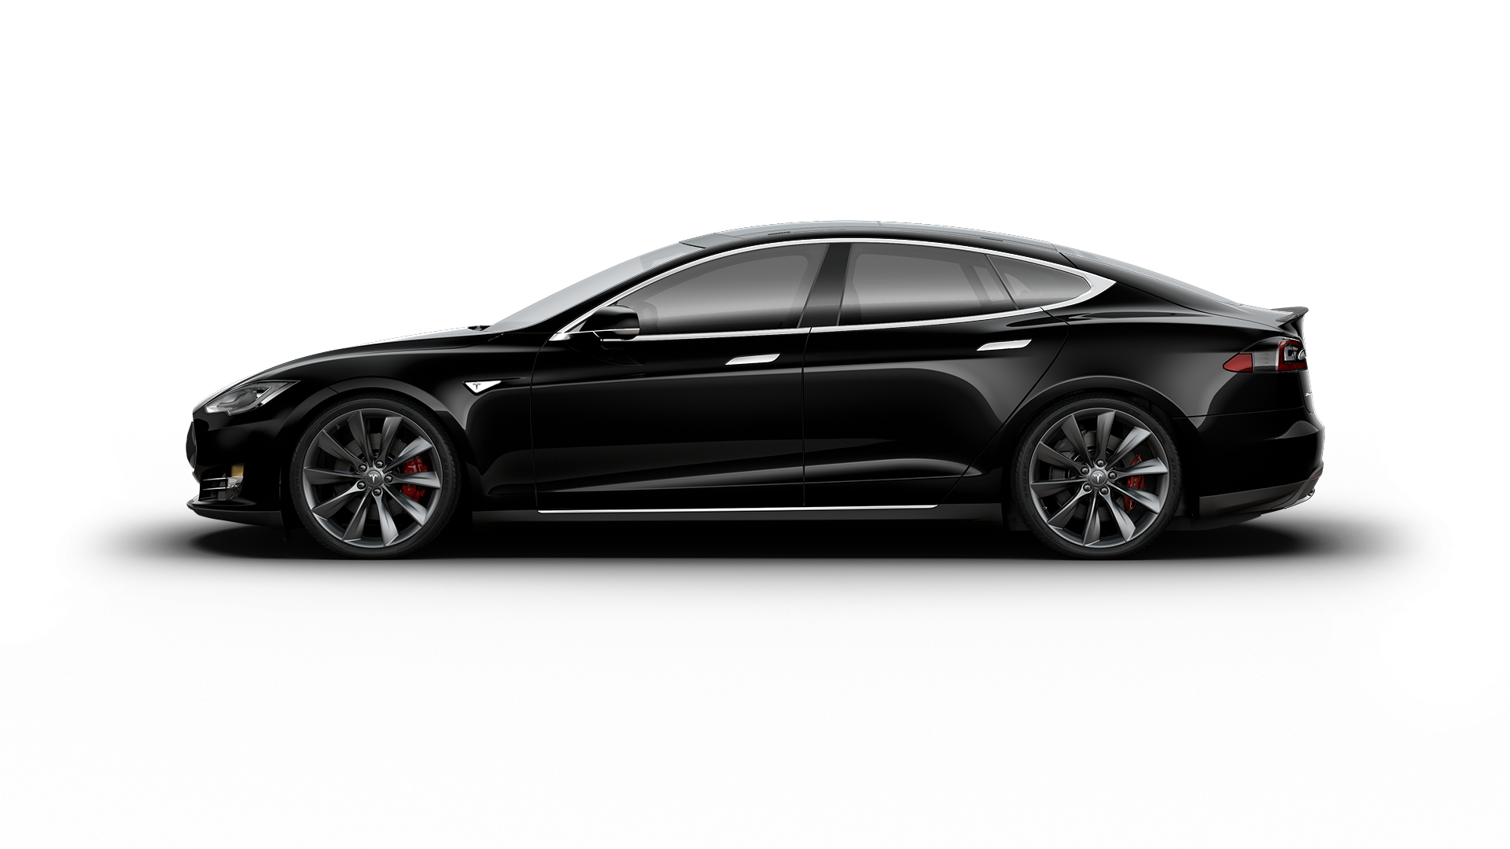
Kinetic Energy
The 5 most common energy stores are:
Chemical
Kinetic
Gravitational Potential
Thermal
Elastic Potential Energy
Developing Experts All rights reserved © 2021

Slide 2
Kinetic Energy
Describe what's meant by kinetic energy
Be able to calculate the kinetic energy of a moving object.
Developing Experts All rights reserved © 2021

Slide 3
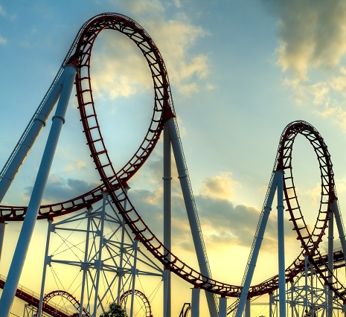
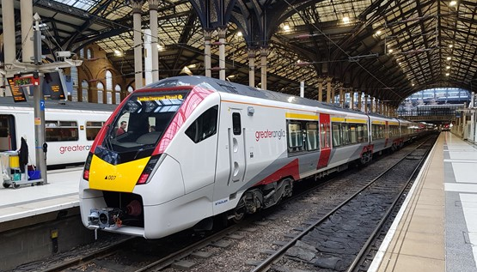
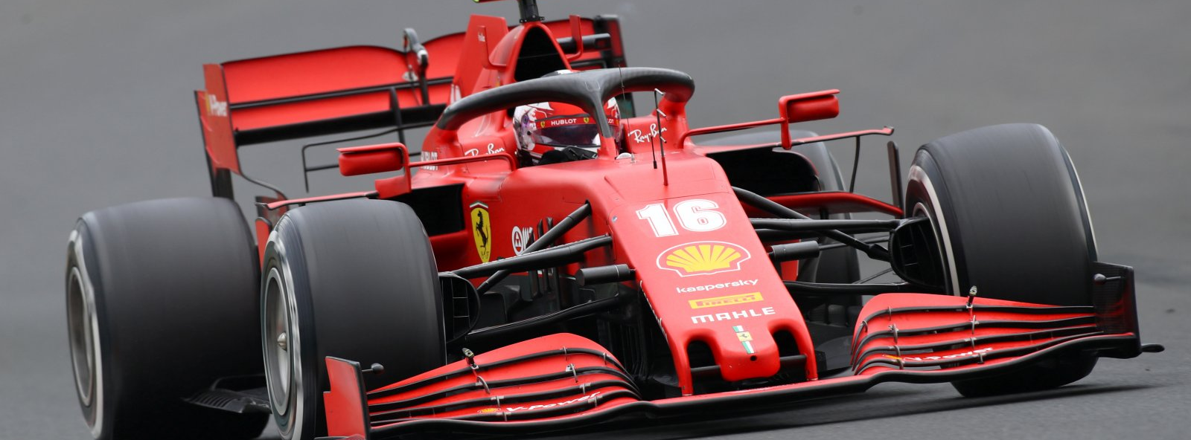
Developing Experts All rights reserved © 2021

Slide 4
Kinetic Energy
Kinetic energy is the energy stored in moving objects.
Stationary objects have no kinetic energy.
E_{K} = 0.5 × m × v²
Kinetic energy
mass (kg)
Speed
(m/s)

Slide 5
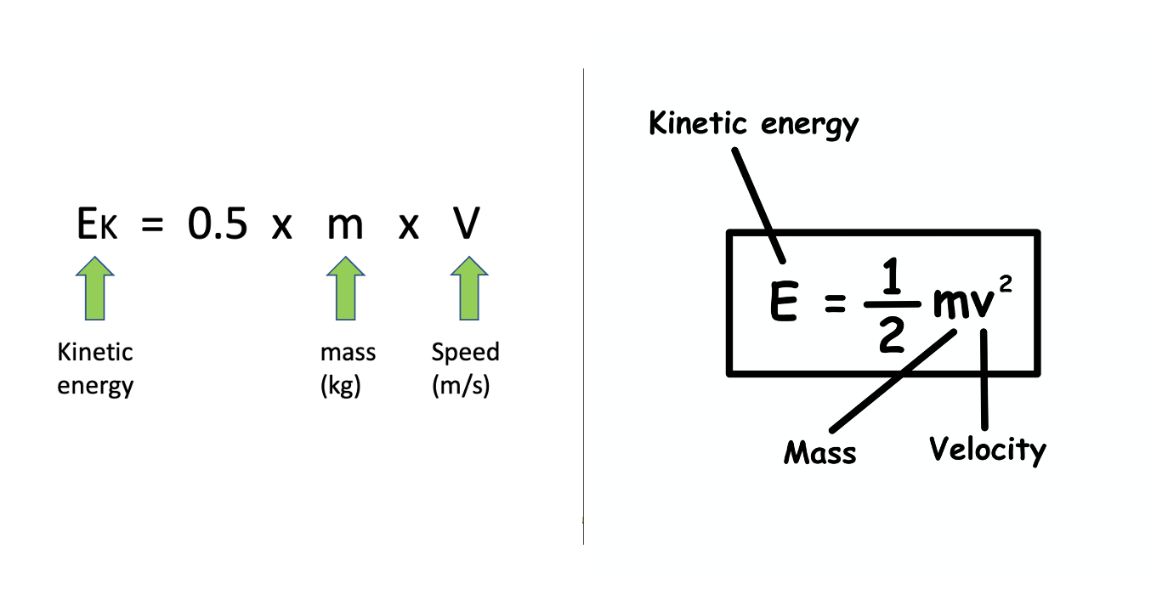
E_{K} = 0.5 × m × v²
speed

Slide 6
Kinetic Energy
Chemical energy stored in petrol
Kinetic energy store
Developing Experts All rights reserved © 2021

Slide 7
20 (m/s)
Kinetic Energy
A car with a mass of 700 kilograms is moving with the speed of 20 metres per second. Calculate the kinetic energy of the car.
E_{K} = 0.5 × m × v²
Developing Experts All rights reserved © 2021

Slide 8
20 (m/s)
Kinetic Energy
A car with a mass of 700 kilograms is moving with the speed of 20 metres per second. Calculate the kinetic energy of the car.
E_{K} = 0.5 × m × v²
E_{K} = 0.5 × 700 × 20²
EK = 140,000 J
E_{K} = 140 kJ
Developing Experts All rights reserved © 2021

Slide 9
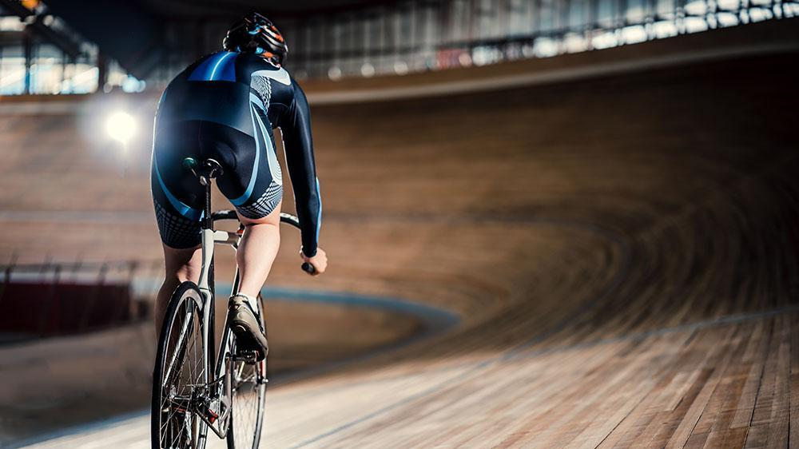
Kinetic Energy
A cyclist and bike have a total mass of 100 kilograms and a speed of 15 metres per second. Calculate the kinetic energy.
E_{K} = 0.5 × m × v²
Developing Experts All rights reserved © 2021

Slide 10
Kinetic Energy
E_{K} = 0.5 × m × v²
E_{K} = 0.5 × 100 × 15²
E_{K} = 11,250 J
E_{K} = 11.25 kJ
Developing Experts All rights reserved © 2021

Slide 11
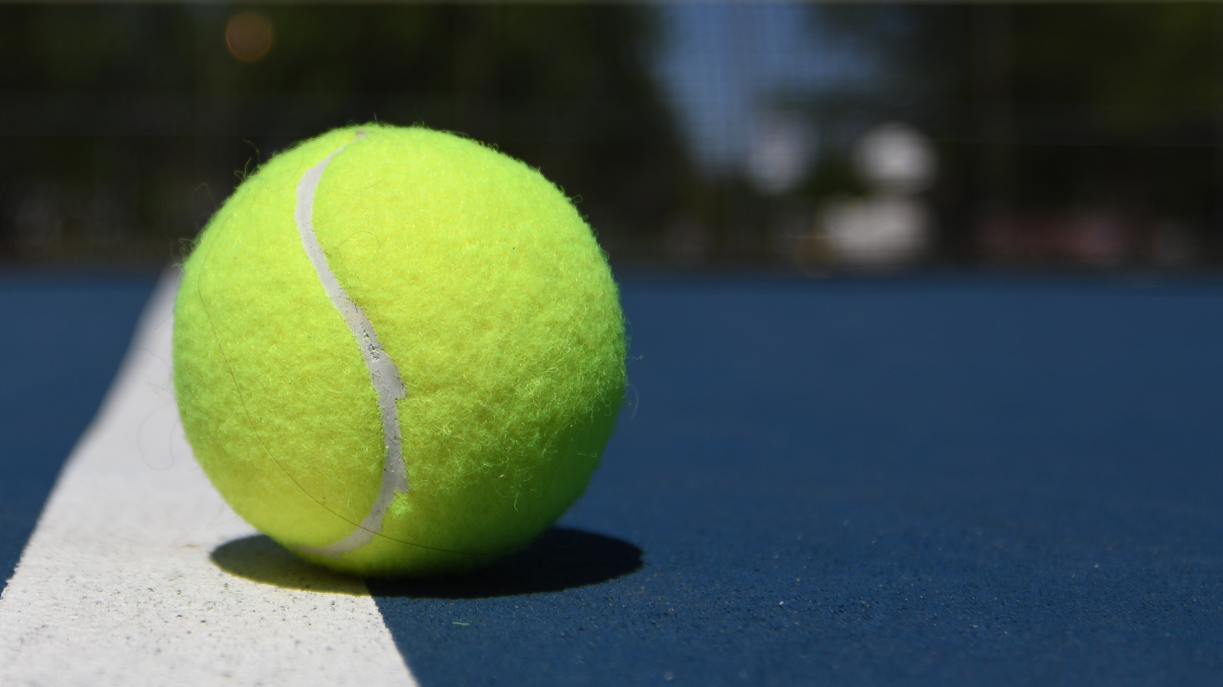
Kinetic Energy
A tennis ball is traveling at 50 metres per second and has a kinetic energy of 75 joules. Calculate the mass of the tennis ball.
E_{K} = 0.5 × m × v²
Developing Experts All rights reserved © 2021

Slide 12
Kinetic Energy
A tennis ball is traveling at 50 metres per second and has a kinetic energy of 75 joules. Calculate the mass of the tennis ball.
E_{K} = 0.5 × m × v²
E_{K}
75
m =
=
0.5 × 50²
0.5 × v²
m = 0.06 kg
Developing Experts All rights reserved © 2021

