Slide 1
Plant some seeds in the following conditions. Leave them for a week or two then draw what they look like.
watered and warm
watered and cold
dry and warm
dry and cold

Slide 2
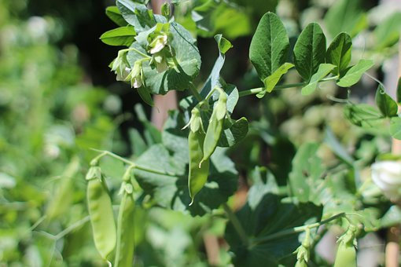
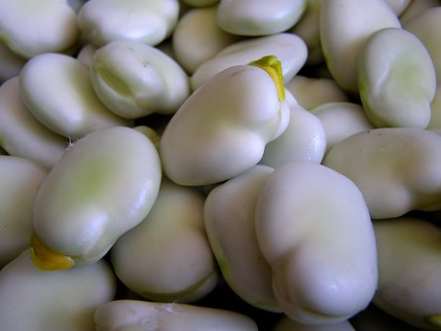
Draw and explain what you need to do to plant and grow a broad bean.
Stretch:
Describe and record in detail how to plant a broad bean.
Challenge:
Describe and record how to plant a broad bean.
___________________________________________________
___________________________________________________
___________________________________________________
___________________________________________________

