Slide 1









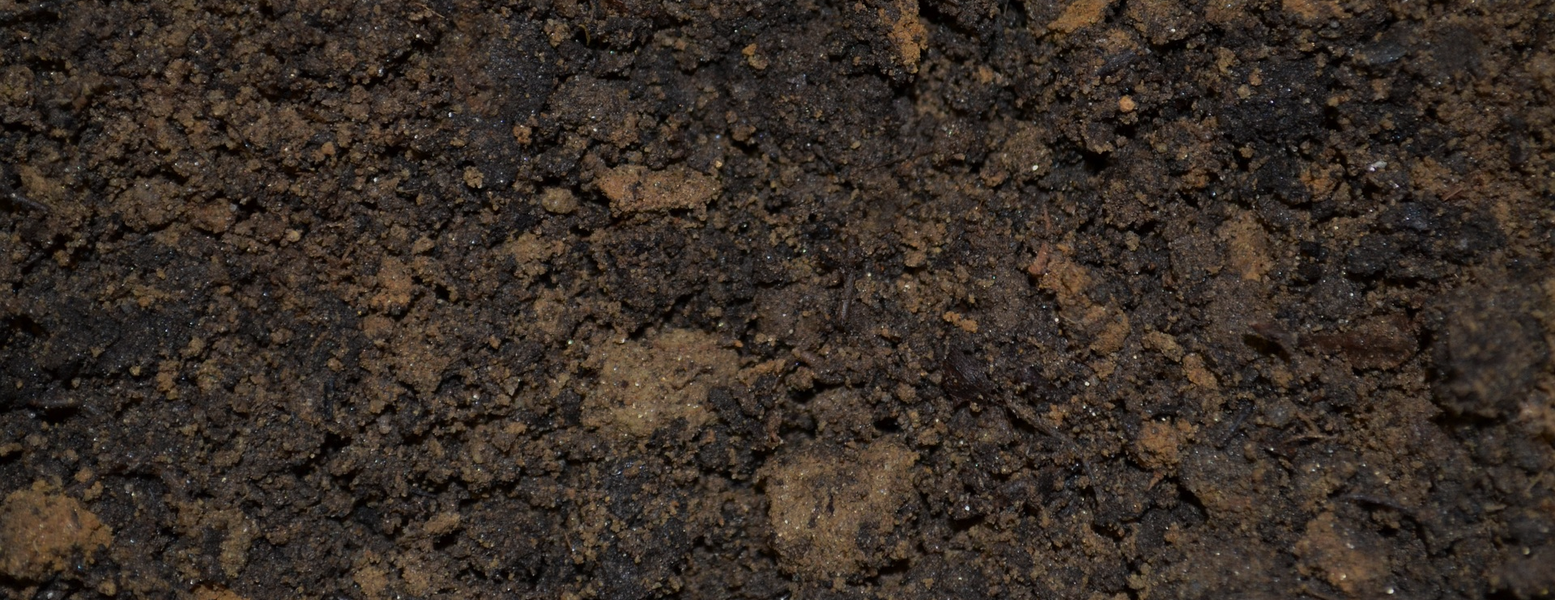
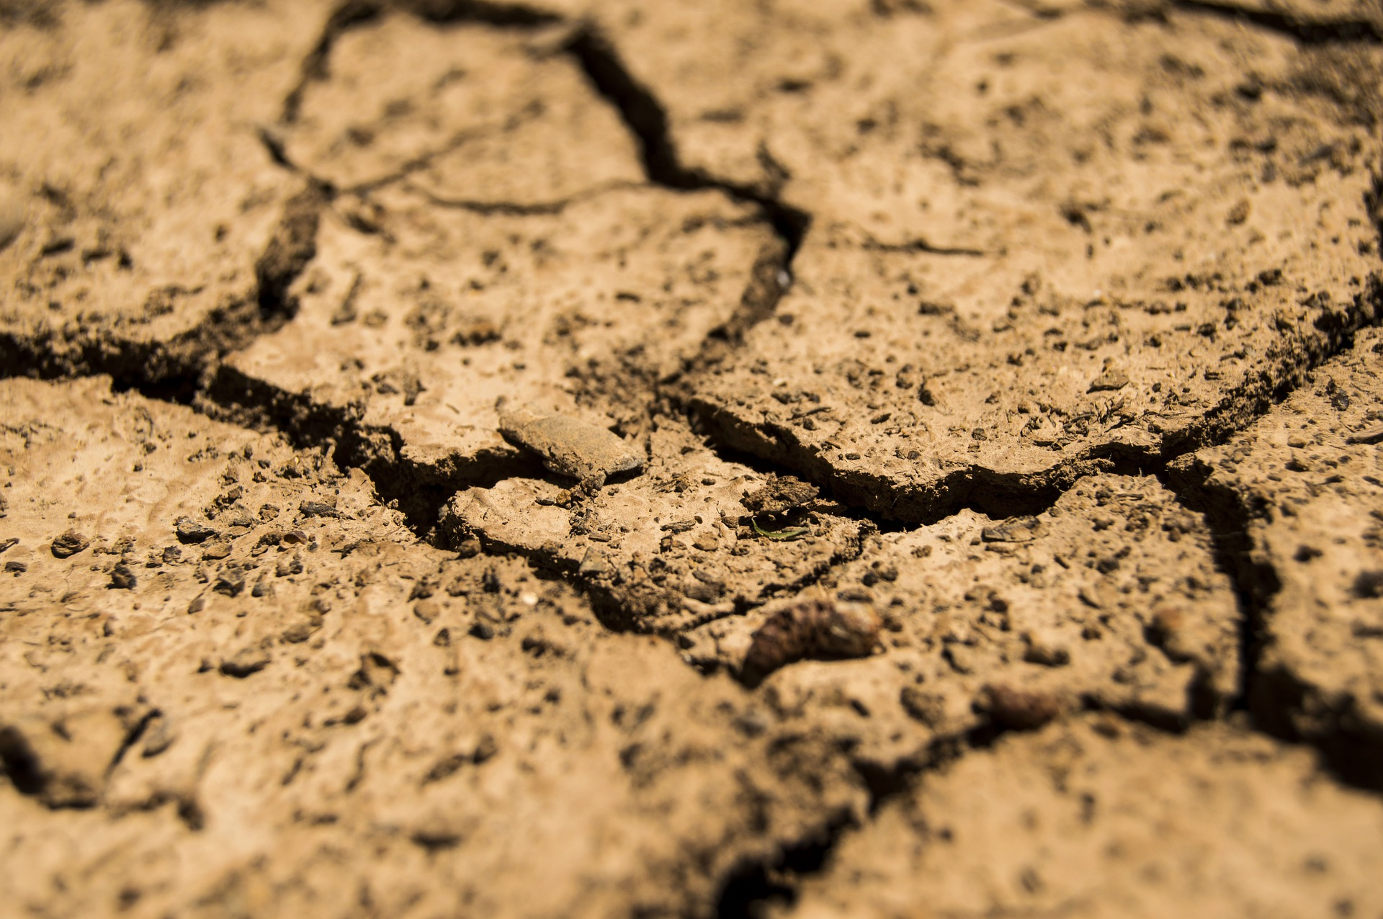
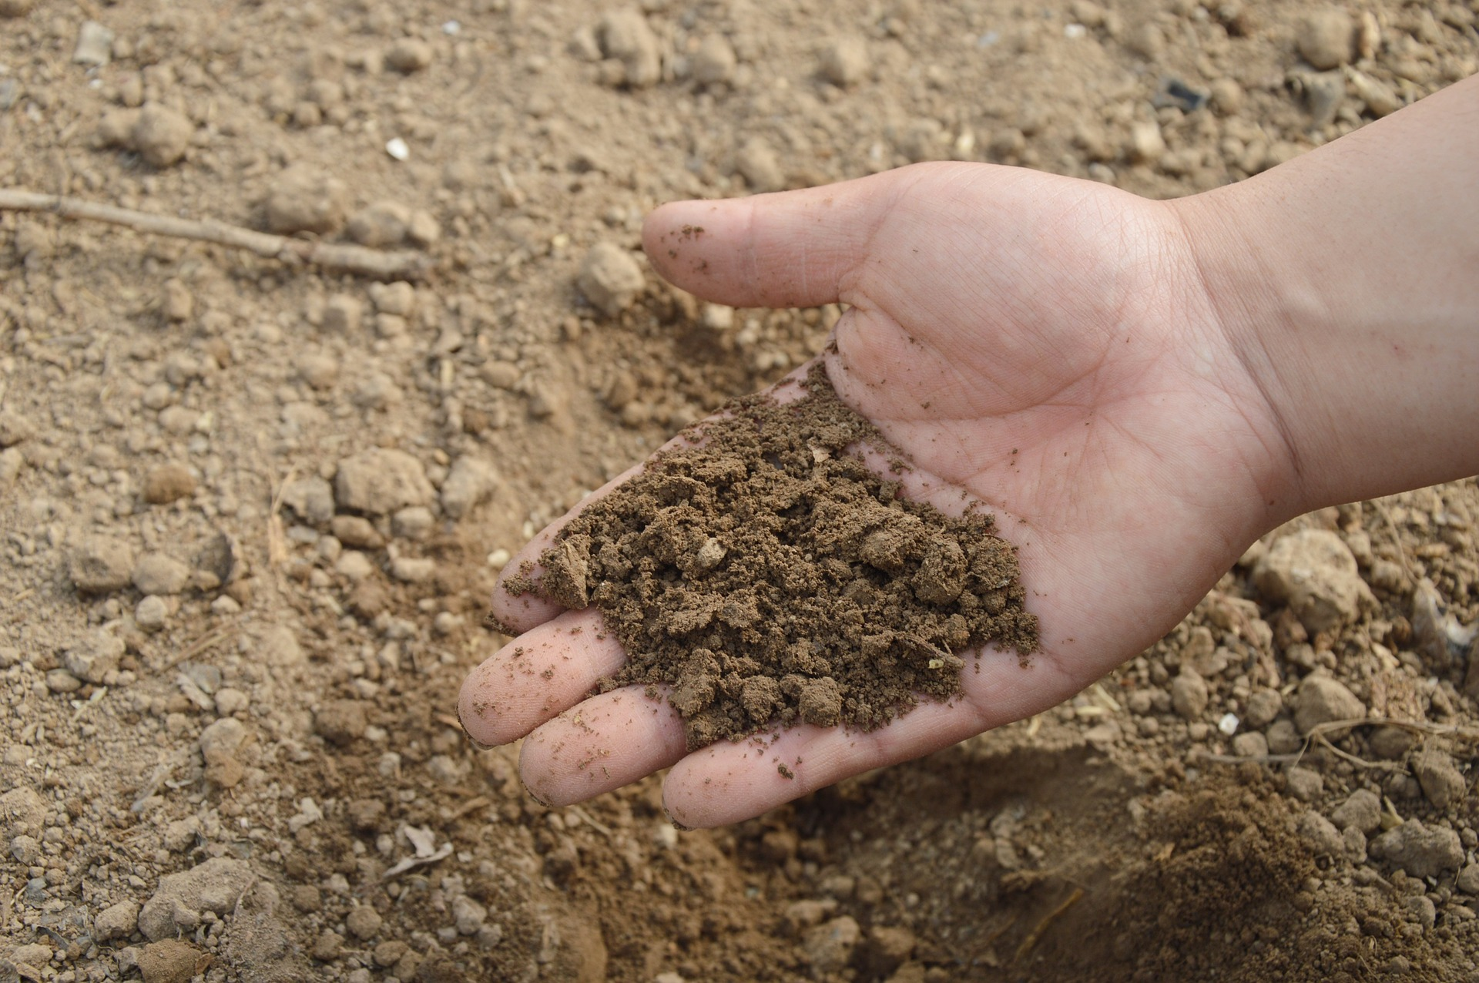
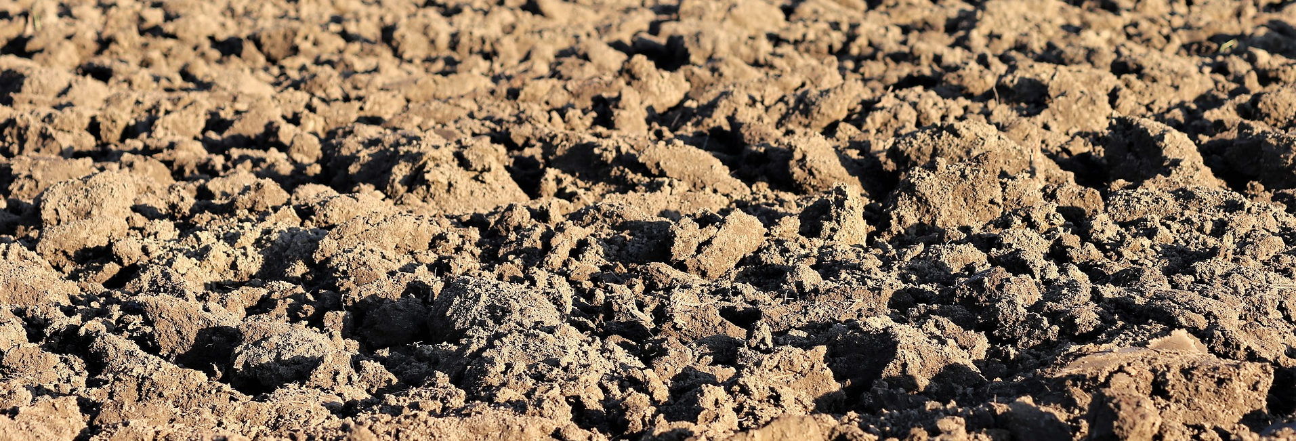
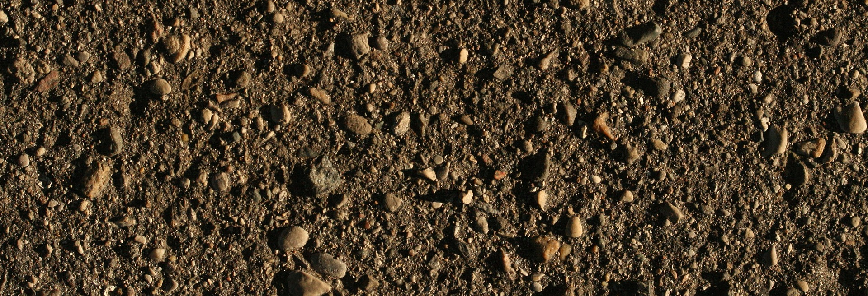
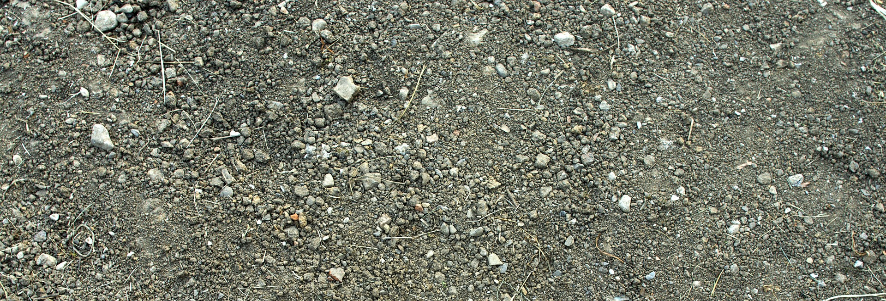
Mission Assignment: Understand what fossils are
MA Code: S03_04_03
Use this soil fact sheet to help you discover the names of the four soil types you have.
Peat soil
Very dark colour
Mostly organic matter
Holds a lot of moisture
Clay soil
Slightly orange colour
Very fine particles
Sticky when wet
Holds a lot of water but water may run off it at first
Sandy soil
Light, yellow/brown colour
Feels gritty
Falls through fingers
Does not hold water well
Silt soil
Medium colour
Feels slippery and smooth
Small particles
Holds some water
Loam soil
Dark/medium colour
Feels slightly gritty & smooth
Holds some water
Chalky soil
Light colour
May have lumps of white stone in it.
Does not hold water well
Developing Experts Copyright 2022 All Right Reserved

Slide 2
Mission Assignment: Understand what fossils are
MA Code: S03_04_03
Fill in the table with your observations.
 | Soil 1 | Soil 2 | Soil 3 | Soil 4
Colour
Texture
Smell
Other notes about its appearance
Amount of water held (ml)
Soil type
Developing Experts Copyright 2022 All Right Reserved

