Slide 1
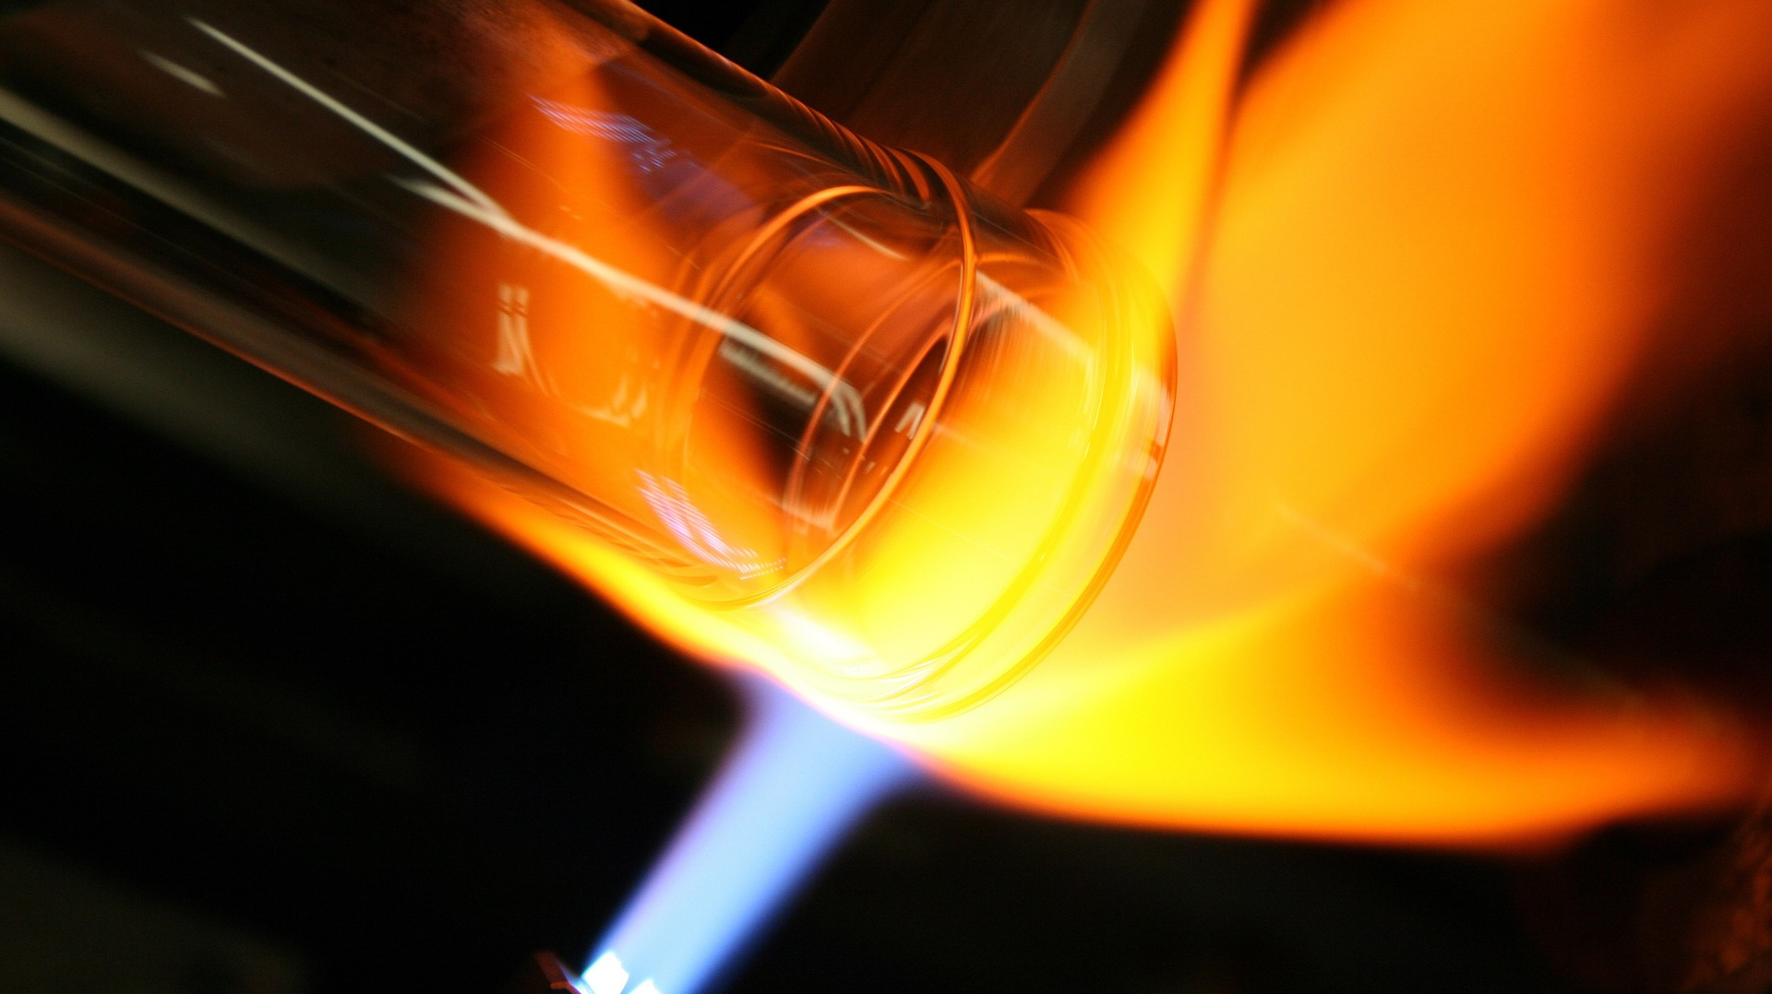
Developing Experts All rights reserved © 2021

Slide 2
The specific heat capacity of a substance is the amount of energy required to raise the temperature of one kilogram of that substance by one degree Celsius. So, a higher specific heat means that more energy is required to raise its temperature. Here are three examples:
1) Pots and pans used for cooking food and boiling water are made from materials with a low specific heat capacity, such as copper and aluminium. It does not take much energy to raise their temperature.
2) Materials of high specific heat capacity make good insulators. For example, wood has a high specific heat capacity. Wooden houses will keep the inside cooler during summer. Builders can choose building materials appropriately depending on the location and altitude. That allows architects to build warmer houses or cooler houses.
3) The handles of utensils at home are made from materials which have very high specific heat. They act as thermal insulators. The insulating capability or conductivity is also dependent on specific heat.
Developing Experts All rights reserved © 2021

Slide 3
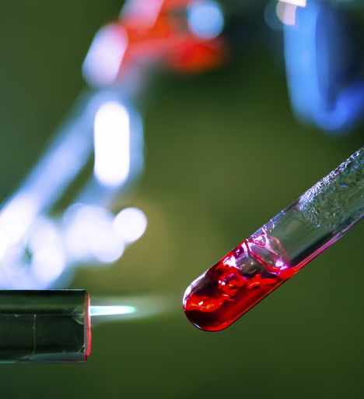
Explore specific heat capacity
Describe the method used to determine the specific heat capacity of a substance
Calculate the specific heat capacity of a substance from experimental data
Evaluate sources of error in the practical procedure
Research and explain an alternative method for calculating specific heat capacity to reduce errors
Developing Experts All rights reserved © 2021

Slide 4
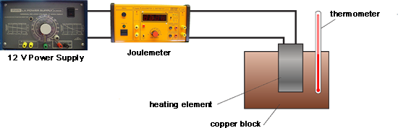
The specific heat capacity of a substance is the amount of energy required to raise the temperature of one kilogram of the substance by one degree Celsius.
thermometer
12 V power supply
Joulemeter
heating element
oil
copper block

Slide 5
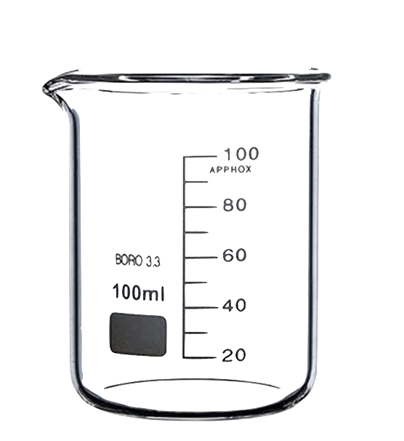
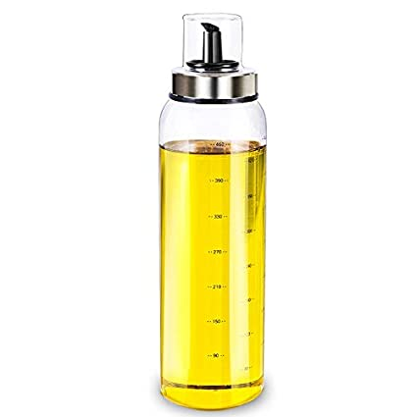
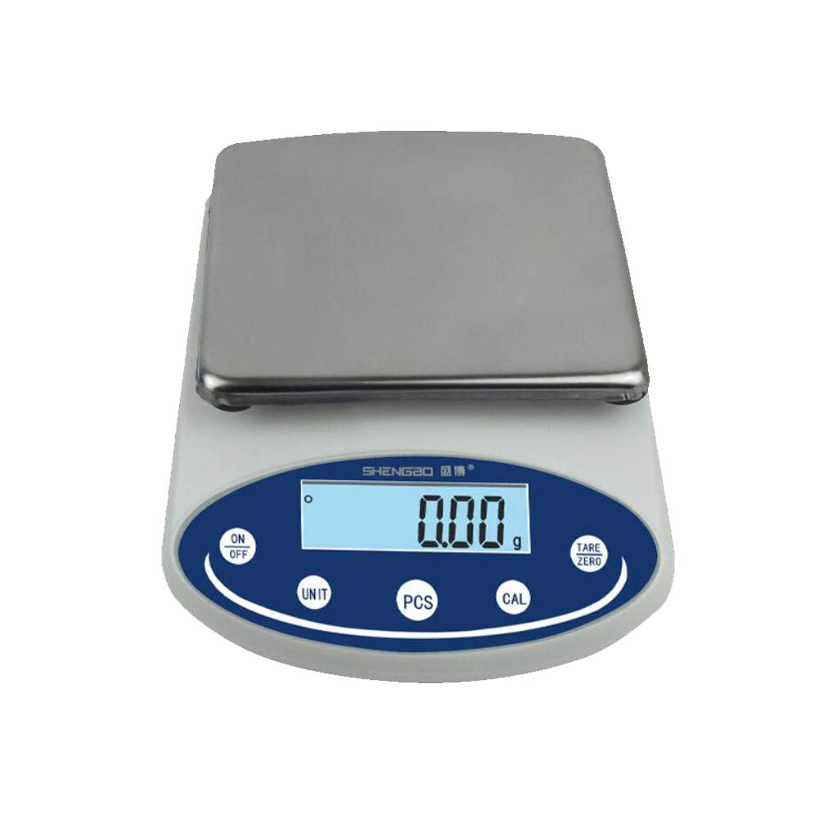
Set the scales to zero, then add the oil into the beaker.

Slide 6
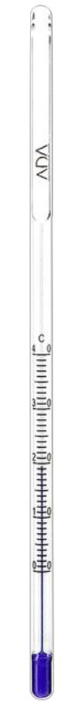
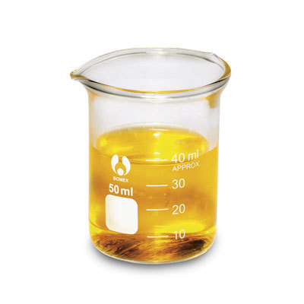
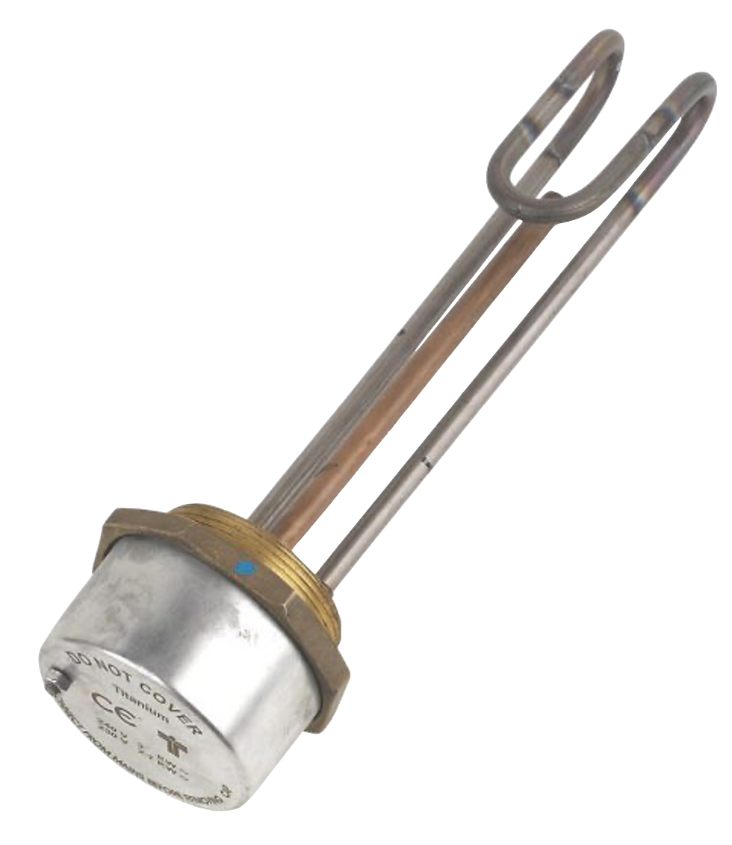
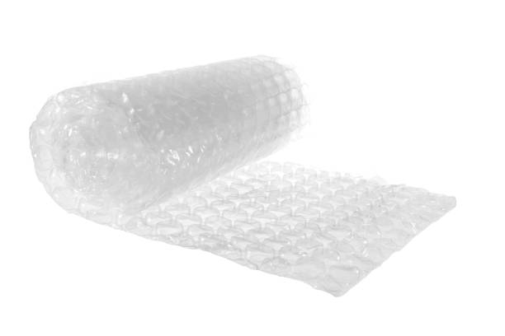
Place the thermometer and immersion heater into the oil.
Read the starting temperature of the oil.
Wrap the beaker in insulating foam to prevent thermal energy being transferred to the surroundings.

Slide 7
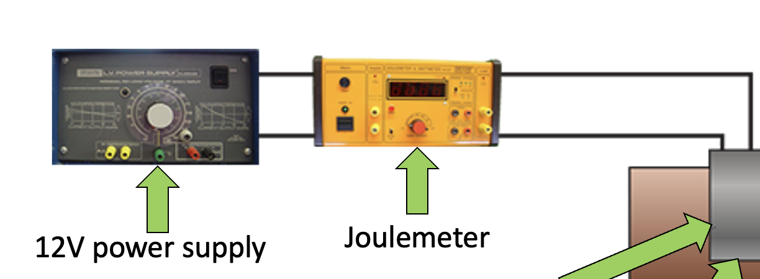
Joulemeter
12 V power supply
Read the total number of joules of energy that passed into the immersion heater and the final temperature of the oil.

Slide 8
Explore specific heat capacity
ΔE
= m × c ×
Δθ
change in thermal energy (J)
mass
(kg)
specific heat capacity (J/kg/°C)
temperature change (°C)
We can rearrange this equation to make ‘c’ the subject:
ΔE
c
=
m × Δθ
Developing Experts All rights reserved © 2021

Slide 9
0.95 kilograms of oil was heated from 20 degrees Celsius to 75 degrees Celsius. 87,258 joules of electrical energy passed into the immersion heater.
Calculate the specific heat capacity of the oil.
ΔE
c
=
m × Δθ
specific heat capacity (J/kg/°C)
mass
(kg)
temperature change (°C)
Developing Experts All rights reserved © 2021

Slide 10
0.95 kilograms of oil was heated from 20 degrees Celsius to 75 degrees Celsius. 87,258 joules of electrical energy passed into the immersion heater.
Calculate the specific heat capacity of the oil.
87,258
c
=
=
1,670 (J/kg/°C)
0.95 × 55
specific heat capacity (J/kg/°C)
mass
(kg)
temperature change (°C)
Developing Experts All rights reserved © 2021

Slide 11
Sources of inaccuracy
Source of inaccuracy
Solution
Thermal energy passing out of the beaker and into the air.
Insulate the beaker with a material that has a low conductivity.
Not all of the thermal energy from the immersion heater passes into the oil.
Ensure that the immersion heater is fully submerged.
Developing Experts All rights reserved © 2021

Slide 12
Sources of inaccuracy
Source of inaccuracy
Solution
Incorrectly reading the thermometer.
Use an electronic temperature probe.
Thermal energy not spreading evenly through the oil.
Stir the oil.
Developing Experts All rights reserved © 2021

