Slide 1
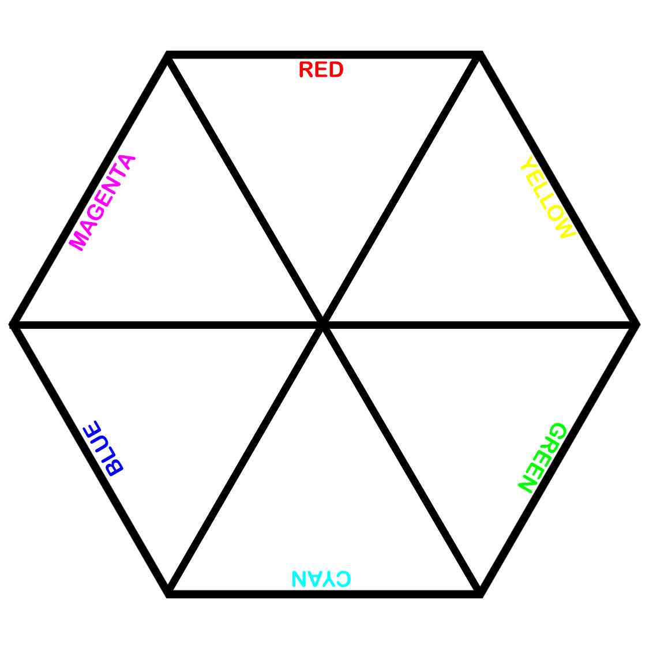
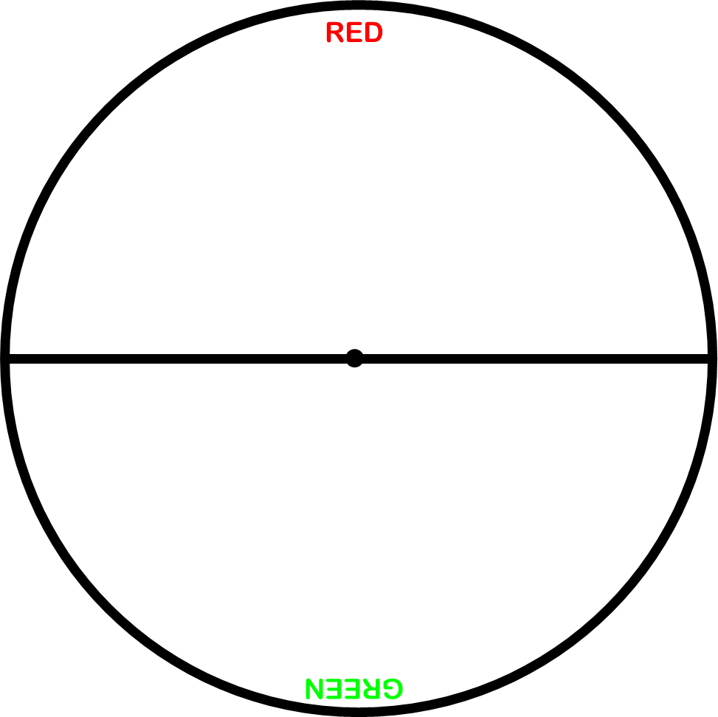
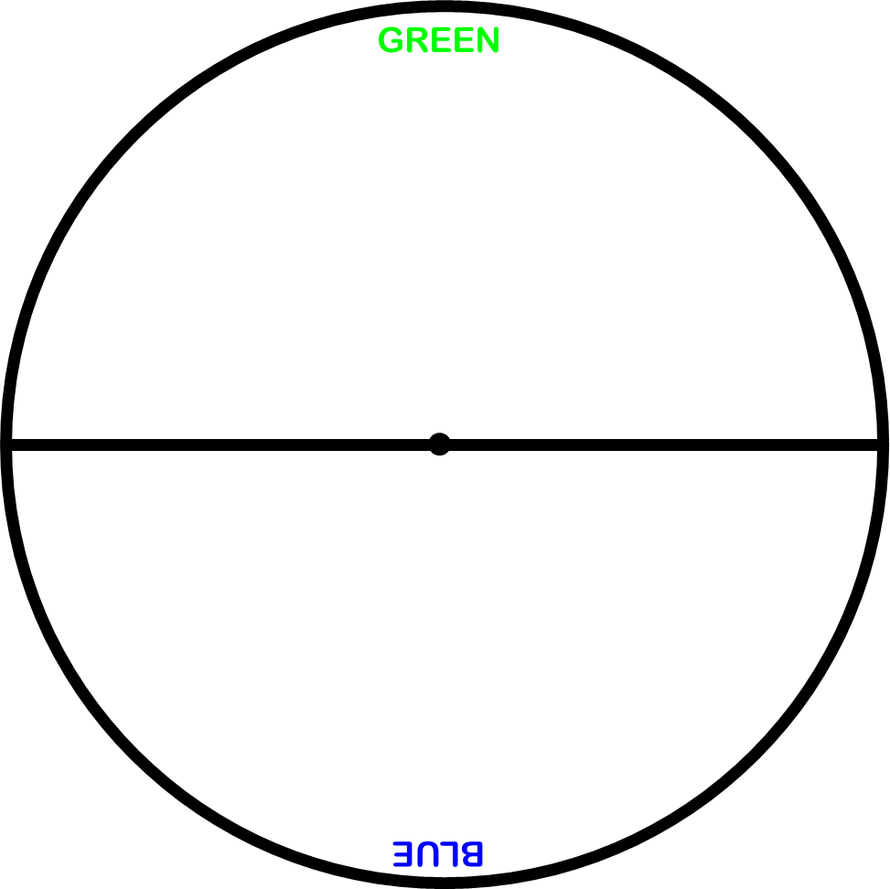
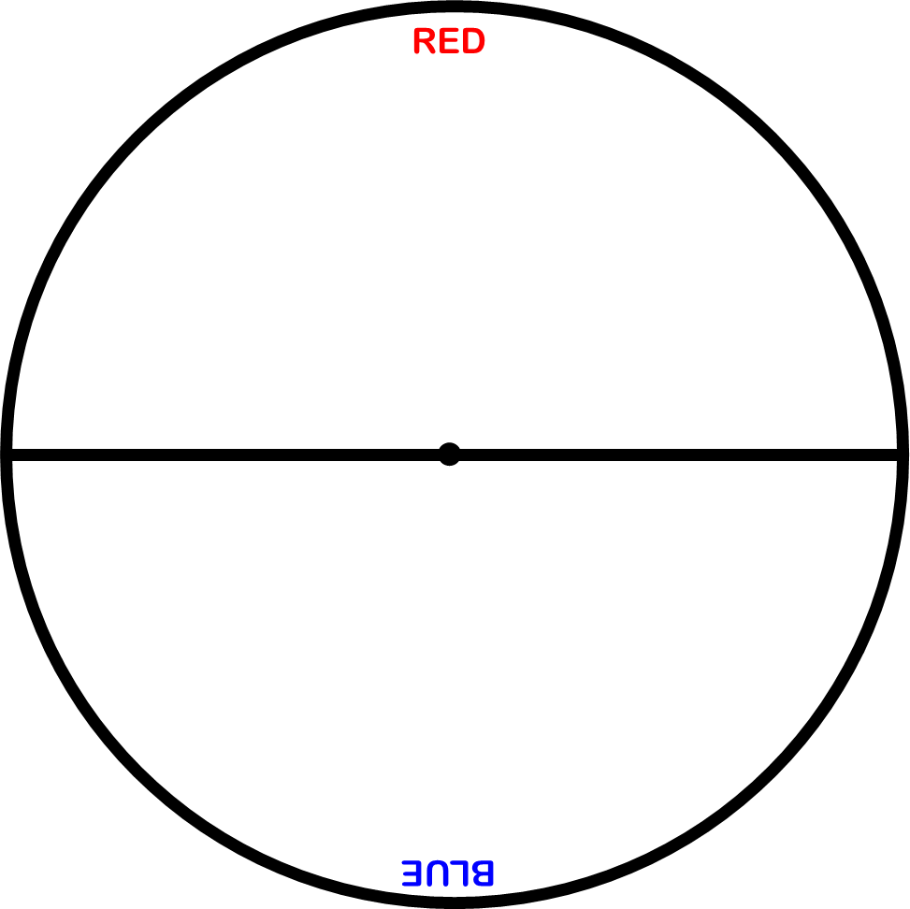
Colour-in the following shapes as shown. Mount them onto card. Then cut them out and either stick them on a motor or push a sharp pencil through them to make a spinning top.

Slide 2
Mount the page onto card, then cut out the shapes below and either stick them on a motor or push a sharp pencil through them to make a spinning top.

Slide 3
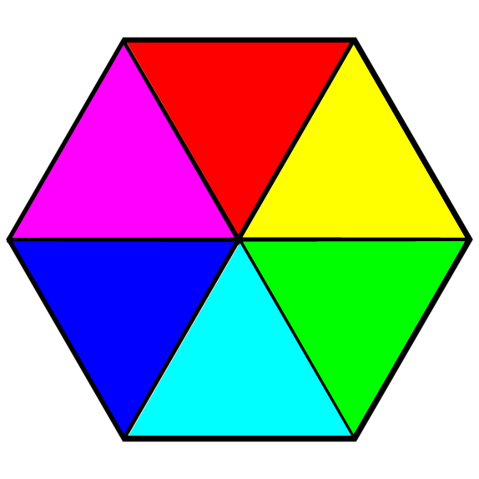
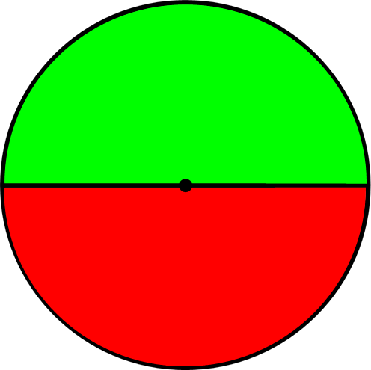
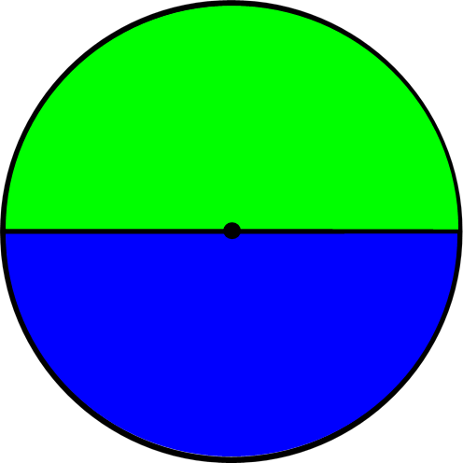
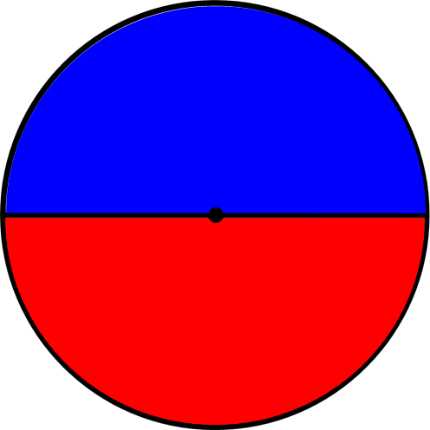
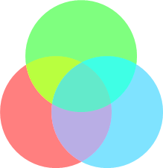
For each colour wheel predict what colour you
think you’ll see when it is rapidly rotated.
Colour wheel | Predicted colour | Explain your prediction | Colour seen
A computer screen is made of pixels. Each pixel is made of three coloured cells (red, green, blue) You can see them with a magnifying lens. Each cell can be illuminated by different amounts.
Explain how these cells help create different colours on the computer screen.
___________________________________________ ___________________________________________ ___________________________________________ ___________________________________________
Explain what this picture shows.
______________________________ ______________________________ ______________________________
______________________________
Stretch
Explain how rainbows show us white light is a mixture.
Challenge
Explain why spinning the colour wheel rapidly causes the colours to mix.

