Slide 1


Mission Assignment: Explain why plants are important
Mission Assignment: Describe the structure of a leaf
KS3-16-03
KS3-16-05
In this experiment you will be investigating the gas produced through photosynthesis.
Method:
Pick a fresh flat leaf and paint a small section on the top and bottom of the leaf, with nail varnish then leave to dry.
Once the varnish is dry, place a piece of sticky tape over the varnish and peel it off.
Stick the tape directly over the microscope slide
Place the slide on the microscope to examine it.
Draw what you observe in the appropriate space below. Label any key structures you notice.
Equipment
Clear nail varnish
Clear sticky tape
Deciduous leaves
Microscope
Microscope slides
Top of leaf
Underside of lead
Describe how the top and underside of a leaf differs in its structure.
__________________________________________________________________________________________________________________________________________________________________________________________________________________________________________________________________________________________________________________________________________________________________________________________________________________________________________________________________________________________________________________
Developing Experts Copyright 2023 All Rights Reserved
Developing Experts Copyright 2023 All Rights Reserved

Slide 2
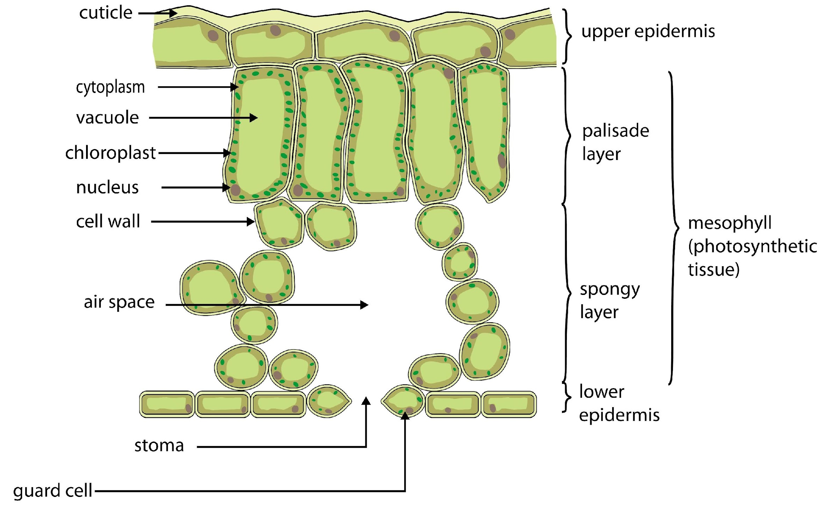
Mission Assignment: Explain why plants are important
Mission Assignment: Describe the structure of a leaf
KS3-16-03
KS3-16-05
Layers of the leaf
The diagram below shows a cross section of a leaf.
The top layer of the leaf (upper epidermis) contains translucent cells topped with a waxy layer called the cuticle. Explain the role of the waxy cuticle.
____________________________________________________________________________________________________________________________________________________________________
The second layer (palisade layer) contains plant cells that are full of chloroplasts. Explain what the main role of the palisade layer is.
____________________________________________________________________________________________________________________________________________________________________
The third layer (spongy layer) contains a lot of air space. Explain why it is important for this layer to contain a lot of air space.
____________________________________________________________________________________________________________________________________________________________________
The underside of the leaf (lower epidermis) contains stomata (singular - stoma). These are openings that open and close at different times of the day. Explain why it is important that stomata don’t remain open all the time.
____________________________________________________________________________________________________________________________________________________________________
Developing Experts Copyright 2023 All Rights Reserved
Developing Experts Copyright 2023 All Rights Reserved

Slide 3
Mission Assignment: Explain why plants are important
Mission Assignment: Describe the structure of a leaf
ANSWERS
KS3-16-03
KS3-16-05
In this experiment you will be investigating the gas produced through photosynthesis.
Method:
Pick a fresh flat leaf and paint a small section on the top and bottom of the leaf, with nail varnish then leave to dry.
Once the varnish is dry, place a piece of sticky tape over the varnish and peel it off.
Stick the tape directly over the microscope slide
Place the slide on the microscope to examine it.
Draw what you observe in the appropriate space below. Label any key structures you notice.
Equipment
Clear nail varnish
Clear sticky tape
Deciduous leaves
Microscope
Microscope slides
Top of leaf
Underside of lead
Describe how the top and underside of a leaf differs in its structure.
__________________________________________________________________________________________________________________________________________________________________________________________________________________________________________________________________________________________________________________________________________________________________________________________________________________________________________________________________________________________________________________
The top of the leaf will appear smooth due to the waxy cuticle. The underside of the leaf has many structures including stomata that open and close to allow gases in and out; midrib, which helps to give the leaf strength to stand out rather than flop; veins, which bring water and nutrients to the leaves and take glucose produced in photosynthesis to other parts of the plant.
Developing Experts Copyright 2023 All Rights Reserved
Developing Experts Copyright 2023 All Rights Reserved

Slide 4
Mission Assignment: Explain why plants are important
Mission Assignment: Describe the structure of a leaf
ANSWERS
KS3-16-03
KS3-16-05
Layers of the leaf
The diagram below shows a cross section of a leaf.
The top layer of the leaf (upper epidermis) contains translucent cells topped with a waxy layer called the cuticle. Explain the role of the waxy cuticle.
____________________________________________________________________________________________________________________________________________________________________
The second layer (palisade layer) contains plant cells that are full of chloroplasts. Explain what the main role of the palisade layer is.
____________________________________________________________________________________________________________________________________________________________________
The third layer (spongy layer) contains a lot of air space. Explain why it is important for this layer to contain a lot of air space.
____________________________________________________________________________________________________________________________________________________________________
The underside of the leaf (lower epidermis) contains stomata (singular - stoma). These are openings that open and close at different times of the day. Explain why it is important that stomata don’t remain open all the time.
____________________________________________________________________________________________________________________________________________________________________
Has to be transparent to allow light through to the palisade layer. It is waxy to prevent water loss from the epidermis as water is needed for photosynthesis.
The palisade layer is where the majority of photosynthesis takes place.
The plant needs to take in carbon dioxide, through the stomata, for photosynthesis. The air spaces are where it collects before being used up.
Stomata allow air in and out of the leaf. If they were open all of the time, water could be lost from the leaf by transpiration. Plants don’t photosynthesise at night, so the stomata do not need to be open to take in carbon dioxide.
Developing Experts Copyright 2023 All Rights Reserved
Developing Experts Copyright 2023 All Rights Reserved

