Slide 1




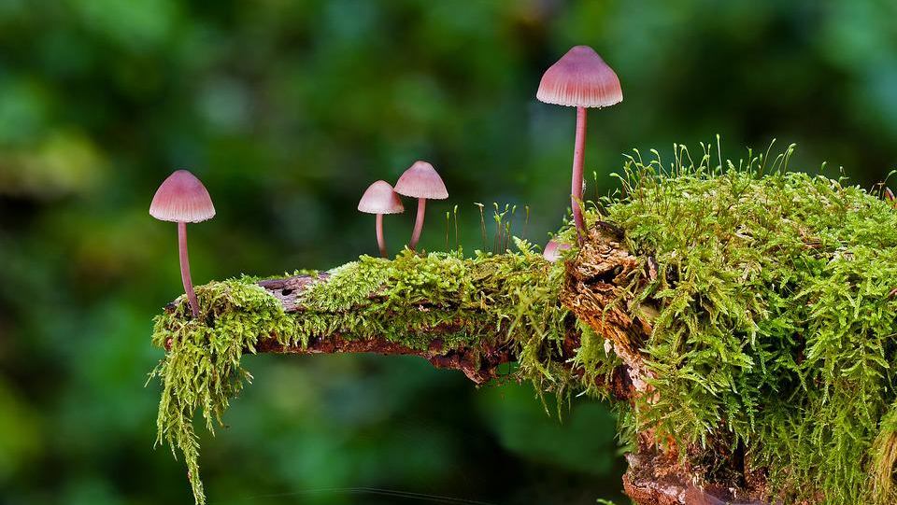
Mission Assignment: Explore what we can do to protect natural habitats and ecosystems
Code: COP26S-02_02
Do some research and find a species that is native to your area. Find out its status (i.e. is it endangered?) and think about how you could support it. Fill the box below with your findings and the actions you could take.
Consider these suggestions in your research:
Plant trees, flowers and bushes.
2. Use environmentally friendly compost.
3. Be bee friendly, build bee hotels, bird boxes and ponds for nature.
4. Reduce, reuse and recycle.
5. Repair items instead of throwing them out and buying new ones.
6. Save water.
2
Developing Experts Copyright 2022 All Rights Reserved

Slide 2
Mission Assignment: Explore what we can do to protect natural habitats and ecosystems
Code: COP26S-02_02
Interview a classmate with some questions about their day-to-day life, based on the 6 suggestions to support natural life from the previous task.
Consider the following questions-
Do they ever garden? Do they or have they ever planted trees or flowers?
If they have, have they used environmentally friendly compost?
Are they bee-friendly? If yes, consider the actions they have taken.
Do they reduce, reuse and recycle?
Do they repair items or just buy new ones?
Do they save water?
Classmate interview answers:
Diagnostic paragraph:
4
Developing Experts Copyright 2022 All Rights Reserved

