Slide 1
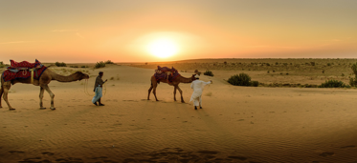
Label all the challenges that living things face in arid deserts and list some animals that live there.
Stretch:
Label the challenges of living in an arid desert and explain why these challenges make life difficult.
List five animals that live in the desert?
________________________________________________
________________________________________________
________________________________________________
________________________________________________
________________________________________________
Why would these challenges make life difficult for animals that live in arid deserts?
________________________________________________________________________________________________________________________________________________________________________________________________________________________________________________________________________________________________________________________________
Challenge:
Use the word bank to identify the challenges of living in an arid desert. Can you think of some animals that live there?
Word bank
dehydration
UV rays
predators
vast distances
high temperatures

Slide 2
Which adaptations are most advantageous for living things in arid deserts. Cut the examples out and arrange them in a diamond, with the most useful adaptations at the top and the least useful at the bottom.
Webbed hands and feet
Pale colouration
Turning food into water
Stretch: arrange the adaptations into your diamond and offer written explanations for your choices.
Tough and/or spikey skin
Ability to discard parts of your body and grow them back
Adopting a nocturnal lifestyle
Challenge:
cut out the boxes and rearrange them in a diamond, with most useful at the top and least useful at the bottom.
Ability to store water in your body
Adaptations that stop sand getting into your body
Limbs that keep your body far from the ground
How might the most useful adaptation benefit the living things that have it?
____________________________________________________________________________________________________________________________________________________________________________________________________________________________________________________________________________________________________________________________________
definitions:
discard
 | to lose, get rid of, or let go of.
colouration
 | the colour of something.
webbed
 | grow stretchy skin between fingers and toes.

