Slide 1
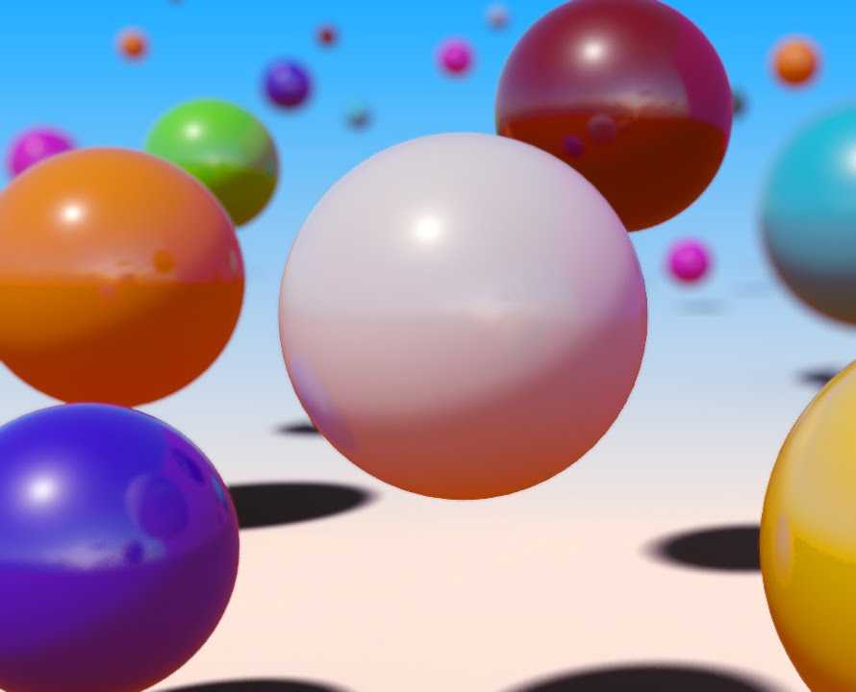
Explore the conservation of energy
Define what's meant by the conservation of energy.
Describe how energy can be transferred in a system.
Explain what happens when energy is dissipated.
Developing Experts All rights reserved © 2021

Slide 2

Different types of energy
Kinetic energy is the energy stored in a moving object.
Gravitational potential energy is the energy stored due to an object's position above the ground.
Elastic potential energy is the energy stored in an object that has been stretched or compressed
Thermal energy is energy being transferred from a hot place to a colder one because of the difference in temperature

Slide 3

The Law of Conservation of Energy
Energy can be transferred from one form to another. It cannot be created or destroyed. The total energy stays the same.

Slide 4

fixed point
string
mass

Slide 5
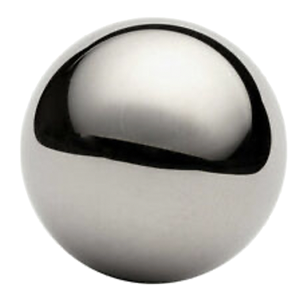
Maximum GPE of the mass
GPE transferred to KE
maximum KE of the mass
minimum GPE of the mass

Slide 6
Maximum GPE of the mass
Maximum GPE of the mass
GPE transferred to KE
KE transferred to GPE
maximum KE of the mass
minimum GPE of the mass

Slide 7
friction at the fixed point
friction as the pendulum passes through the air particles
Friction causes energy to be transferred to
thermal energy.

Slide 8
friction at the fixed point
The fixed point and the air around the pendulum gradually get warmer.
The thermal energy is less useful. Scientists say it has been dissipated or wasted.
friction as the pendulum passes through the air particles

