Slide 1

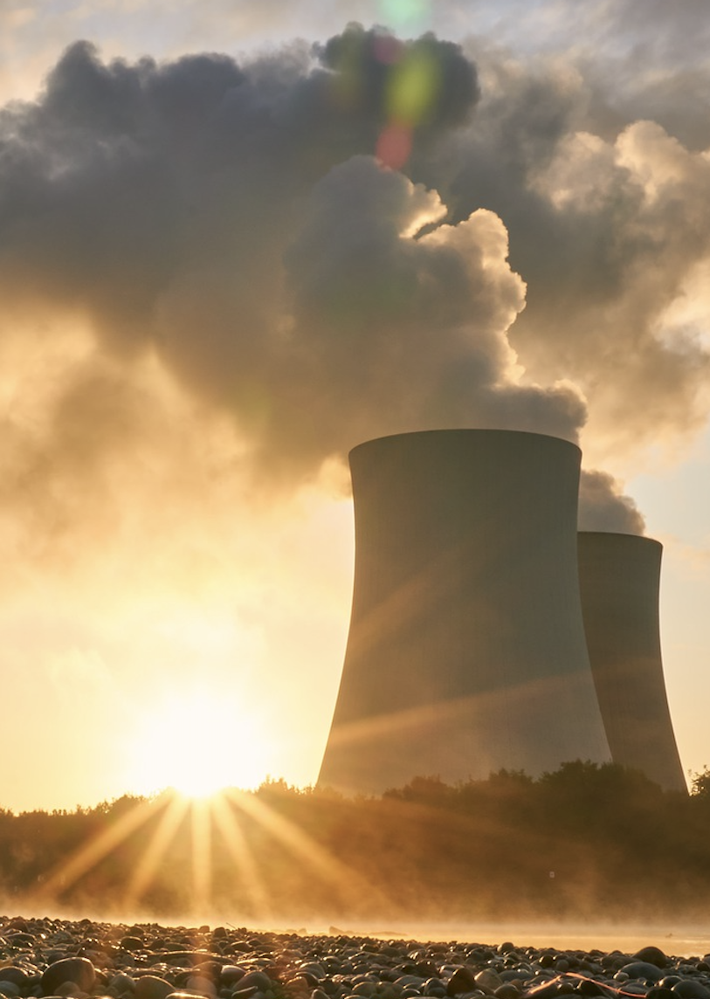
0001.01
Mission Assignment
Task | Watch the film by Lewis Matheson of Physics Online which explains how a nuclear power station generates electricity. Make notes whilst watching the video.
Developing skills | Practise writing full and descriptive written answers to questions – read the question and check what information the question is asking for
Think about… | The need to generate more nuclear power to be able to meet the domestic demand for electrical energy. Go online and research SMR nuclear generation.
KS4-18-11:
Explore nuclear energy

