Slide 1



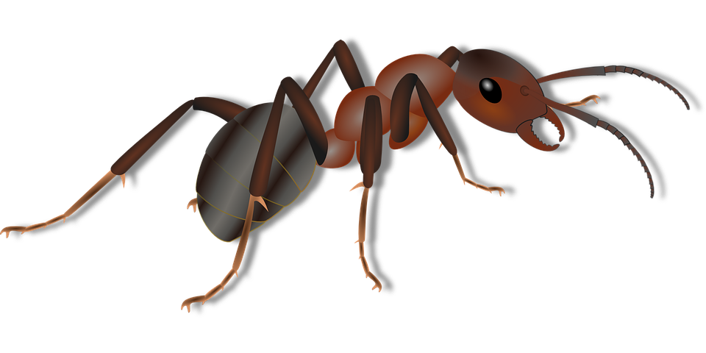


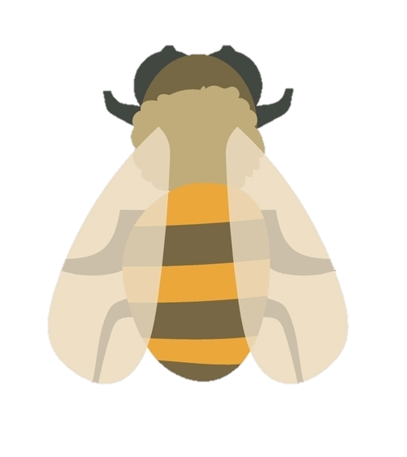
Mission Assignment: Discover where insects and invertebrates live
EYFS-05-02
Work out which path leads to each minibeast. Record your answers below using words or pictures.
roses
garden
ladybird
worm
snail
earth
When I walk in the garden I bump into a ____________________.
When I dig in the soil I find a _______________________________.
When I look at the roses I can see a ________________________.
1
Developing Experts Copyright 2024 All Rights Reserved

Slide 2
Mission Assignment: Discover where insects and invertebrates live
EYFS-05-02
Use a magnifying glass to complete your hunt and identify, draw and count what you see.
Draw and name what you find.
How many?
1
Developing Experts Copyright 2024 All Rights Reserved

Slide 3
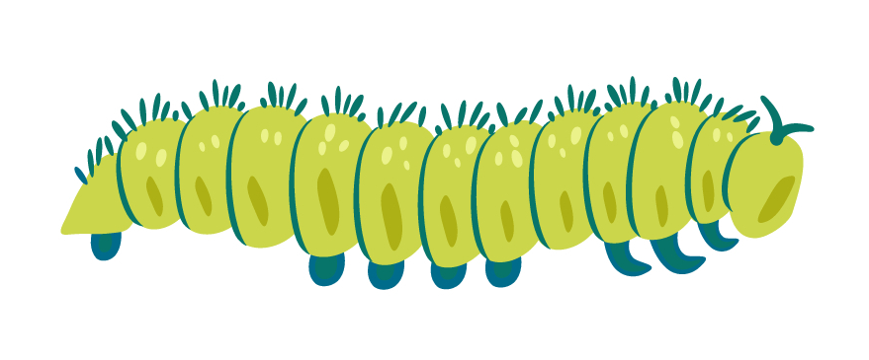
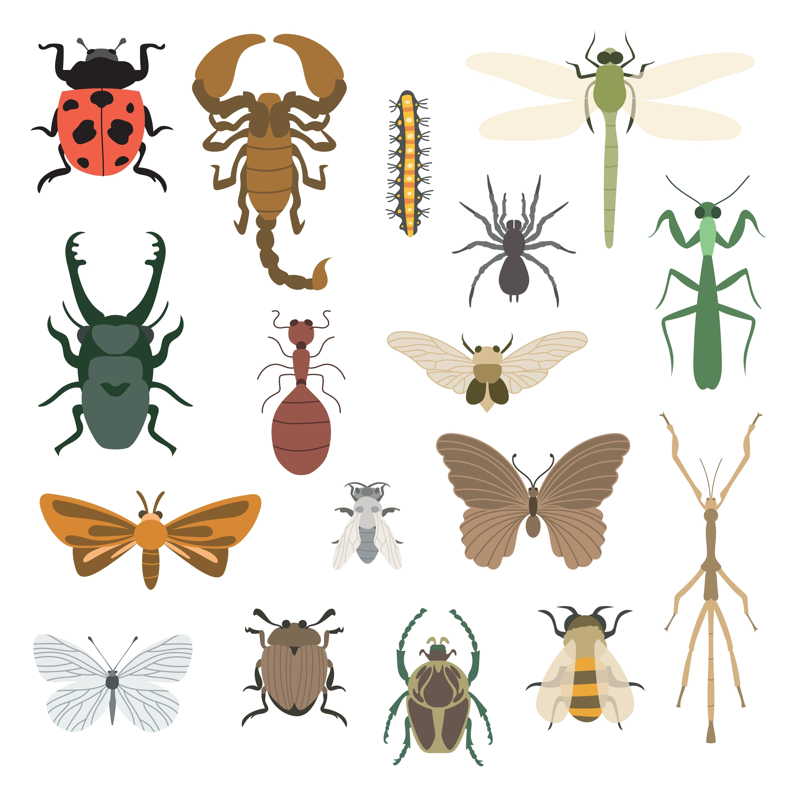
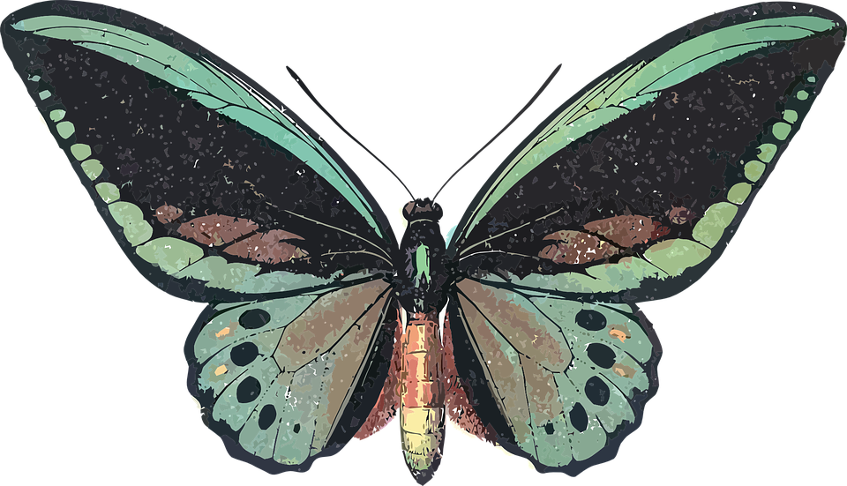
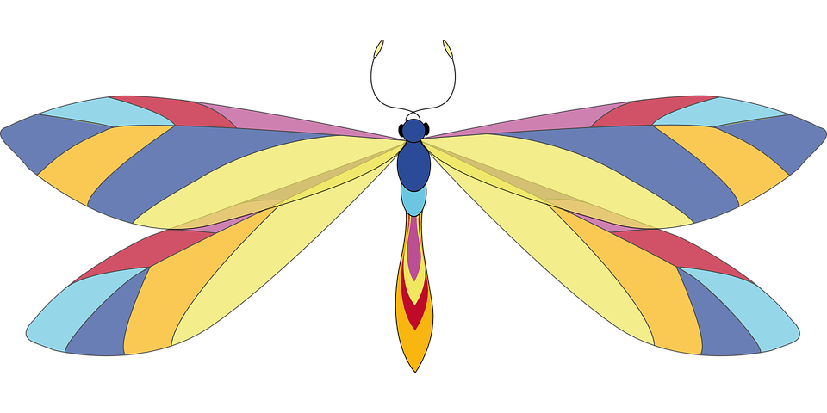

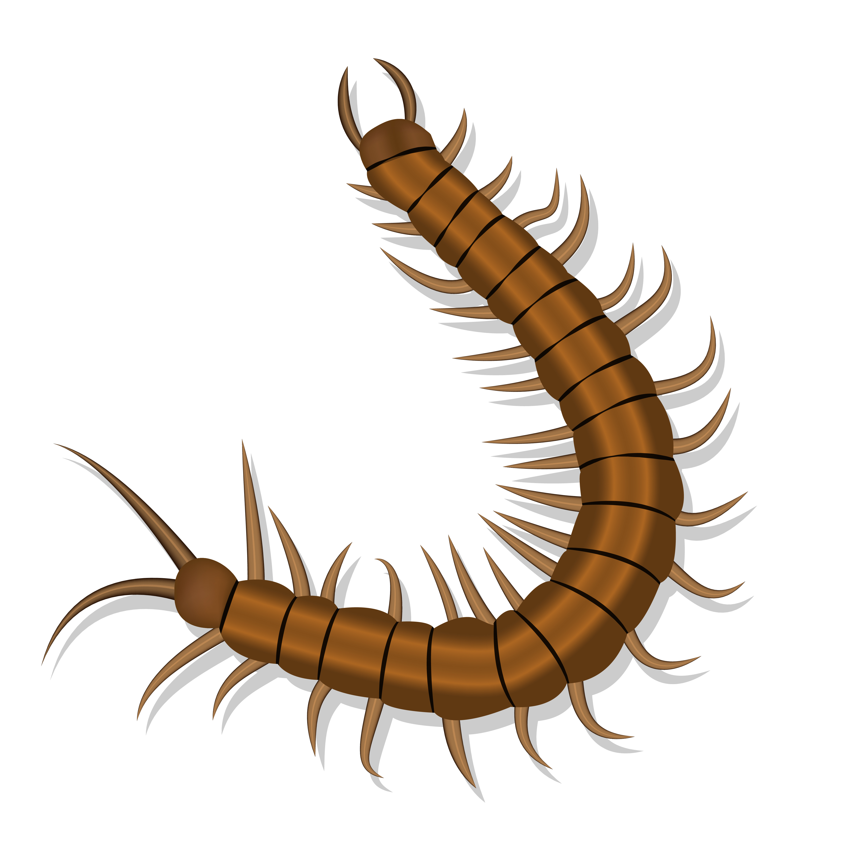
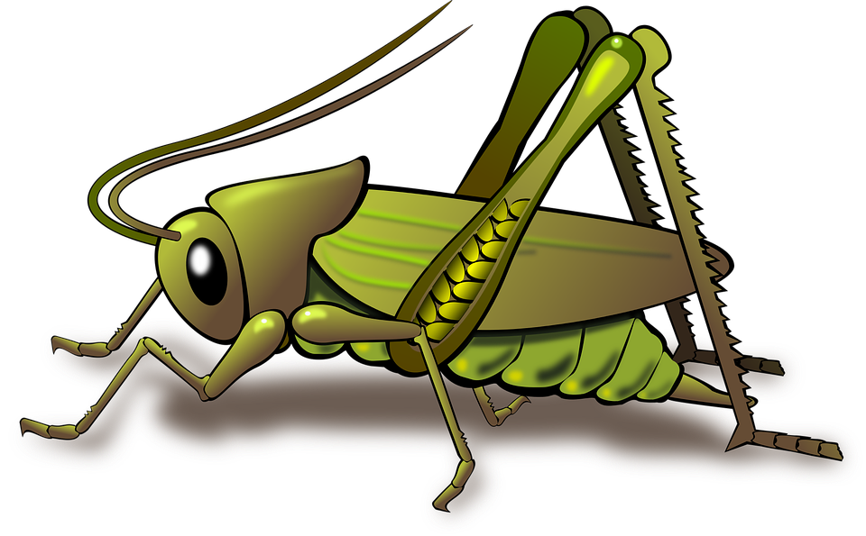
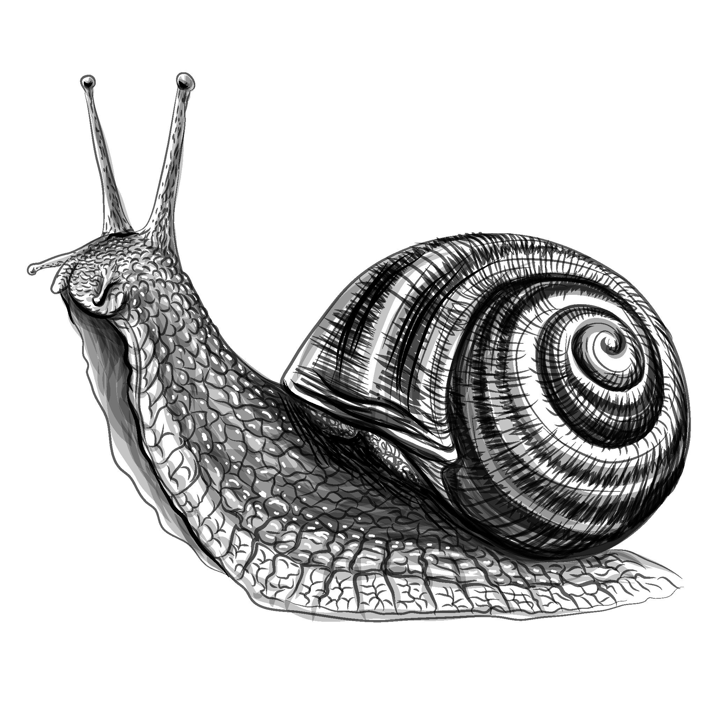
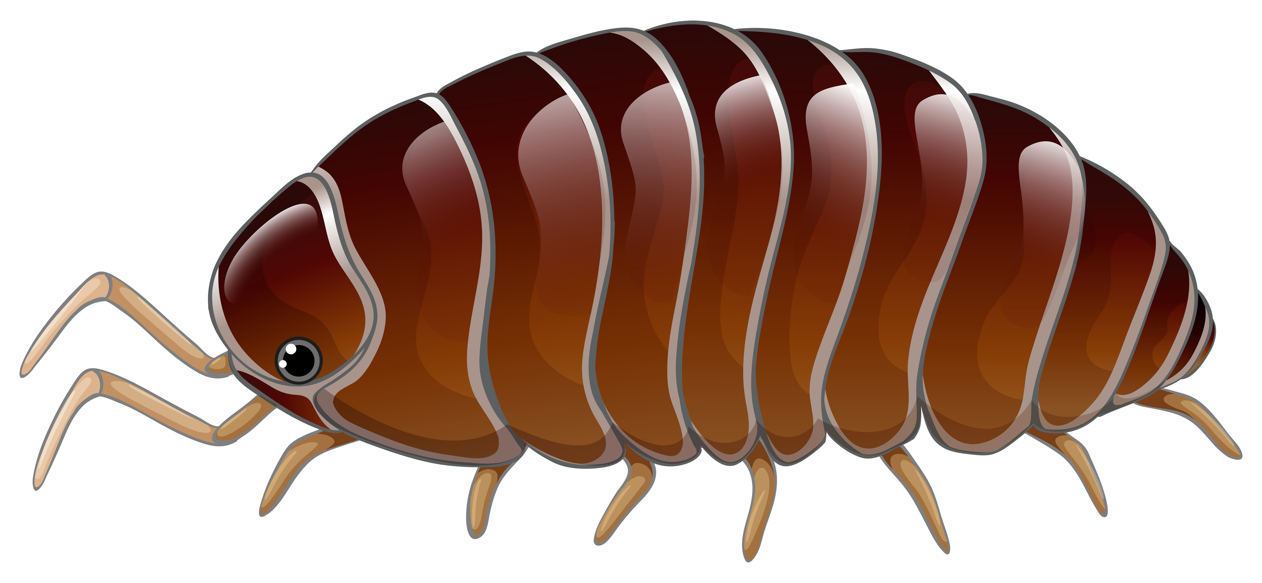
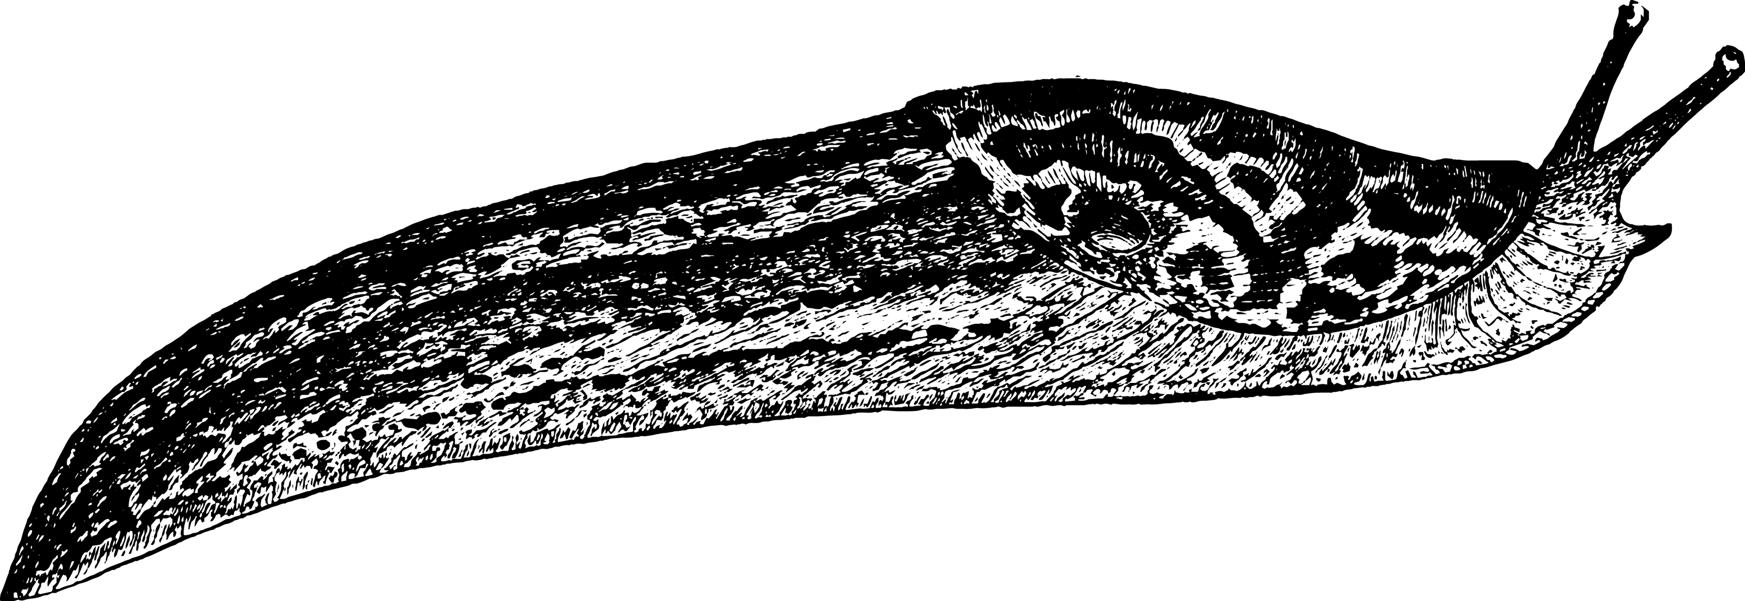
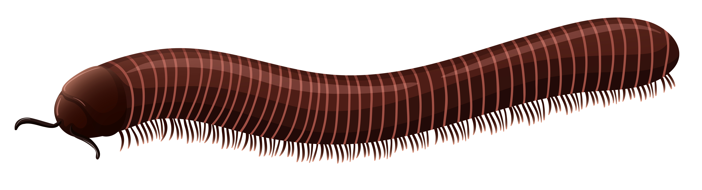
Mission Assignment: Discover where insects and invertebrates live
EYFS-05-02
Identify the insects or invertebrates you find.
ladybird
ant
caterpillar
bee
butterfly
dragonfly
fly
worm
spider
centipede
grasshopper
snail
woodlouse
slug
millipede
beetle
1
Developing Experts Copyright 2024 All Rights Reserved

