Slide 1
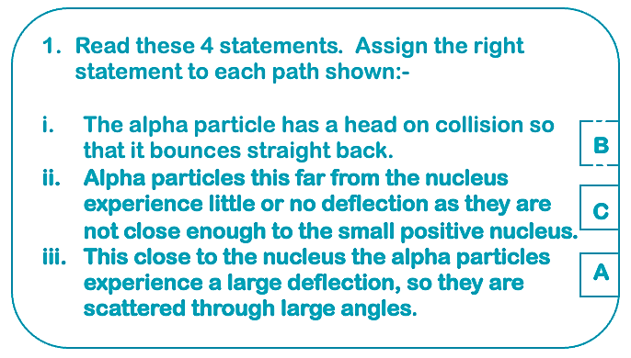
t
Alpha particles are positively charged, The nucleus is also positively charged (contains positively charges protons and neutral neutrons) Consequently, when you stream alpha particles at an atom, as like charges they repel each other. The closer these particles to the nucleus, the more likely they are to deflect at greater angles, explaining path A. With path B, if that stream of alpha particles is directly in line with the nucleus, they are highly likely to deflect directly backwards. Finally, the size of the nucleus in relation to the complete atom is very small, so many alpha particles will pass straight through the atom without collision, as in path C.
Rutherford was able to deduce that the nucleus is positively charged, that most of the mass of the atom is held in the nucleus, and that the nucleus is much smaller than the complete atom.
In both cases the alpha particles would have more energy and would deflect at a far greater angle.
iii Strong nuclear force
Bohr suggested that the negatively charged electrons were circulating around the central nucleus of the atom at fixed distances from that nucleus in energy levels, or shells. The closer the shell is to the nucleus, the lower the energy level.
Teacher Answers

Slide 2
From the experiments conducted by Rutherford and Bohr, it was deduced that protons are positively charged and electrons are negatively charged. There was a theory proposed that there had to be a neutral particle that formed the nucleus along with the proton in order to explain difference in the atomic mass. James Chadwick conducted a similar experiment to the alpha scattering experiment, where he used beryllium and a paraffin block. He streamed alpha particles at the beryllium that released neutrons; those neutrons in turn collided with the paraffin block, releasing protons. He was able to deduce from the energy in the protons that particles of the same size as protons must have collided with the paraffin block – neutrons.

