Slide 1


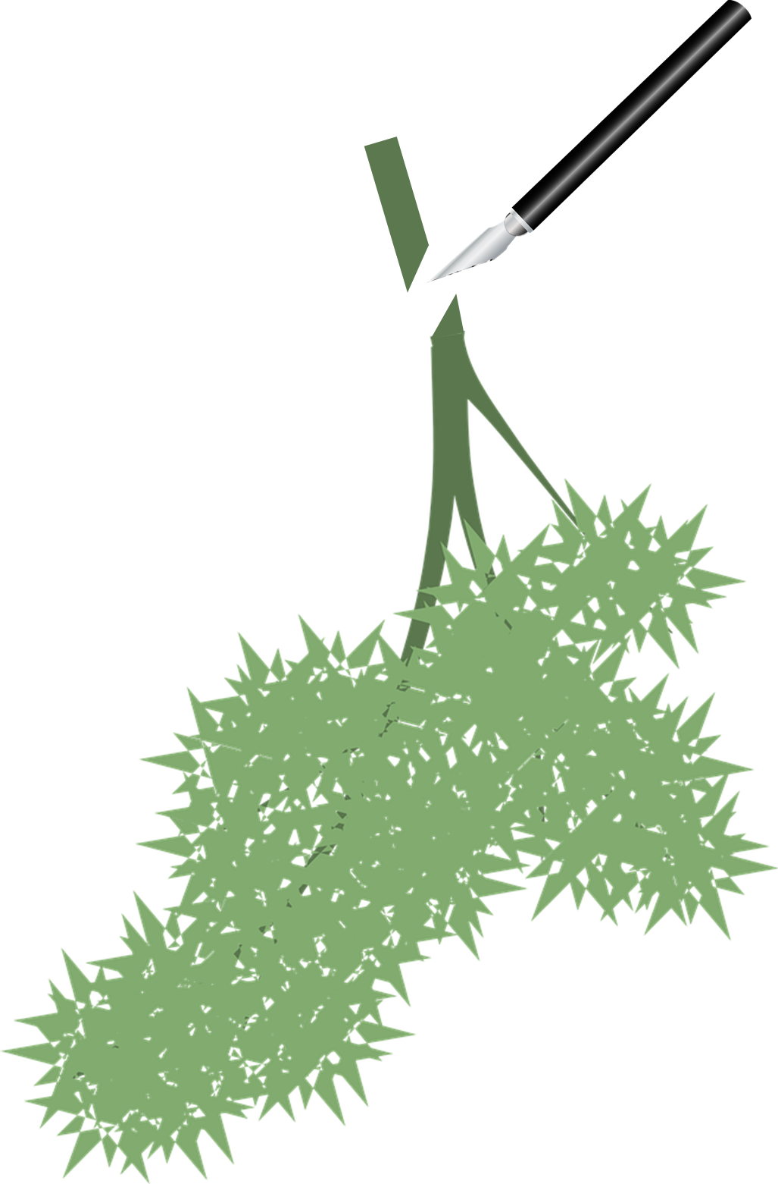
Mission Assignment: Explain why plants are important
Mission Assignment: Explain how plants maintain gas levels in the atmosphere
KS3-16-03
KS3-16-04
In this experiment you will be investigating the gas produced through photosynthesis.
Method:
Fill a large beaker with water and add a spatula of sodium hydrogen carbonate.
Take a sprig of pond weed and submerge it in the beaker of water. Use scissors to cut the stem at an angle, keeping it underwater at all times.
Place a clear funnel over the pond weed.
Top up the beaker with more water until the water level covers the tip of the funnel.
Fill the test tube to the brim with water. Place your thumb over the end of the tube, invert the tube and place the top of the test tube underwater before removing your thumb.
Then, place the test tube over the tip of the funnel.
Repeat this for another beaker.
Place one beaker in direct sunlight and the other in a darkened space for 15 minutes. Then, compare how much gas has been collected in the two test tubes.
You can test the gas collected to see if it is oxygen by placing a glowing splint into the tube to see if it relights.
Equipment
Pond weed – elodea or cabomba
Scissors
Clear funnel
Test tube
Beaker
Stopwatch
Sodium hydrogen carbonate.
1. Describe how the gas collected in the test tubes differ.
________________________________________________________________________________________________________________________________________________________________________________________________________________________________________________________________________________________________________________________________________
2. Explain why is it important the test tube is filled to the brim and uncovered underwater.
________________________________________________________________________________________________________________________________________________________________________________________________________________________________________________________________________________________________________________________________________
3. Explain how plants help maintain oxygen levels in the atmosphere.
________________________________________________________________________________________________________________________________________________________________________________________________________________________________________________________________________________________________________________________________________
Developing Experts Copyright 2023 All Rights Reserved
Developing Experts Copyright 2023 All Rights Reserved

Slide 2
Mission Assignment: Explain why plants are important
Mission Assignment: Explain how plants maintain gas levels in the atmosphere ANSWERS
KS3-16-03
KS3-16-04
In this experiment you will be investigating the gas produced through photosynthesis.
Method:
Fill a large beaker with water and add a spatula of sodium hydrogen carbonate.
Take a sprig of pond weed and submerge it in the beaker of water. Use scissors to cut the stem at an angle, keeping it underwater at all times.
Place a clear funnel over the pond weed.
Top up the beaker with more water until the water level covers the tip of the funnel.
Fill the test tube to the brim with water. Place your thumb over the end of the tube, invert the tube and place the top of the test tube underwater before removing your thumb.
Then, place the test tube over the tip of the funnel.
Repeat this for another beaker.
Place one beaker in direct sunlight and the other in a darkened space for 15 minutes. Then, compare how much gas has been collected in the two test tubes.
You can test the gas collected to see if it is oxygen by placing a glowing splint into the tube to see if it relights.
Equipment
Pond weed – elodea or cabomba
Scissors
Clear funnel
Test tube
Beaker
Stopwatch
Sodium hydrogen carbonate.
1. Describe how the gas collected in the test tubes differ.
________________________________________________________________________________________________________________________________________________________________________________________________________________________________________________________________________________________________________________________________________
2. Explain why is it important the test tube is filled to the brim and uncovered underwater.
________________________________________________________________________________________________________________________________________________________________________________________________________________________________________________________________________________________________________________________________________
3. Explain how plants help maintain oxygen levels in the atmosphere.
________________________________________________________________________________________________________________________________________________________________________________________________________________________________________________________________________________________________________________________________________
There should be more gas collected from the plant in the sunlight than the plant in the dark. Sometimes neither plant produces very much oxygen due to the temperature or time of year.
If this is done properly, the test tube will remain filled with water and any gas collected will have come from the plant.
Plants do photosynthesis which involves taking in carbon dioxide from the air and converting it to glucose and oxygen, which is then released into the air for us to breathe.
Developing Experts Copyright 2023 All Rights Reserved
Developing Experts Copyright 2023 All Rights Reserved

