Slide 1


KS4-17-06: Using Resources - Explore alloys
● State uses of the alloys bronze, brass and steel
● Interpret and evaluate the composition and uses of alloys given appropriate information
● Explain why alloys are more useful than pure metals
Key Facts
Alloys are a mixture of metals. They are added together when they are melted. Some metals by themselves do not have all the properties needed that the job designers and engineers need them to do. By creating alloys, the pure metal can be strengthened or have other enhanced properties.
Alloys are used to make coins, bridges, some jewellery artificial joints, drinks cans, bicycles, car bodywork, tanks, screws and more.
Cut out the boxes and match each alloy to what it is made from and its uses.
Alloy | What it is mainly made from | Uses
aluminium alloy | iron and carbon | jewellery
brass | titanium, aluminium and vanadium | sculptures and ship’s propellers
solder | aluminium and magnesium | musical instruments, doorknobs, fixtures and fittings on a boat
gold alloy | copper and usually tin | to join parts of an electrical circuit
titanium alloy | gold and copper | used to make car bodies
bronze | lead and tin | replacement joints
steel | copper and zinc | air industry
Developing Experts All rights reserved © 2021

Slide 2
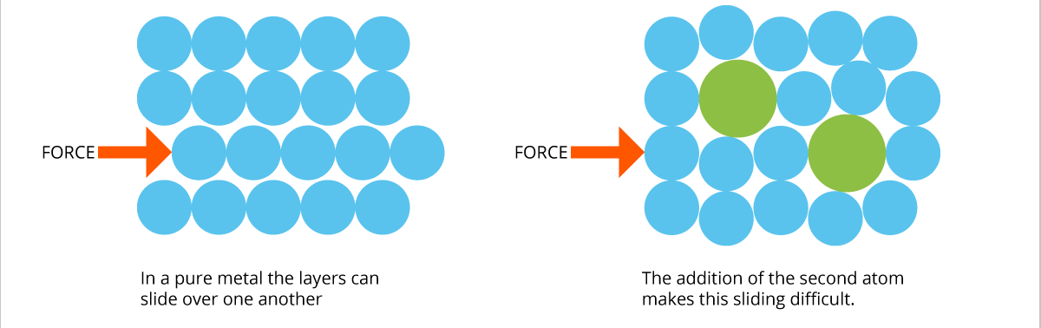
KS4-17-06: Using Resources - Explore alloys
● State uses of the alloys bronze, brass and steel
● Interpret and evaluate the composition and uses of alloys given appropriate information
● Explain why alloys are more useful than pure metals
Pure Metal
Alloy
Draw a molecular diagram of brass
Draw a molecular diagram of copper
Define the terms:
alloy:
____________________________________________________________________________________________________________________________________________________________________
high carbon steel:
____________________________________________________________________________________________________________________________________________________________________
low carbon steel:
____________________________________________________________________________________________________________________________________________________________________
Describe the composition of common alloys and their uses.
____________________________________________________________________________________________________________________________________________________________________
____________________________________________________________________________________________________________________________________________________________________
____________________________________________________________________________________________________________________________________________________________________
____________________________________________________________________________________________________________________________________________________________________
__________________________________________________________________________________
Developing Experts All rights reserved © 2021

