Slide 1
S06.04.08 Handout
Describe the effects of smoking.
Use the template below to help you plan your anti-smoking campaign.
Remember to work as a team and listen to everyone’s ideas.
Step 1: Campaign Name
Campaign Name
Step 2: Logo
Step 3: Slogan
A logo is a symbol or small design which helps identify the campaign. Make it colourful and simple. Do some rough sketches first and then draw your final design below.
A slogan is a striking or memorable phrase which companies use in advertising or in charity campaigns.
See if you can come up with three or four good slogans for your campaign below and then agree on one to use!
Chosen Slogan:
Developing Experts Ltd. © 2022
.

Slide 2
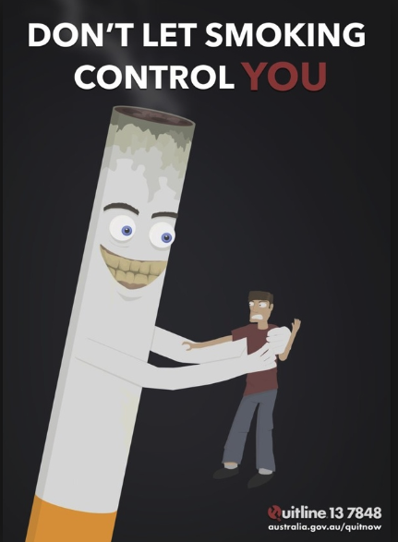
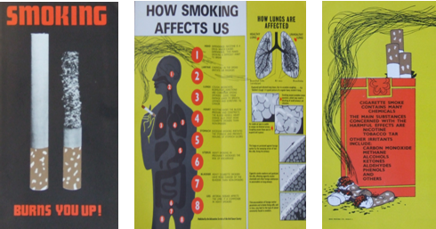
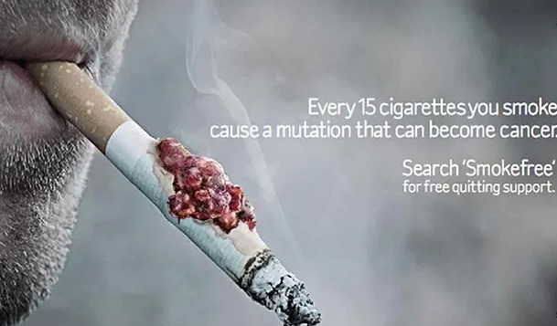
S06.04.08 Handout
Describe the effects of smoking.
Use the template below to help you plan your anti-smoking campaign.
Remember to work as a team and listen to everyone’s ideas.
Step 3: Poster Design
Skills needed:
Creativity
Design / Drawing
Include:
Logo
Slogan
Image
Colour
Contact Details
Step 4: Leaflet
Skills needed:
Creativity
Design
Writing
Include:
Logo
Slogan
Key Facts and Information
Images
Colour
Contact Details
Step 5: TV/Radio Advert
Skills needed:
Creativity
Writing / storyboarding
Acting
Include:
A story / anecdote
Key Facts and Information
Contact Details
Developing Experts Ltd. © 2022

Slide 3
S06.04.08 Handout
Describe the effects of smoking.
On this page, you are going to review other team’s campaigns.
Give marks out of 10 for each part of the campaign.
Campaign Name | Team Members | Poster | Leaflet | TV or Radio Advert
The team which had the best teamwork was ……………………..
because ……………………………………………………………....... ……………………………………………………………………………… ……………………………………………………………………………..
The team whose campaign was best overall was …………………
because……………………………………………………………....... ……………………………………………………………………………… ……………………………………………………………………………..
Developing Experts Ltd. © 2022

