Slide 1


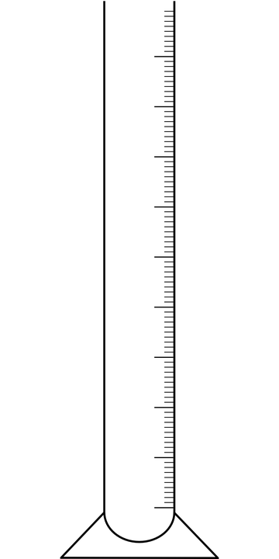
Mission Assignment: Explain how density affects buoyancy
KS3-12-06
Measuring volume
The volume of an object is how much three-dimensional space it takes up. We can calculate the volume of regular shapes such as cuboids, however, for more complicated irregular shapes, we have to measure the shape as a whole.
Regular Cuboid Shape | Irregular Shape
To find the volume of a regular cuboid, measure the height (h), width (w), and depth of the shape and multiply these values. V = h x w x d If the object is an exact cube, the volume can be calculated by cubing one of the height, width or depth measurements. V = h³ | To measure the volume of an irregular shape, use a displacement can*. Fill the can up to the point where any additional water would cause it to spill. Place an object into the can so it is submerged under the water level and collect the water that is displaced from the can. Measure the volume of the water in a measuring cylinder.
h
d
w
Archimedes, the ancient Greek philosopher discovered that when a solid object is placed in water, the object will displace the same volume of water. This is known as the Archimedes principal. He made his discovery in the bath and immediately leapt up and ran naked through the streets of Syracuse shouting Eureka! (I have it!).
What is the density of a substance? __________________________________________________________________________________________________________________________________________
What is the formula for density? __________________________________________________________________________________________________________________________________________
Developing Experts Copyright 2023 All Rights Reserved

Slide 2
Mission Assignment: Explain how density affects buoyancy
KS3-12-06
Calculating density
Measure the mass and volume of the objects and the calculate their density. Include any volume or density calculations in the table.
For each object, predict if it will sink or float.
density = mass ÷ volume
object | mass (g) | volume (cm³) | density (g/cm³) | prediction sink or float
Use the Archimedes principle to explain how the displacement can help us to measure volume.
__________________________________________________________________________________________________________________________________________
Explain why the measurement is inaccurate if an object floats in the can. _________________________________________________________________________________________________________________________________________
Ships are made of dense materials such as steel. Explain why ships can float.
__________________________________________________________________________________________________________________________________________
A student suggests, “Objects sink because they are too heavy, if you cut them smaller they will float”. Explain if this is correct or incorrect.
_______________________________________________________________________________________________________________________________________________________________________________________________________________
Developing Experts Copyright 2023 All Rights Reserved

Slide 3
Mission Assignment: Explain how density affects buoyancy ANSWERS
KS3-12-06
Measuring volume
The volume of an object is how much three-dimensional space it takes up. We can calculate the volume of regular shapes such as cuboids, however, for more complicated irregular shapes, we have to measure the shape as a whole.
Regular Cuboid Shape | Irregular Shape
To find the volume of a regular cuboid, measure the height (h), width (w), and depth of the shape and multiply these values. V = h x w x d If the object is an exact cube, the volume can be calculated by cubing one of the height, width or depth measurements. V = h³ | To measure the volume of an irregular shape, use a displacement can*. Fill the can up to the point where any additional water would cause it to spill. Place an object into the can so it is submerged under the water level and collect the water that is displaced from the can. Measure the volume of the water in a measuring cylinder.
h
d
w
Archimedes, the ancient Greek philosopher discovered that when a solid object is placed in water, the object will displace the same volume of water. This is known as the Archimedes principal. He made his discovery in the bath and immediately leapt up and ran naked through the streets of Syracuse shouting Eureka! (I have it!).
What is the density of a substance? __________________________________________________________________________________________________________________________________________
What is the formula for density? __________________________________________________________________________________________________________________________________________
Density is the measure of mass per unit volume of a substance
Mass / volume
Developing Experts Copyright 2023 All Rights Reserved

Slide 4
Mission Assignment: Explain how density affects buoyancy
KS3-12-06
Calculating density
Measure the mass and volume of the objects and the calculate their density. Include any volume or density calculations in the table.
For each object, predict if it will sink or float.
density = mass ÷ volume
object | mass (g) | volume (cm³) | density (g/cm³) | prediction sink or float
Use the Archimedes principle to explain how the displacement can help us to measure volume.
__________________________________________________________________________________________________________________________________________
Explain why the measurement is inaccurate if an object floats in the can. _________________________________________________________________________________________________________________________________________
Ships are made of dense materials such as steel. Explain why ships can float.
__________________________________________________________________________________________________________________________________________
A student suggests, “Objects sink because they are too heavy, if you cut them smaller they will float”. Explain if this is correct or incorrect.
_______________________________________________________________________________________________________________________________________________________________________________________________________________
The Archimedes principle says that an object in water pushes water out of the way, making room for its own volume. We can measure the volume of an object by measuring the amount of water it pushes aside.
If not all of the object is submerged, then not all of its volume will be represented by displaced water. When we measure the volume of displaced water, it will not equal the volume of the object.
Ships float because the weight of the water they displace is greater than the weight of the ship, which is made of dense materials like steel.
Objects sink or float based on their density, not just their weight. Cutting an object into smaller pieces does not change its density.
Developing Experts Copyright 2023 All Rights Reserved

