Slide 1
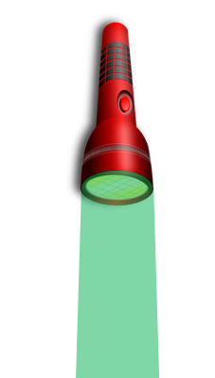
Examine different coloured objects under different colours of light. Record in the table what colour they appear below.
Method
This activity should be done in a dark room.
Place different coloured sheets of paper on the table (white, blue, red, yellow, and green).
Shine a torch (white light) on each piece of paper in turn. Record the colour each piece of paper appears on your table.
Place different coloured filters (red, blue and green) in front of the torch and shine it at the pieces of paper.
Record what colour each piece of paper appears under different coloured light.
Filter Paper | None (white) | Blue | Red | Green
White
Blue
Red
Green
Yellow
Stretch:
Explain how yellow is different to red, green and blue
Challenge:
Suggest how black paper would appear under the different coloured lights.

Slide 2
Use your results to answer the questions below
Explain why it was important to conduct this activity in a dark room.
____________________________________________________________________________________________________________________________________________________________________________________________________________________________
Using your results, suggest three rules that could help you work out what colour something would appear under different light
Rule 1: ________________________________________________________________________________________________________
Rule 2: ________________________________________________________________________________________________________
Rule 3: ________________________________________________________________________________________________________
A students suggests “Red surfaces only reflect red light.” Use your results to explain if this statement is true or false.
____________________________________________________________________________________________________________________________________________________________________________________________________________________________
Suggest a job where colour mixing of light is important. Explain your idea.
____________________________________________________________________________________________________________________________________________________________________________________________________________________________

