Slide 1
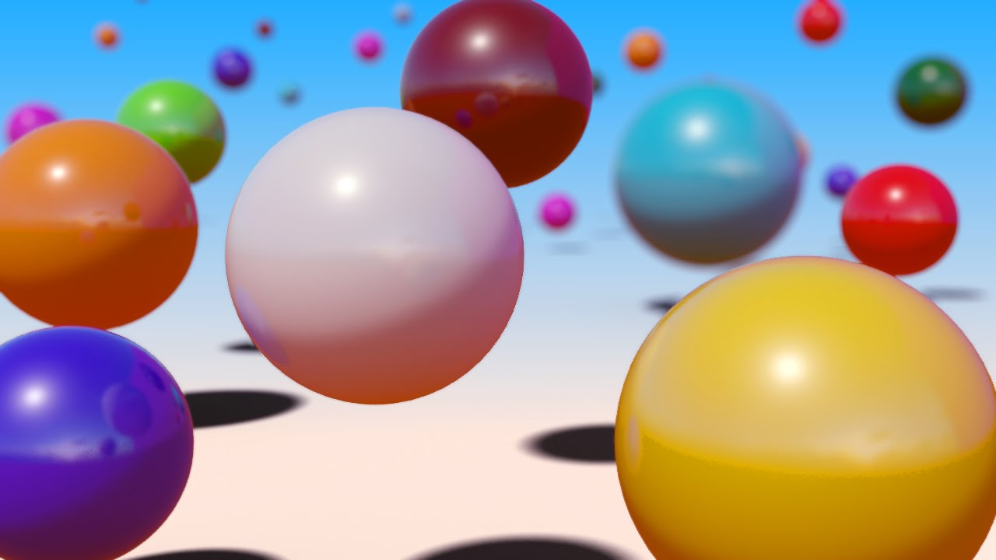
Gravitational Potential Energy Store
The stronger the gravitational field the more energy in the gravitational potential energy store.
The greater the mass of the object the more energy in the gravitational potential energy store.
The greater the height of the object the more energy in the gravitational potential energy store.

Slide 2
Gravitational Potential Energy Store
Calculate the amount of gravitational potential energy gained by an object raised above ground level.
Developing Experts All rights reserved © 2021

Slide 3

Gravitational potential energy is the energy stored in an object due to its position above the Earth's surface.
Developing Experts All rights reserved © 2021

Slide 4
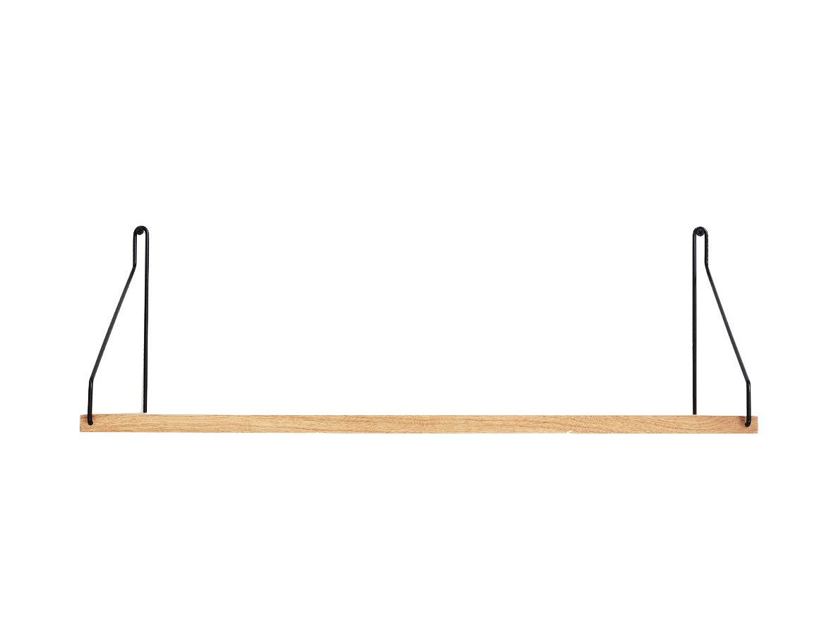
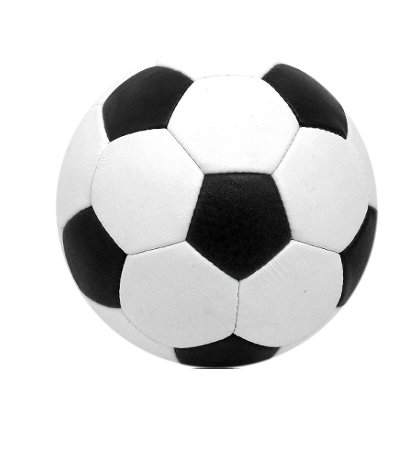
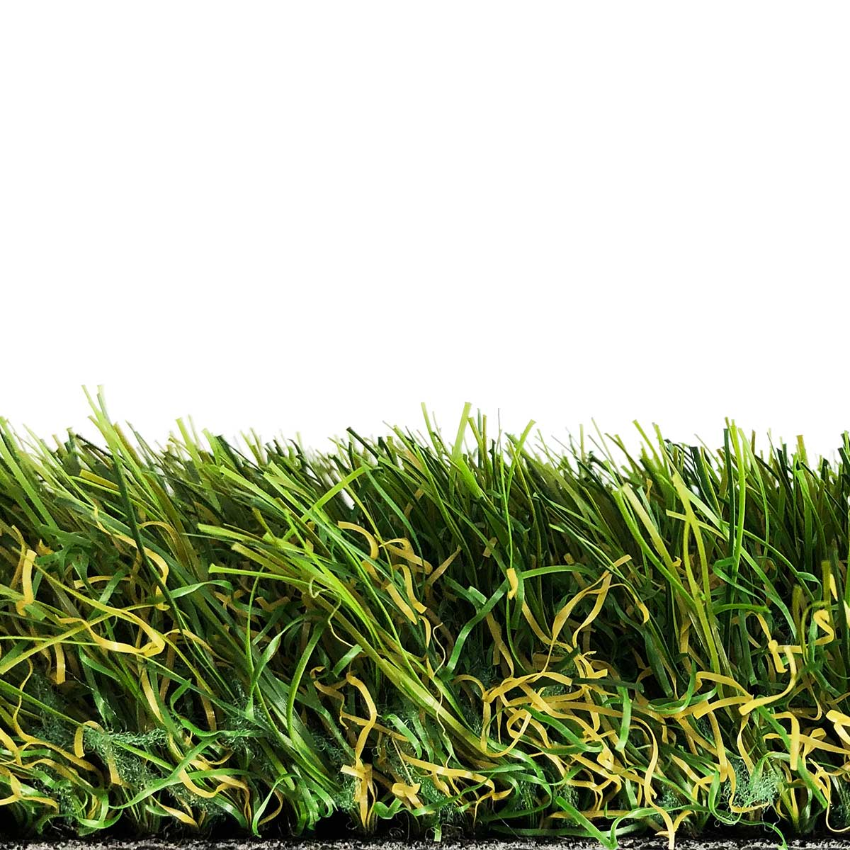
Developing Experts All rights reserved © 2021

Slide 5
The ball now has a store of gravitational potential energy.
Developing Experts All rights reserved © 2021

Slide 6
The ball now has no gravitational potential energy.
Developing Experts All rights reserved © 2021

Slide 7
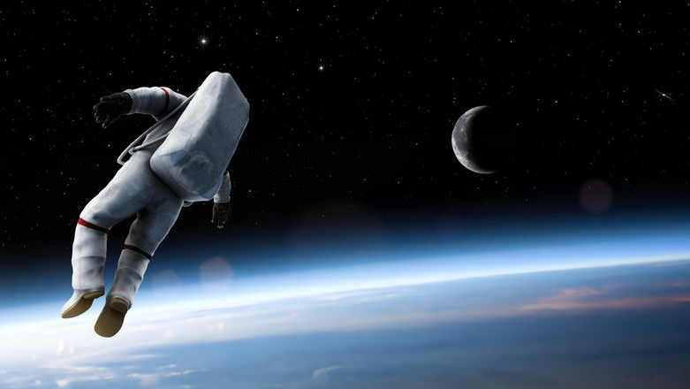
Gravitational potential energy store
E
=
m
×
g
×
h
p
Developing Experts All rights reserved © 2021

Slide 8
Gravitational potential energy store
E
=
m
×
g
×
h
p
gravitational potential energy (J)
mass
(kg)
gravitational field strength (N/kg)
height
(m)
Developing Experts All rights reserved © 2021

Slide 9
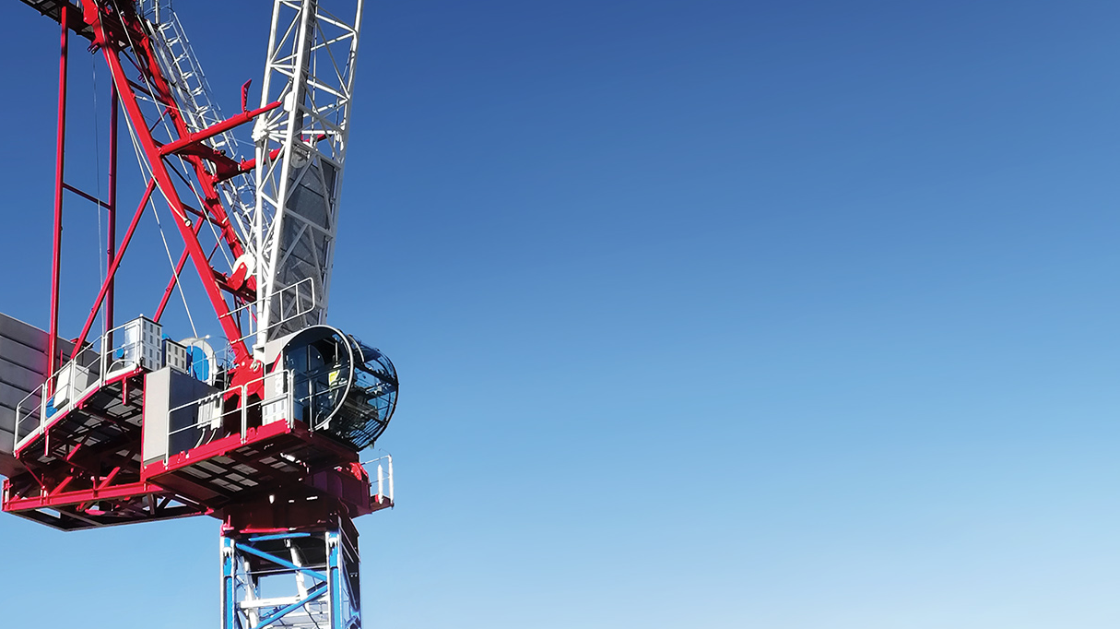
Sample question
A crane lifts a 75 kg mass a height of 8 m. Calculate the gravitational potential energy gained by the mass (g = 9.8 N/kg).
E_{p}
=
m
×
g
×
h
gravitational potential energy (J)
mass
(kg)
gravitational field strength (N/kg)
height
(m)
Developing Experts All rights reserved © 2021

Slide 10
Sample question
A crane lifts a 75 kg mass a height of 8 m. Calculate the gravitational potential energy gained by the mass (g = 9.8 N/kg).
E
=
m
×
g
×
h
p
E
=
75
×
9.8
×
8
p
E
=
5880 J
p
Developing Experts All rights reserved © 2021

Slide 11
Sample question
A ball with a mass of 500 grams is lifted onto a shelf which is 1.5 metres above the ground. Calculate the gravitational potential energy gained by the ball.
(g = 9.8 N/kg).
E
=
m
×
g
×
h
gravitational potential energy (J)
mass
(kg)
gravitational field strength (N/kg)
height
(m)
Developing Experts All rights reserved © 2021

Slide 12
Sample question
A ball with a mass of 500 grams is lifted onto a shelf which is 1.5 metres above the ground. Calculate the gravitational potential energy gained by the ball.
(g = 9.8 N/kg).
E
=
m
×
g
×
h
p
E
=
0.5
×
9.8
×
1.5
p
E
=
7.35 J
p
Developing Experts All rights reserved © 2021

Slide 13
Gravitational Potential Energy Store
Calculate the amount of gravitational potential energy gained by an object raised above ground level.
Developing Experts All rights reserved © 2021

