Slide 1

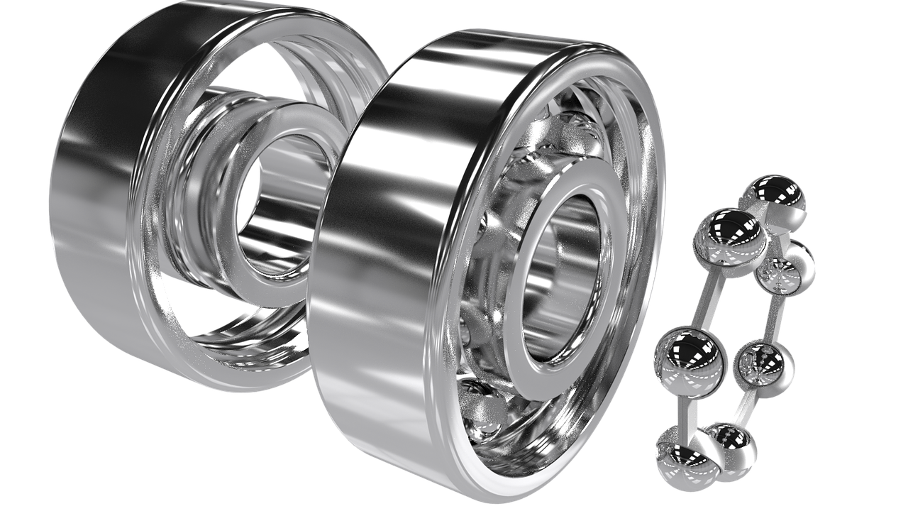
0001.01
Mission Assignment
Task | Complete 3 to 4 simulations and record the variables that you set – screenshots may be helpful here. Once you have played the simulation, record your findings.
Developing skills | Identify one additional energy system
Think about… | There are times that friction is essential - like walking or cycling on a bicycle. Give another example of friction being part of a positive process.
KS4-18-03:
The Conservation of Energy

