Slide 1
Mission Assignment: Describe the structure of a flower
KS3-09-06
Referring to the presentation, complete this comprehension task about plant reproduction.
1. What part of a plant is its reproductive structure? ___________________________________________________________________________________
2. What types of plants bear fruits and flowers? ___________________________________________________________________________________
3. What are the two main types of reproduction in plants? a. ________________________________________________________________________________ b. ________________________________________________________________________________
4. What are the female reproductive structures called? ___________________________________________________________________________________
5. What three parts does the pistil have? a. ________________________________________________________________________________ b. ________________________________________________________________________________ c. ________________________________________________________________________________
6. Why can’t plants cross-fertilise? ______________________________________________________________________________________________________________________________________________________________________
7. What are the male reproductive structures called? ___________________________________________________________________________________
8. How is pollen carried to another plant? ______________________________________________________________________________________________________________________________________________________________________
9. What is self-fertilisation in plants? ___________________________________________________________________________________
10. What is the definition of a fruit in terms of a plant? ___________________________________________________________________________________
Developing Experts Copyright 2023 All Rights Reserved

Slide 2
Mission Assignment: Describe the structure of a flower
KS3-09-06
As you dissect the flower, lay each part within the boxes. Use clear tape to stick the parts down once you have finished.
Petals: | Stem and leaves:
Pistil: | Stamen:
Sepals: | Other:
Developing Experts Copyright 2023 All Rights Reserved

Slide 3
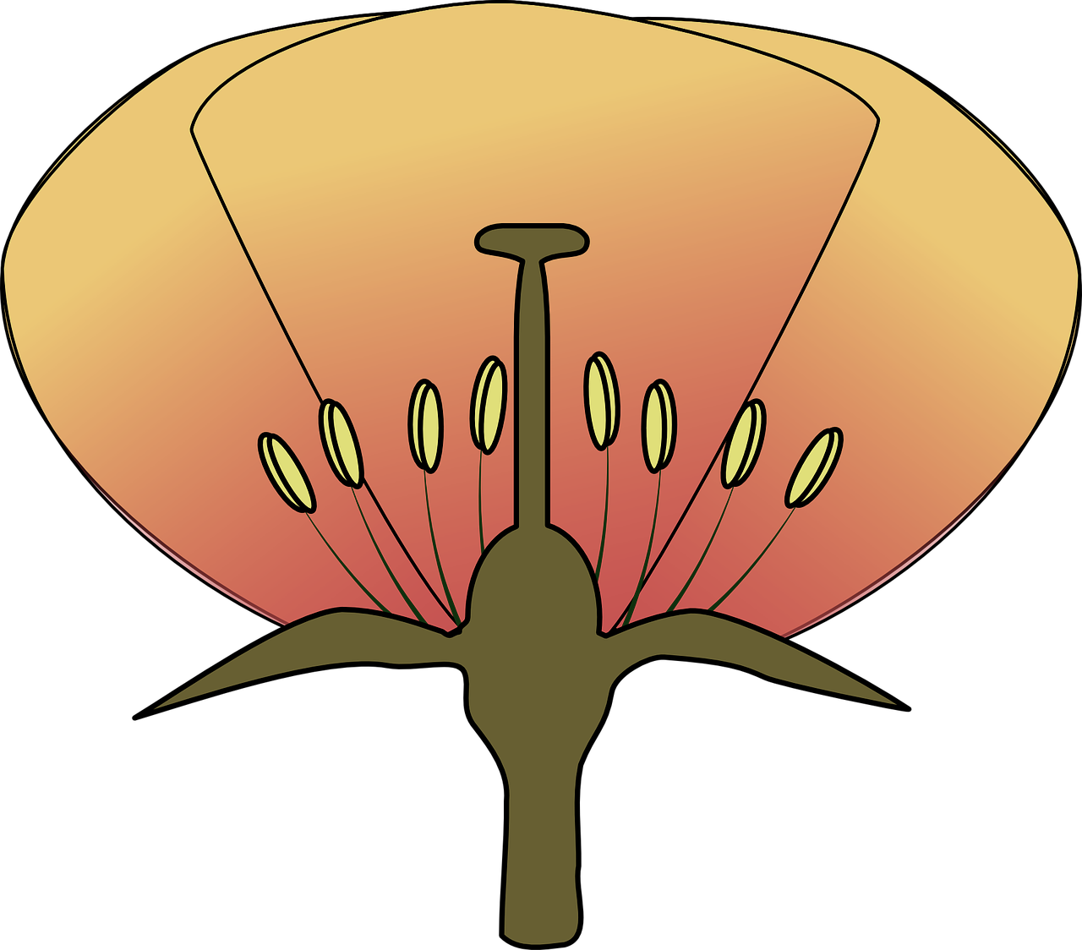
Mission Assignment: Describe the structure of a flower
KS3-09-06
Label and name the reproductive parts of a flower, using the word bank to help you.
Word bank:
sepal pistil filament
ovary style petal
stamen anther stigma
Developing Experts Copyright 2023 All Rights Reserved

Slide 4
Mission Assignment: Describe the structure of a flower ANSWERS
KS3-09-06
Label and name the reproductive parts of a flower, using the word bank to help you.
stigma
style
pistil
ovary
petal
anther
stamen
filament
sepal
Word bank:
sepal pistil filament
ovary style petal
stamen anther stigma
Developing Experts Copyright 2023 All Rights Reserved

Slide 5
Mission Assignment: Describe the structure of a flower ANSWERS
KS3-09-06
Referring to the presentation, complete this comprehension task about plant reproduction.
1. What part of a plant is its reproductive structure? ___________________________________________________________________________________
2. What types of plants bear fruits and flowers? ___________________________________________________________________________________
3. What are the two main types of reproduction in plants? a. ________________________________________________________________________________ b. ________________________________________________________________________________
4. What are the female reproductive structures called? ___________________________________________________________________________________
5. What three parts does the pistil have? a. ________________________________________________________________________________ b. ________________________________________________________________________________ c. ________________________________________________________________________________
6. Why can’t plants cross-fertilise? ______________________________________________________________________________________________________________________________________________________________________
7. What are the male reproductive structures called? ___________________________________________________________________________________
8. How is pollen carried to another plant? ______________________________________________________________________________________________________________________________________________________________________
9. What is self-fertilisation in plants? ___________________________________________________________________________________
10. What is the definition of a fruit in terms of a plant? ___________________________________________________________________________________
Flowers
Flowering plants/angiosperms
Sexual
Asexual
Pistil or capels
Ovary
Stigma
Style
They cannot move to another plant to transfer pollen
Stamen (anther and filament)
Blown by the wind/carried by insects
When the plant fertilises itself as there might not be other plants nearby to transfer the pollen
A mature ripened ovary
Developing Experts Copyright 2023 All Rights Reserved

