Slide 1


S04.03.07 Handout
Know about the different types of teeth
Explore the impact of stains on your teeth by
conducting an experiment.
Time spent cleaning | Initial observation | 1 Minutes | 2 Minutes
Substance
Which substance was the hardest to brush off? ____________________________
Why do you think this substance stained the eggshell the most? ______________
________________________________________________________________________________________________________________________________________________________
What have you learnt about the things you drink and eat and the impact on your teeth?
________________________________________________________________________________________________________________________________________________________
Why is brushing your teeth important? _____________________________________
___________________________________________________________________________
Developing Experts Ltd. © 2022

Slide 2
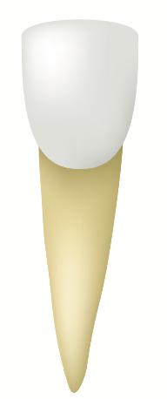
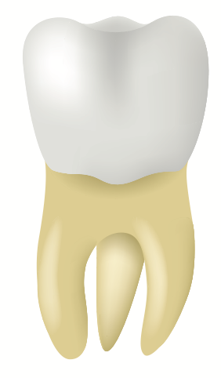
S04.03.07 Handout
Know about the different types of teeth
Explore the impact of stains on your teeth by
conducting an experiment.
Which teeth are used for biting into your food?
____________________________
Which type of teeth, named after dogs, are used to tear up food? ____________________________
Which type of teeth at the back of our mouths, are used to grind the food, so it is ready to swallow?
____________________________
Who do you go to see if you need treatment on your teeth?
____________________________
Can you identify the different types of teeth?
Give three top tips for keeping your teeth healthy.
____________________________________________________________
____________________________________________________________
____________________________________________________________
Developing Experts Ltd. © 2022

