Slide 1
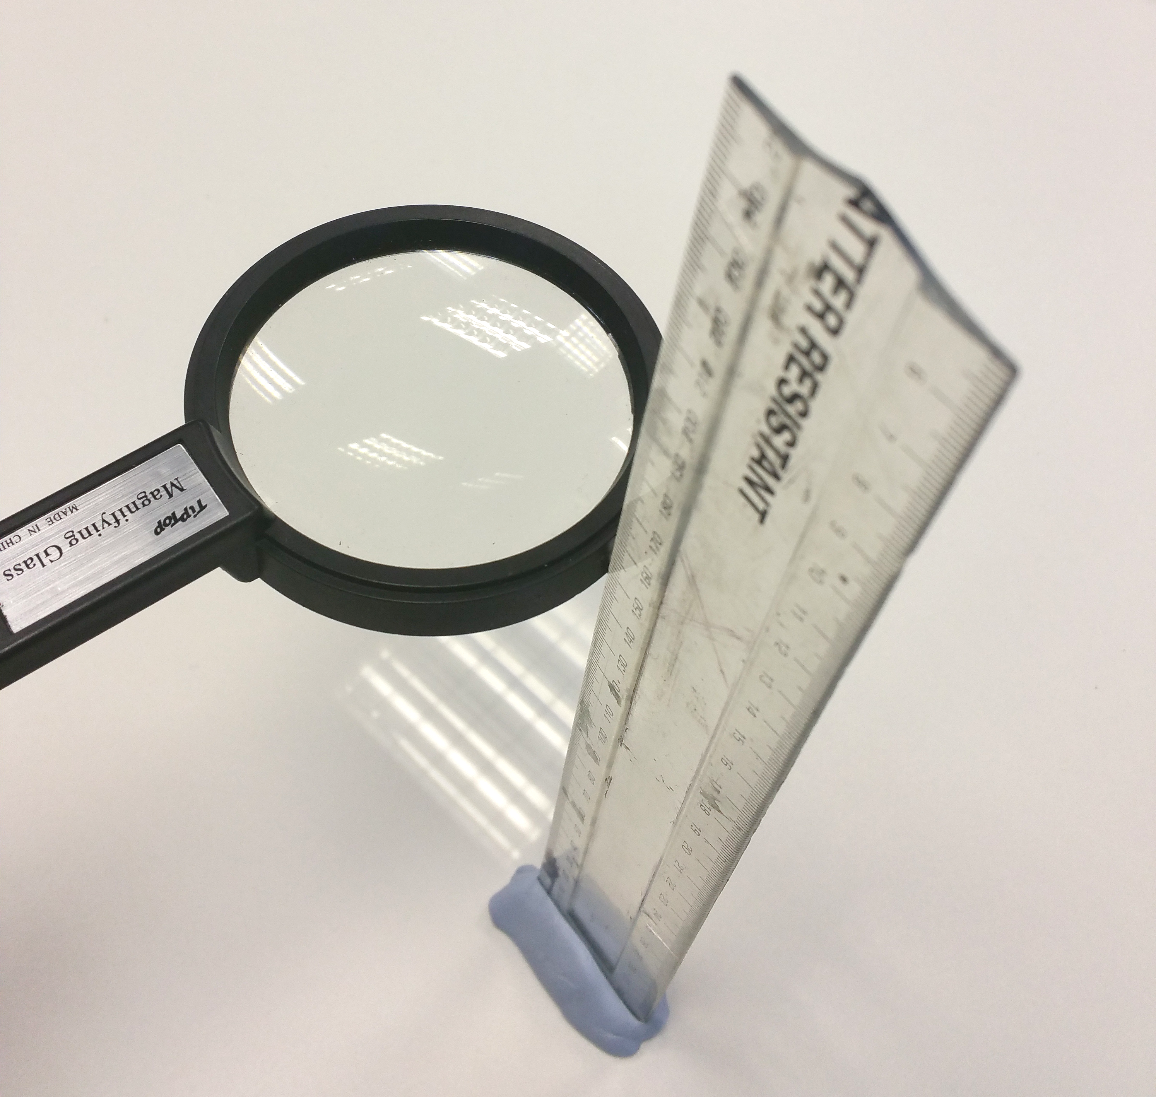
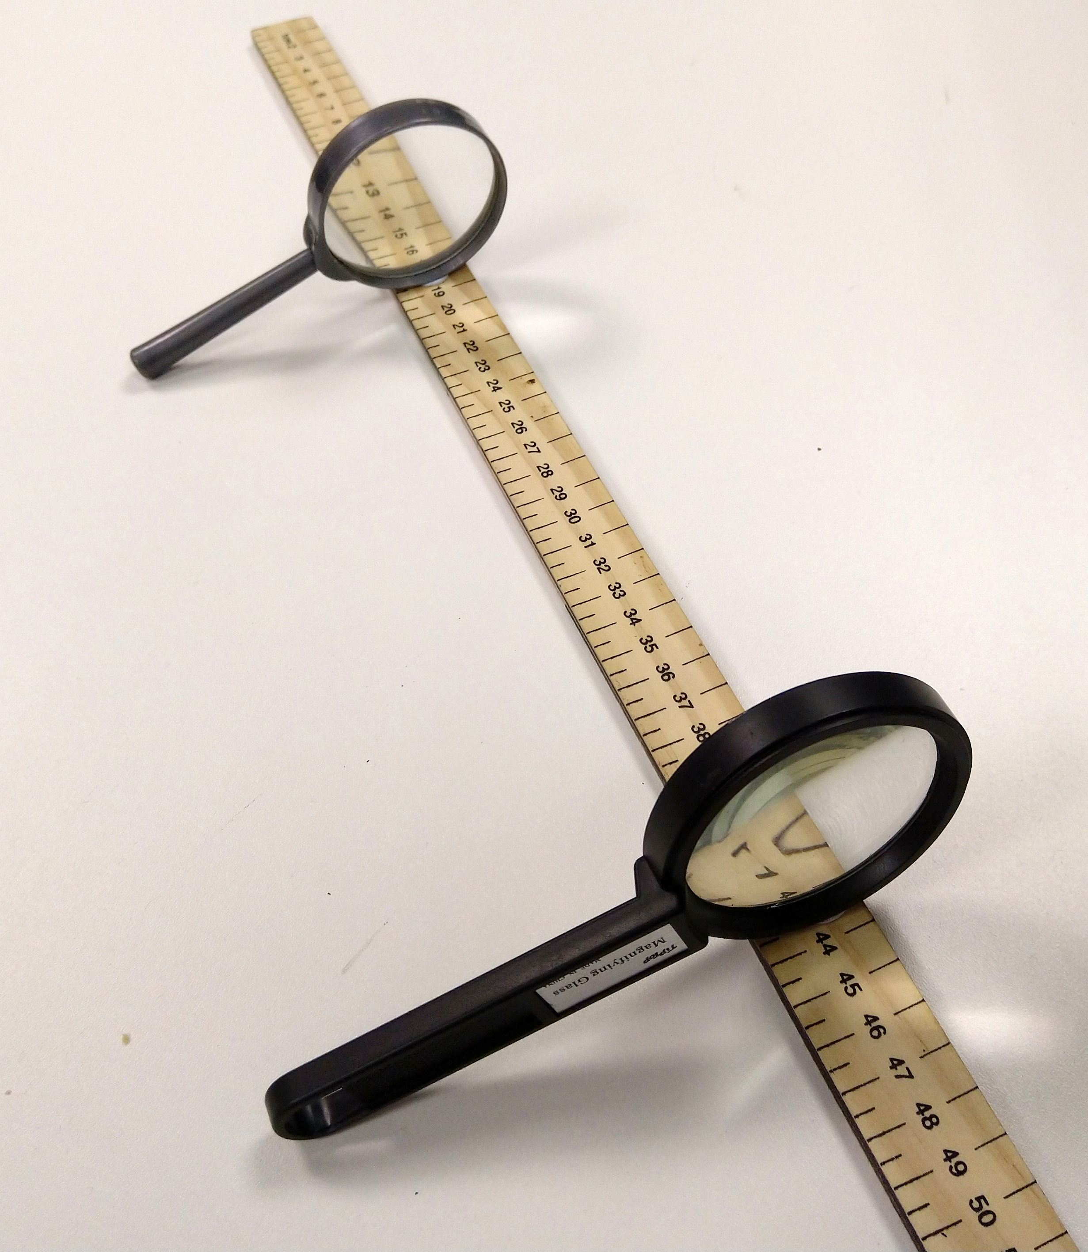
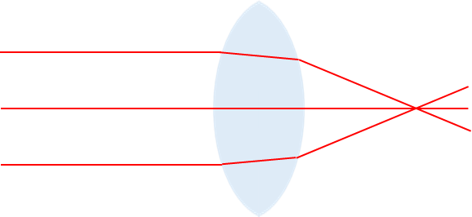

Build a refracting telescope from two magnifying lenses. First find the focal length of the two lenses then stick them down that distance apart.
Method
This experiment works best under fluorescent strip lights
Hold the lens directly under the florescent lighting
above a clear plain desk. Make sure it is flat.
Move the lens up and down until the image of the
lights is clear and focused on the surface.
Use a set square to keep your ruler perpendicular to
the desk and measure the distance from the desk.
Focal length lens 1 _____________ cm
Focal length lens 2 _____________ cm
            Add together the two focal lengths.
            Use the modelling clay to stick the two lenses to the metre stick so that they are this distance apart from each other.
Describe how the image appears when you look
down your telescope.
_____________________________________
_____________________________________
_____________________________________
Add light rays to the diagram to show how they
pass through the telescope.
Focal length
Focal length
Stretch:
“The first lens magnifies the second lens and that’s why it appears closer.” Do you agree? Explain your idea.
Challenge:
Explain what is happening to the rays of light as they pass through a lens. You can use the diagram to help you.

