Slide 1


Mission Assignment: Explain why plants are important
Mission Assignment: Explain how muscles work in pairs
KS3-16-03
KS3-05-03
Chicken wing dissection
Answer these questions before you dissect the wing.
1. How many bones do you think you will find inside the wing?
___________________________________________________________________________________
2. How will you know which parts of the wing are muscle and which parts are tendon?
______________________________________________________________________________________________________________________________________________________________________
3. Why do you need to ensure you do not touch anything other than the wing and scissors whilst you are dissecting the wing?
______________________________________________________________________________________________________________________________________________________________________
4. What will you do with the wing and your equipment when the dissection is finished?
_________________________________________________________________________________________________________________________________________________________________________________________________________________________________________________________
Answer these questions once the dissection is complete.
1. What was the texture of the skin like? Were there any features you could see that showed where feathers grew from?
_________________________________________________________________________________________________________________________________________________________________________________________________________________________________________________________
2. What could you see once the skin had been removed?
_________________________________________________________________________________________________________________________________________________________________________________________________________________________________________________________
3. How was the muscle attached to the rest of the wing?
____________________________________________________________________________________________________________________________________________________________________________________________________________________________________________________________________________________________________________________________________________
Developing Experts Copyright 2023 All Rights Reserved
Developing Experts Copyright 2023 All Rights Reserved

Slide 2
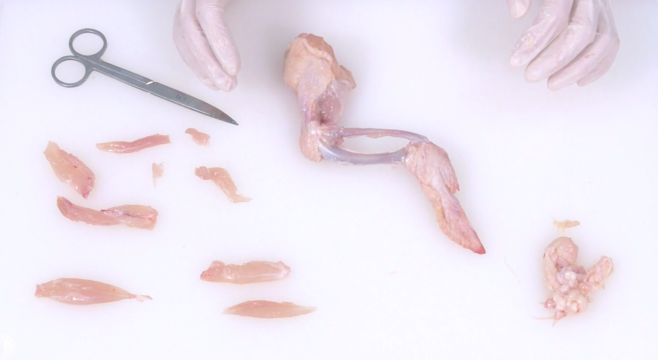
Mission Assignment: Explain why plants are important
Mission Assignment: Explain how muscles work in pairs
KS3-16-03
KS3-05-03
Chicken wing dissection
When the muscles were removed, what other parts of the wing were also removed?
______________________________________________________________________________________________________________________________________________________________
Why were the ends of the bones smoother than the centre of the bones?
______________________________________________________________________________________________________________________________________________________________
What was in the middle of the bones? Does its colour give you any clues?
_______________________________________________________________________________
4. At what point in the dissection were you unable to make the wing tip extend? What does this tell you?
______________________________________________________________________________________________________________________________________________________________________________________________________________________________________________________
5. Why was it important to remove one part of the wing at a time?
______________________________________________________________________________________________________________________________________________________________________________________________________________________________________________________
6. How is a chicken wing similar to a human arm?
______________________________________________________________________________________________________________________________________________________________________________________________________________________________________________________
Developing Experts Copyright 2023 All Rights Reserved
Developing Experts Copyright 2023 All Rights Reserved

Slide 3
Mission Assignment: Explain why plants are important
Mission Assignment: Explain how muscles work in pairs ANSWERS
KS3-16-03
KS3-05-03
Chicken wing dissection
Answer these questions before you dissect the wing.
1. How many bones do you think you will find inside the wing?
___________________________________________________________________________________
2. How will you know which parts of the wing are muscle and which parts are tendon?
______________________________________________________________________________________________________________________________________________________________________
3. Why do you need to ensure you do not touch anything other than the wing and scissors whilst you are dissecting the wing?
______________________________________________________________________________________________________________________________________________________________________
4. What will you do with the wing and your equipment when the dissection is finished?
_________________________________________________________________________________________________________________________________________________________________________________________________________________________________________________________
Answer these questions once the dissection is complete.
1. What was the texture of the skin like? Were there any features you could see that showed where feathers grew from?
_________________________________________________________________________________________________________________________________________________________________________________________________________________________________________________________
2. What could you see once the skin had been removed?
_________________________________________________________________________________________________________________________________________________________________________________________________________________________________________________________
3. How was the muscle attached to the rest of the wing?
____________________________________________________________________________________________________________________________________________________________________________________________________________________________________________________________________________________________________________________________________________
Credit any valid hypotheses.
They will feel/ look different. Tendons will be at the end.
Contamination of surfaces from raw chicken.
Wing will go in trash, equipment and work surfaces will be sterilised.
Answers to be based on students’ observations
Developing Experts Copyright 2023 All Rights Reserved
Developing Experts Copyright 2023 All Rights Reserved

Slide 4
Mission Assignment: Explain why plants are important
Mission Assignment: Explain how muscles work in pairs ANSWERS
KS3-16-03
KS3-05-03
Chicken wing dissection
When the muscles were removed, what other parts of the wing were also removed?
______________________________________________________________________________________________________________________________________________________________
Why were the ends of the bones smoother than the centre of the bones?
______________________________________________________________________________________________________________________________________________________________
What was in the middle of the bones? Does its colour give you any clues?
_______________________________________________________________________________
4. At what point in the dissection were you unable to make the wing tip extend? What does this tell you?
______________________________________________________________________________________________________________________________________________________________________________________________________________________________________________________
5. Why was it important to remove one part of the wing at a time?
______________________________________________________________________________________________________________________________________________________________________________________________________________________________________________________
6. How is a chicken wing similar to a human arm?
______________________________________________________________________________________________________________________________________________________________________________________________________________________________________________________
Tendons
They had to pass over one another for movement and are covered in cartilage
Blood and bone marrow
One of the muscles was cut; the wing tip would not be able to extend.This tells us that muscles work in pairs.
So that you could see the effect of each part and study them as components of the working wing.
Human arms also have antagonistic muscles as well as an elbow joint with two main muscles above and two below.
Developing Experts Copyright 2023 All Rights Reserved
Developing Experts Copyright 2023 All Rights Reserved

