Slide 1


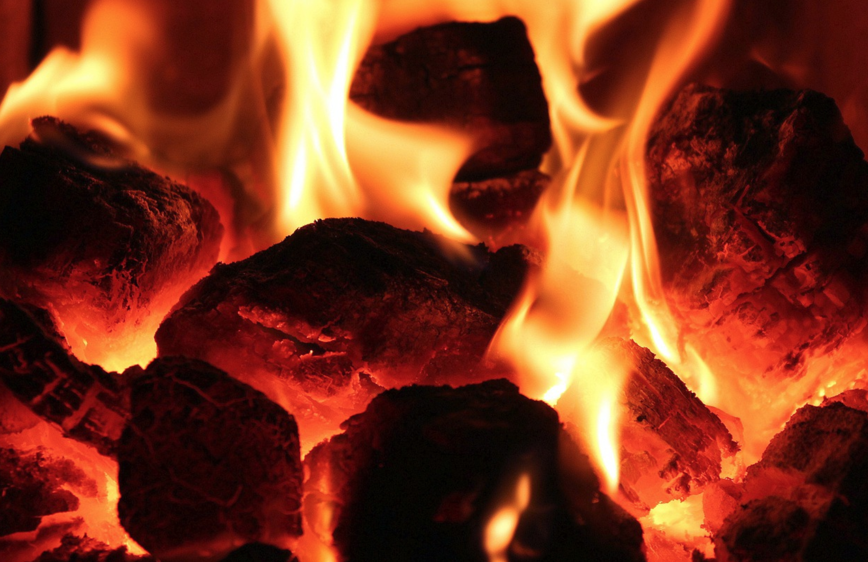


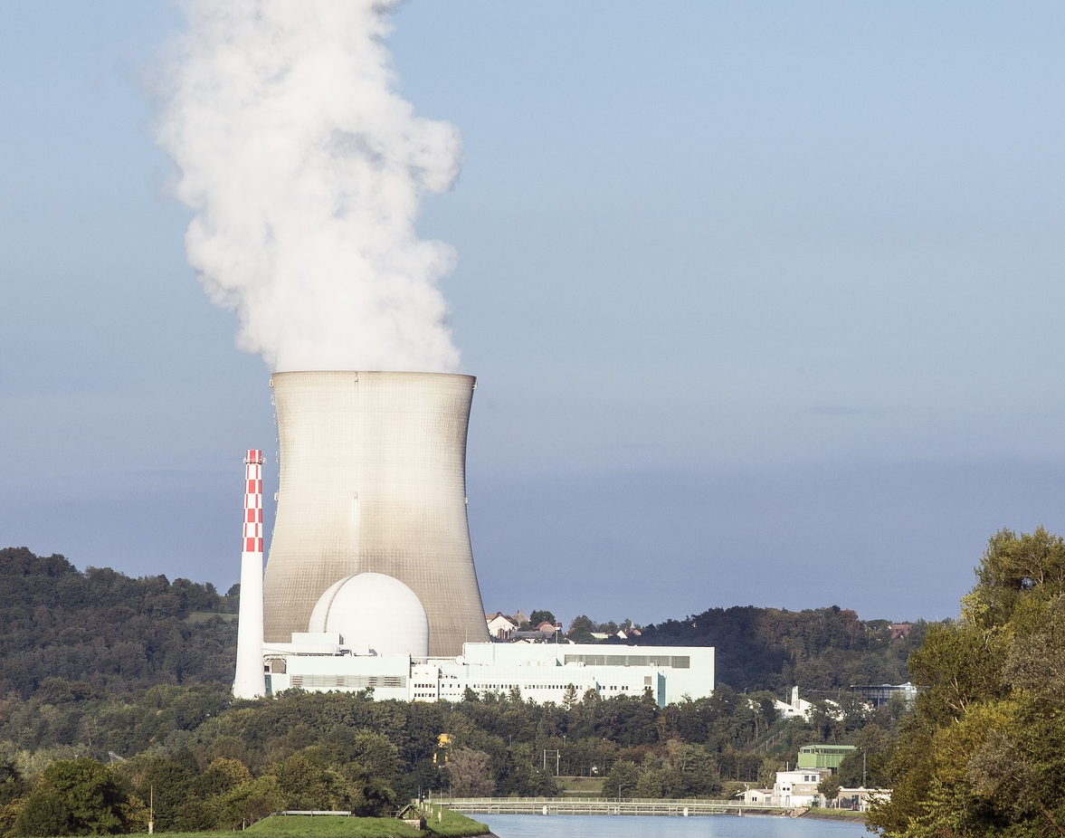
Mission Assignment: Compare renewable and non-renewable energy resources
KS3-03-04
What are the advantages and disadvantages of these energy sources?
Type of Energy | Advantages | Disadvantages
coal
oil
gas
nuclear
Developing Experts Copyright 2023 All Rights Reserved

Slide 2
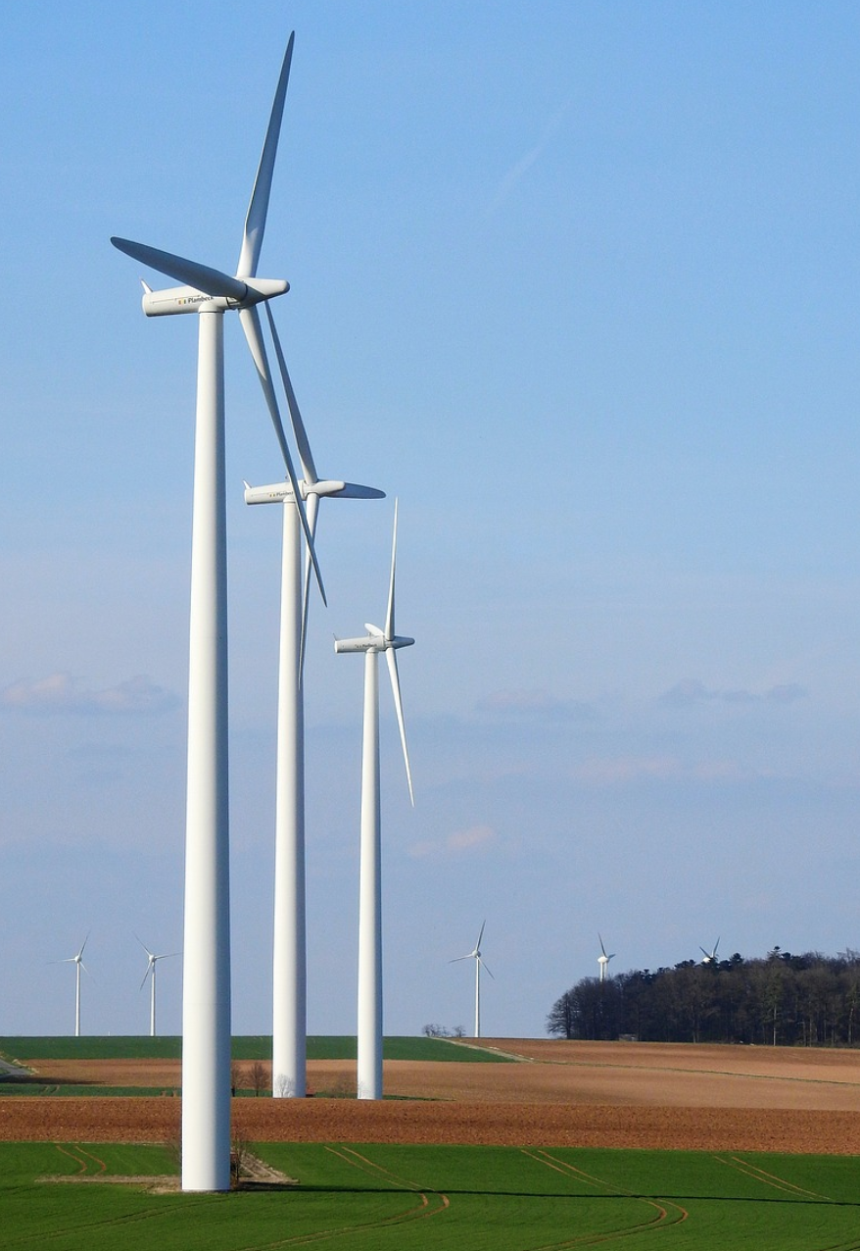
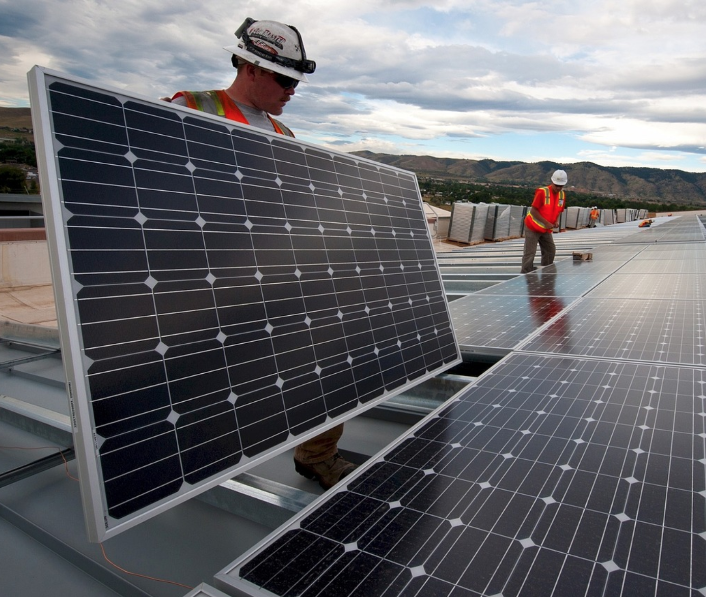
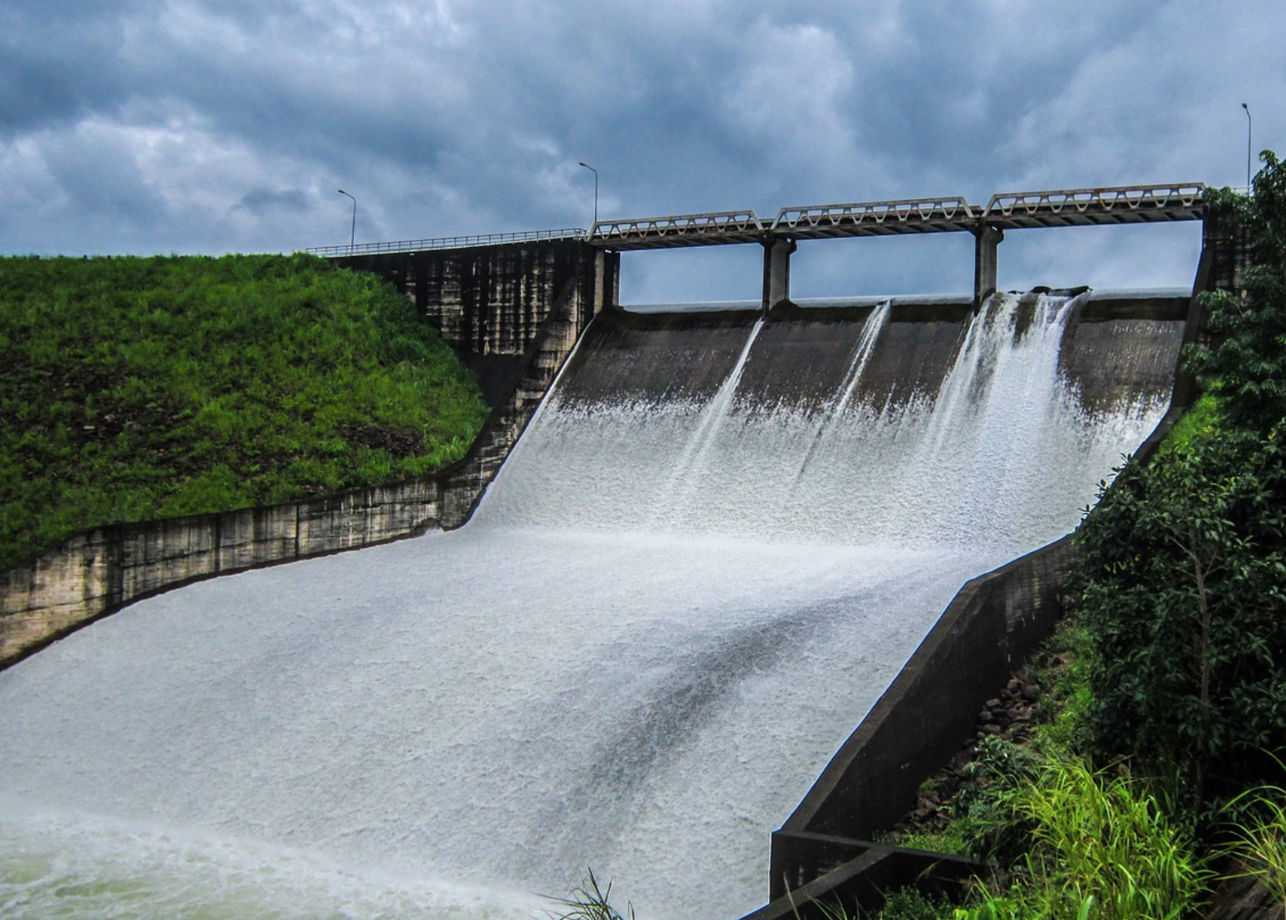
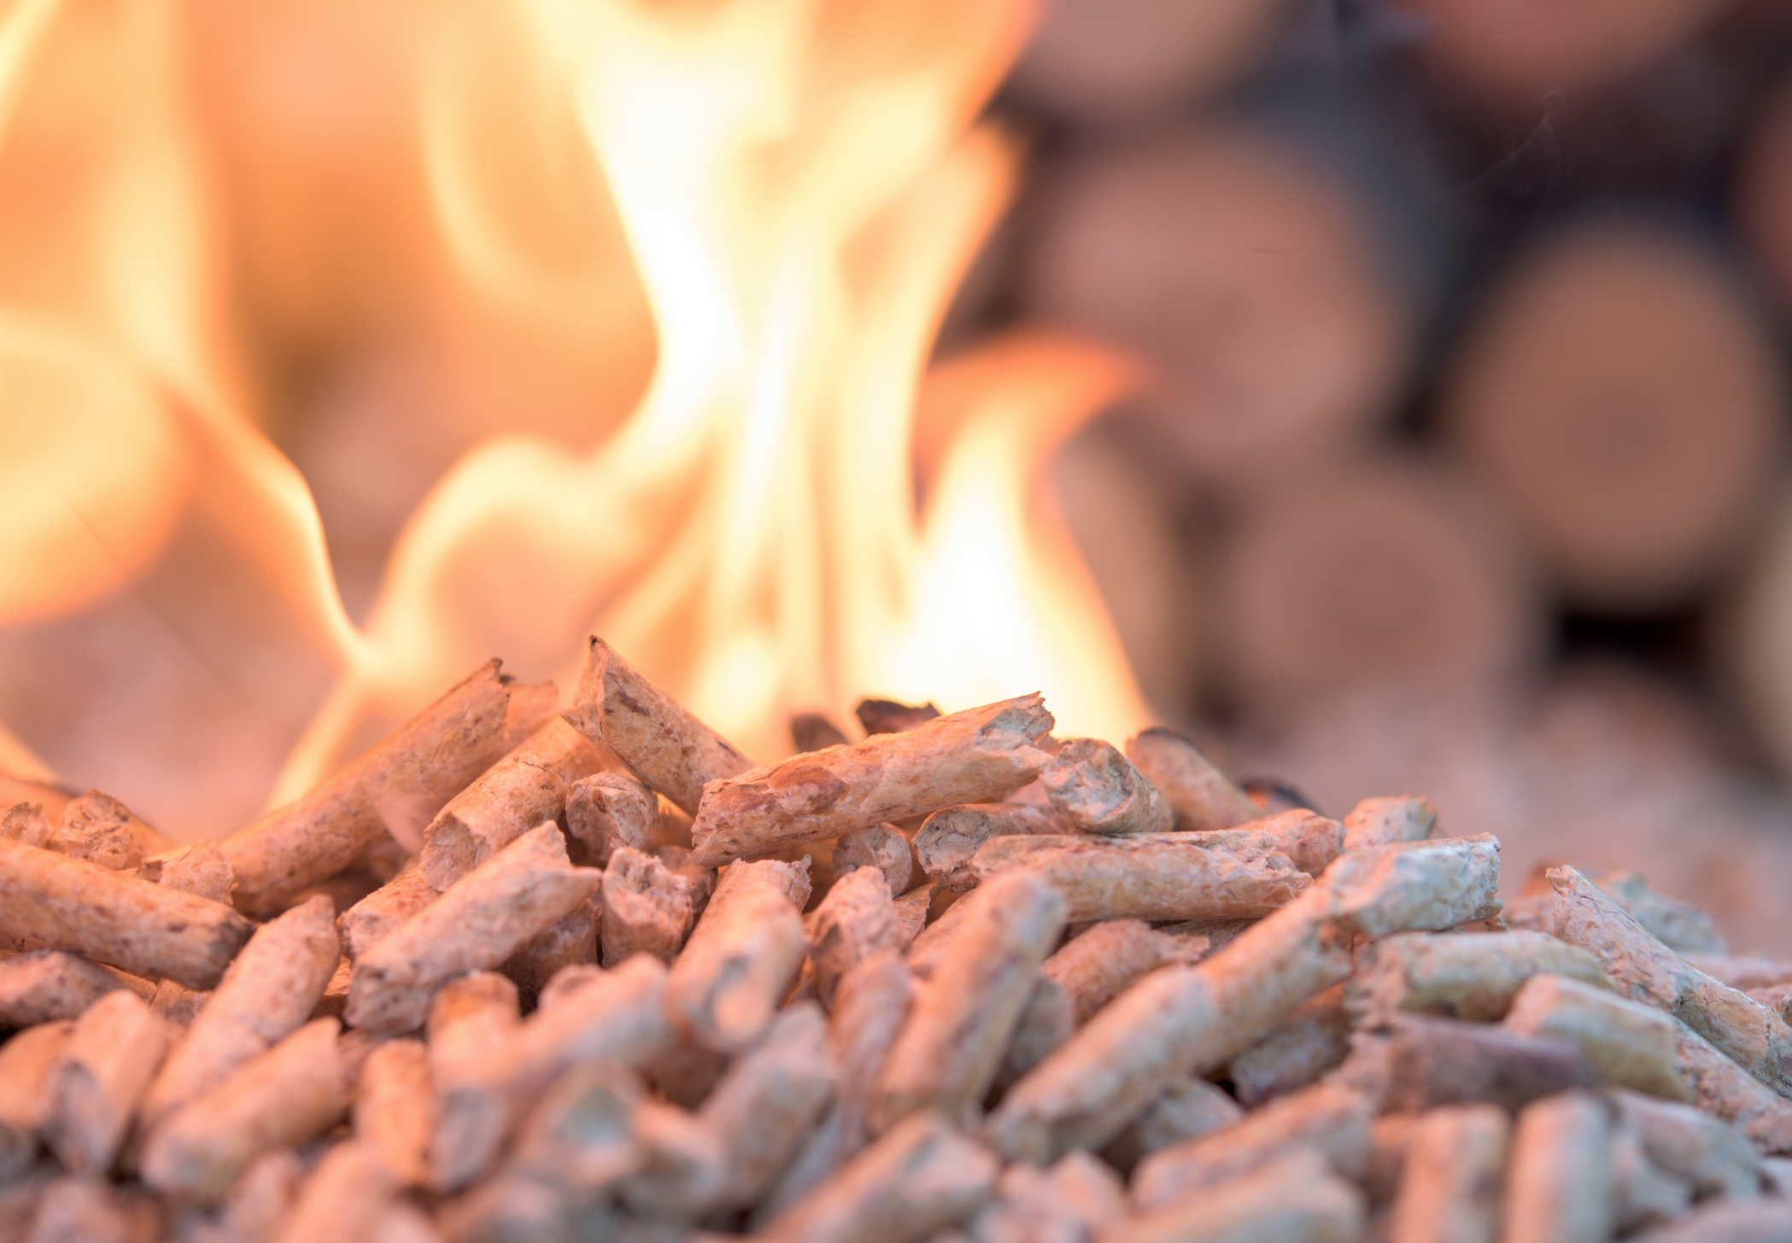
Mission Assignment: Compare renewable and non-renewable energy resources
KS3-03-04
What are the advantages and disadvantages of these energy sources?
Type of Energy | Advantages | Disadvantages
wind
solar
hydro
biomass
Developing Experts Copyright 2023 All Rights Reserved

Slide 3

Mission Assignment: Compare renewable and non-renewable energy resources
KS3-03-04
Write a speech for a local council meeting, convincing protestors that building a wind turbine in their village will benefit them.
________________________________________________________________________________________________________________________________________________________________________________________________________________________________________________________________________________________________________________________________________________________________________________________________________________________________________________________________________________________________________________________________________________________________________________________________________________________________________________________________________________________________________________________________________________________________________________________________________________________________________________________________________________________________________________________________________________________________________________________________________________________________________________________________________________________________________________________________________________________________________________________________________________________________________________________________________________________
Key Words
sustainable environment renewable
future benefit advantage
wind-power energy economic
Developing Experts Copyright 2023 All Rights Reserved

