Slide 1
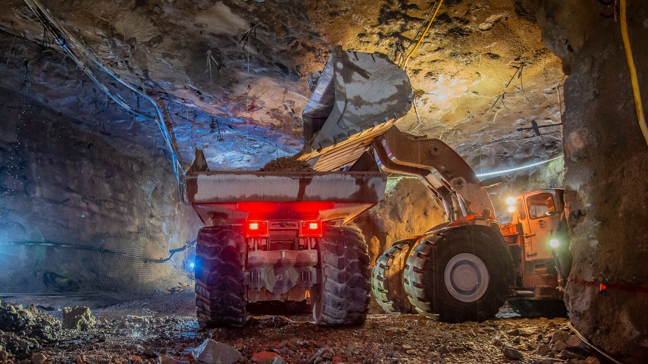
Developing Experts All rights reserved © 2021

Slide 2
In 2015 an estimated 19,100,000 tonnes of copper were produced worldwide!
There are approximately 13 g of copper in a typical iPhone. As of June 2014, approximately 500 million iPhones had been sold. That is more than 6 500 tons of copper in 500 million pockets around the world. That is $35.7 million worth of copper at 2015 prices. ● There are, on average, 1.5 km of copper wiring in a typical car. A typical small car contains about 20 kg of copper, while a large car contains about 40 kg.
Developing Experts All rights reserved © 2021

Slide 3
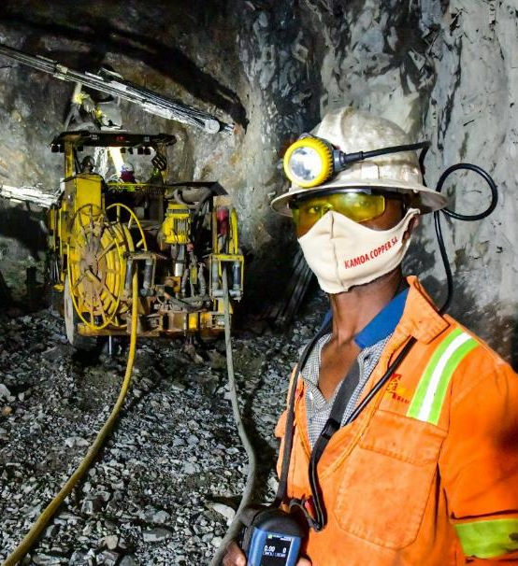
Explore phytomining and bioleaching
Describe how phytomining and bioleaching are used to extract copper.
Developing Experts All rights reserved © 2021

Slide 4
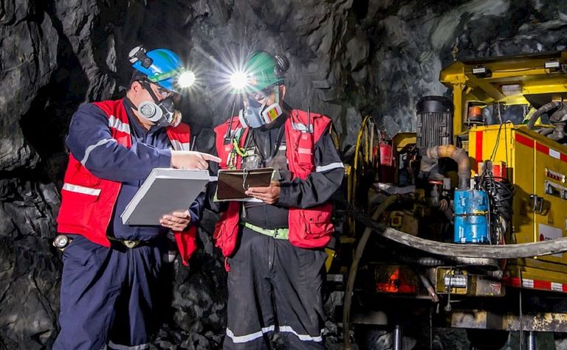
Developing Experts All rights reserved © 2021

Slide 5

Developing Experts All rights reserved © 2021

Slide 6
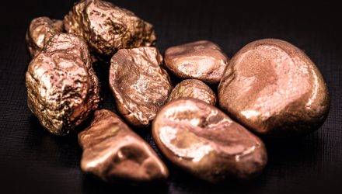
Developing Experts All rights reserved © 2021

Slide 7
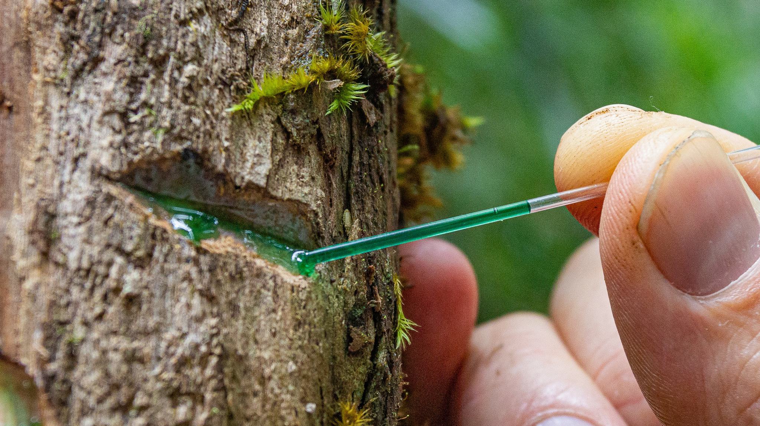
Developing Experts All rights reserved © 2021

Slide 8

Developing Experts All rights reserved © 2021

Slide 9

Developing Experts All rights reserved © 2021

Slide 10
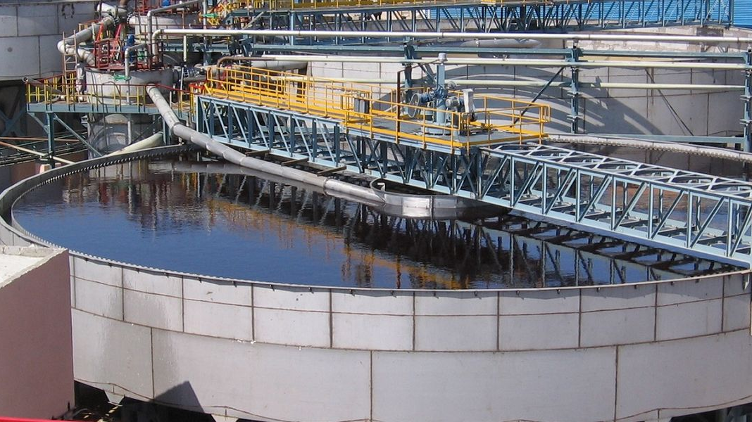
Developing Experts All rights reserved © 2021

Slide 11
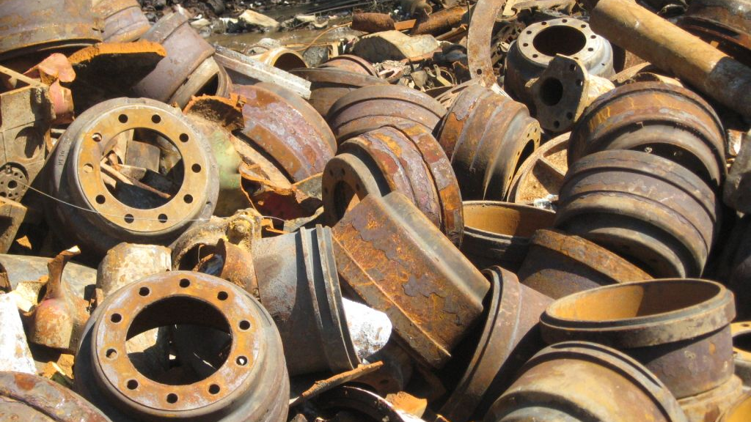
Developing Experts All rights reserved © 2021

Slide 12

Developing Experts All rights reserved © 2021

Slide 13
Explore phytomining and bioleaching
Describe how phytomining and bioleaching are used to extract copper.
Developing Experts All rights reserved © 2021

