Slide 1

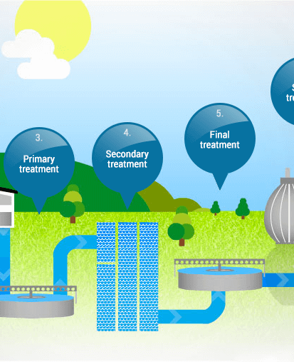
0001.01
Mission Assignment
Task
Developing skills
Think about…
Complete the comprehension task on the water treatment process.
Analysing secondary sources of information
Research how water is treated.
KS4-17-11:
Using Resources - Explore wastewater treatment

