Slide 1

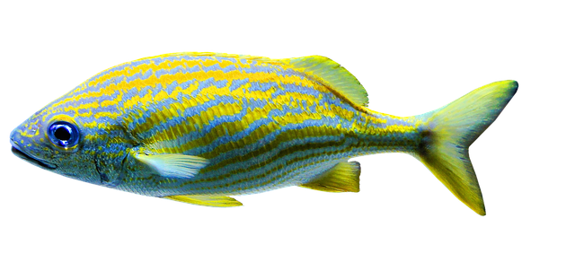
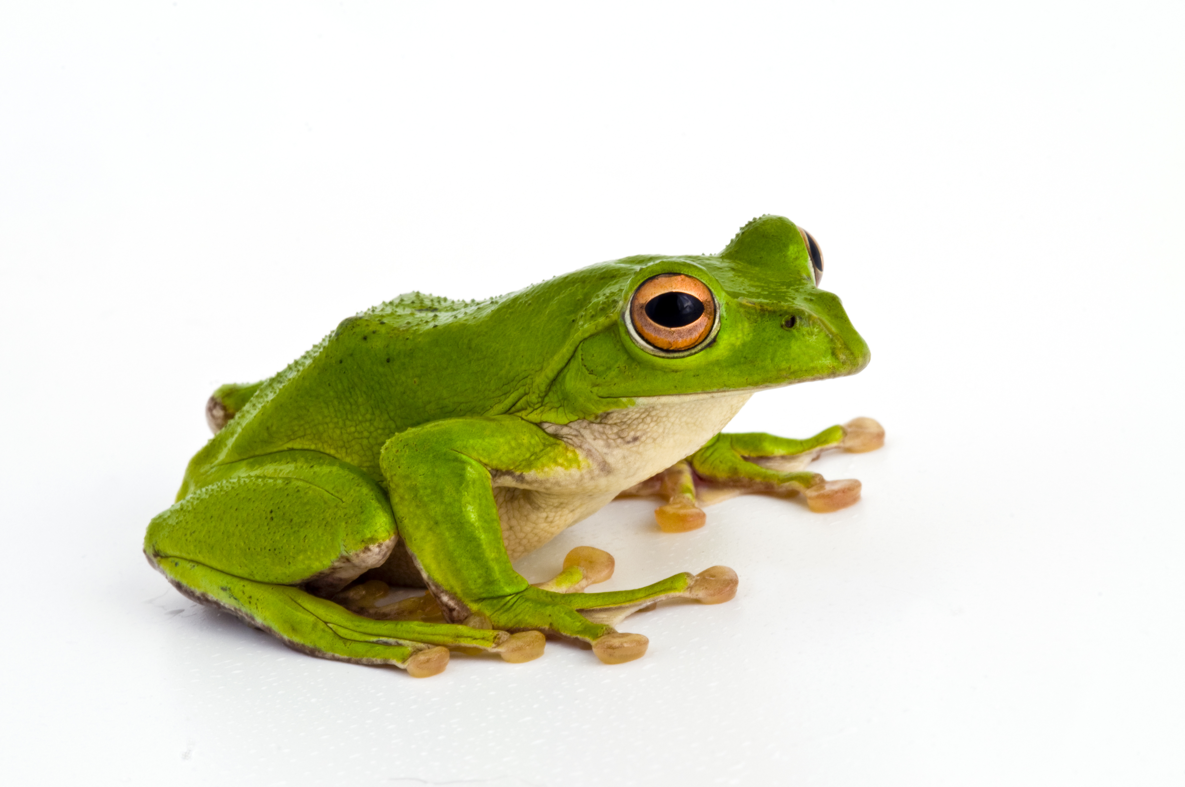
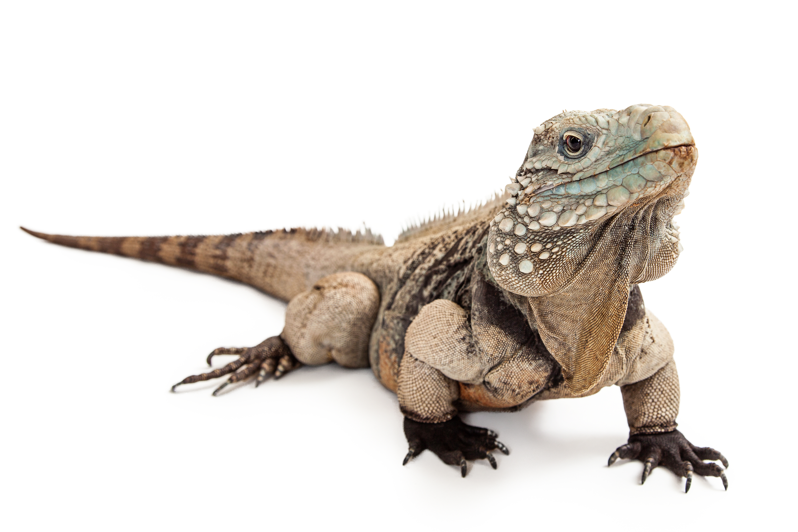
S04.05.06 Handout
Understand how fish are different from amphibians and reptiles.
Explain how fish are different from amphibians and reptiles
Appearance
Birth
Habitat
Diet
Developing Experts Ltd. © 2022

Slide 2
S04.05.06 Handout
Understand how fish are different from amphibians and reptiles
Colour in and cut out some fish for a magnetic fishing game. On the back of each fish, write a fact about it to quiz on!
Developing Experts Ltd. © 2022
.

