Slide 1


Mission Assignment: Investigate Hooke’s Law
KS3-12-02
Investigating Hooke’s Law
Equipment:
Spring or rubber band
Slotted masses
Ruler
Clamp, boss and stand
G-clamp
SAFETY
Method:
Set up a clamp, boss and stand, so that the clamp hangs over the edge of the desk. Clamp the stand to the desk.
Hang a spring or rubber band from the clamp and measure its length unstretched. Record this in the box below. NB: The rubber band may need to be flattened to gauge its length.
Hang a slotted mass from the spring or band and measure its length. Then subtract the original length from its current length to find the extension.
Record this information in the table below.
Repeat steps 3-4, adding an additional mass each time.
Original length of spring / band ____________ mm
Weight (N) | Length (mm) | Extension (mm) Length – Original length =
Developing Experts Copyright 2023 All Rights Reserved

Slide 2
Mission Assignment: Investigate Hooke’s Law
KS3-12-02
Finding the spring constant
When you have completed your experiment, answer the following questions.
1. Plot your results into the following graph. Remember to draw a line of best fit, not dot-to-dot.
2. What is the general trend you have observed in your results between force and weight (N)?
As the weight in ______ increased, the extension of the spring/band ____________ .
3.Circle the statements below that could have been sources of human error.
Weight (N)
Extension (mm)
Using the ruler to measure extension
The weights
Setting up the clamp and stand
Calculating extension
Not waiting for the experiment to stop moving
Developing Experts Copyright 2023 All Rights Reserved

Slide 3
Mission Assignment: Investigate Hooke’s Law
KS3-12-02
Finding the spring constant
When you have completed your experiment, answer the following questions.
Plot your results into the following graph. Remember to draw a line of best fit, not dot-to-dot.
2. What is the general trend you have observed in your results between force and weight (N)?
______________________________________________________________________________________________________________________________________________________________________
3. Take the gradient of your graph to calculate the spring constant.
(Total weight ÷ Total extension = spring constant.
Show your workings below.
_________________________________________________________________________________________________________________________________________________________________________________________________________________________________________________________
Weight (N)
Extension (mm)
Developing Experts Copyright 2023 All Rights Reserved

Slide 4
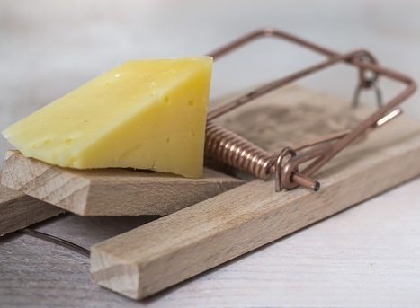

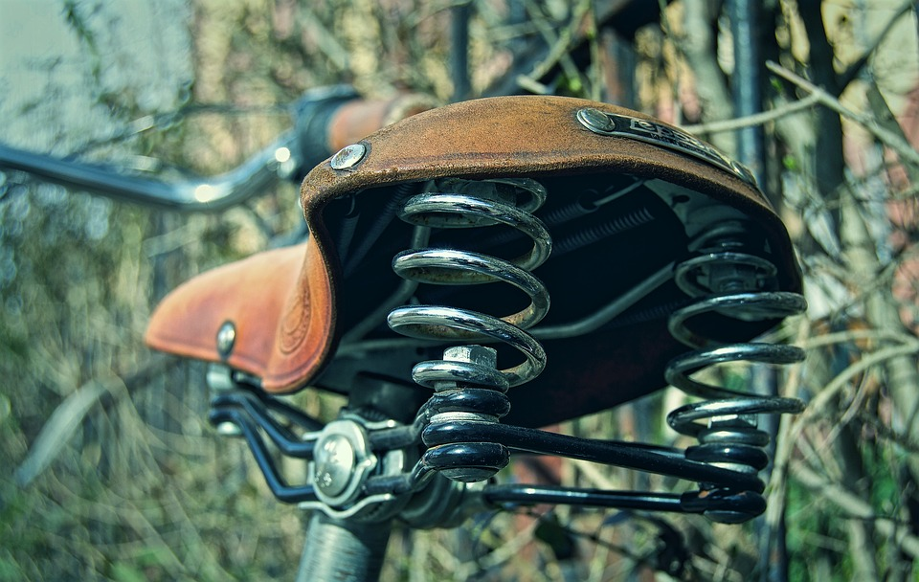

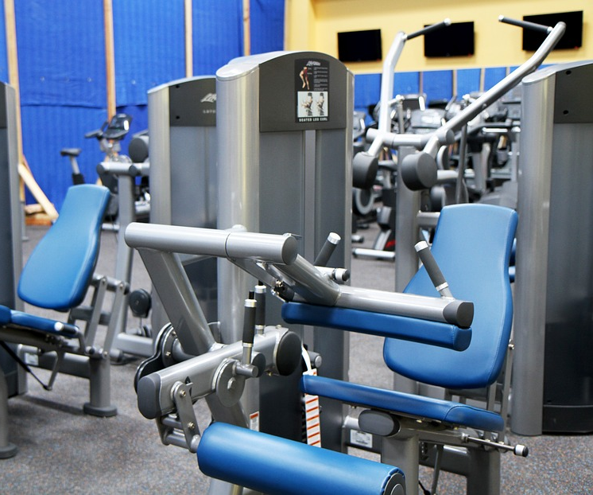

Mission Assignment: Investigate Hooke’s Law
KS3-12-02
Identifying springs
List as many examples as you can think of for uses for springs. Use the pictures for inspiration.
________________________________________________________________________________________________________________________________________________________________________________________________________________________________________________________________________________________________________________________________________________________________________________________________________________________________________________________________________________________________________________________________________________________________________________________________________________________________________________________________________________________________________________________________________________
Why do we need so many types of springs with different levels of springiness? ________________________________________________________________________________________________________________________________________________________________________________________________________________________________________________________________________________________________________________________________________________________________________________________________________________________________________________
Developing Experts Copyright 2023 All Rights Reserved

Slide 5
Mission Assignment: Investigate Hooke’s Law
ANSWERS
KS3-12-02
Finding the spring constant
When you have completed your experiment, answer the following questions.
1. Plot your results into the following graph. Remember to draw a line of best fit, not dot-to-dot.
2. What is the general trend you have observed in your results between force and weight (N)?
As the weight in __________ increased, the extension of the spring/band ____________ .
3.Circle the statements below that could have been sources of human error.
Weight (N)
Extension (mm)
Newtons
increased
Using the ruler to measure extension
The weights
Setting up the clamp and stand
Not waiting for the experiment to stop moving
Calculating extension
Developing Experts Copyright 2023 All Rights Reserved

Slide 6
Mission Assignment: Investigate Hooke’s Law
ANSWERS
KS3-12-02
Identifying springs
List as many examples as you can think of for uses for springs. Use the pictures for inspiration.
________________________________________________________________________________________________________________________________________________________________________________________________________________________________________________________________________________________________________________________________________________________________________________________________________________________________________________________________________________________________________________________________________________________________________________________________________________________________________________________________________________________________________________________________________________________________________________________________________________________________________________________________________________________________________________________________________________________________________________________________________________________________________________
Why do we need so many different types of springs with different levels of springiness? ________________________________________________________________________________________________________________________________________________________________________________________________________________________________________________________________________________________________________________________________________________________________________________________________________________________________________________________________________________________________________________________
Car
Computer key on the keyboard
Buttons on a computer mouse
Game controller buttons
Mattresses
Toasters and kettles
Door handles
Pens
Clock
Not all springs need to deal with the same amount of force when being used.
Developing Experts Copyright 2023 All Rights Reserved

