Slide 1
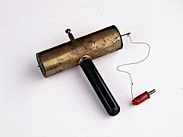
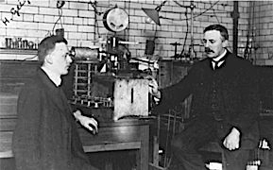
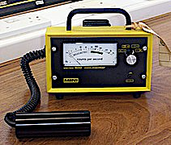
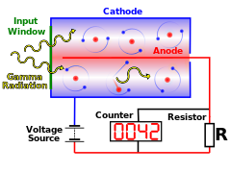
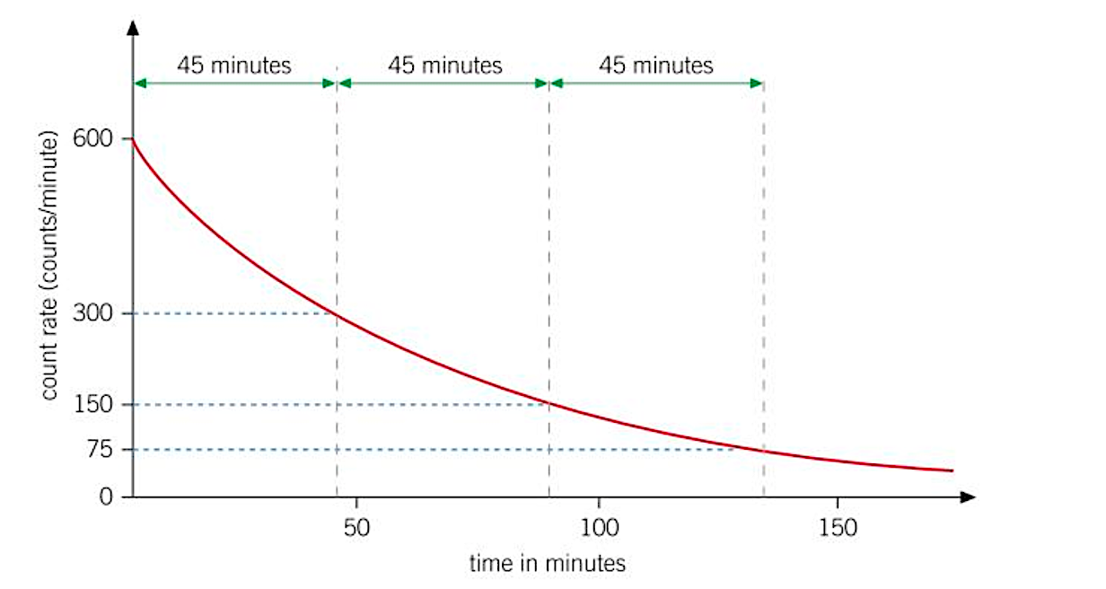
Rutherford and Geiger
Back in his earlier work, Rutherford had already determined the hypothesis of half-life for radioactive decay. He had also tried, and failed, to count alpha particles. Upon taking up his position at Manchester University, he developed the alpha scattering experiment with the assistance of Hans Geiger. Geiger invented the ‘electrometer’ for counting the particles; this was the earlier version of the Geiger-Muller counter.
How does a Geiger-Muller counter work?
A Geiger-Mueller counter has two parts—a sealed tube, or chamber, filled with gas. Radiation enters the tube and when it collides with the gas, it pushes an electron away from the gas atom and creates an ion pair. A wire in the middle of the tube attracts electrons, creating other ion pairs and sending a current through the wire. The current goes to the information display and moves a needle across a scale or makes a number display on a screen. These devices usually provide "counts per minute," or the number of ion pairs created every 60 seconds. It clicks every time an ion pair is created.
Radioactive decay & half-life
Radioactive decay is a completely random process; as such, it is too difficult to predict when it will occur, so we use the measure of half-life. Half-life is the time it takes for half of the unstable nuclei in a sample to decay, for the activity of the sample to halve or for the count rate to halve.
Gravitational
field strength
10N/kg
How to calculate half-life:
In the graph above for iodine 131 we note that the radiation has dropped to half after 45 minutes,
it halves again after a further 45 minutes and it halves again after a further 45 minutes. The count rate will always fall by the same
half-life of 45 minutes.
Higher tier students will be able to calculate what isotope remains and the decrease in count rate. That should be expressed as a fraction, a decimal, or a ratio. After 2 hours and 15 minutes the count rate for iodine 131 in this sample is 75 Bq per minute and there is 1/8 (0.125) of the sample left.

Slide 2
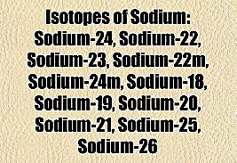
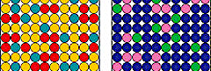
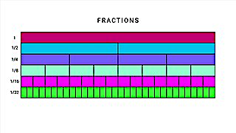
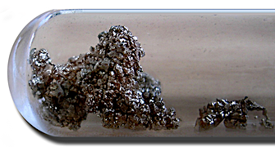
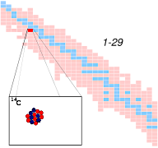
Practice
The radioactive isotope of sodium-25 has a half-life of one minute. What fraction of it remains after 3 minutes?
  a) 1/3 b) 1/4 c) 1/6 d) 1/8
True or false: the activity of a source will reduce to 1/16 after four half-lives. ________________________________________
Xenon-133 is a radioactive gas used for diagnosing lung problems. In 15 days, its activity falls to 1/8 of its original value. What is its half-life?
  a) 2 b) 3 c) 4 d) 5
Calculate the half-life of a strontium-90 whose activity falls from 5000 Bq to 625 Bq over 90 years. ________________________________________________________________________________________________________________________
A radioactive isotope of silver has a half-life of 20 minutes. A sample provides a count rate of 6400 counts per second at 9.20am. At what time will the count be 200 counts per second?
_________________________________________________________________________________________________________________________________________________________________________________
Bones from living animals contain carbon-14 which we use to carbon-date. The half-life of carbon-14 is 5730 years. How old is an antler with a count rate that has dropped from 208 to 52 counts per hour? _______________________________________________________________________________________________________________________________________ _______________________________________

Slide 3
Radioactive decay & half-life
Colbalt-60 is a source used for sterilising medical instruments. It has a half-life of 5.27 years.
  What percentage of the source remains after 10.54 years? __________________________________________________________________________________________________
  After the activity of the sources drops too low to be used, the cobalt-60 must be disposed of safely. The source must be stored until its activity has dropped to be below 1/1000 of its activity today – that is:
  i) 1 half-life. ii) 10 half-lives. iii) 190 half-lives iv) 1000 half-lives
These three radon isotopes are emitted from the walls of a room by the same rate.
Isotope | Half-life | Emissions
Radon - 220 | 55 seconds | Alpha
Radon - 222 | 92 hours | Alpha
Radon - 226 | 1602 years | Alpha
  Which one is the fastest to decay?________________________
  Which one are you least likely to breath in? Explain your answer. _____________________________________________________________________________________________________________________________________________________________________________________________
  Which one has a nuclei that is least likely to decay? __________________________________________________________________________________________________
  Of the two that can be breathed in, which one is liable to be the most dangerous? Explain your reasoning. __________________________________________________________________________________________________ ________________________________________

