Slide 1
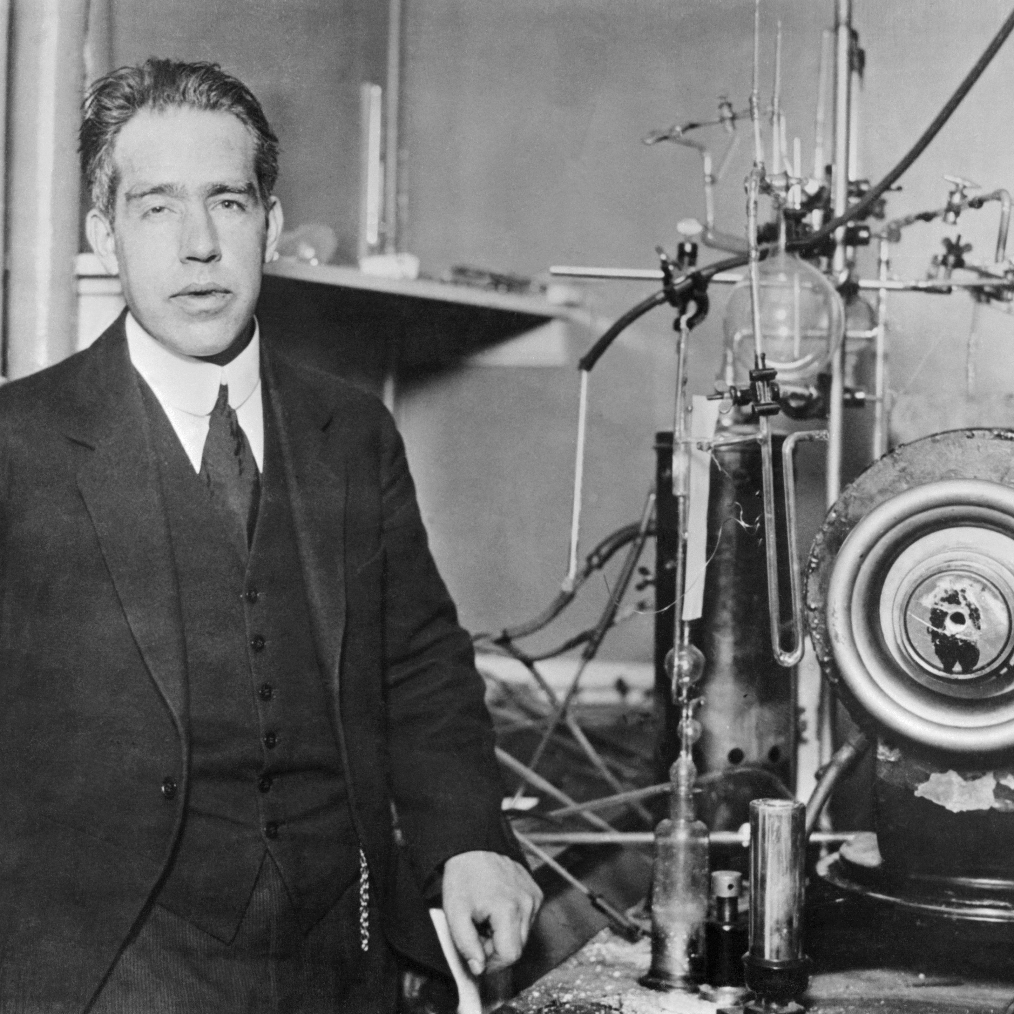
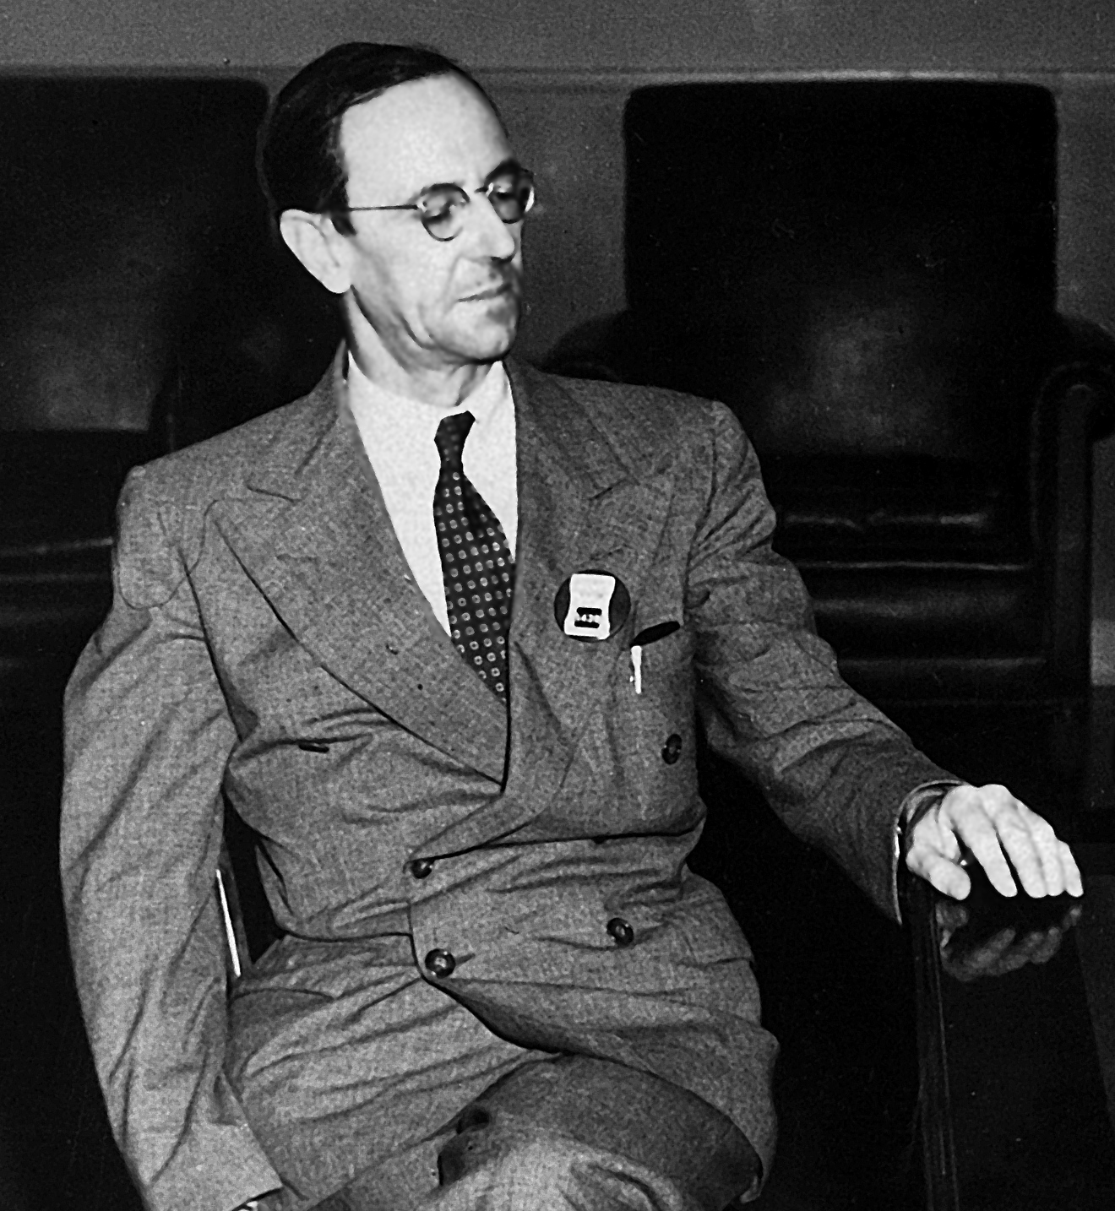
Niels Bohr
James Chadwick
Developing Experts All rights reserved © 2021

Slide 2

History of atomic models
Name some of the scientists who worked on models of the atom and place them in chronological order
Describe earlier models of the structure of the atom
Explain the results of the alpha scattering experiment and how this was used to deduce a new model of the atom
Developing Experts All rights reserved © 2021

Slide 3
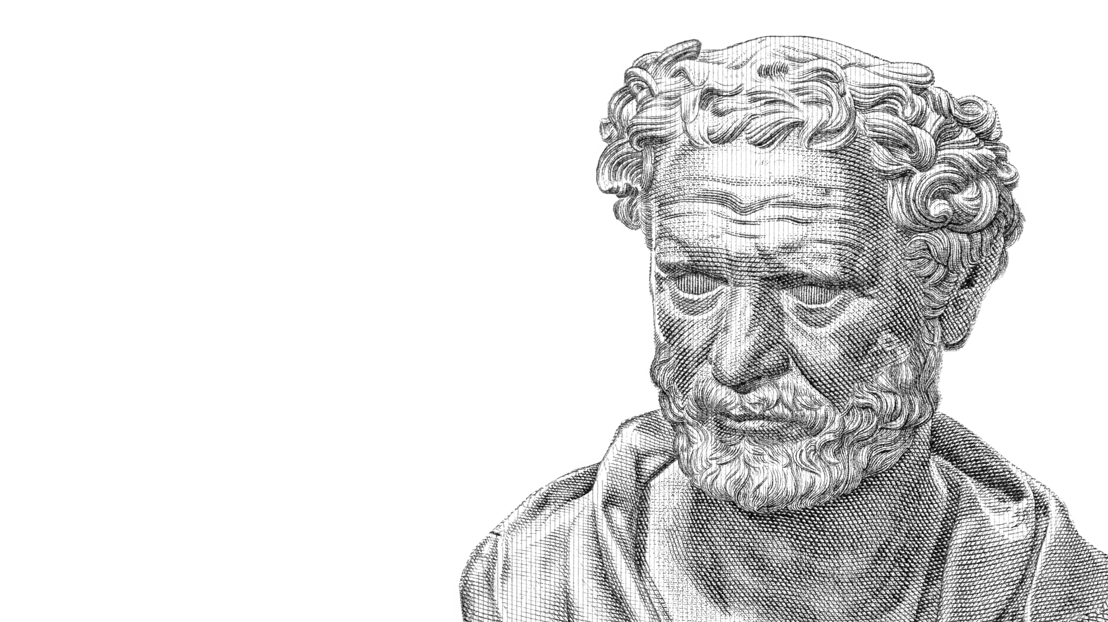

Slide 4
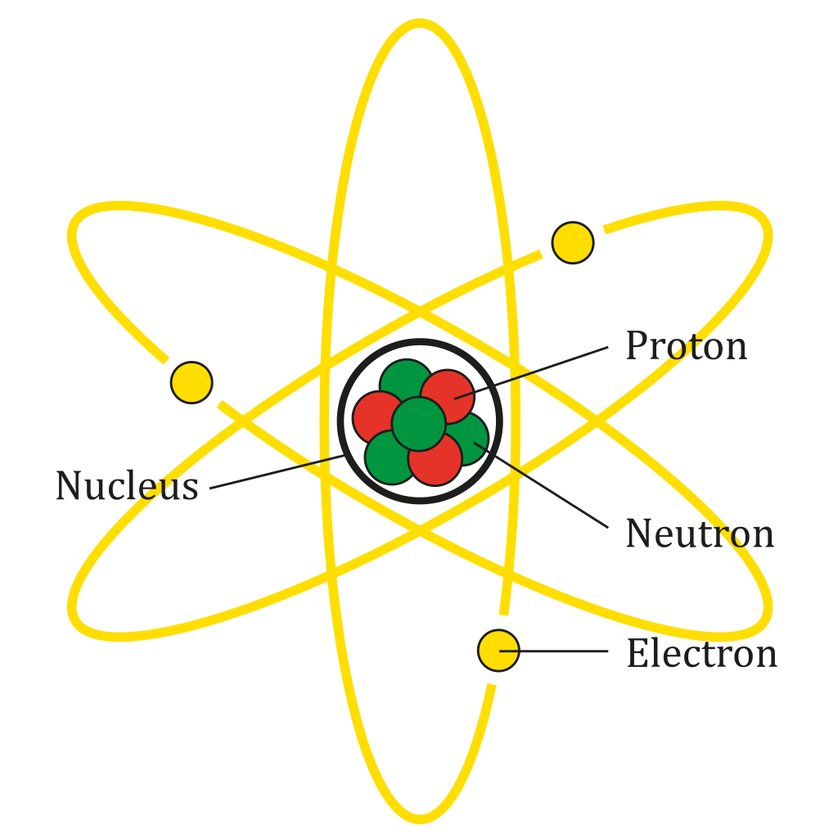
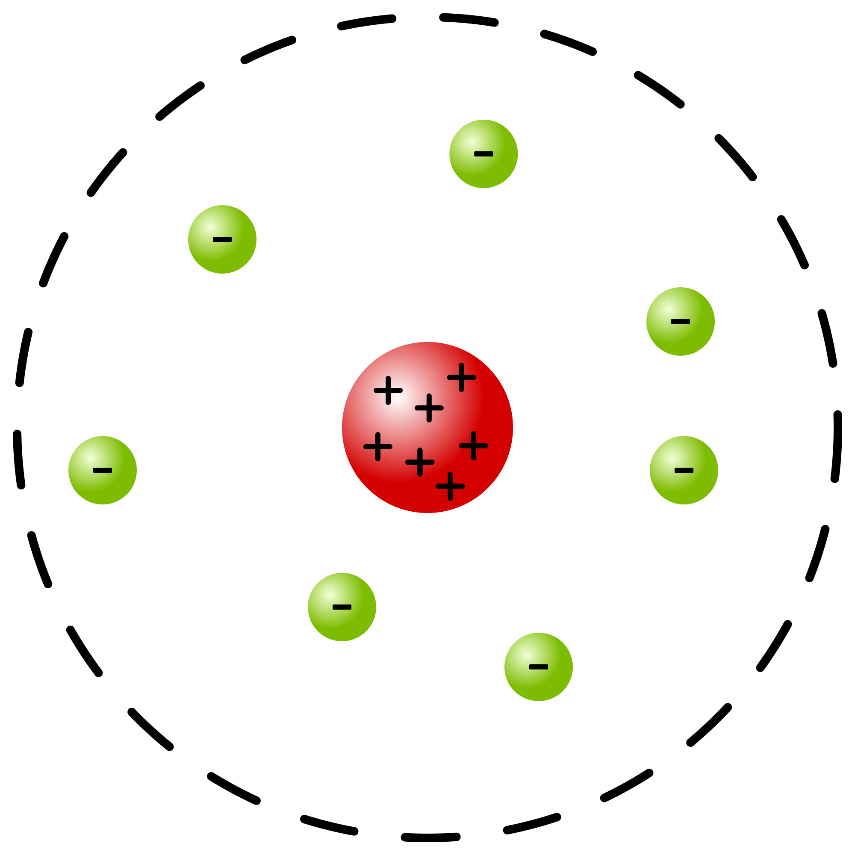

Slide 5
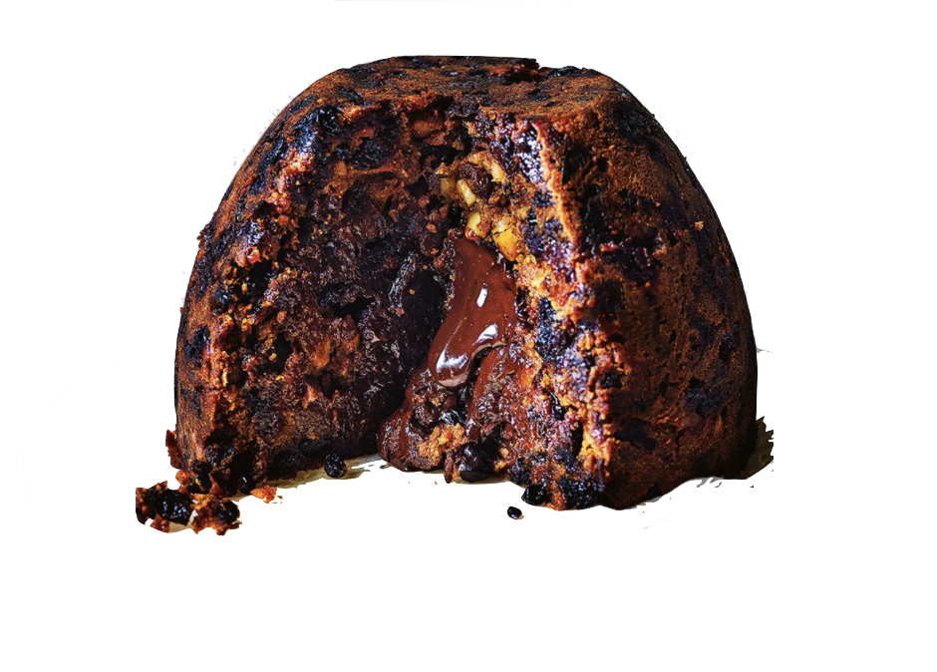
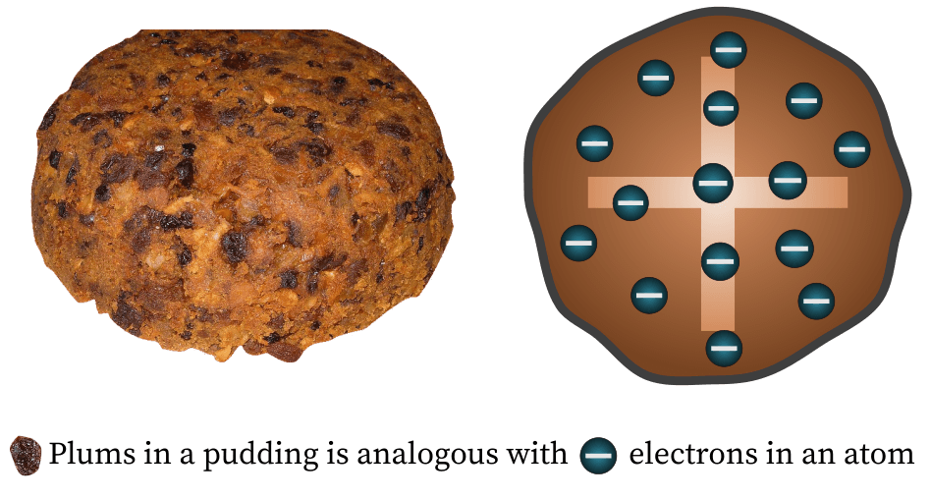

Slide 6
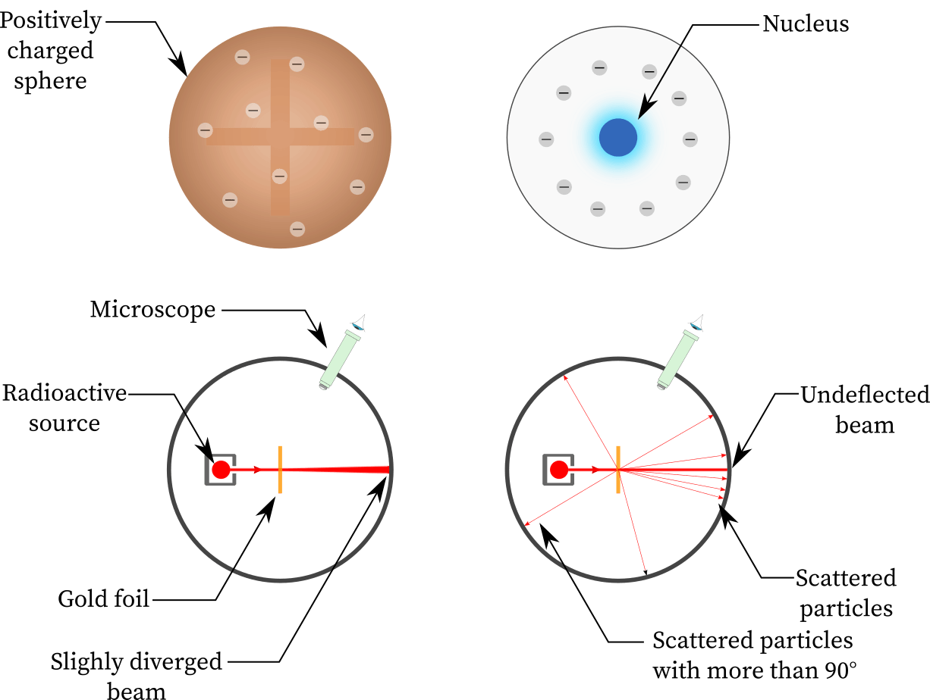
Thomson’s model
Rutherford’s model
Developing Experts All rights reserved © 2021

Slide 7
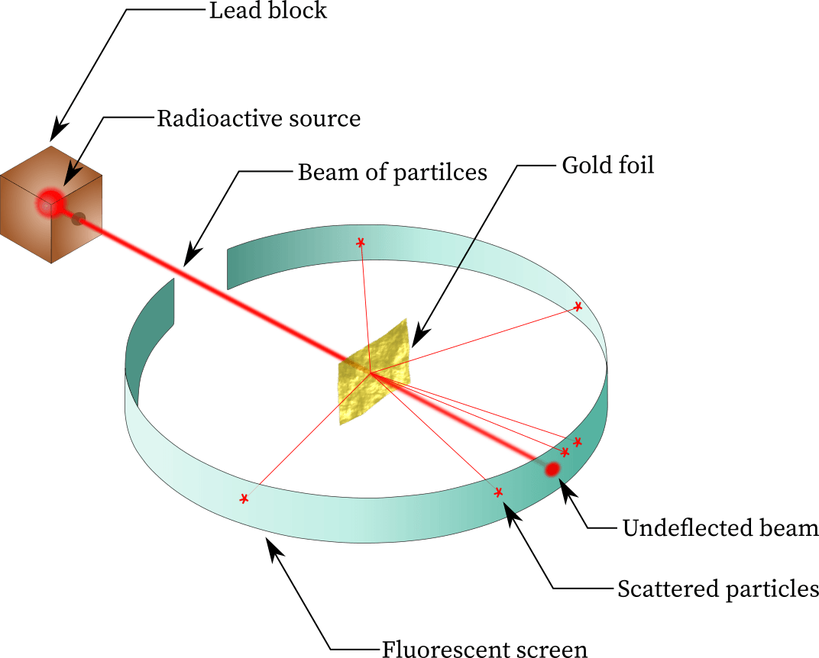

Slide 8
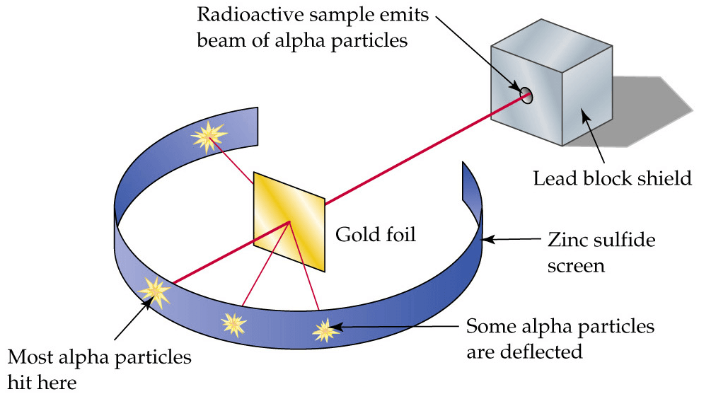

Slide 9
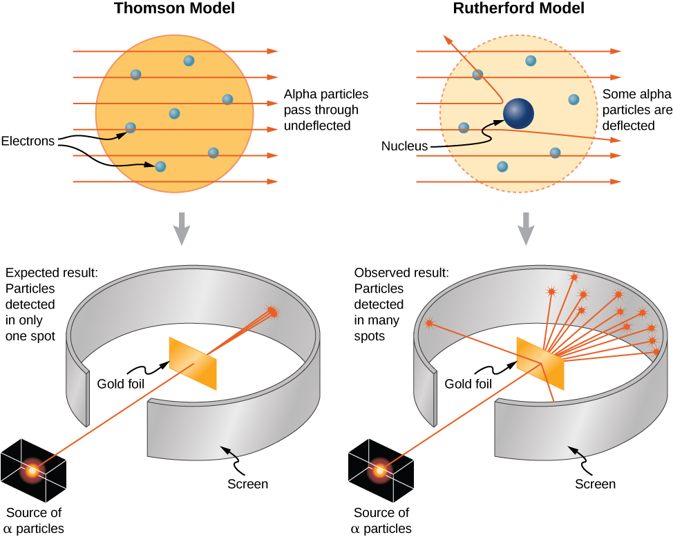
Thomson’s model
Rutherford’s model

Slide 10
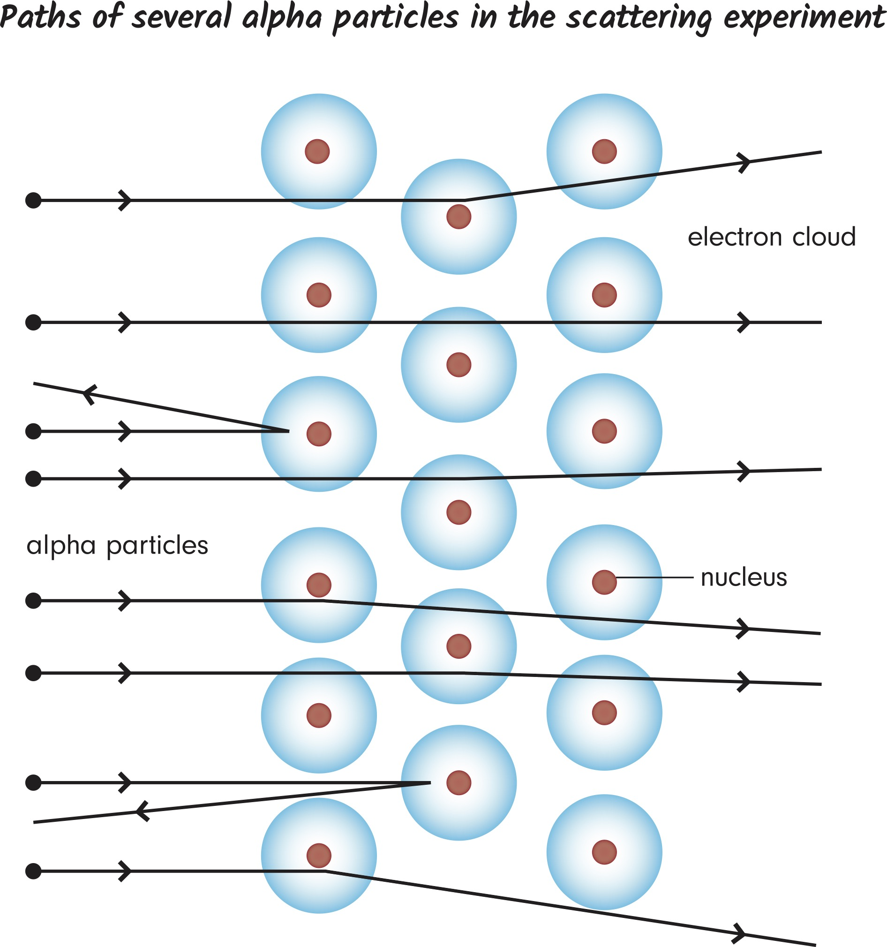

Slide 11
Niels Bohr

Slide 12
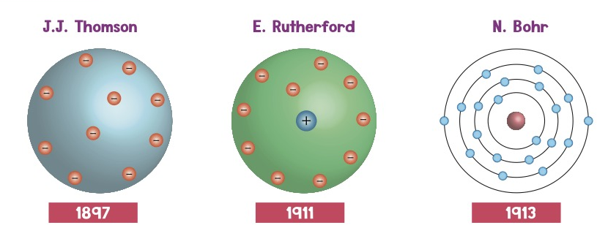
Plum-pudding
Rutherford
Bohr

Slide 13
James Chadwick

