Slide 1


Mission Assignment: Getting back on track - What we can do in our homes and schools
Code: COP26S-01_01
Draw up a personal plan which sets out the changes you need to make in your school and personal life to reduce your contribution to greenhouse emissions.
Priority area | Target for school | Target for home
Energy- consider who supplies your energy at home and at school.
Agriculture- does the food you eat come from sustainable and eco-friendly farming practices?
Land-use change and forestry- when buying new items do you check for sustainable production?
Industrial processes- do you buy locally and understand where your items come from?
Waste produced- do you recycle?
Which areas do you think you can make a priority? Discuss and evaluate your actions in the space below.
2
Developing Experts Copyright 2022 All Rights Reserved

Slide 2

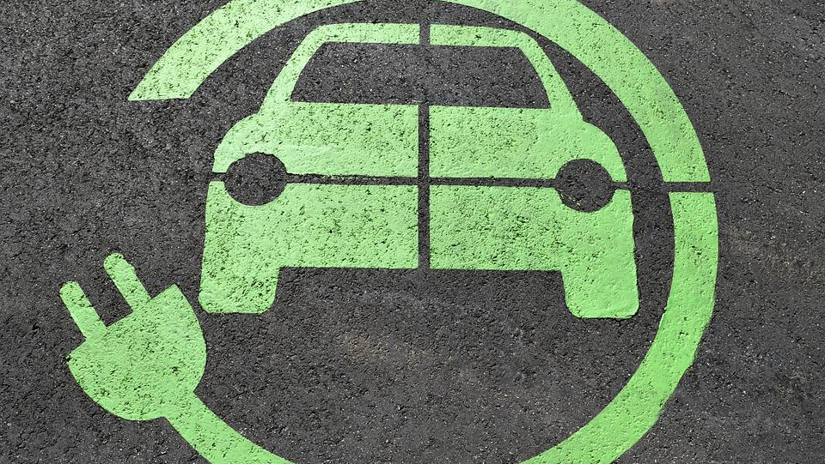

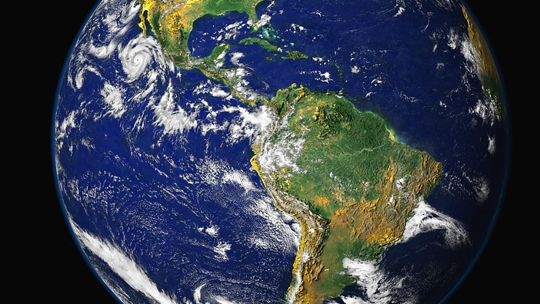
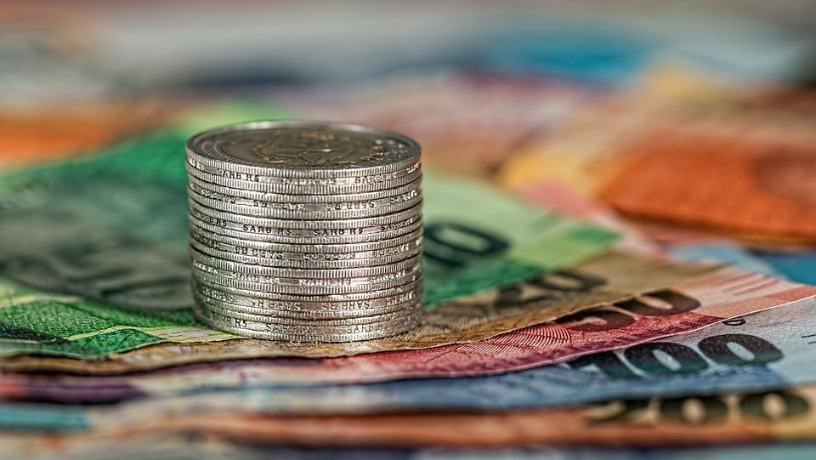
Mission Assignment: Getting back on track - What we can do in our homes and schools
Code: COP26S-01_01
Using a computer, choose a large organization to investigate. This can be an organisation completely of your choice, this could be a high street brand, an e-commerce site or a transport manufacturer.
Consider their contribution to net zero and rate their existing system, making suggestions for improvement.
Organisation:
Company eco-commitments?
Rating of existing system:
Suggestions for improvement:
4
Developing Experts Copyright 2022 All Rights Reserved

