Slide 1
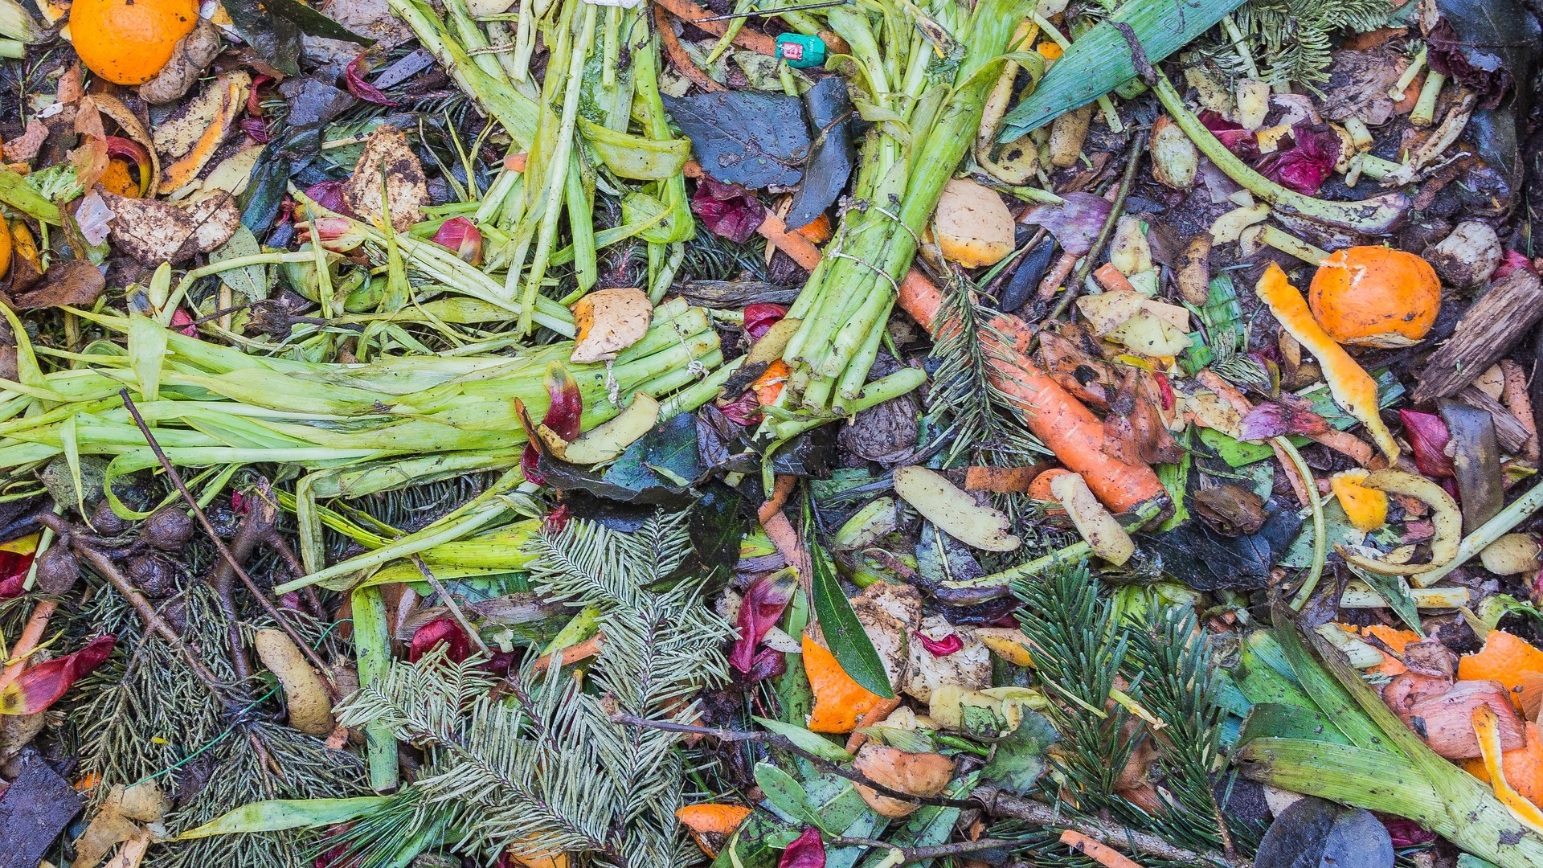

Slide 2
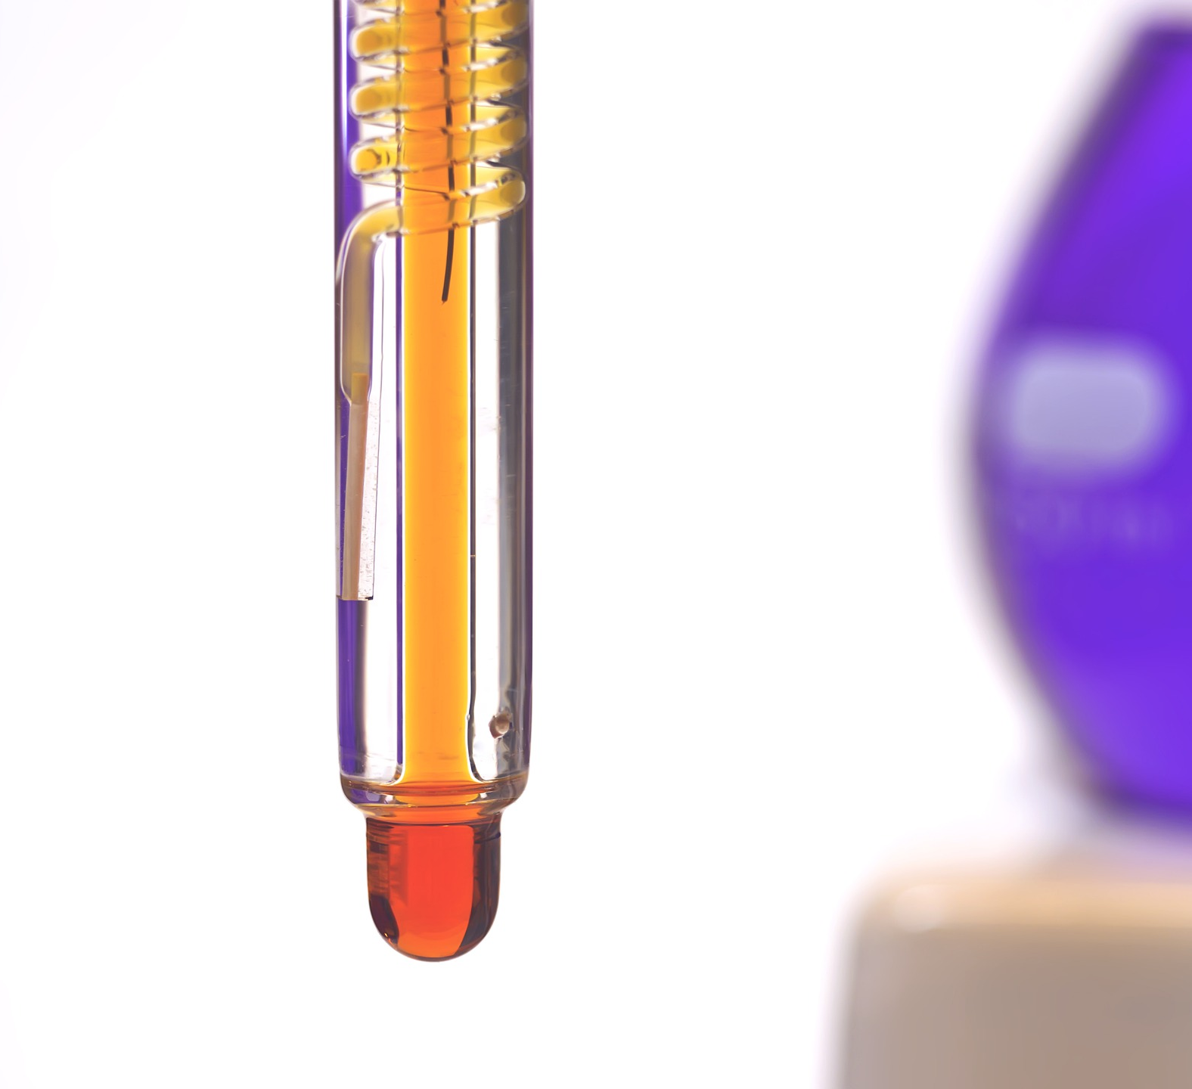
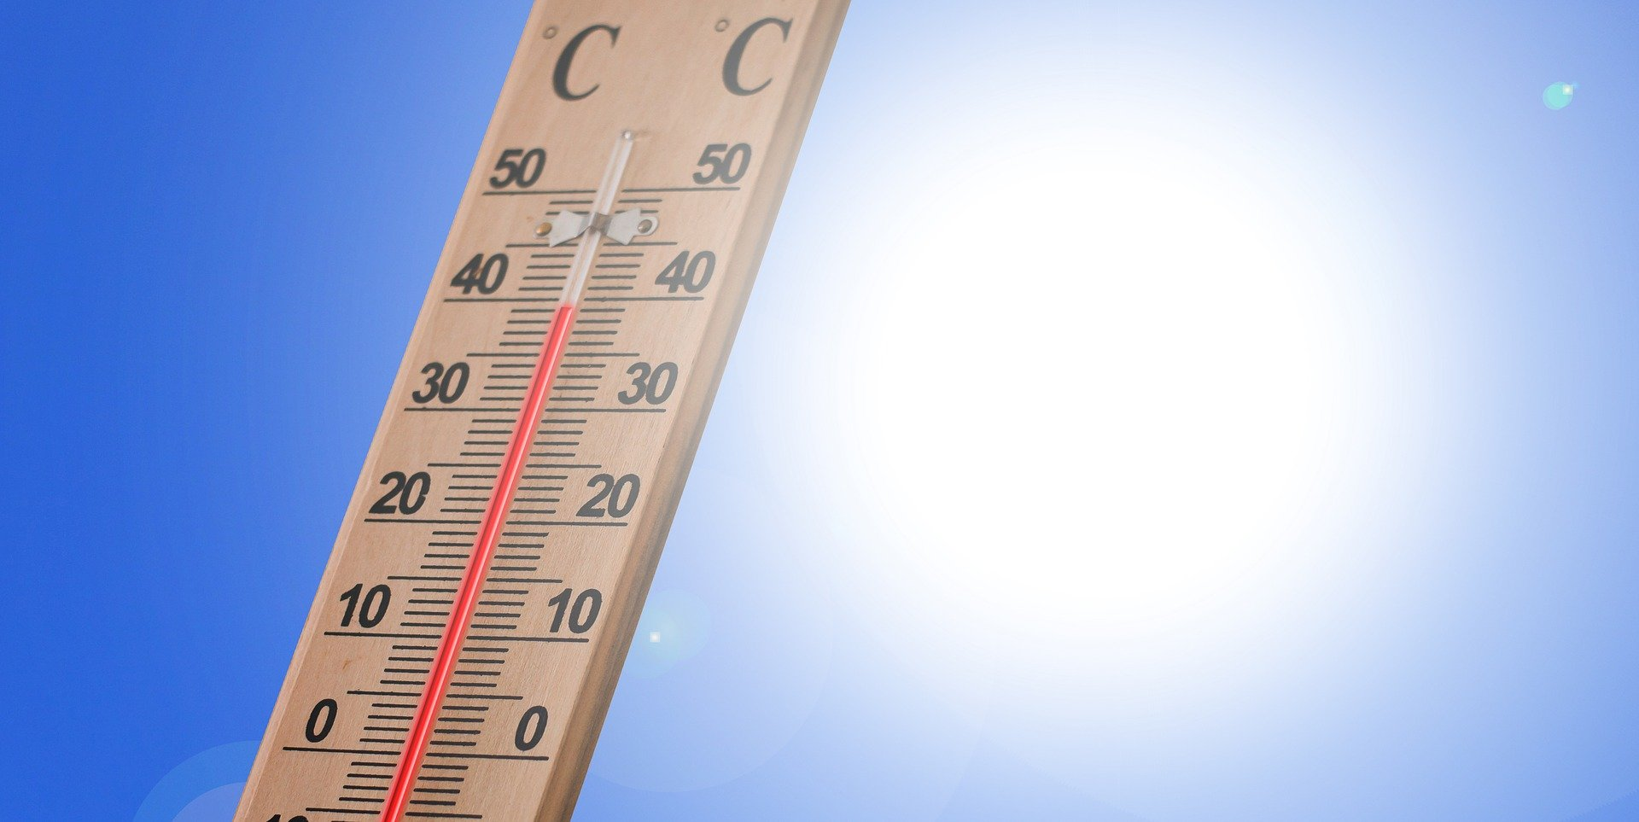
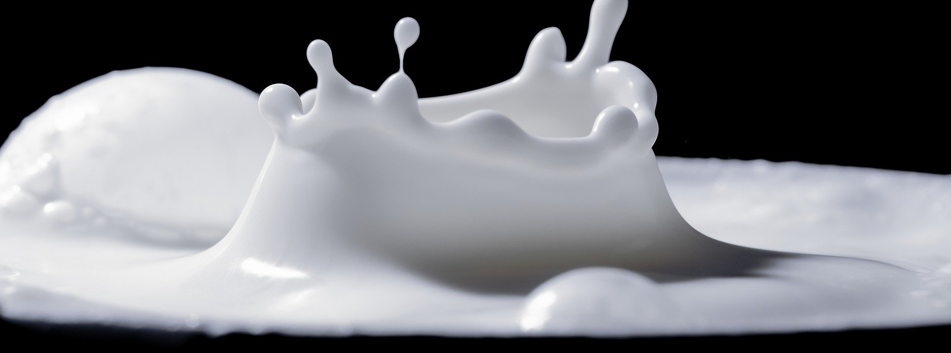

Slide 3
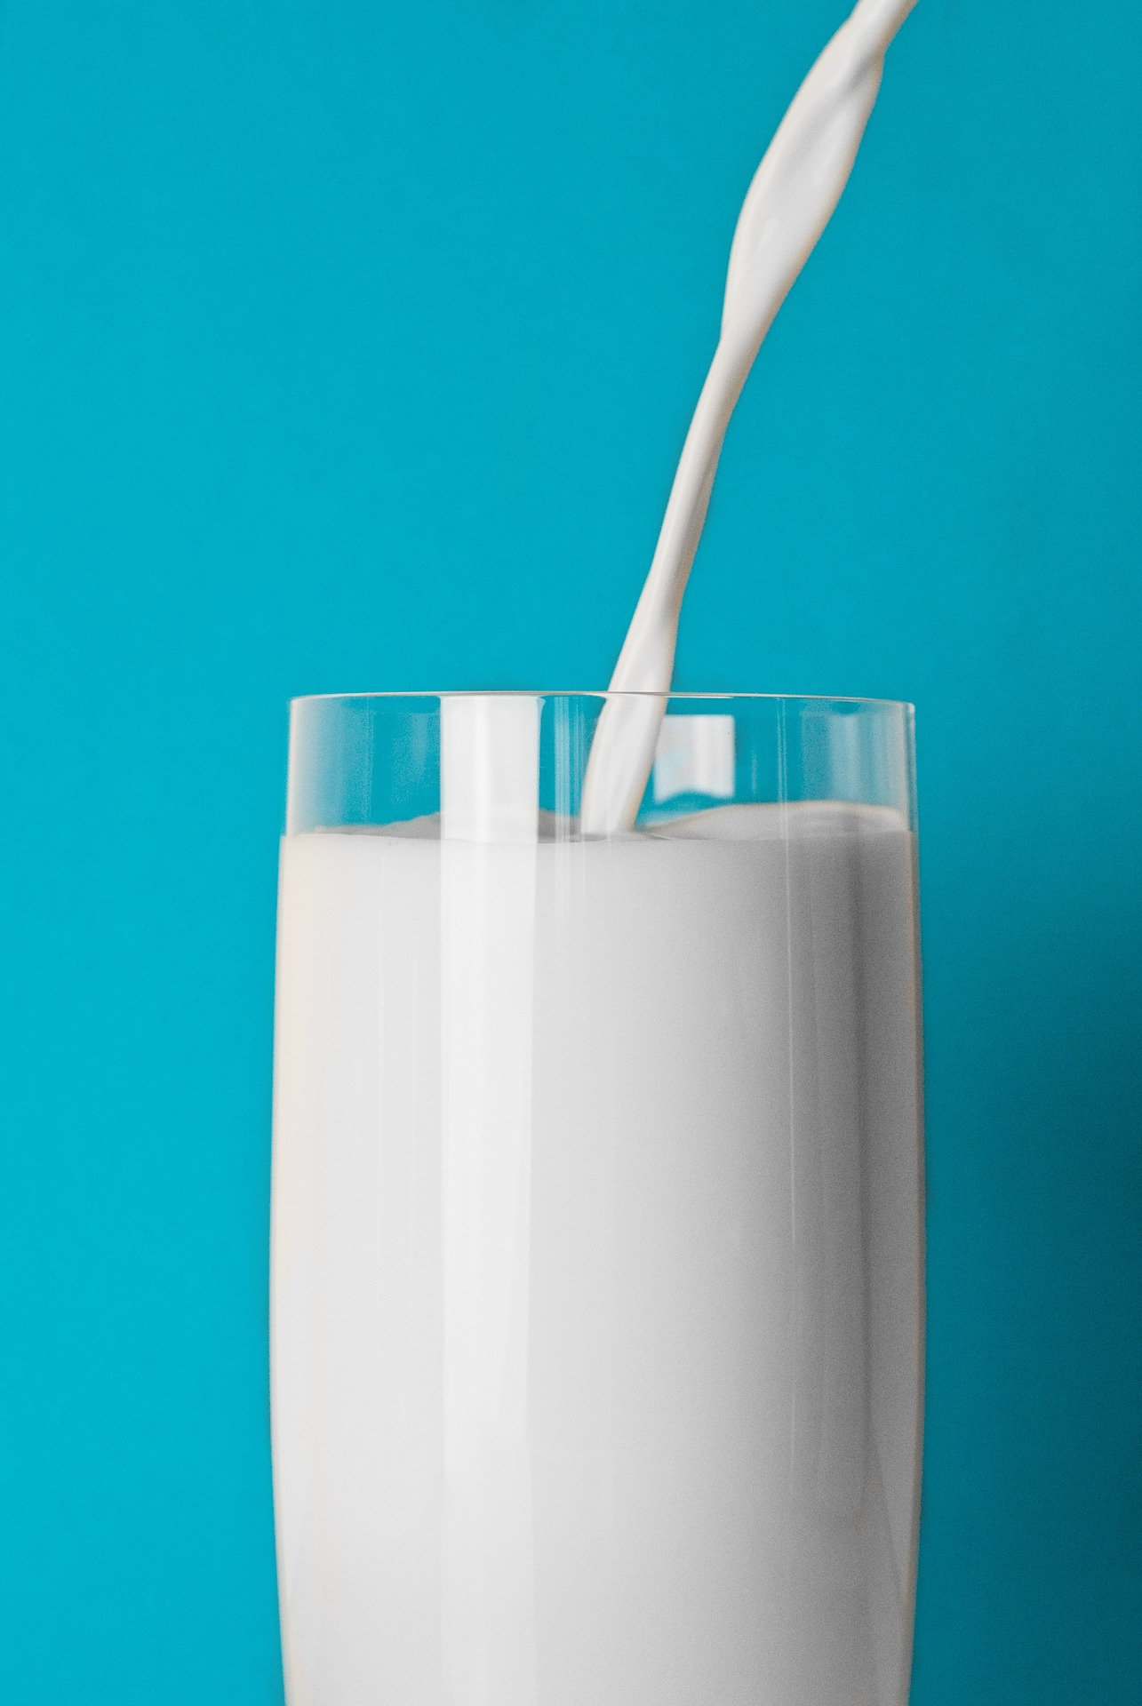

Slide 5
Lipase solution
Lipase

Slide 6
Lipase solution
Milk + sodium carbonate
Lipase
Milk

Slide 7
thermometer

Slide 8
1 cm³

Slide 9
00:00
timer

Slide 10
08:15
timer

Slide 11
08:15
Control variables
timer
Dependent variable

Slide 12
08:15
timer
Clean test tubes!!

Slide 13
Slow reaction
Time for reaction to turn yellow
Temperature (⁰C)

Slide 14
Fastest rate
Time for reaction to turn yellow
Temperature (⁰C)

Slide 15
Slow reaction
Time for reaction to turn yellow
Temperature (⁰C)

