Slide 1
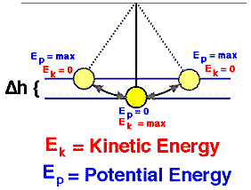
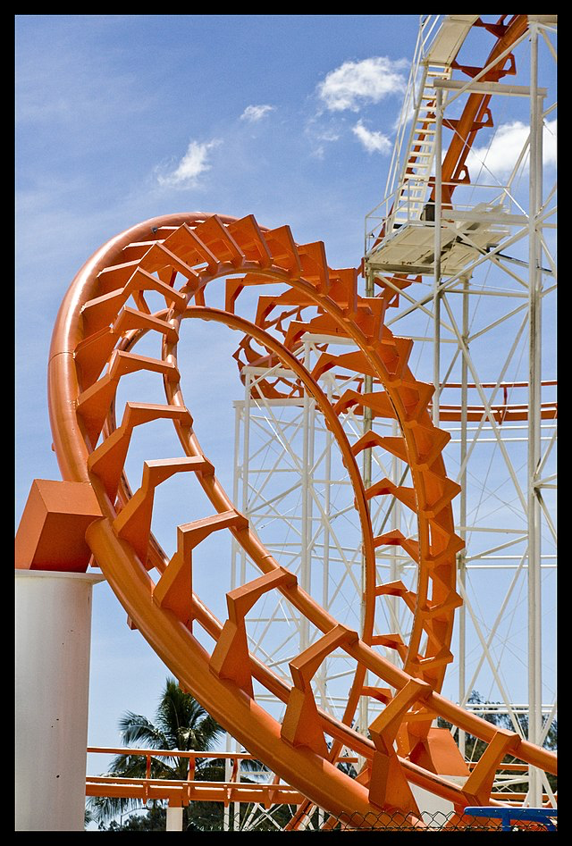
Emilie du Chatelet & the laws of conservation
Emilie du Chatelet was an inquisitive natural philosopher; she was extremely gifted and highly intellectual. She was born in France in 1706 and spoke several languages, including Ancient Greek and Latin.
Among other things, she is famous for a commentary and French translation of Sir Isaac Newton’s book – ‘Principia’.
After studying theories of momentum and energy, she proposed that total energy was conserved. She proved this by dropping metal balls from different heights into soft clay.
The dent left in the clay was proportional to the height that the ball had been dropped from.
The law of ‘conservation of energy’ states that:
The energy of an isolated system remains the same over time. This means that energy cannot be created or destroyed - only transferred from one energy store to another.
1. A roller-coaster has a complex
energy transfer.
Put these types of energy in the correct order of energy
transfer (Start from the rollercoaster pulling away
at the start of the ride.)
thermal GPE
sound electrical
kinetic kinetic
________________________________________________________________________________
____________________________________________________________
Which of the types of energy listed in question 1 are lost into the surroundings?
____________________________________________________________

Slide 2
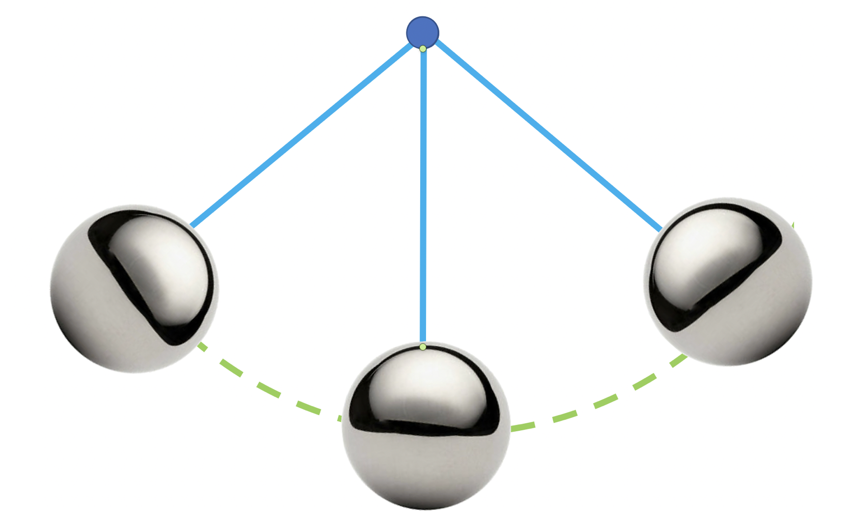
The pendulum swing
Transfers of energy and stores of energy
This table lists the stages of energy store or transfer of a pendulum swing. Put them in the correct order and number them from 1 to 6.
Stage of energy transfer or store | 1 - 6
In the centre the pendulum has the maximum kinetic and the minimum GPE
As it swings away from the middle, kinetic energy is transferred to GPE
The pendulum is released from a maximum point of GPE
At the top of the swing the pendulum has the maximum GPE and minimum kinetic energy
It swings back to the centre and continues to swing
As it swings toward the middle, GPE is transferred to kinetic energy
Gravitational
field strength
10N/kg

Slide 3
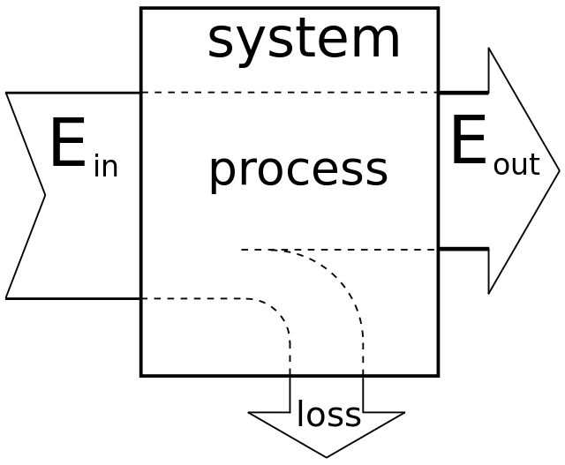
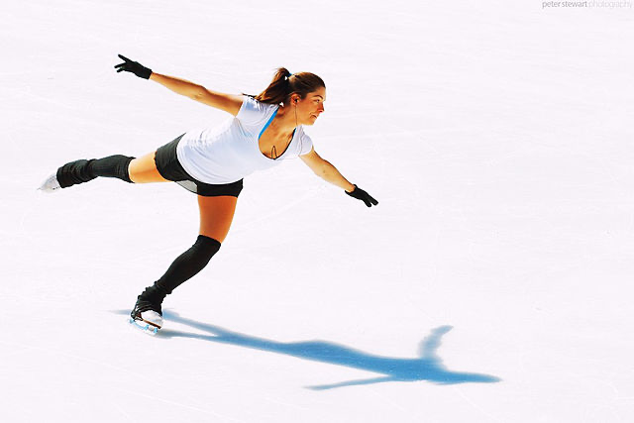

The dissipation of energy
A SANKEY DIAGRAM is a visual diagram to
represent an input/output in an energy system.
It is drawn to illustrate the FLOW of a PROCESS
or SYSTEM.
The proportionality of the width of the arms is a
visual representation of the difference in amount
of energy flowing in that system or process.
When two surfaces are rubbed together this creates _________________ which causes energy to be lost to the surroundings.
We call this transfer of energy to the surroundings _______________________
Is ice slippery?
Did you know that ice is not slippery – actually, it is very rough?
The reason why skaters can skate is because of the transfer of kinetic energy to the surface of the ice and the loss of thermal energy through dissipation, causing the ice to melt and leaving a thin film of water.
Skaters skate on water, not on ice.
A bearing for a bicycle wheel
Wheel bearings reduce friction. Research online how they work and write a sentence here to explain how they reduce friction.
_______________________________
_______________________________
_______________________________
_______________________________
_______________________________
_______________________________

