Slide 1

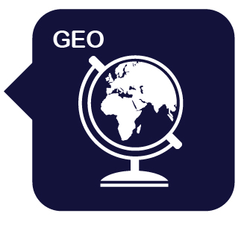

Year 4: Volcanoes, Mountains and Earthquakes
Mission Assignment: What is the equator?
5. Do volcanoes still erupt?
Write a fact file about a recent volcanic eruption.
Where is the location of the volcano? ________________________________________________
When did the volcano erupt? ________________________________________________
Draw a map of the country where the volcano is located.
What was the impact on the people living in the region? _________________________________________________________________________________________________________________________________________________________________________________________________________________________________________________________________________________________________________________________________________________________________________________________________
Draw a diagram of the volcanic eruption.
1
Developing Experts Copyright 2025 All Rights Reserved
Developing Experts Copyright 2022 All Rights Reserved
Developing Experts Copyright 2022 All Rights Reserved
Developing Experts Copyright 2024 All Rights Reserved

Slide 2
Year 4: Volcanoes, Mountains and Earthquakes
Mission Assignment: What is the equator?
5. Do volcanoes still erupt?
Write a fact file about a recent volcanic eruption.
___________________________________________________________________________________________________________________________________________________________________________________________________________________________________________________
__________________________________________________________________________________________________________________________________________________________________________________________________________________________________________________________________________________________________________________________________________________________________________________________
2
Developing Experts Copyright 2025 All Rights Reserved
Developing Experts Copyright 2022 All Rights Reserved
Developing Experts Copyright 2022 All Rights Reserved
Developing Experts Copyright 2022 All Rights Reserved
Developing Experts Copyright 2024 All Rights Reserved

Slide 3
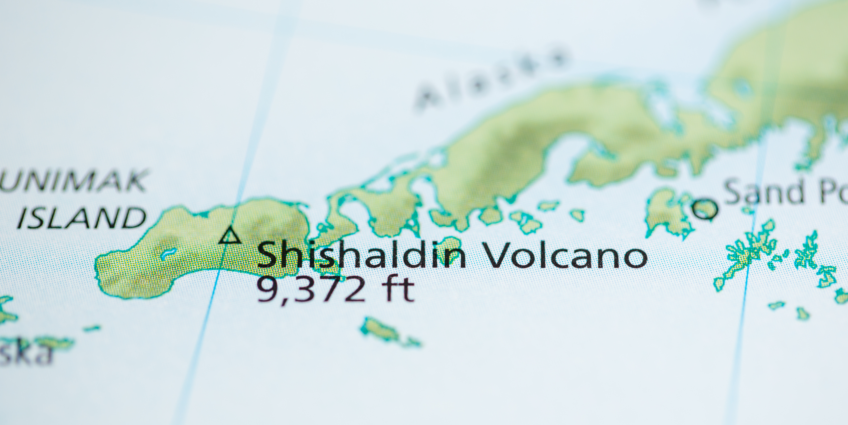
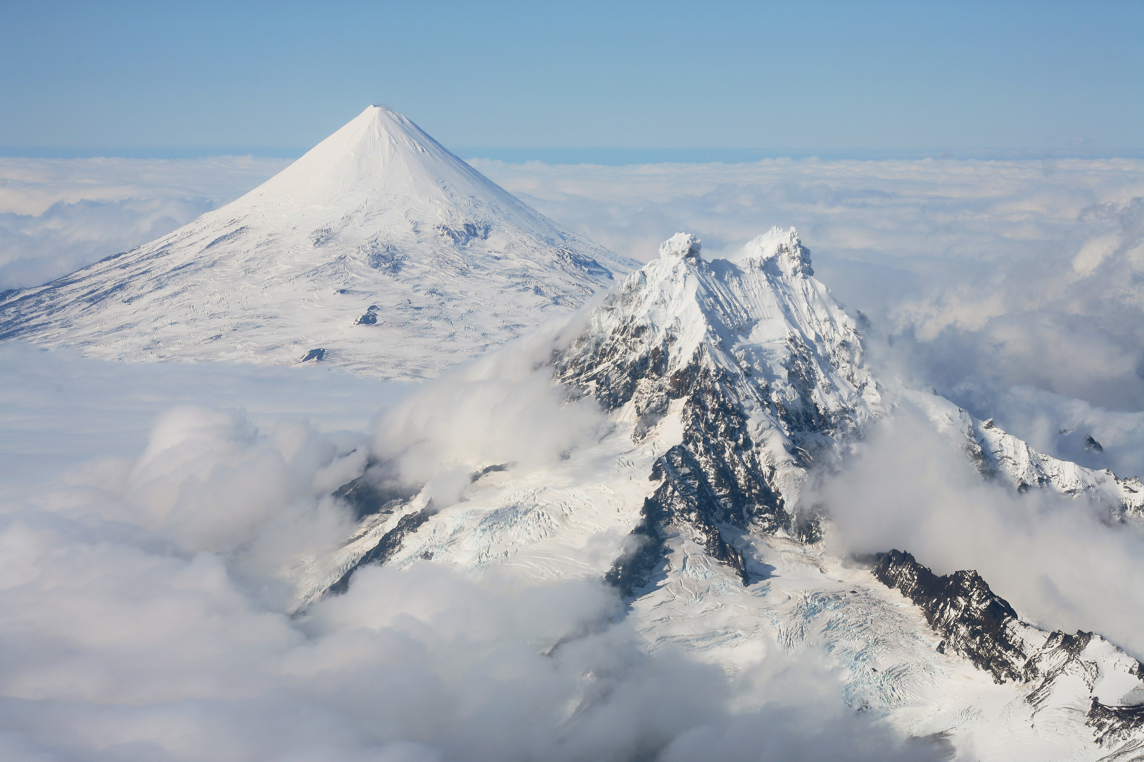
Year 4: Volcanoes, Mountains and Earthquakes
Mission Assignment: What is the equator?
5. Do volcanoes still erupt?
Research tool
Example fact file 1:
Shishaldin Volcano, Alaska, USA (2023)
In 2023, Shishaldin Volcano, a big mountain in Alaska’s Aleutian Islands, showed how powerful volcanoes can be!
Having been quiet for over two year, in July 2023, it erupted multiple times during the year.
The volcano sent shooting ash high into the sky—almost as high as 30,000 feet! This made it hard for aeroplanes to fly safely, so some flights had to change their routes or be cancelled. The ash could be dangerous for aeroplane engines and make it difficult to see in the sky.
The eruption was also concerning because it could
affect the plants and animals that live in the cold, wild areas nearby. When the volcano erupts, it releases ash that falls to the ground and covers plants. This can block sunlight, making it harder for plants to grow. Volcanic ash can pollute rivers, lakes and streams, making the water unsafe for fish and other creatures.
Alaskan officials acted quickly, telling people in small towns to stay inside when ash was falling from the sky.
Even though most people weren’t in danger, Shishaldin’s eruptions remind us that volcanoes are powerful and can still change the land around them!
Developing Experts Copyright 2025 All Rights Reserved
Developing Experts Copyright 2022 All Rights Reserved
Developing Experts Copyright 2022 All Rights Reserved
3
Developing Experts Copyright 2024 All Rights Reserved
Developing Experts Copyright 2022 All Rights Reserved

Slide 4
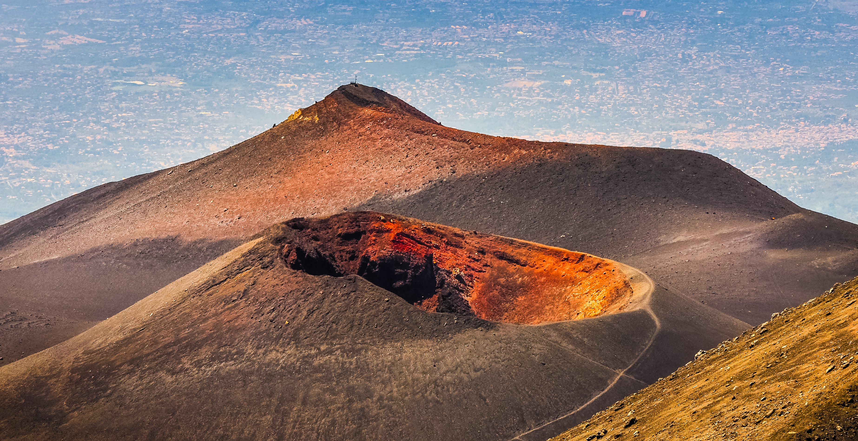
Year 4: Volcanoes, Mountains and Earthquakes
Mission Assignment: What is the equator?
5. Do volcanoes still erupt?
Research tool
Example fact file 2:
Mount Etna, Sicily, Italy (2024)
Mount Etna is a volcano located on the island of Sicily in Italy. It erupted in August 2024 and cause significant disruption to the local communities.
As one of the most active volcanoes in Europe, Mount Etna has long captured the world’s attention. It is one of the most famous volcanoes in the world, attracting tourists from all over. This tourism brings money and jobs to the area in hotels, restaurants and local businesses.
However, this recent eruption disrupted daily life on the island, including the temporary closure of Catania’s airport.
The eruption covered nearby towns in volcanic ash, turning day to night in some areas and creating a layer of fine grit over homes, cars and streets. Local authorities issued health warnings, advising residents to wear masks and stay indoors as much as possible to avoid inhaling ash.
While the Italian government and scientists closely monitor Mount Etna, the eruption once again showed the importance of being prepared for those living near active volcanic zones.
By observing changes in gas emissions, ground deformation and seismic activity, researchers hope to improve predictions for future eruptions, which could help protect the residents who live in Etna’s shadow.
5
Developing Experts Copyright 2025 All Rights Reserved
Developing Experts Copyright 2022 All Rights Reserved
Developing Experts Copyright 2022 All Rights Reserved
Developing Experts Copyright 2022 All Rights Reserved
Developing Experts Copyright 2024 All Rights Reserved

Slide 5
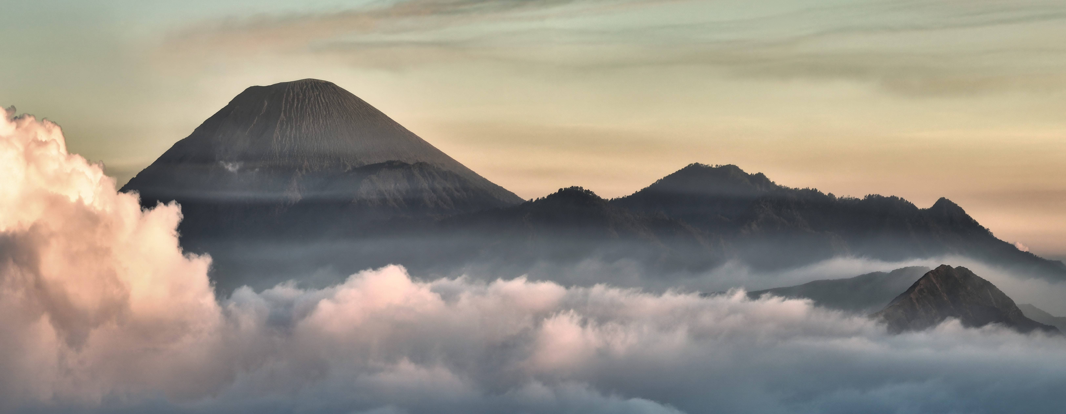
Year 4: Volcanoes, Mountains and Earthquakes
Mission Assignment: What is the equator?
5. Do volcanoes still erupt?
Research tool
Example fact file 3:
Semeru Volcano, East Java, Indonesia (2022)
Semeru Volcano in East Java, Indonesia, made headlines in December 2022 with a powerful eruption that forced over 2,000 people to leave their homes.
Although Semeru had been showing signs of increased activity, the scale of the eruption caught people by surprise. Lava and hot ash flowed down the slopes, covering nearby villages and prompting local authorities to declare a state of emergency. This eruption was part of a series of recent volcanic events in Indonesia, a country known for lots of volcanic
activity due to its location along tectonic plate boundaries.
The eruption also triggered dangerous mudflows, known as lahars, that flowed down the rivers near Semeru. These thick, fast-moving mudflows carried debris and ash into villages, damaging buildings and threatening lives.
Indonesia’s National Agency for Disaster Management sent additional teams to monitor the volcano and support ongoing evacuations, showing how well the government reacted to the volcanic disaster.
5
Developing Experts Copyright 2025 All Rights Reserved
Developing Experts Copyright 2022 All Rights Reserved
Developing Experts Copyright 2022 All Rights Reserved
Developing Experts Copyright 2022 All Rights Reserved
Developing Experts Copyright 2022 All Rights Reserved
Developing Experts Copyright 2024 All Rights Reserved

Slide 6
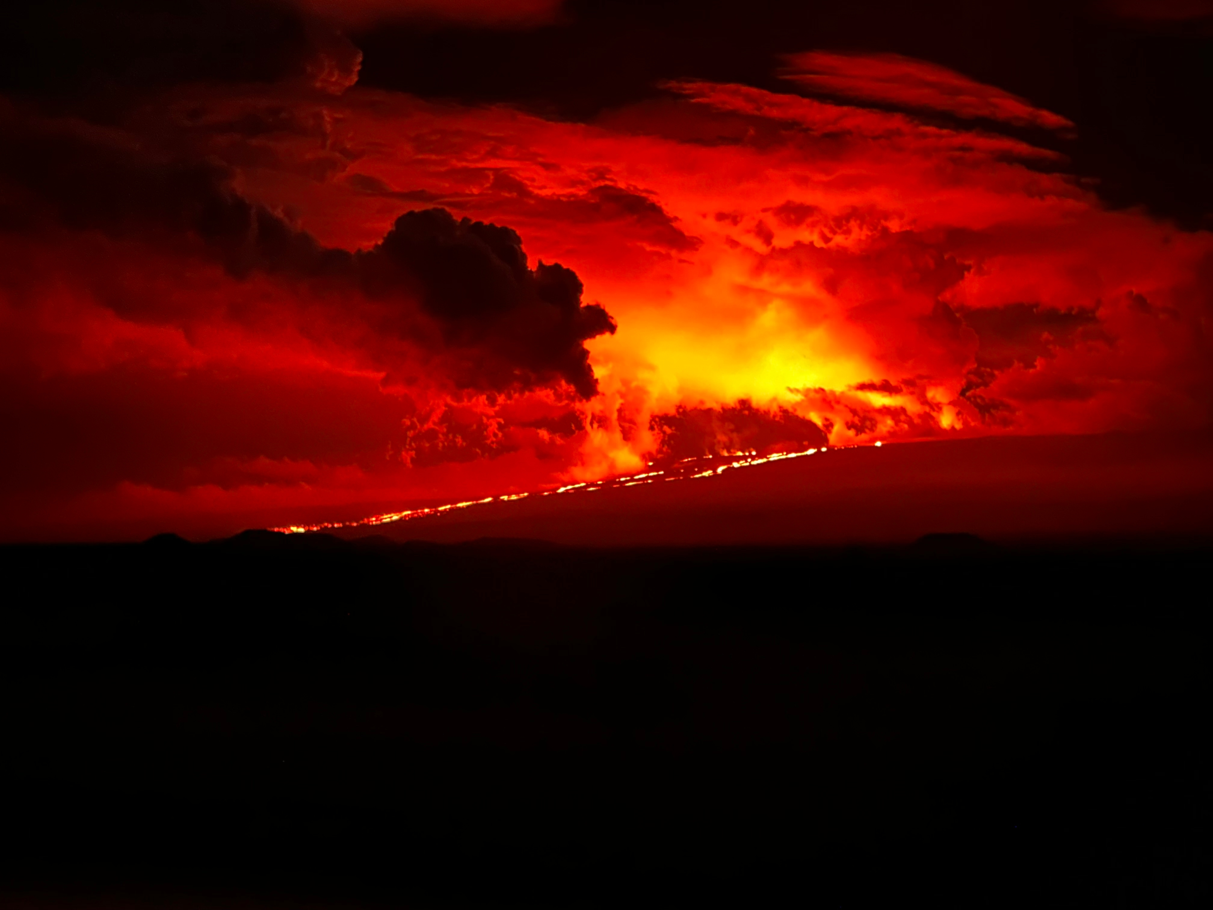
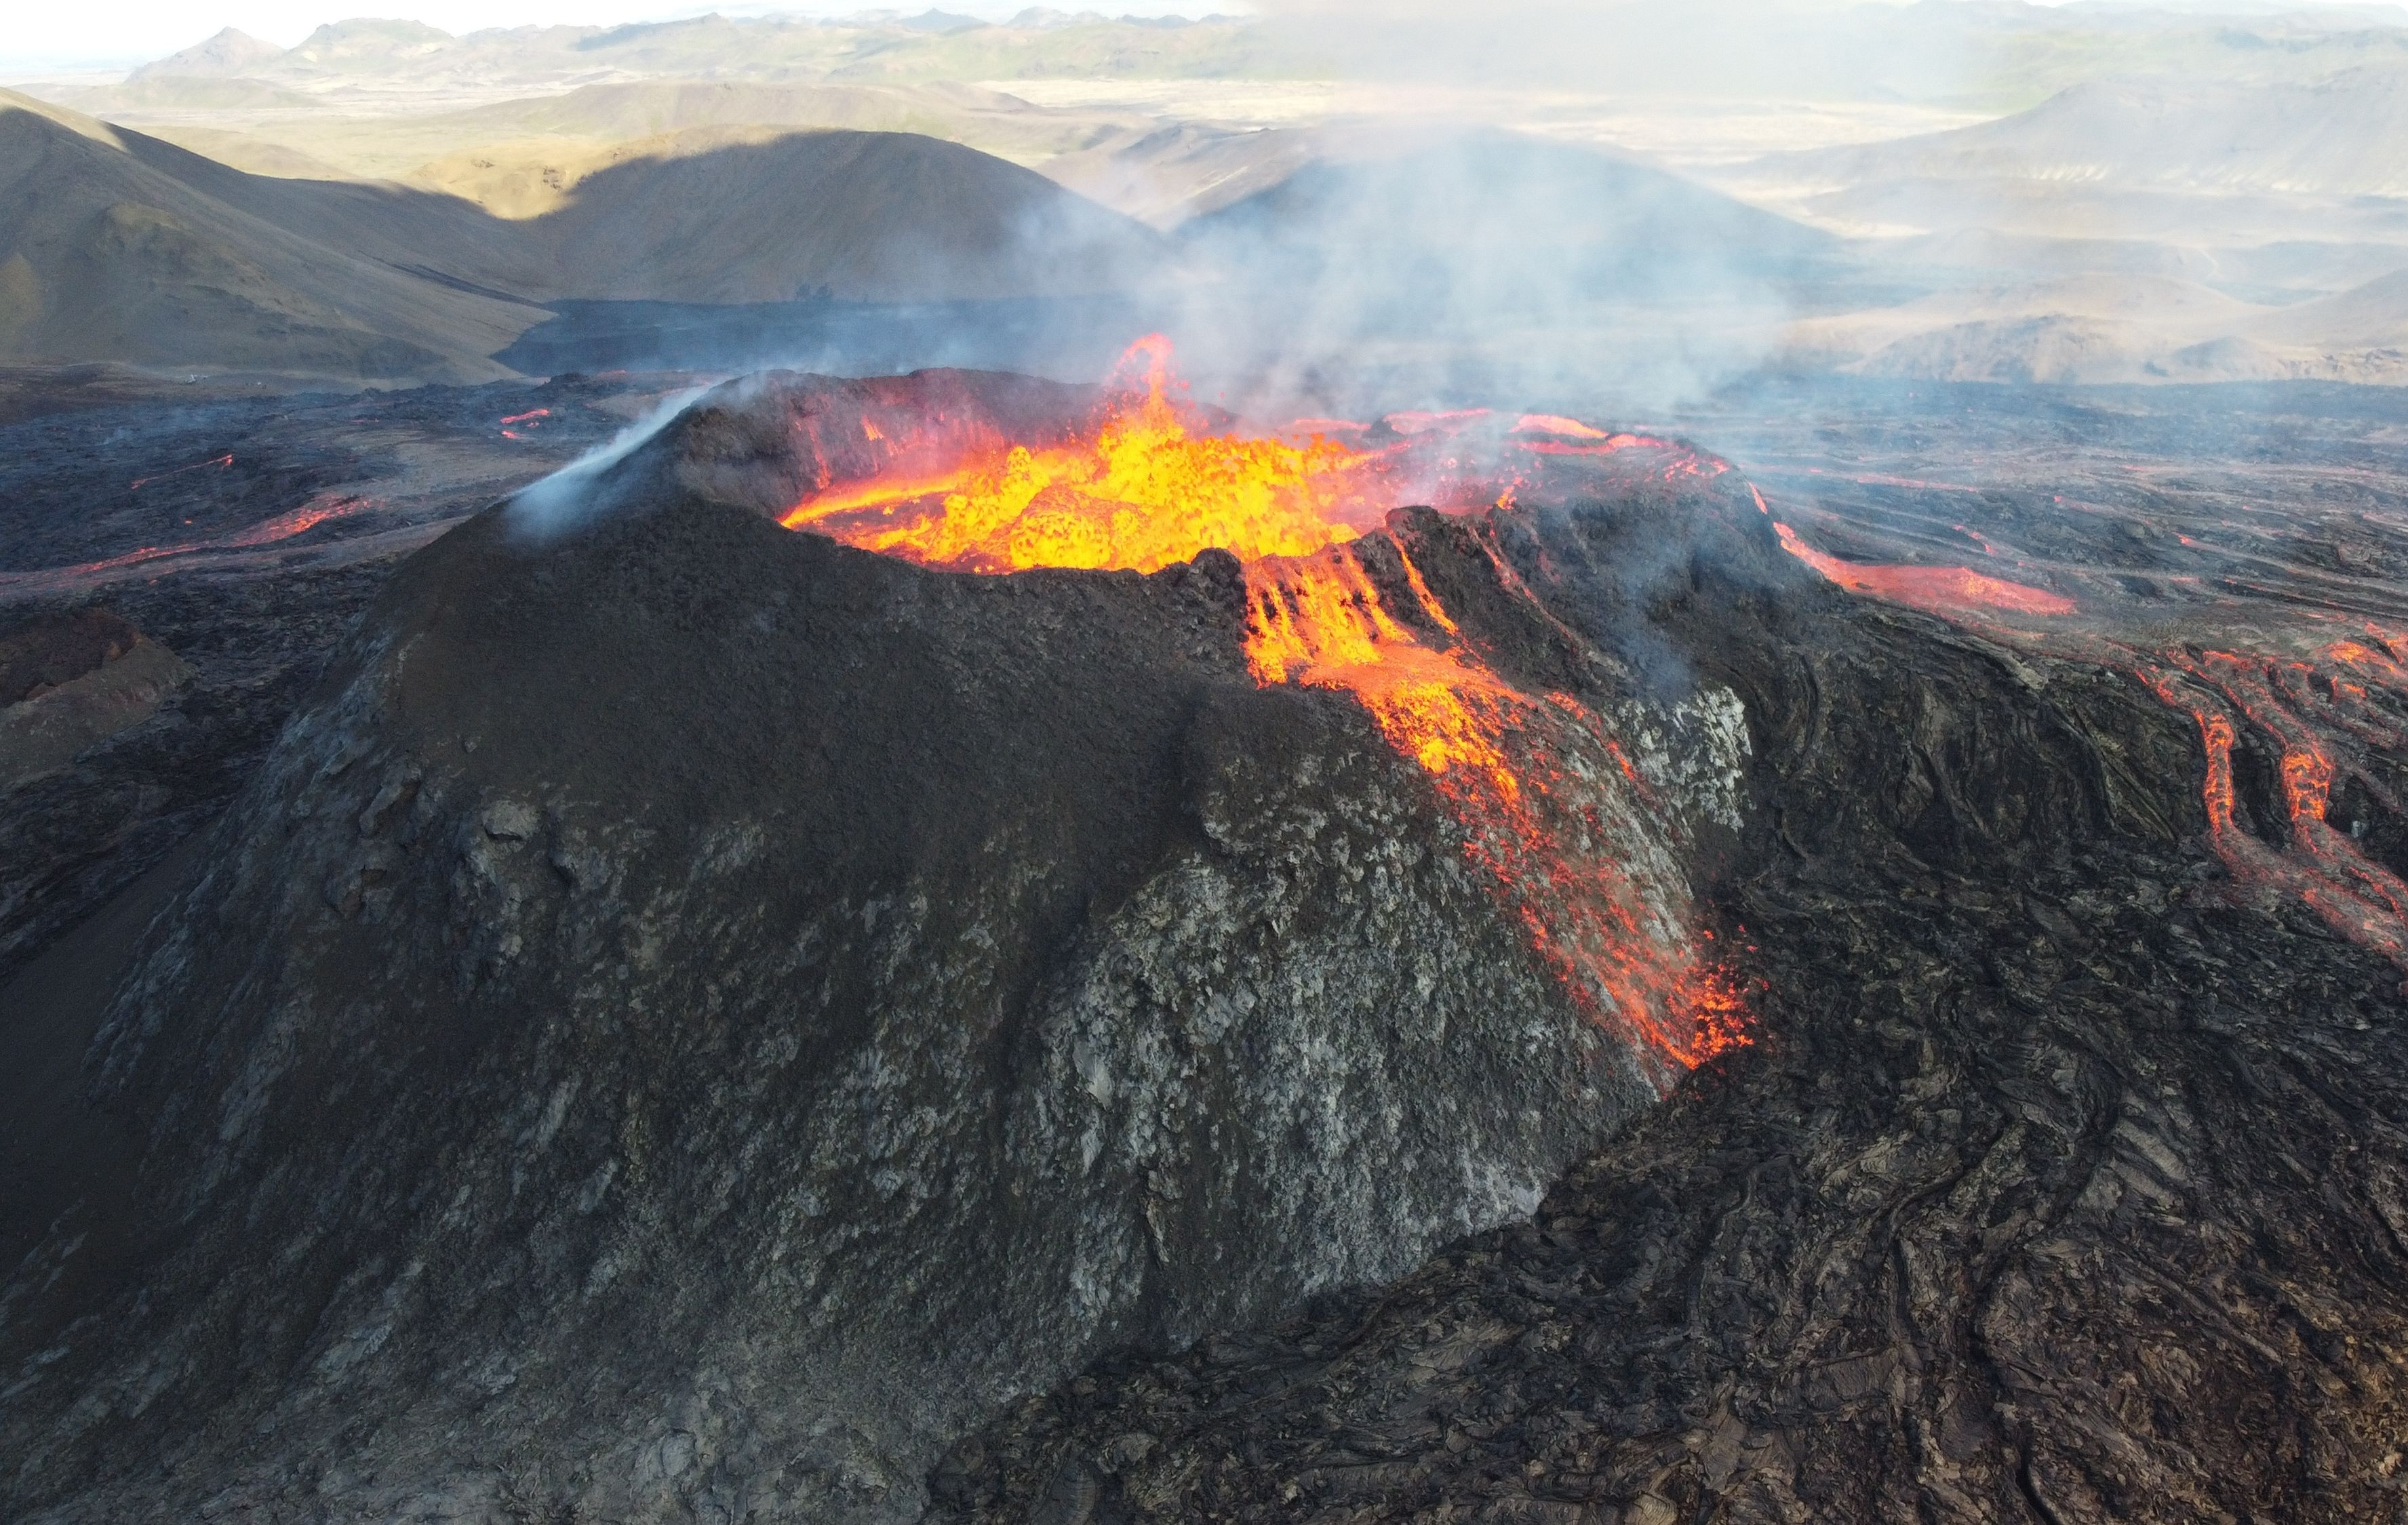
Year 4: Volcanoes, Mountains and Earthquakes
Mission Assignment: What is the equator?
5. Do volcanoes still erupt?
Research tool
Example fact file 4:
Mauna Loa, Hawaii, USA (2022)
After being dormant for almost 40 years, Mauna Loa, one of the biggest and most famous volcanoes in the world, started to erupt in November 2022. Lava began flowing down its sides, and people were amazed by the incredible sight of the volcano waking up!
Luckily, even though the lava flows got close to important roads and buildings, they stopped before reaching any big towns. The local authorities worked fast to make sure everyone was safe by planning evacuations, closing roads, and keeping people updated.
Scientists were really interested in this eruption because Mauna Loa is so big, and it gave them a special chance to learn more about how volcanoes work on a huge scale!
Located on the Big Island of Hawaii, Mauna Loa’s eruption was a significant event, drawing attention from scientists, residents and tourists alike.
However, the eruption posed a unique challenge, as Mauna Loa’s slopes come very close to populated areas where people live.
6
Developing Experts Copyright 2025 All Rights Reserved
Developing Experts Copyright 2022 All Rights Reserved
Developing Experts Copyright 2022 All Rights Reserved
Developing Experts Copyright 2022 All Rights Reserved
Developing Experts Copyright 2022 All Rights Reserved
Developing Experts Copyright 2024 All Rights Reserved

