Slide 1

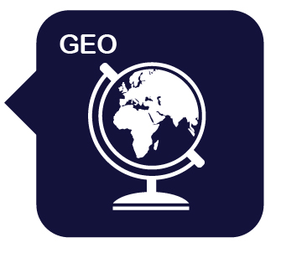

Year 4: Volcanoes, Mountains and Earthquakes
Mission Assignment: What is the equator?
3. Do earthquakes still happen?
Use this planning sheet to prepare your news report on a recent earthquake.
Where did the earthquake happen? ____________________________________________________
What happened? ____________________________________________________________________________________________________________________________________________________________
How severe was the earthquake? ____________________________________________________
What was the impact on people living in the region? ______________________________________________________________________________________________________________________________________________________________________________________
Draw a map of the country where the earthquake happened. Label the area where it occurred.
Draw the effects of the earthquake.
1
Developing Experts Copyright 2025 All Rights Reserved
Developing Experts Copyright 2022 All Rights Reserved
Developing Experts Copyright 2022 All Rights Reserved
Developing Experts Copyright 2024 All Rights Reserved

Slide 2
Year 4: Volcanoes, Mountains and Earthquakes
Mission Assignment: What is the equator?
3. Do earthquakes still happen?
Create a news report on a recent earthquake.
________________________________________________________________________________________________________________________________________________________________________________________________________________________________________________
________________________________________________________________________________________________________________________________________________________________________________________________________________________________________________________________________________________________________________________
2
Developing Experts Copyright 2025 All Rights Reserved
Developing Experts Copyright 2022 All Rights Reserved
Developing Experts Copyright 2022 All Rights Reserved
Developing Experts Copyright 2024 All Rights Reserved

Slide 3
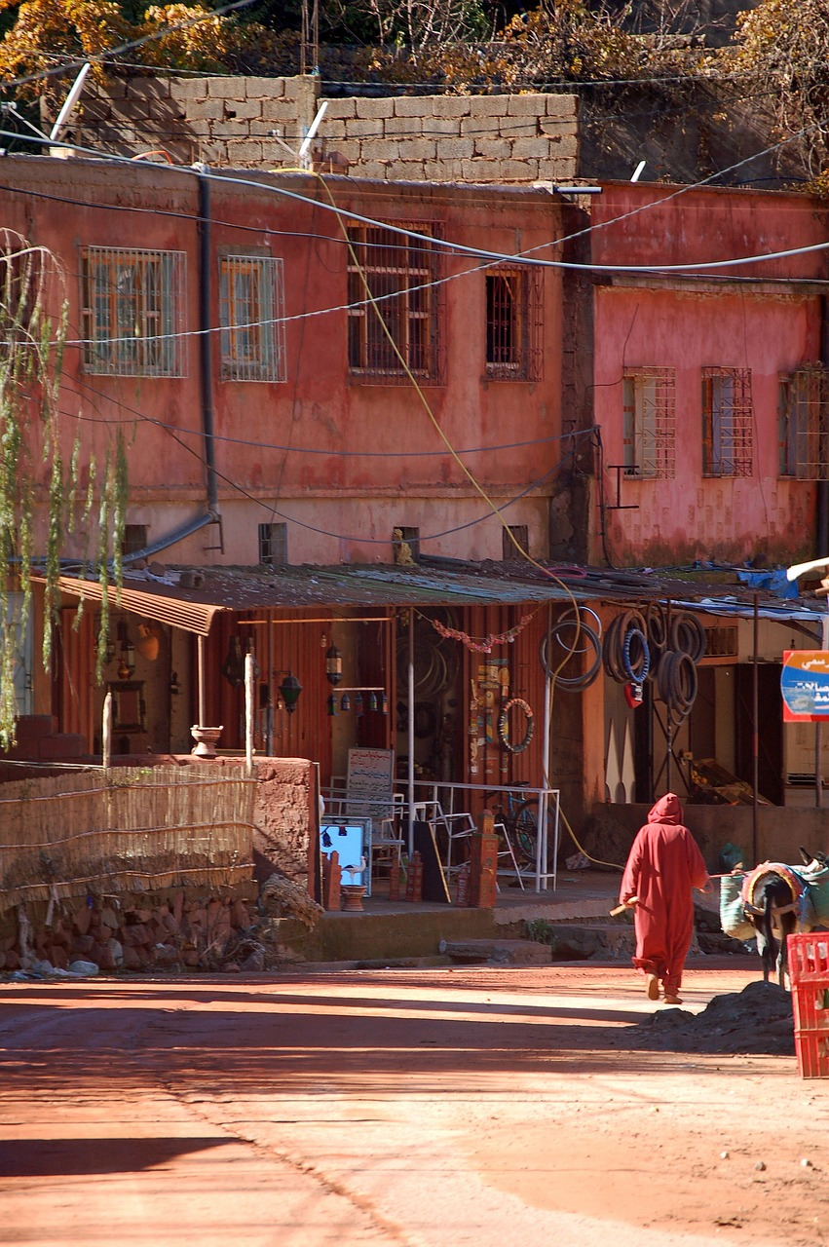
Year 4: Volcanoes, Mountains and Earthquakes
Mission Assignment: What is the equator?
3. Do earthquakes still happen?
Research tool
Research sheet 1: The Devastating Morocco Earthquake of 2023
In September 2023, a big earthquake hit Morocco. It was one of the strongest in the country’s history, measuring 6.8 on the Richter Scale. The earthquake was very powerful, shaking the ground near the Atlas Mountains, close to the city of Marrakesh. People even felt it in other big cities like Casablanca and Rabat. Sadly, many people lost their lives, and many more were hurt.
The earthquake happened in the evening when people were at home, resting or asleep. Some old buildings, especially in Marrakesh, fell down, covering the streets with broken bricks and dust. In the mountains, the shaking caused big rocks to fall, blocking roads and making it hard for help to arrive. Many houses were made of weak materials and could not stand up to the shaking, so they collapsed.
Rescue teams from different countries, like Spain, the UK and Qatar, quickly came to help. They brought special tools and trained dogs to find people trapped under the broken buildings. It was very sad, but people worked together and never gave up hope.
Now, this area of Morocco is starting to rebuild. It will take time, but the kindness and support from people all over the world are helping the country get back on its feet.
3
Developing Experts Copyright 2025 All Rights Reserved
Developing Experts Copyright 2022 All Rights Reserved
Developing Experts Copyright 2022 All Rights Reserved
Developing Experts Copyright 2022 All Rights Reserved
Developing Experts Copyright 2024 All Rights Reserved

Slide 4
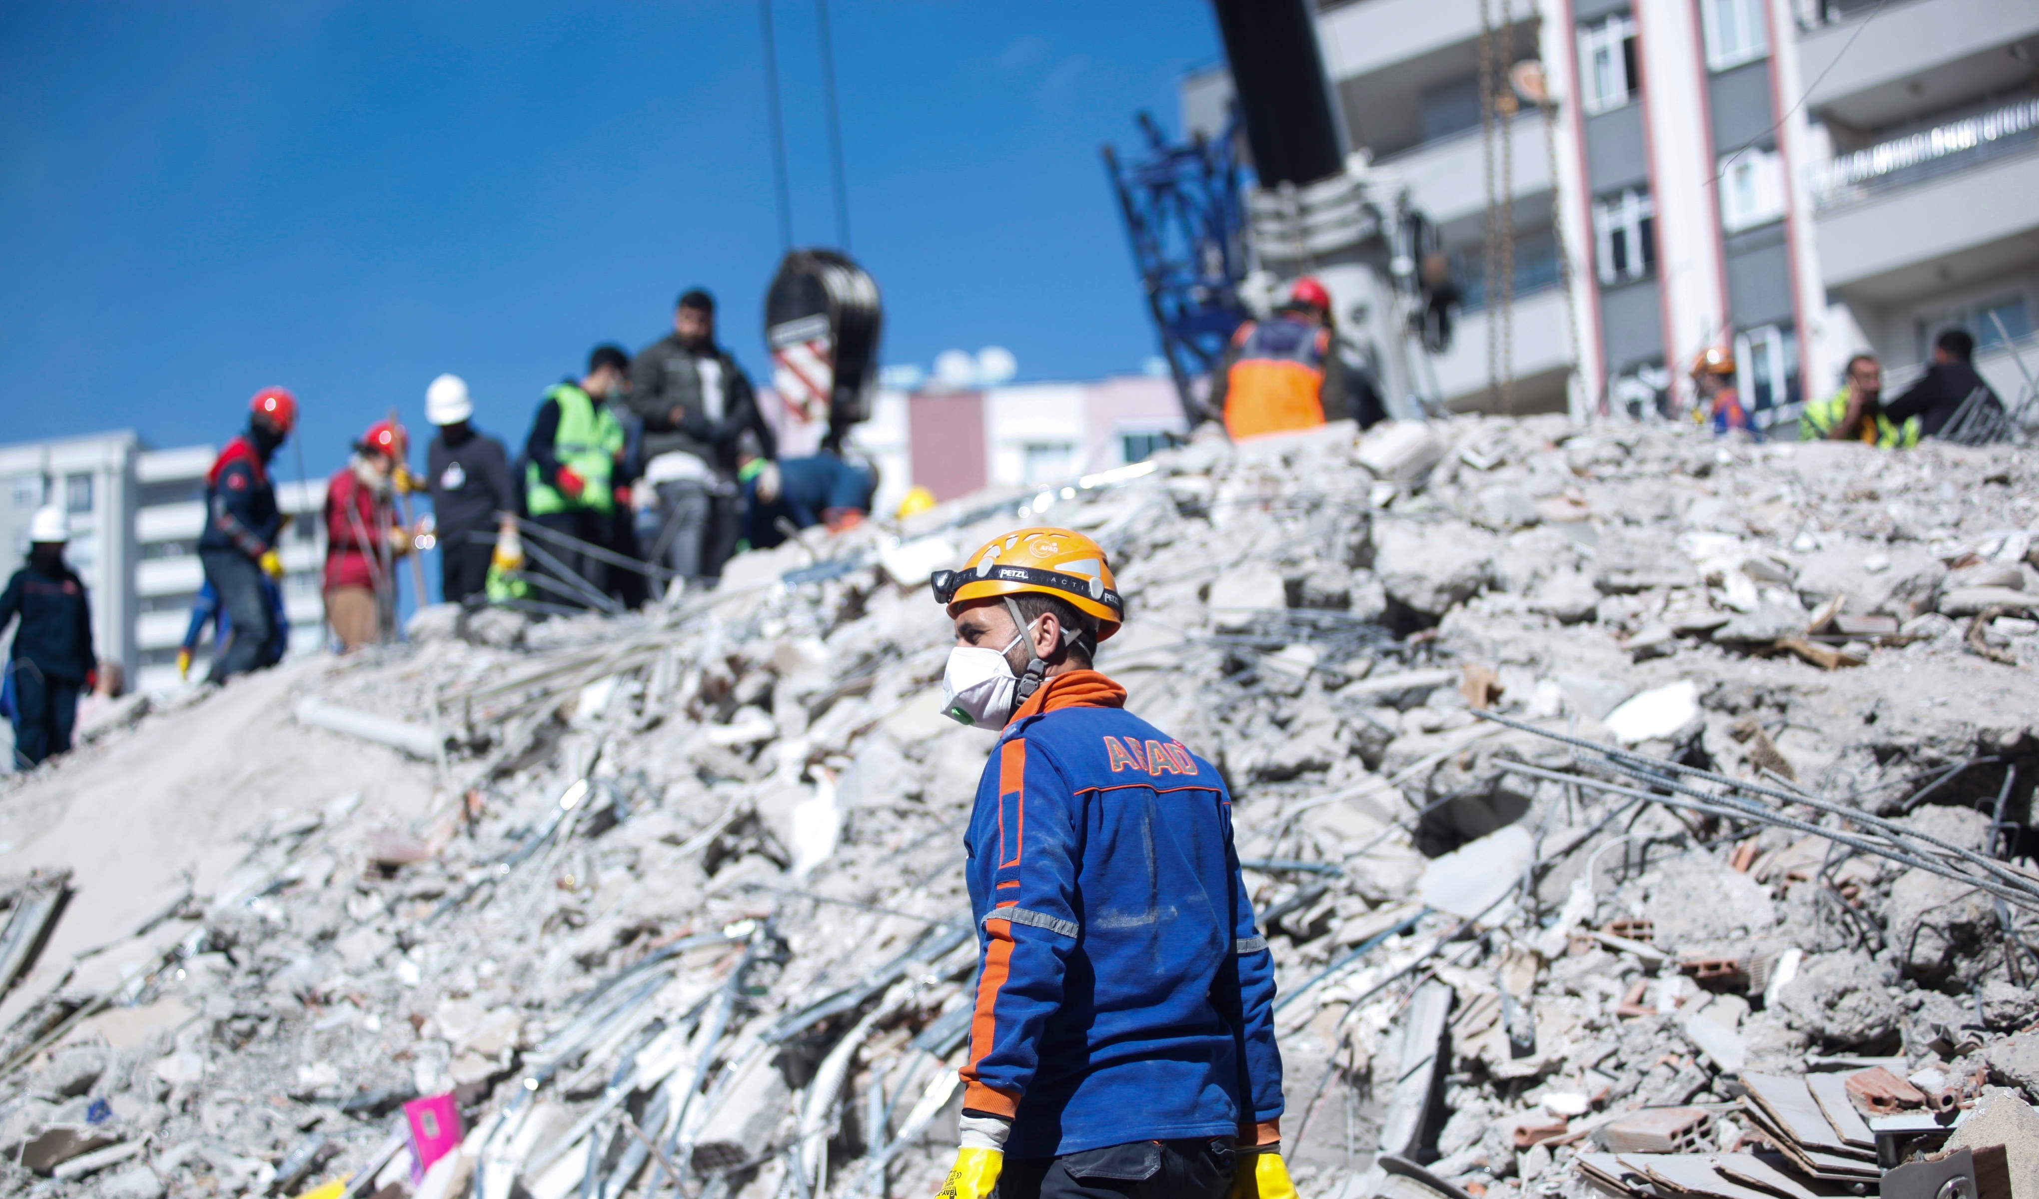
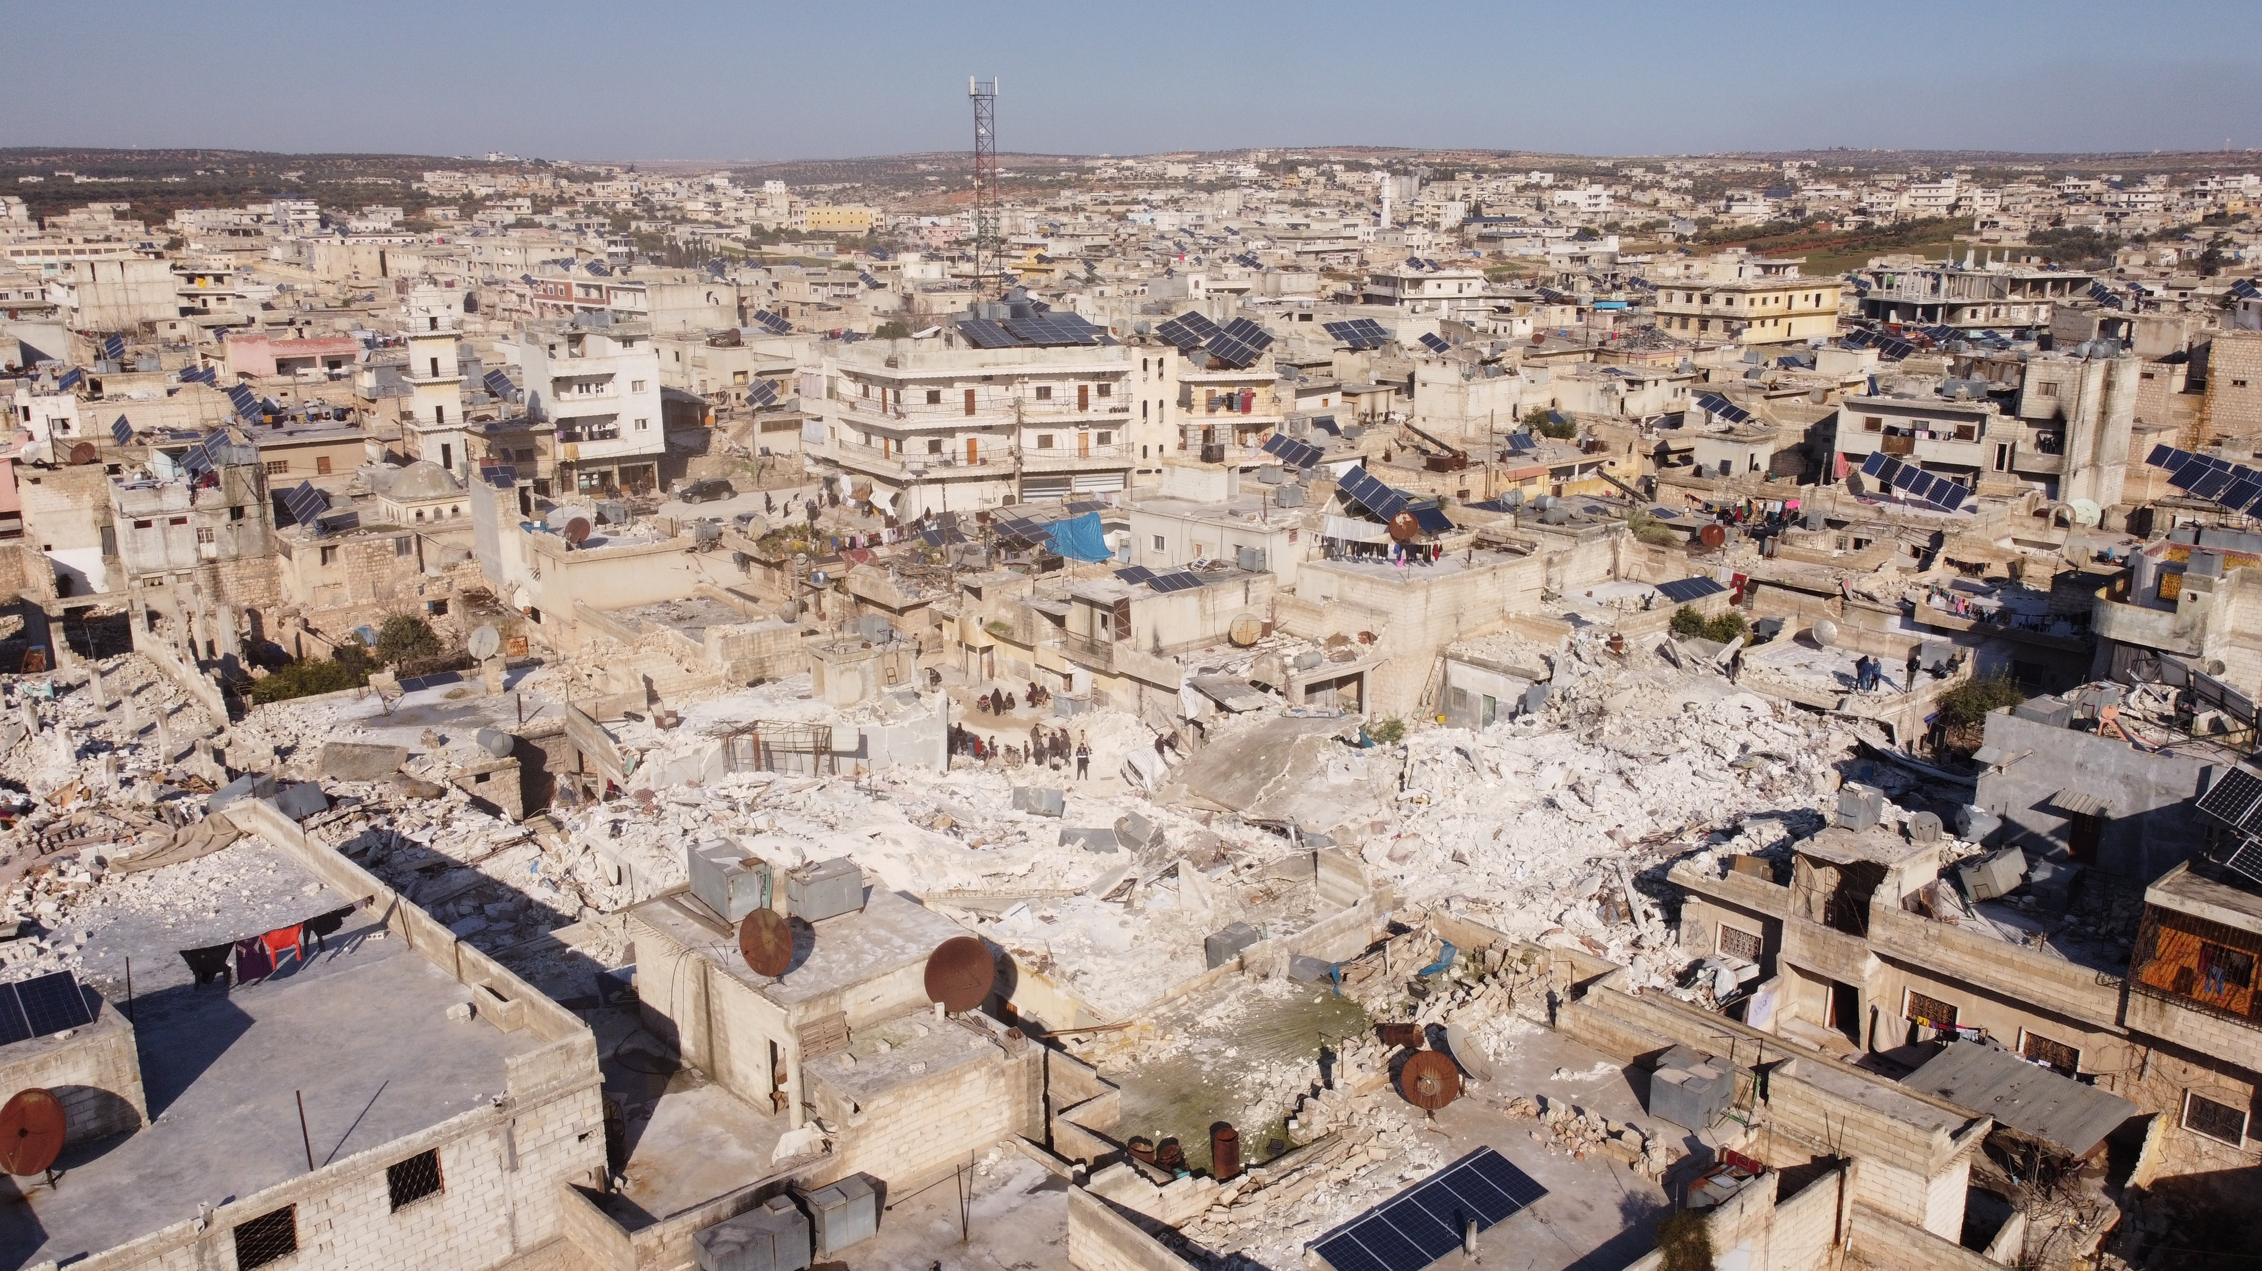
Year 4: Volcanoes, Mountains and Earthquakes
Mission Assignment: What is the equator?
3. Do earthquakes still happen?
Research tool
Research sheet 2: Turkey and Syria’s Dual Earthquakes - A Catastrophe of 2023
In February 2023, two very strong earthquakes hit Turkey and Syria just a few hours apart, measuring 7.8 on the Richter Scale. They were so powerful that many buildings fell down, and whole neighbourhoods were destroyed. People were shocked and scared because the ground kept shaking. Both countries struggled to help everyone because there was so much damage.
Turkey was hit very hard, especially in cities like Gaziantep and Antakya, where tall buildings collapsed, trapping many people inside.
In Syria, the earthquakes caused even more destruction, and many families lost their homes and loved ones.
Even though it was a very sad time, brave people worked together to help. Families and strangers searched for survivors, shared food, and gave each other shelter. Charities and helpers from around the world came to support and rebuild homes and communities.
This disaster showed how unpredictable nature can be, but it also proved that when people stand together, they can overcome even the hardest times.
4
Developing Experts Copyright 2025 All Rights Reserved
Developing Experts Copyright 2022 All Rights Reserved
Developing Experts Copyright 2022 All Rights Reserved
Developing Experts Copyright 2022 All Rights Reserved
Developing Experts Copyright 2024 All Rights Reserved

Slide 5
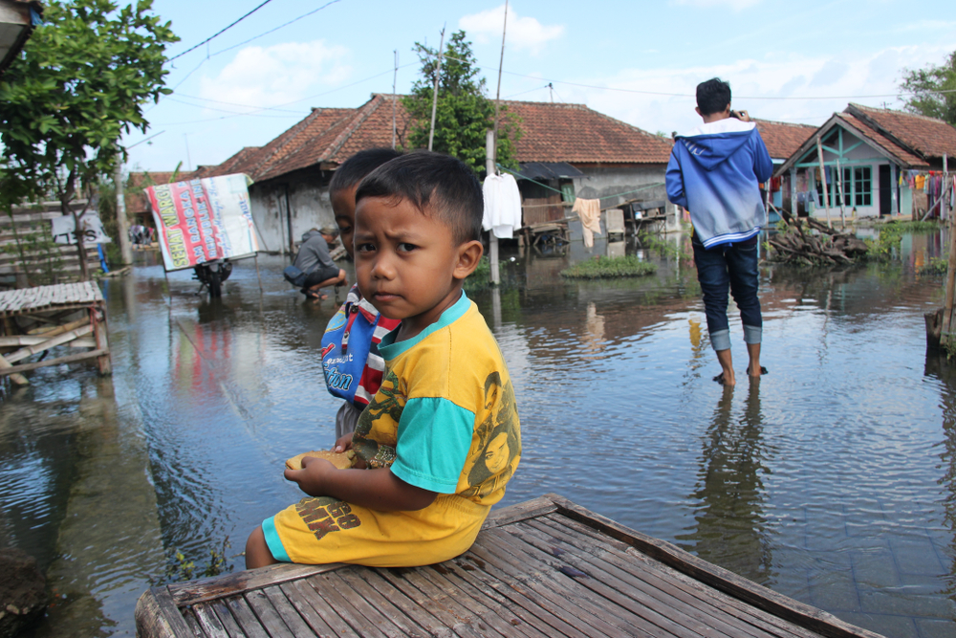
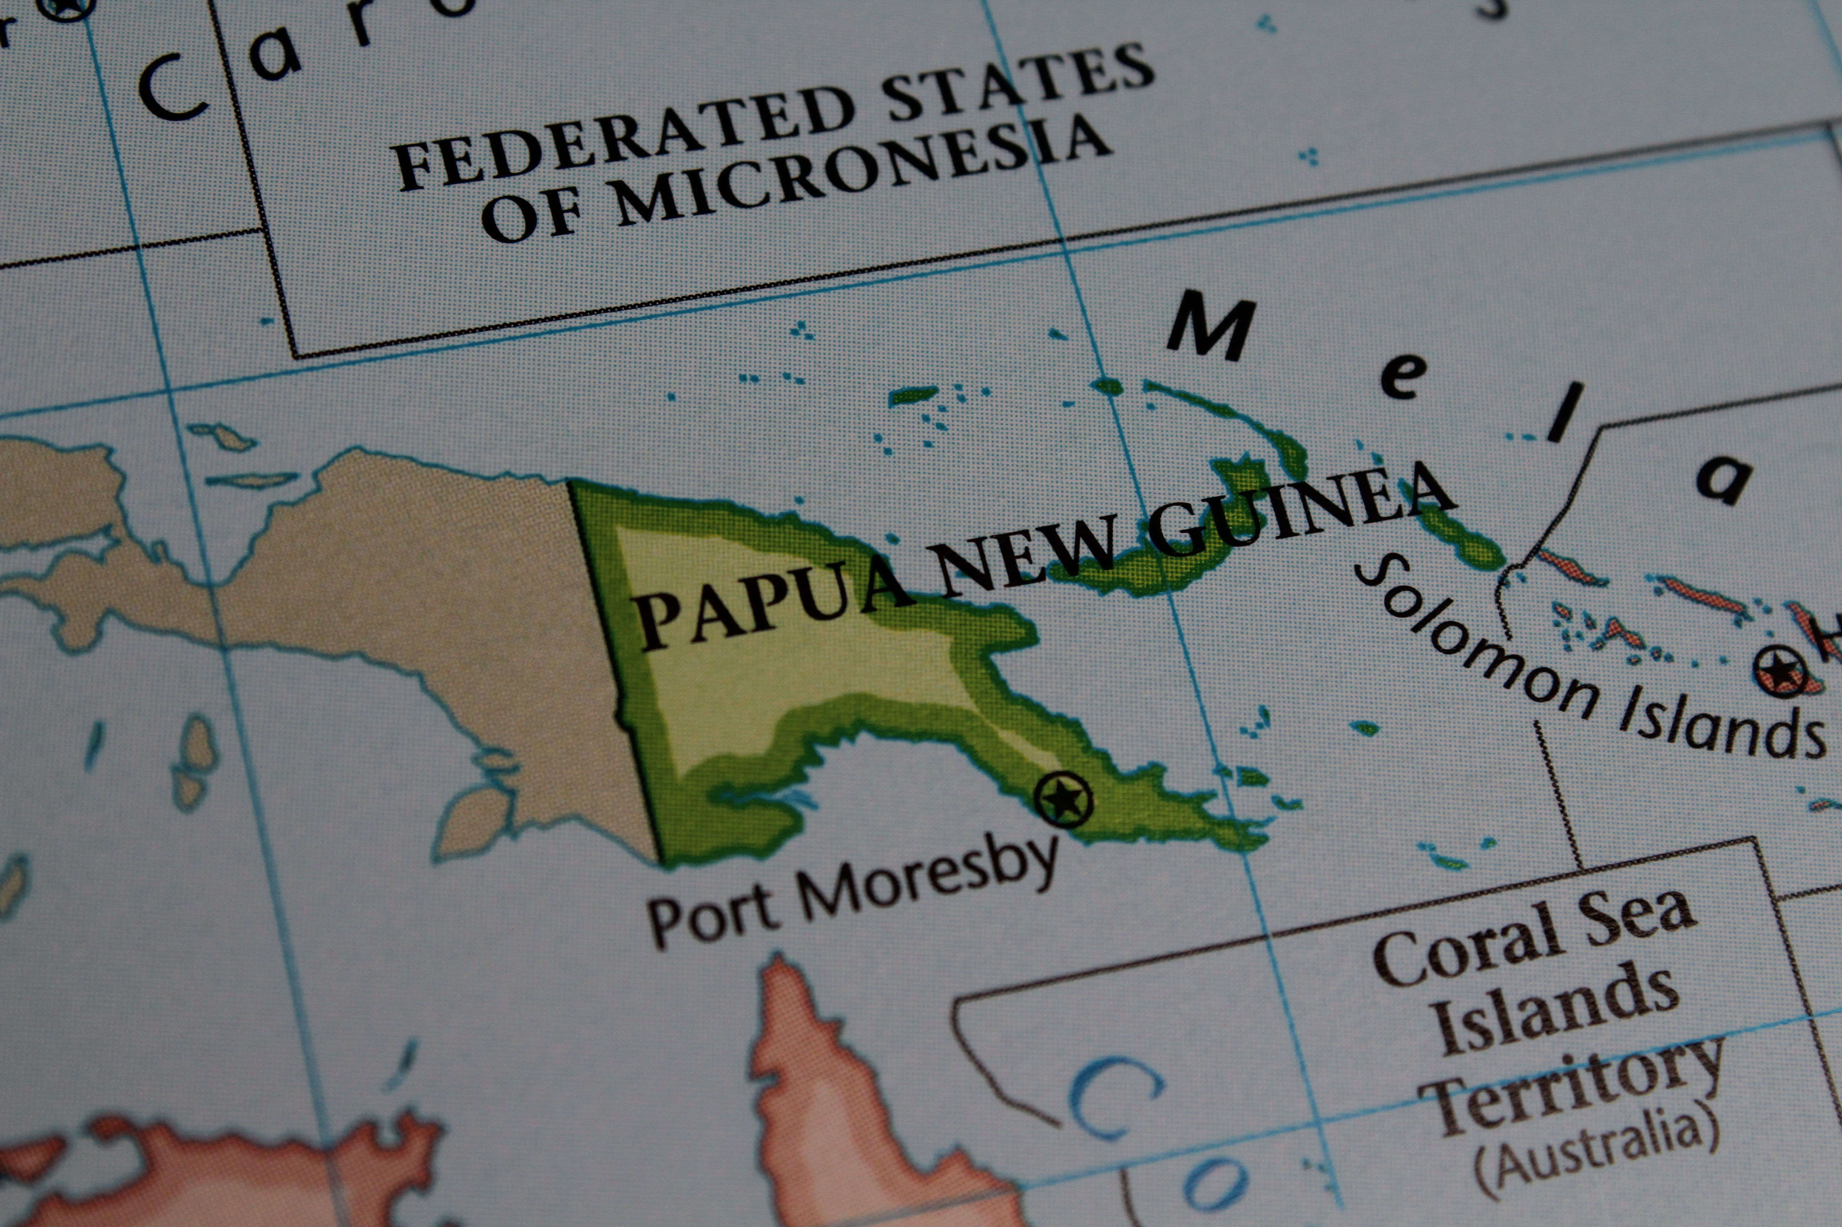
Year 4: Volcanoes, Mountains and Earthquakes
Mission Assignment: What is the equator?
3. Do earthquakes still happen?
Research tool
Research sheet 3: The Papua New Guinea Earthquake in March 2024
A big earthquake hit a faraway part of Papua New Guinea, shaking the ground very hard. It had a magnitude of 6.9 and happened early in the morning. Sadly, several people lost their lives, and about 1,000 homes were destroyed.
The earthquake happened near a town called Ambunti, and the shaking damaged many villages. Some people were already struggling because of flooding from heavy rains earlier in March.
Pictures showed houses falling into the floodwater and an old bridge breaking in the city of Wewak. The leader of the area, Allan Bird, said people needed help quickly. They needed medicine, clean water and safe places to stay.
Papua New Guinea often has earthquakes because it sits on the "Ring of Fire," a part of the world where the ground moves a lot. Last year, two big earthquakes hit the country.
5
Developing Experts Copyright 2025 All Rights Reserved
Developing Experts Copyright 2022 All Rights Reserved
Developing Experts Copyright 2022 All Rights Reserved
Developing Experts Copyright 2022 All Rights Reserved
Developing Experts Copyright 2022 All Rights Reserved
Developing Experts Copyright 2024 All Rights Reserved

Slide 6
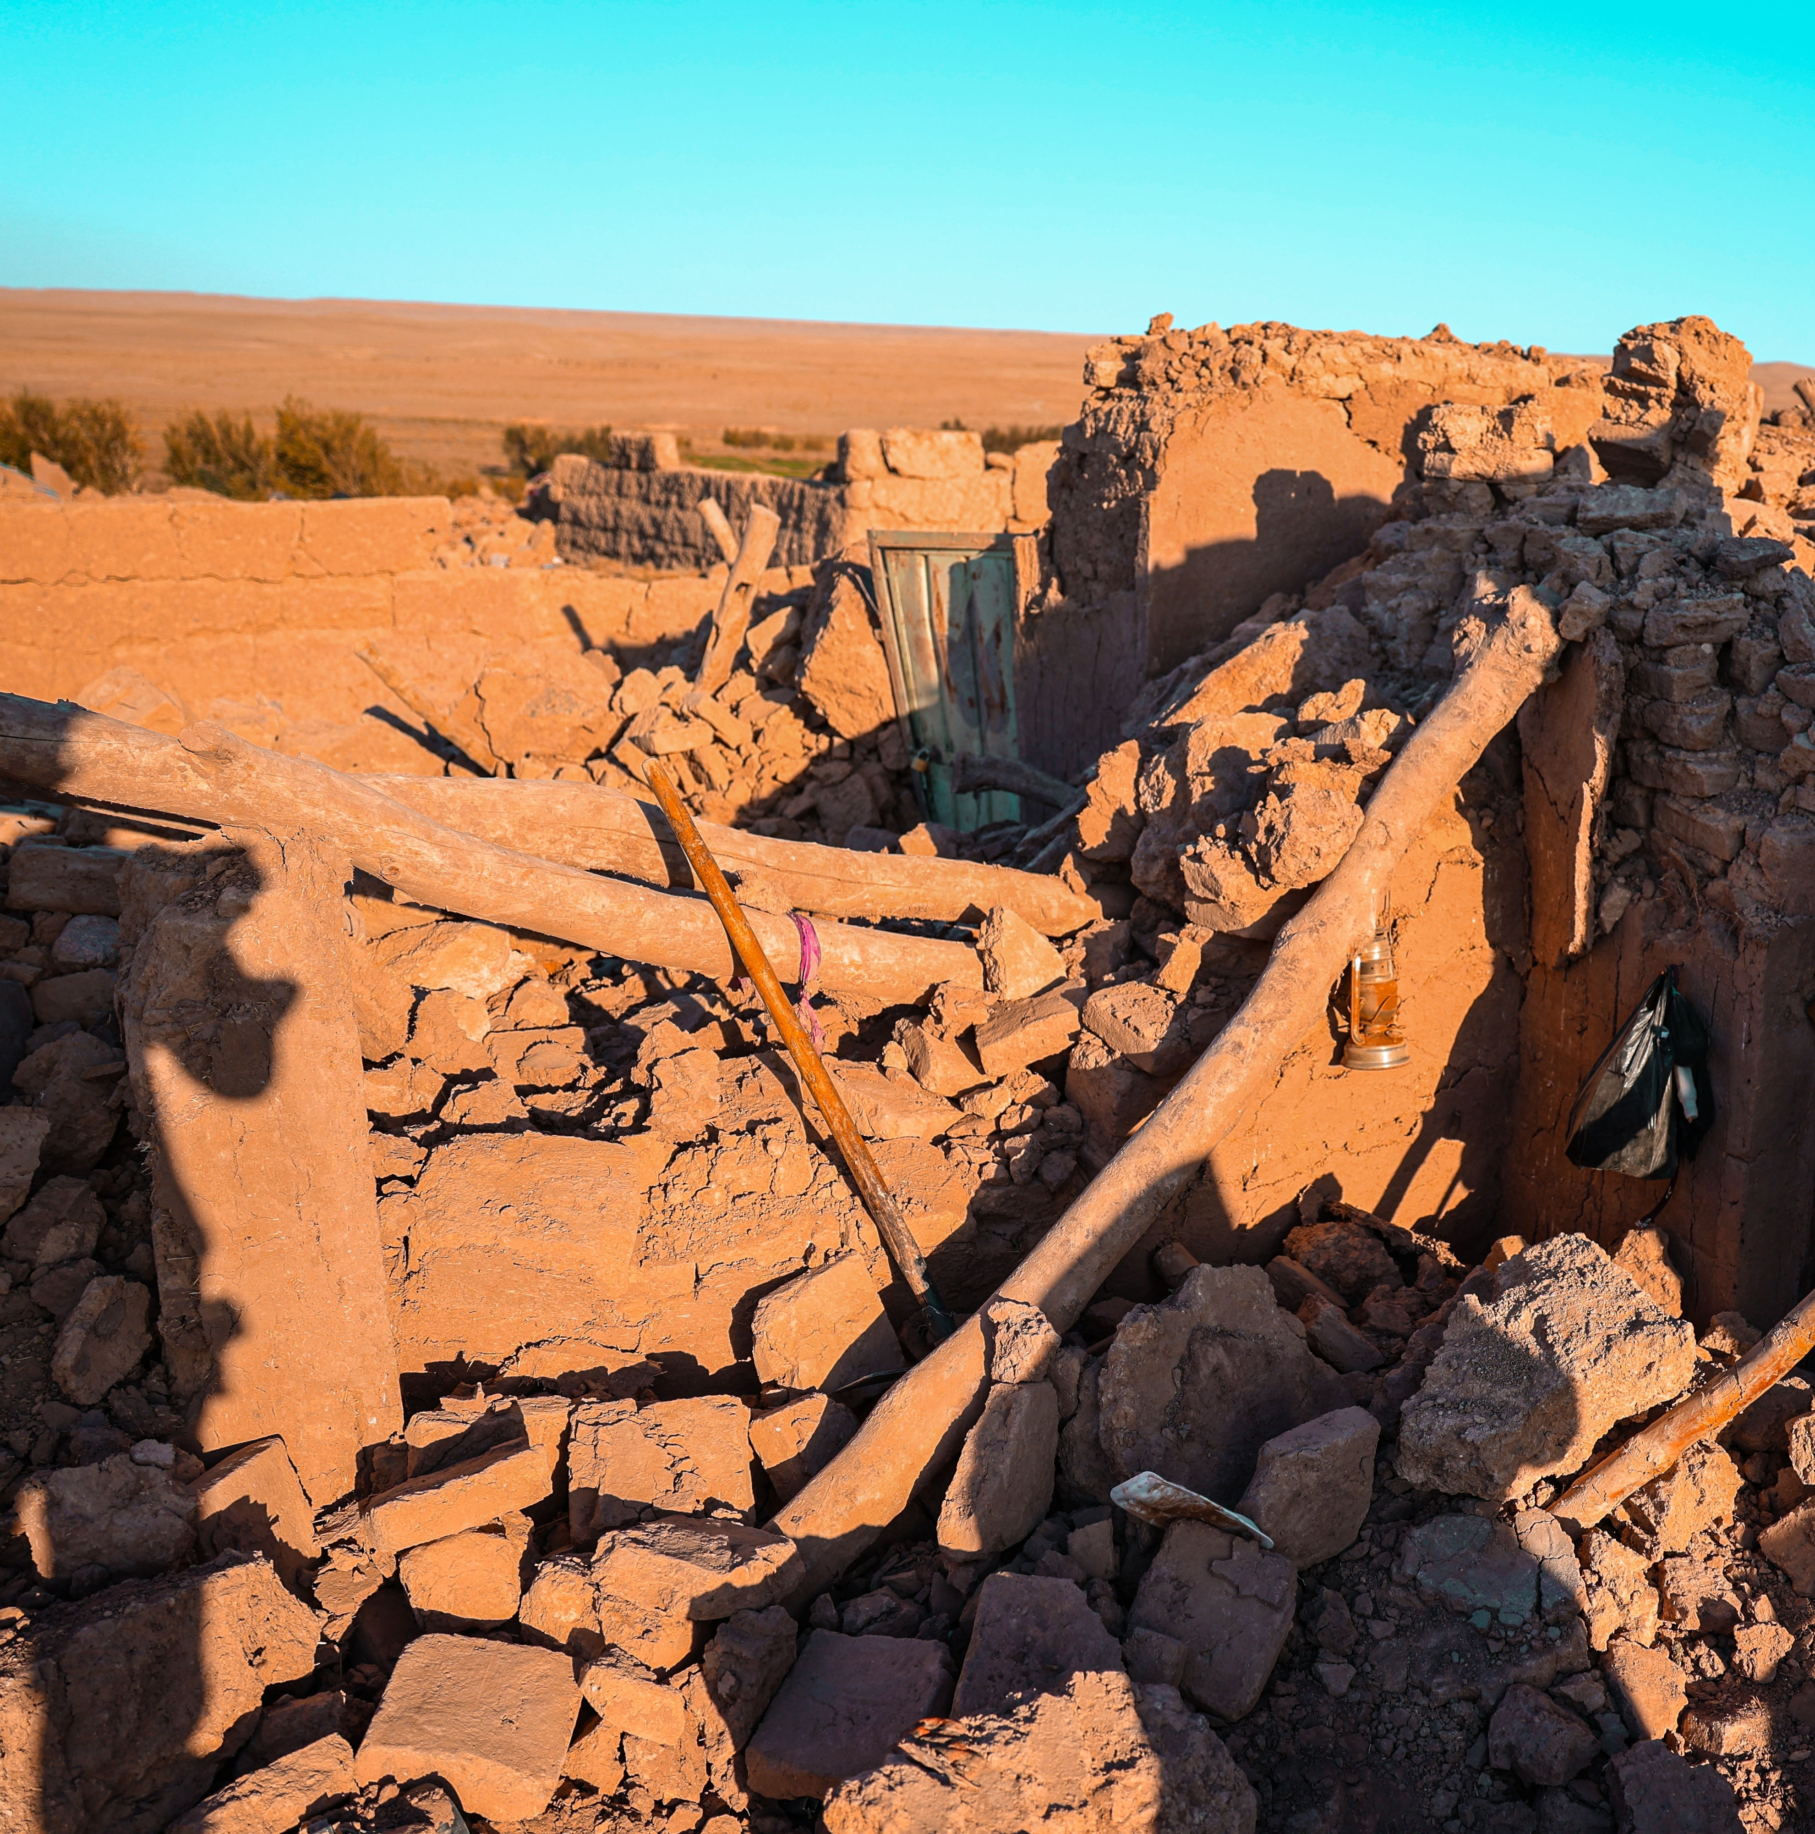
Year 4: Volcanoes, Mountains and Earthquakes
Mission Assignment: What is the equator?
3. Do earthquakes still happen?
Research tool
Research sheet 4: Afghanistan’s Quake of 2023 - A Search and Rescue Worker’s Perspective
Early in the morning on October 7, 2023, a big earthquake hit Herat province in Afghanistan. It was very strong, with a 6.3 magnitude, and it shook villages so hard that many houses fell down. A man named Hamid, who helps with rescues, rushed to Herat as soon as he heard the news. He worked with others to search for people in the broken mud-brick homes.
“The destruction was unlike anything I’ve seen,” Hamid recalls. “You think you’re prepared for these situations, but it hits you differently when you arrive and see entire families sitting in the dust, their houses just a pile of rubble.”
Many houses in Herat were made from mud-brick, a material that crumbles easily under pressure, leaving rescuers with piles of dust and debris to sift through by hand. Equipped with only basic tools and guided by the faintest sounds, Hamid and his team worked tirelessly, often relying on their ears and intuition to locate survivors.
Hamid knows that the path to recovery will be long and challenging, but he remains committed to helping his community rebuild. “We can’t change what happened, but we can offer people a hand to hold as they start again,” he says.
6
Developing Experts Copyright 2025 All Rights Reserved
Developing Experts Copyright 2022 All Rights Reserved
Developing Experts Copyright 2022 All Rights Reserved
Developing Experts Copyright 2022 All Rights Reserved
Developing Experts Copyright 2022 All Rights Reserved
Developing Experts Copyright 2022 All Rights Reserved
Developing Experts Copyright 2024 All Rights Reserved

