Slide 1



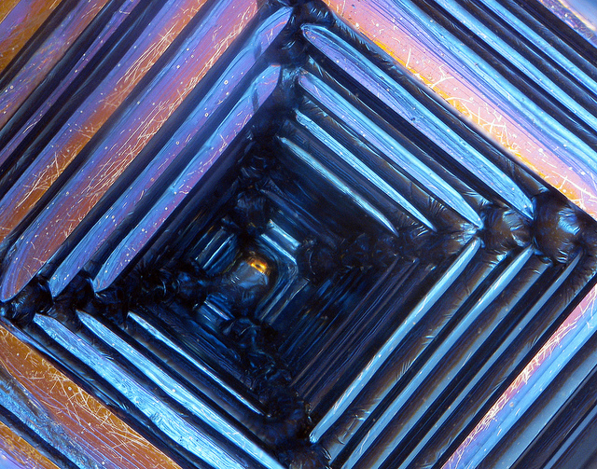
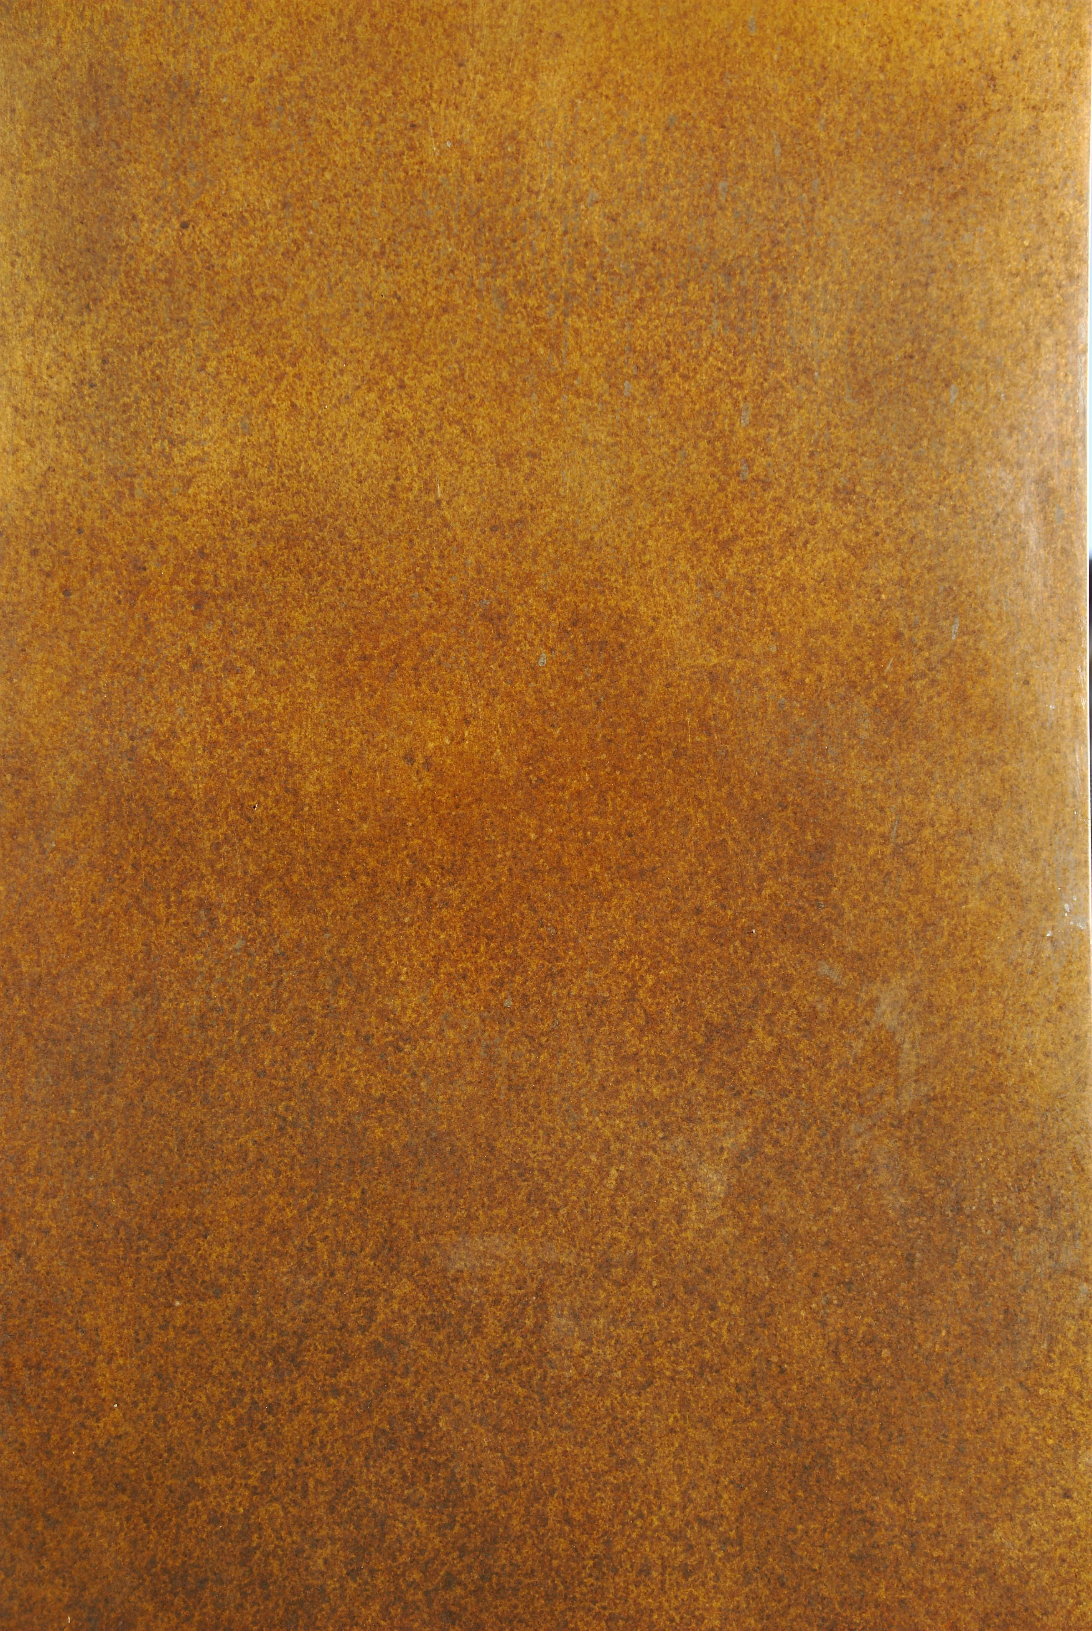


Mission Assignment: Describe the properties of magnets
KS3-23-03
Magnetic games
You are going to design and build a magnetic board game. It must:
Use magnetism effectively to enhance the game.
Be fun! Nobody likes boring board games!
Have a 5-10 minute play-time.
Your board game will be rated!
Level | Success criteria
Copper | Design a board game that features a magnet Write a basic set of rules Give a brief description of the game
Bronze | Design a board game that uses a magnet Write a clear set of rules and brief description Describe how the magnet is used in the game
Silver | Design a board game that needs a magnet to be played Write clear rules and a detailed description Describe how the magnet is used and why they used it in this way
Gold | Design a board game that needs a magnet and other magnetic materials to be played Write clear rules and a detailed description of the game Explain how the magnet is used and why it is important that it is used in this way
Bismuth | Design a board game that needs a magnet and other magnetic materials to be played Write clear rules and a detailed description of the game Explain how the magnet is used and why it is important that it is used in this way Explain why the game works in terms of magnetic fields (with a diagram if appropriate)
Game Ideas
magnetic football magnetic trap magnetic darts
magnetic fishing magnetic maze
Developing Experts Copyright 2023 All Rights Reserved

Slide 2
Mission Assignment: Describe the properties of magnets
KS3-23-03
Magnetic games
Game name:
Game Description: What makes it fun to play? |  |  |  | Game rules
How have you used magnets? |  |  |  | Why have you used magnets in this way?
Level Awarded
Copper |  | Bronze | Silver |  | Gold | Bismuth
Why you were awarded this level.
Developing Experts Copyright 2023 All Rights Reserved

