Slide 1
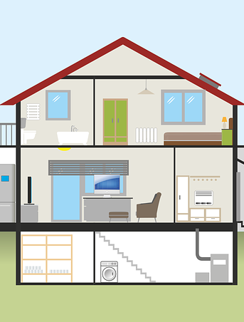
S06.10.05 Handout
Explore the thermal conductivity of materials to improve energy efficiency in buildings or other systems.
Explain the energy saving devices you plan to add to the house you have designed below and describe how you have used thermal conductivity.
Stretch:
Design and explain the thermal conductive devices you can add to a house to help make it more energy efficient.
Loft/wall insulation
____________________________________________ ____________________________________________ ____________________________________________ ____________________________________________ Double glazing
____________________________________________ ____________________________________________ ____________________________________________ ____________________________________________ Solar panels
____________________________________________ ____________________________________________ ____________________________________________ ____________________________________________ Energy-saving lightbulbs
____________________________________________
____________________________________________
____________________________________________
____________________________________________
Challenge:
Design and explain the devices you can add to a house to help make it more energy efficient.
Developing Experts Ltd. © 2022

Slide 2
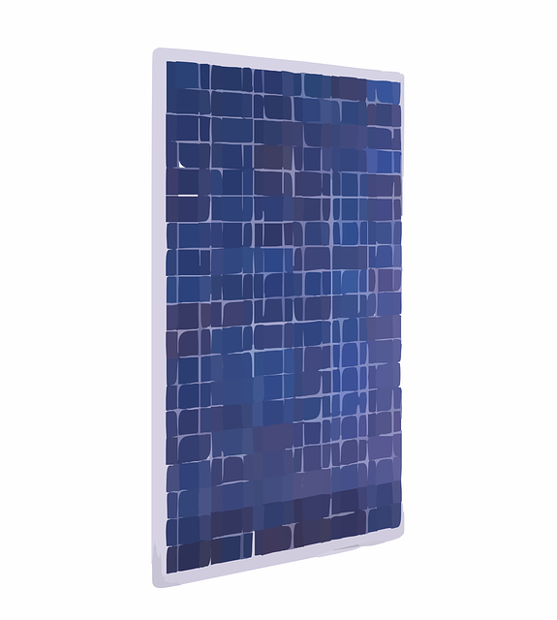
S06.10.05 Handout
Explore the thermal conductivity of materials to improve energy efficiency in buildings or other systems.
Explain the energy saving devices you plan to add to the house you have designed below and describe how you have used thermal conductivity.
________________________________________________ ________________________________________________ ________________________________________________ ________________________________________________
________________________________________________
Stretch:
Design and explain the thermal conductive devices you can add to a house to help make it more energy efficient.
____________________________________________________________________________________________________________________________________________________________________________________________________________________________________________________________ __________________________________________ __________________________________________
______________________________________________________________________________________________________________________________________________________________________________________________________________________________________________________________________________________________________
Challenge:
Design and explain the devices you can add to a house to help make it more energy efficient.
DevelopingDeveloping Experts Ltd. © 2022

