Slide 1
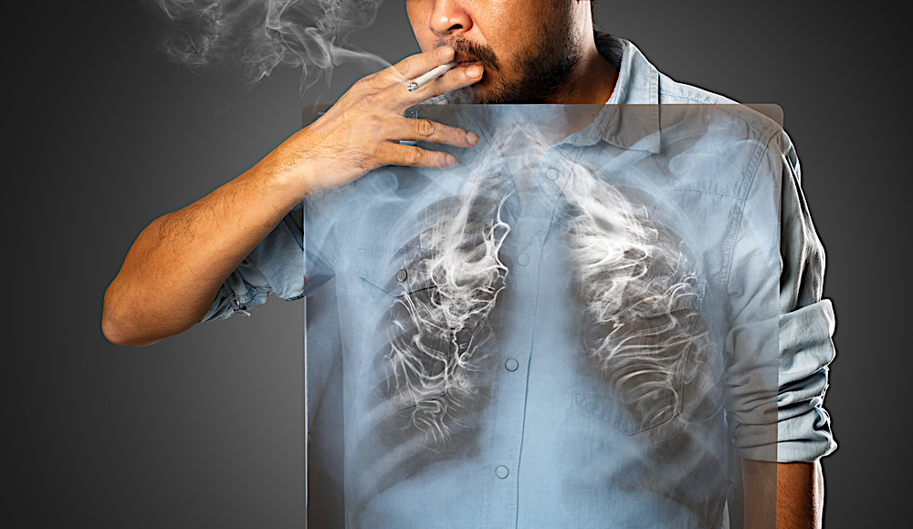
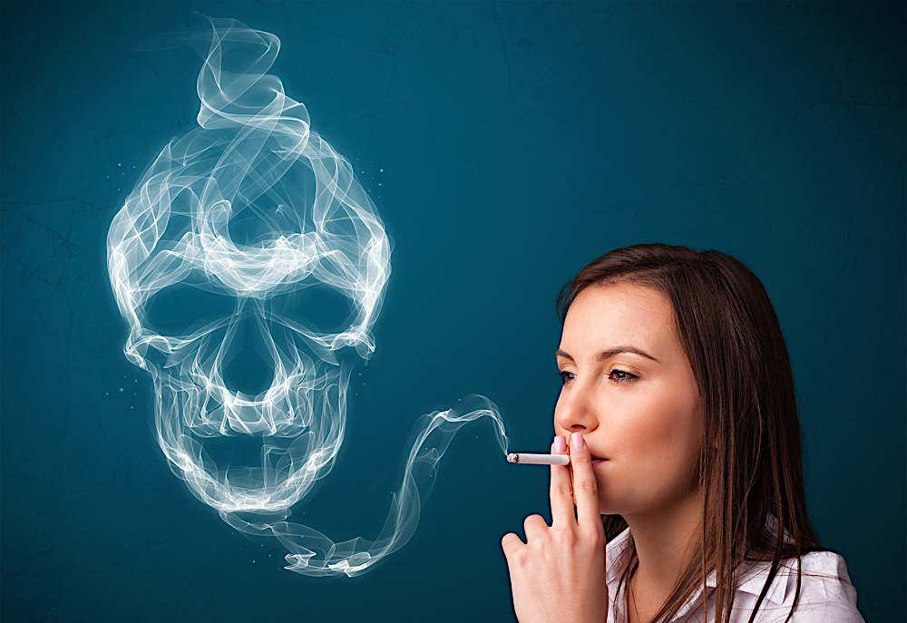
S06.04.08 Handout
The objective is for you to understand the dangers of smoking and how it affects the lungs.
Please use the information below to create a poster which help prevent people smoking.
Stretch:
Create a poster which makes a strong argument about the dangers of smoking.
Every cigarette you smoke is harmful
Did you know that smoking and the use of tobacco results in over 80,000 deaths each year in England? This makes it the largest cause of preventable death in the country. The health problems associated with spoken are varied and shocking. Here are some facts associated with smoking: - Smoking causes around 15 different cancers - 93% of throat cancers are caused by smoking
- Smoking can age your skin by between 10 ands 20 years
- Smoking can reduce fertility in women
- Over 100,000 men in the UK are infertile due to smoking - Smoking causes around 11,000 deaths in the UK each year due to non-smokers inhaling ‘secondary’ smoke Furthermore, many people are non impressed by those who smoke because it makes you look unhealthy – it causes a yellow- grey appearance and can turn your fingers and skin yellow. It also makes your hair dry and broken and can ruin your teeth and gums.
There are over 5000 different chemicals in cigarettes – many of which are harmful. These include tar, used for building roads and nicotine, which is the addictive substance in cigarettes.
On top of that, smoking is expensive. In 2018, a packet of 20 cigarettes in the UK costs an average of £9!
Challenge:
Create a poster which sends a message about the dangers of smoking.
Developing Experts Ltd. © 2022
.

Slide 2
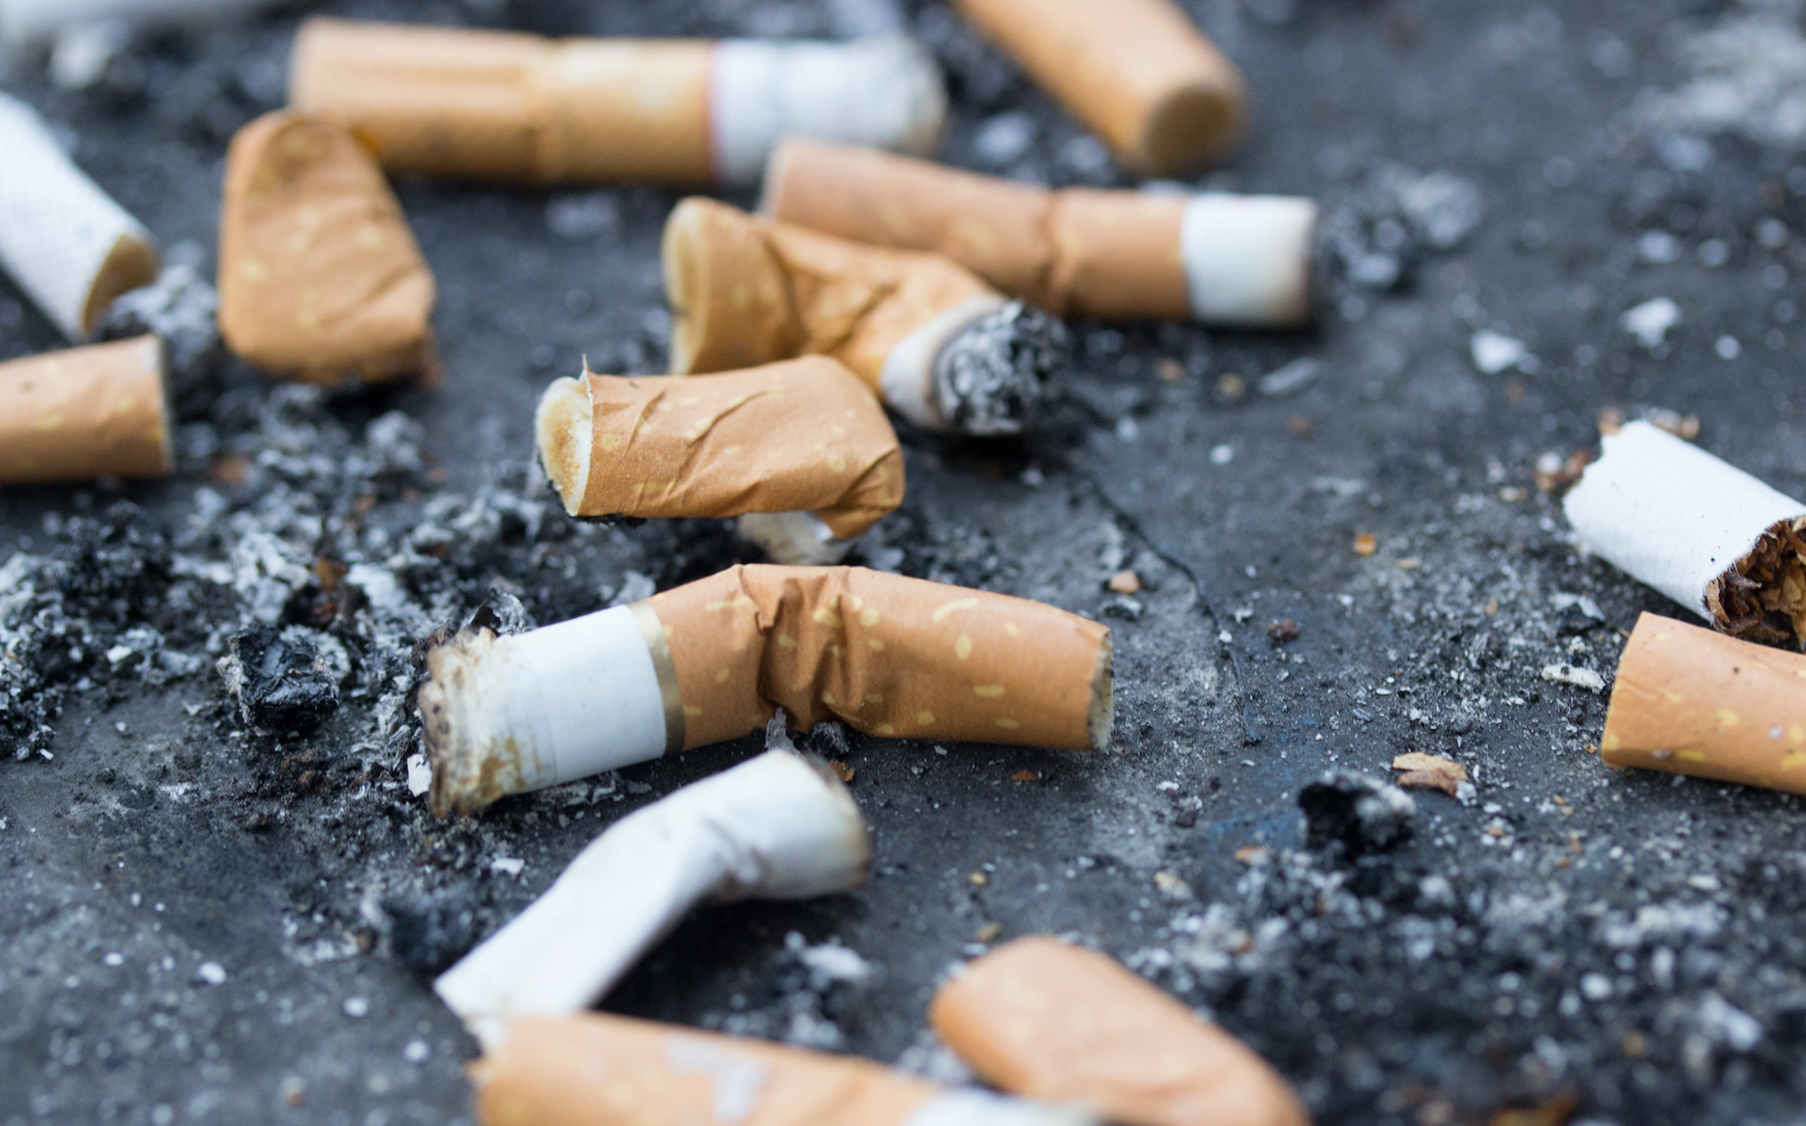
S06.04.08 Handout
The objective is for you to understand the dangers of smoking and how it affects the lungs.
Suggest persuasive argument that you can include in a letter to your local council to ban smoking in public parks.
Stretch:
Create a poster which makes a strong argument about the dangers of smoking.
Smoking in Public Places
Around the world, different countries have different laws about smoking in public places (pubs, offices, restaurants, work vehicles).
In Australia, some of the strictest smoking laws have been enforced, in that smoking is banned outside in places like beaches and sports grounds. They also have some of the most expensive cigarette prices. Ireland was the first country to enforce a complete public-place smoking ban in 2004, and this was followed in 2007 by the UK. In the USA, the laws vary between states. China currently has no laws to punish those who violate smoking rules. In the UK, there is now a legal duty to display a NO Smoking sign so that all customers and staff can clearly see it. Whoever owns or manages the premises has a legal duty to enforce the ban, or they face fines.
Challenge:
Create a poster which sends a message about the dangers of smoking.
Developing Experts Ltd. © 2022

