Slide 1
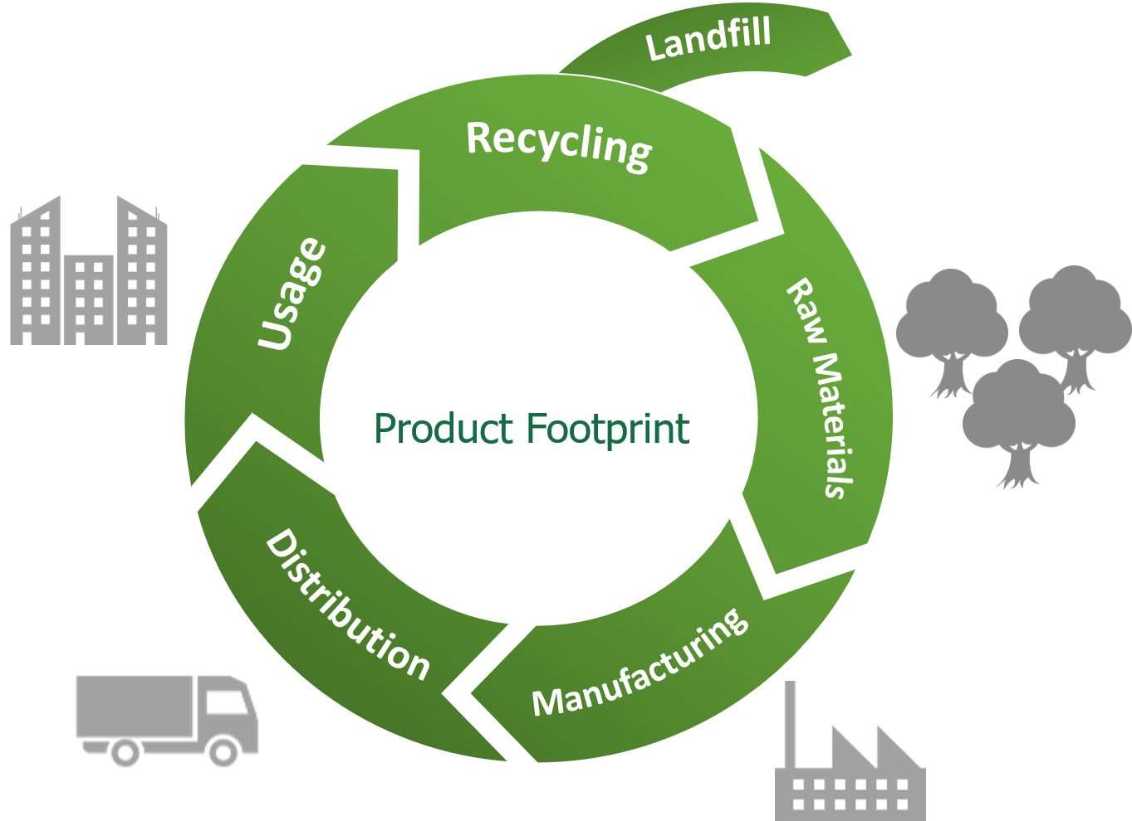

Developing Experts All rights reserved © 2021

Slide 2
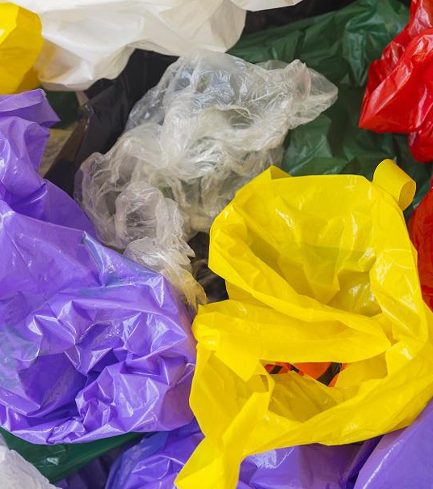
Explore life Cycle Assessments
Describe what's meant by a lifecycle assessment.
Discuss the life cycle assessments for a plastic shopping bag and a paper shopping bag.
Describe the problems with life cycle assessments.
Developing Experts All rights reserved © 2021

Slide 3
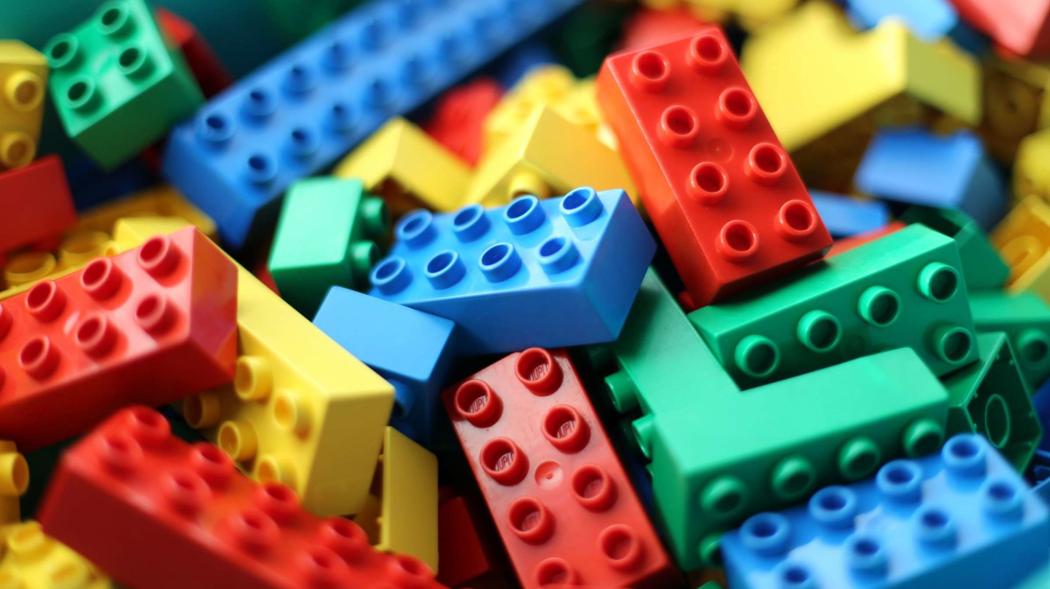

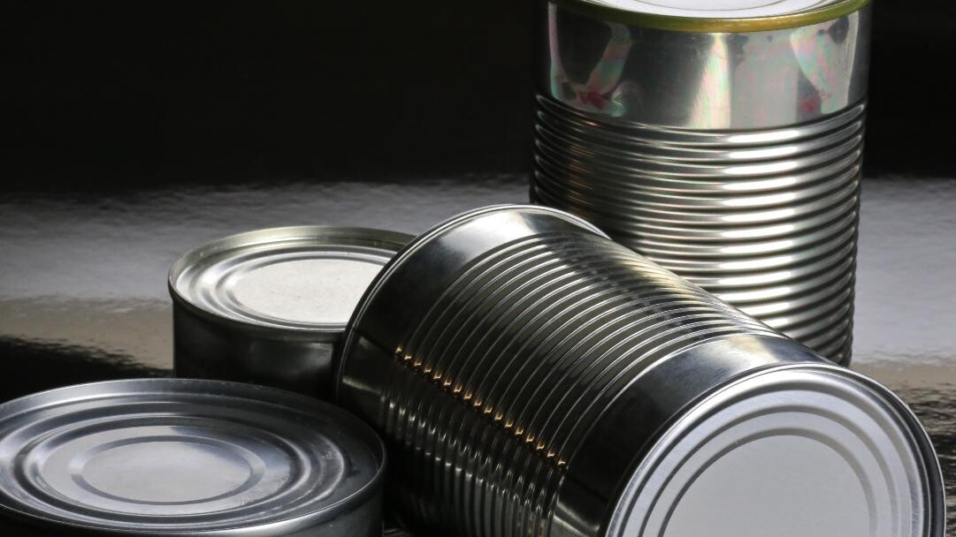
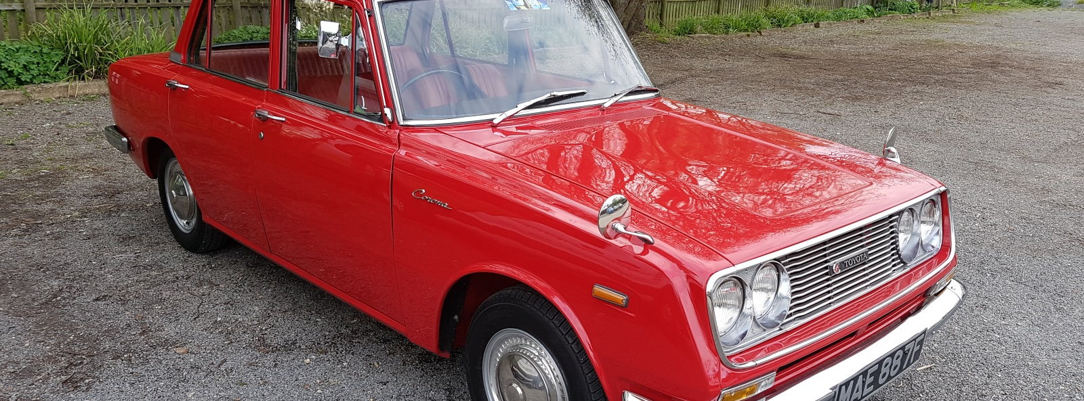
Developing Experts All rights reserved © 2021

Slide 4
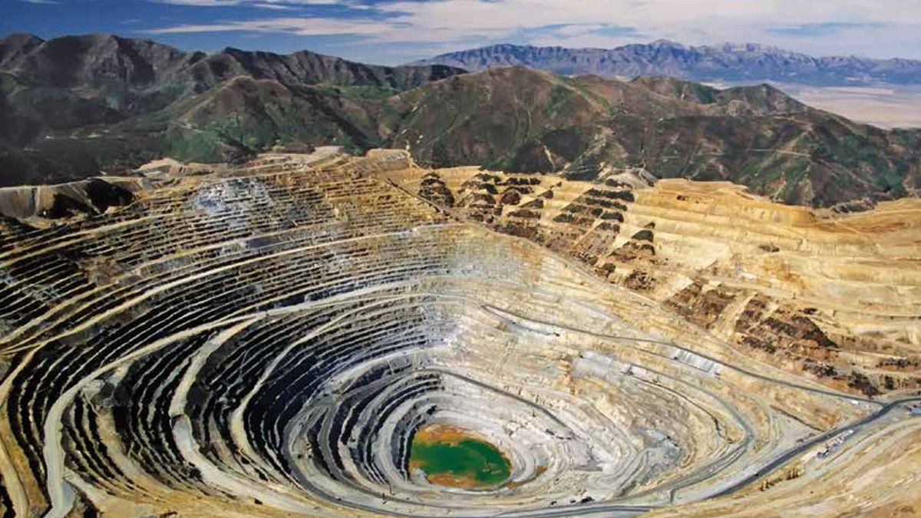
Developing Experts All rights reserved © 2021

Slide 5
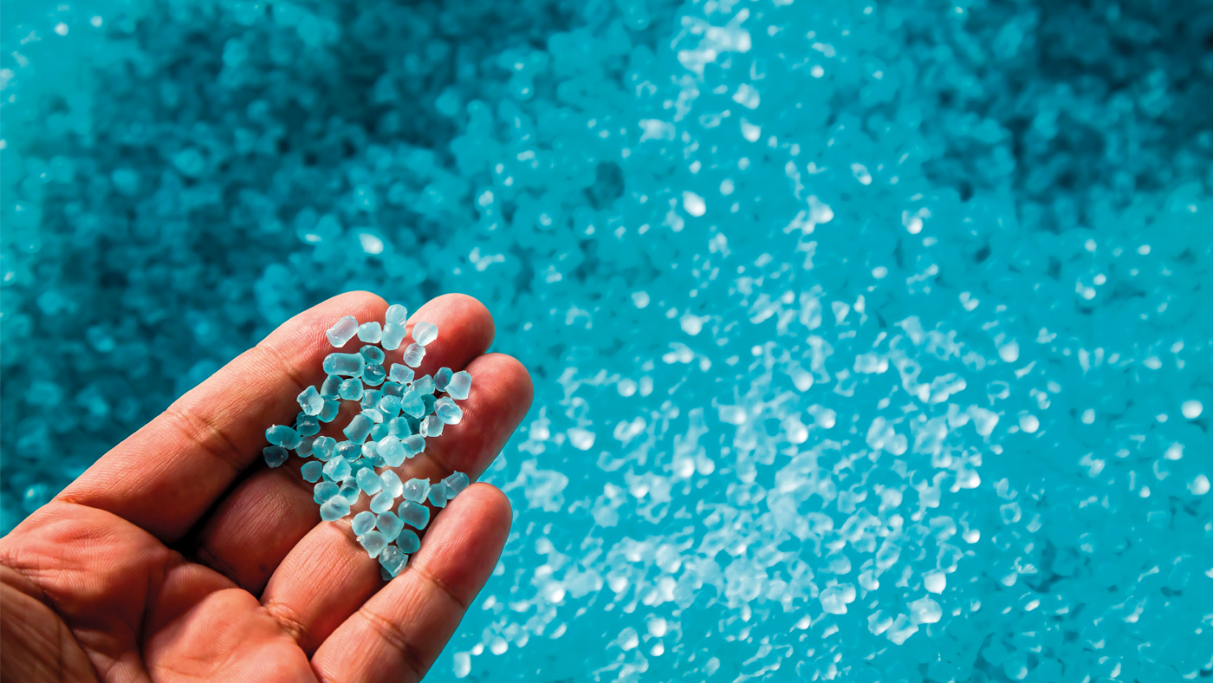
Developing Experts All rights reserved © 2021

Slide 6
Developing Experts All rights reserved © 2021

Slide 7

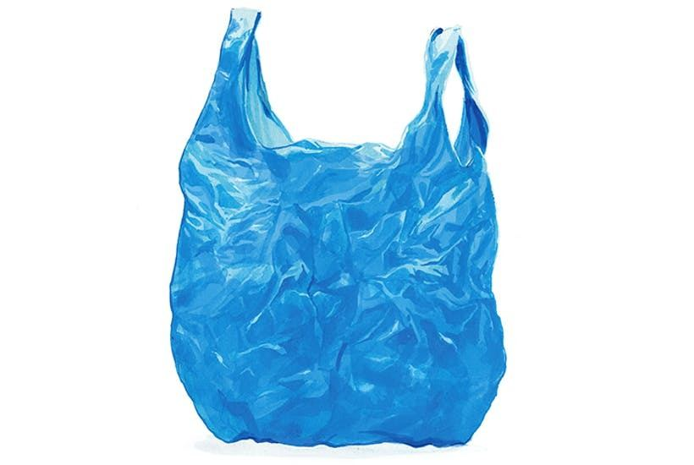
Carry out a simple lifecycle assessment for shopping bags made from plastic or from paper.
Developing Experts All rights reserved © 2021

Slide 8
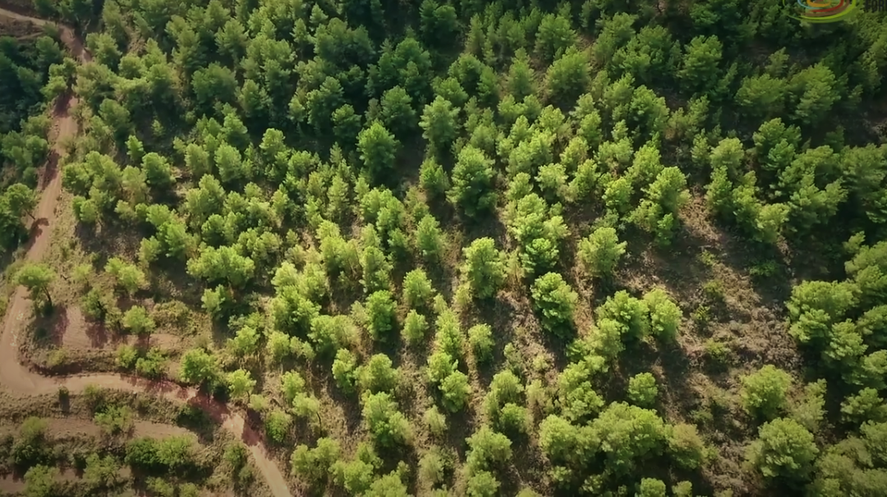
Developing Experts All rights reserved © 2021

Slide 9
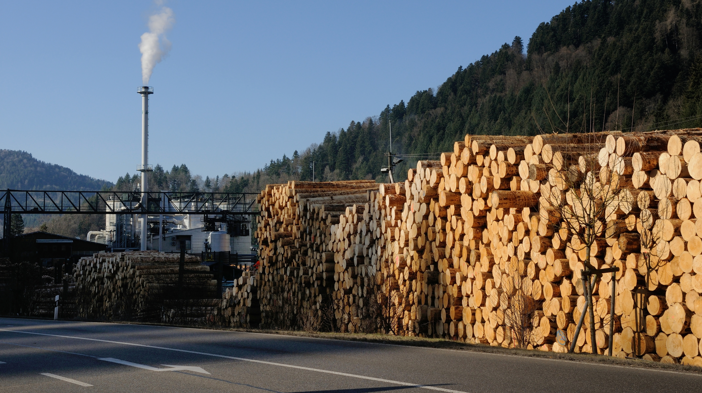
Developing Experts All rights reserved © 2021

Slide 10
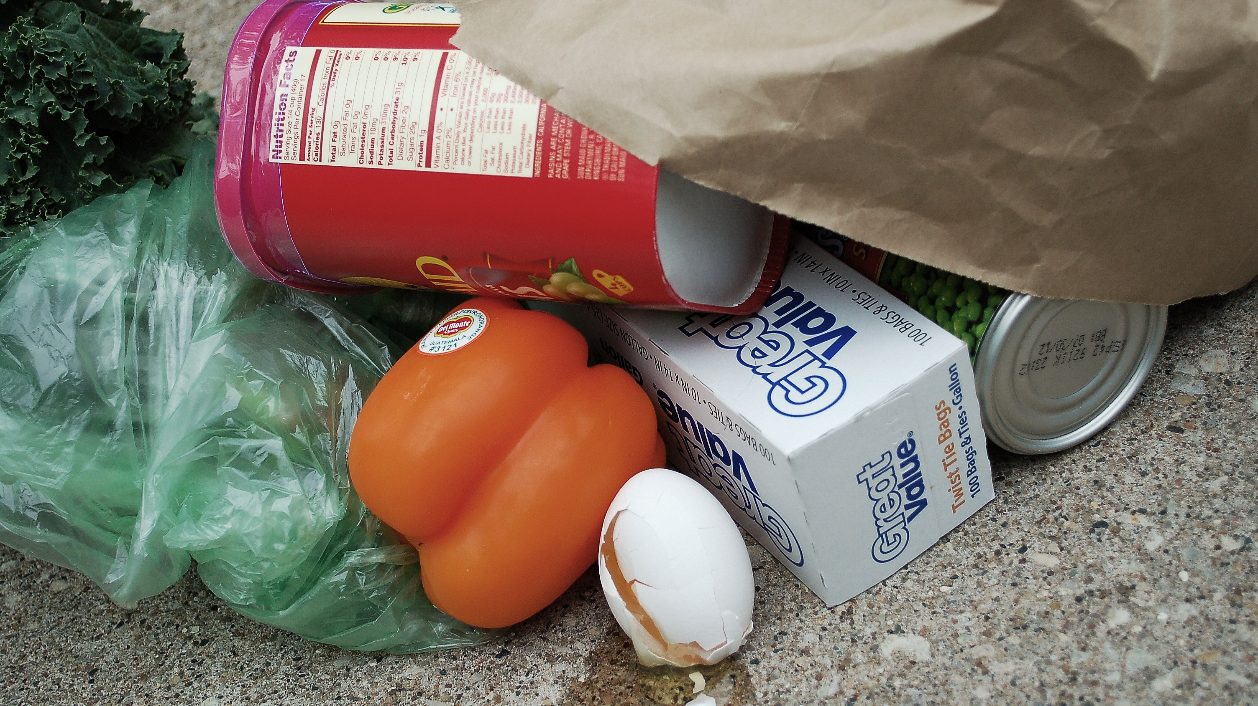
Developing Experts All rights reserved © 2021

Slide 11
Developing Experts All rights reserved © 2021

Slide 12
Explore life Cycle Assessments
Describe what's meant by a lifecycle assessment.
Discuss the life cycle assessments for a plastic shopping bag and a paper shopping bag.
Describe the problems with life cycle assessments.
Developing Experts All rights reserved © 2021

