Slide 1

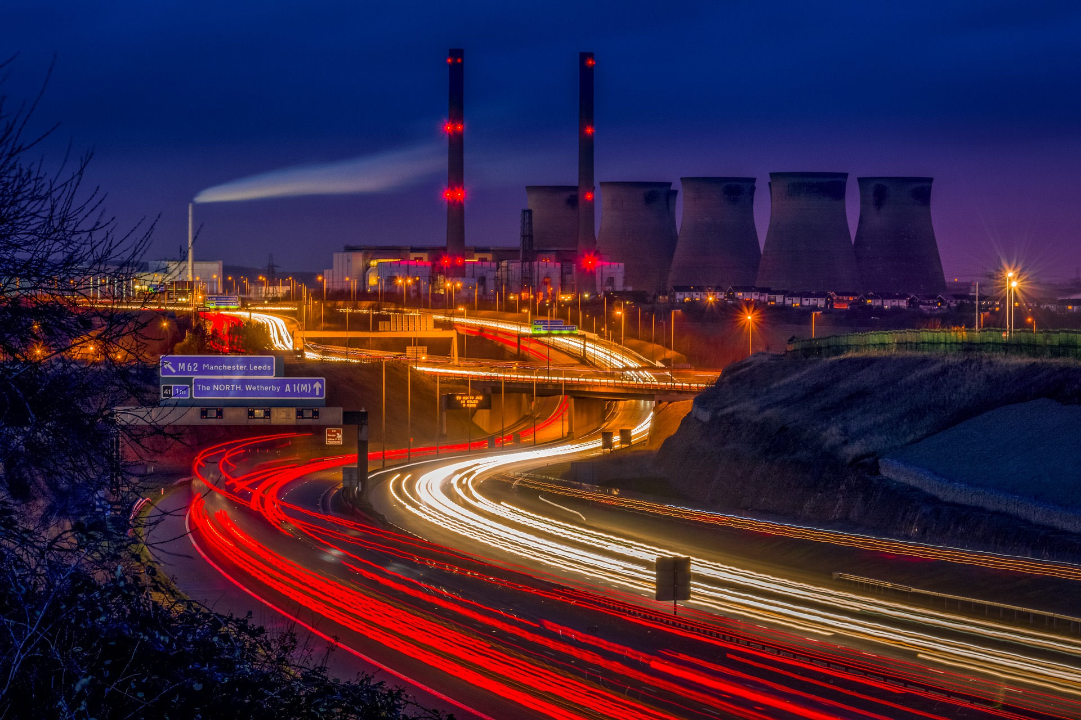
0001.01
Mission Assignment
Task | Use your handout to reinforce learning around the topic of fossil fuels.
Developing skills | Practise writing answers to questions that require full answers. Identify the elements of the question; the subject, the facts and the expectation.
Think about… | The change from a ‘fossil fuel-based economy’ to a ‘renewable energy-based economy’ – what are the problems associated with changing over?
KS4-18-10:
Explore non-renewable sources

