Slide 1

Handout: S03.08.01
Explore how animals change over time
Create the perfect predator for each of these environments. Label your diagrams to help explain how your animal would be well adapted
polar
ocean
rainforest
desert
Stretch:
Explain how your animals are adapted to the conditions.
Challenge:
Draw adapted animals and label their new features.
Developing Experts Ltd. Copyright 209

Slide 2
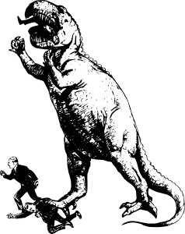

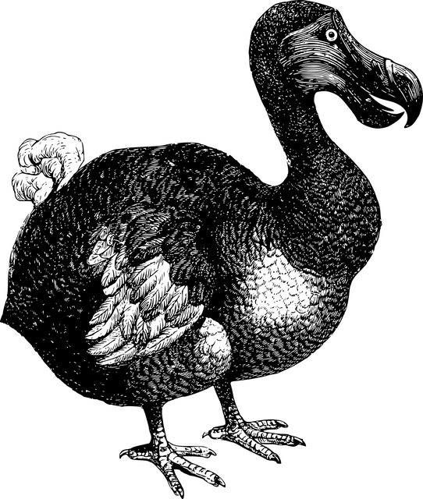

Handout: S03.08.01
Explore how animals change over time
Research and find out how these animals became extinct.
animal
lived: time/place
how it became extinct
__________________________________________________________________________________________________________________
__________________________________________________________________________________________________________________
__________________________________________________________________________________________________________________
Stretch:
Explain how each species of animal became extinct
Challenge:
Name each animal and think of an idea of how it might have become extinct.
Developing Experts Ltd. Copyright 2019

