Slide 1


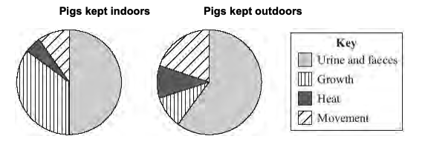
Mission Assignment: Explore modern farming
Code: KS4_07_21
Discuss the food and energy requirements of animals raised outdoors and those raised by ‘factory farming’. Suggest reasons for the difference.
1. Pigs may be kept indoors or outdoors. The pie charts below show what happens to the energy in the food eaten by pigs kept indoors and pigs kept outdoors. Farmers make more profit from keeping pigs indoors than from keeping pigs outdoors. Use information from the pie charts to explain why.
__________________________________________________________________________________________________________________________________________________________________________________________________________________________________________________________________________________________________________________________________________________________________________________________________________________________
2. To produce cheap meat, animals must be grown (reared) efficiently. When pigs are reared intensively they are kept indoors. Their surroundings are closely monitored to make sure they have even ventilation and the correct temperature. The risk of infection is high but is reduced by feeding them antibiotics and removing their faeces. The pigs live in cages and cannot move around much.
(A) Explain why farmers control the temperature.
______________________________________________________________________________________________________________________________________________________________________________________________________________________________________________________
(B) Explain why farmers want to stop the pigs moving about.
______________________________________________________________________________________________________________________________________________________________________________________________________________________________________________________
(C) Give two arguments against rearing pigs indoors instead of outdoors.
1.__________________________________________________________________________________________________________________________________________________________________2.__________________________________________________________________________________________________________________________________________________________________
Developing Experts Copyright 2022 All Rights Reserved

Slide 2
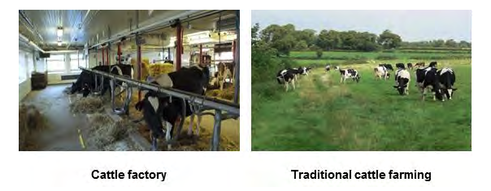
Mission Assignment: Explore modern farming
Code: KS4_07_21
3. There are plans for a ‘cattle factory’ to be built in the UK. Information about the cattle factory and traditional cattle farming in the UK is given below. Use the information to answer the questions.
Cattle factory:
There will be over 8 000 cows in three large sheds.
Each cow will be milked three times a day.
Each cow will produce about 50 litres of milk every day.
Waste will be collected and used to produce electricity for 2 000 homes.
Cows are kept near to each other so disease can spread easily.
Traditional cattle farming:
Most farms have between 5 and 500 cows.
The cows spend most of the time in fields.
Cows are milked once or twice a day.
Each cow produces up to 20 litres of milk a day.
The waste is used as natural fertiliser for crops.
(A) Give two reasons why some people think the cattle factory is a good idea
1.__________________________________________________________________________________________________________________________________________________________________2.__________________________________________________________________________________________________________________________________________________________________
(B) Give two reasons why some people think traditional farming is better
1.__________________________________________________________________________________________________________________________________________________________________2.__________________________________________________________________________________________________________________________________________________________________
Developing Experts Copyright 2022 All Rights Reserved

