Slide 1
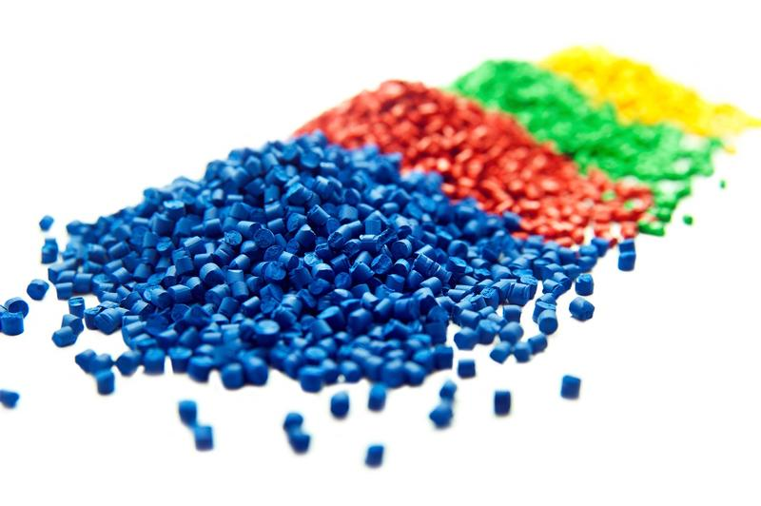
Developing Experts All rights reserved © 2021
Developing Experts All rights reserved © 2021

Slide 2
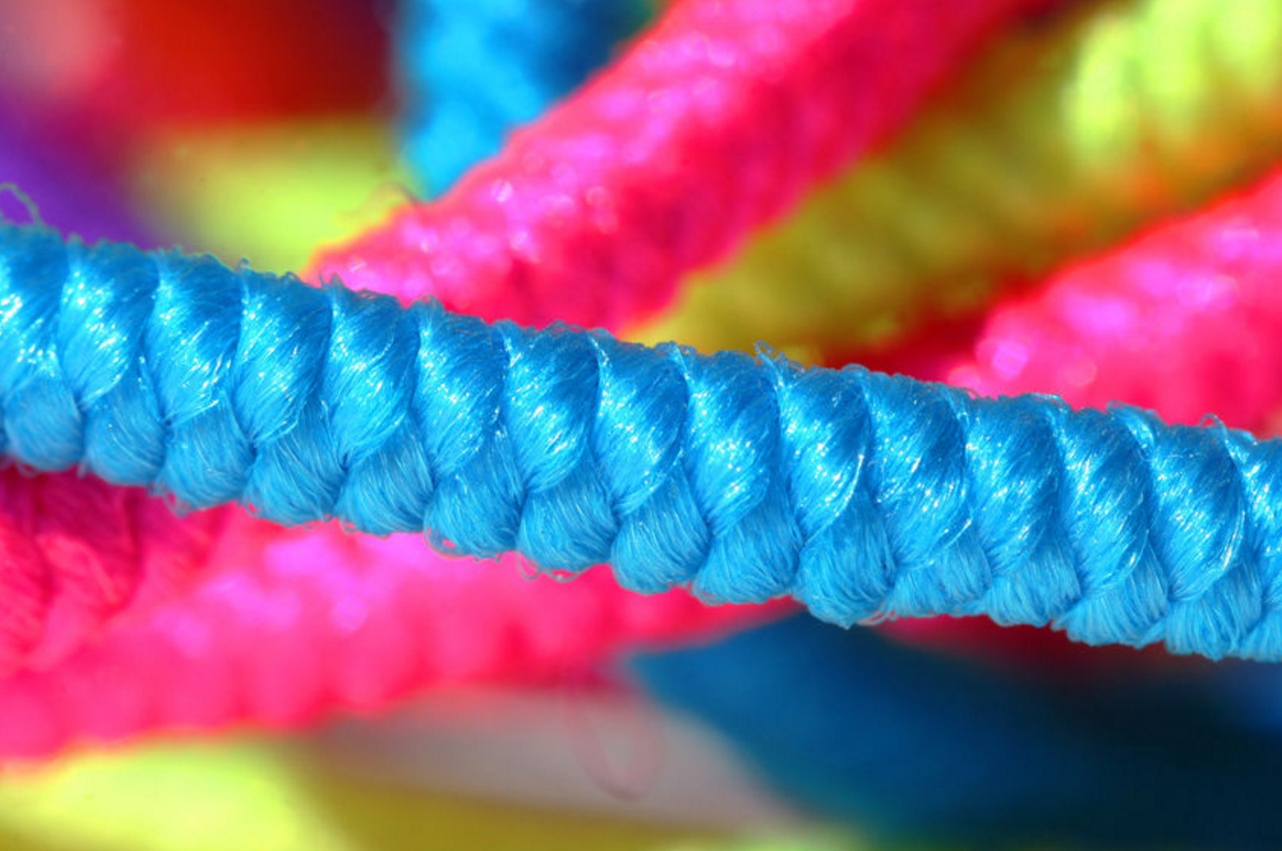
What examples of polymerisation can you remember?
What type of structures do polymers have?
Some polymers are made via condensation polymerisation.
In condensation polymerisation, a small molecule is formed as a by-product each time a bond is formed between two monomers. This small molecule is often water.
An example of a condensation polymer is nylon.
Polymers have very large molecules. The atoms in a polymer molecule are joined together by strong covalent bonds in long chains. There are variable numbers of atoms in the chains of a given polymer. One example of a polymer is poly(ethene).
Developing Experts All rights reserved © 2021
Developing Experts All rights reserved © 2021

Slide 3
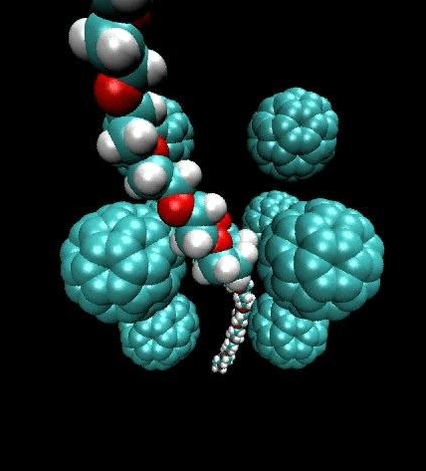
Explore polymers
Describe the structure and the bonding of polymers.
Explain why polymers are solid at room temperature.
Developing Experts All rights reserved © 2021

Slide 4
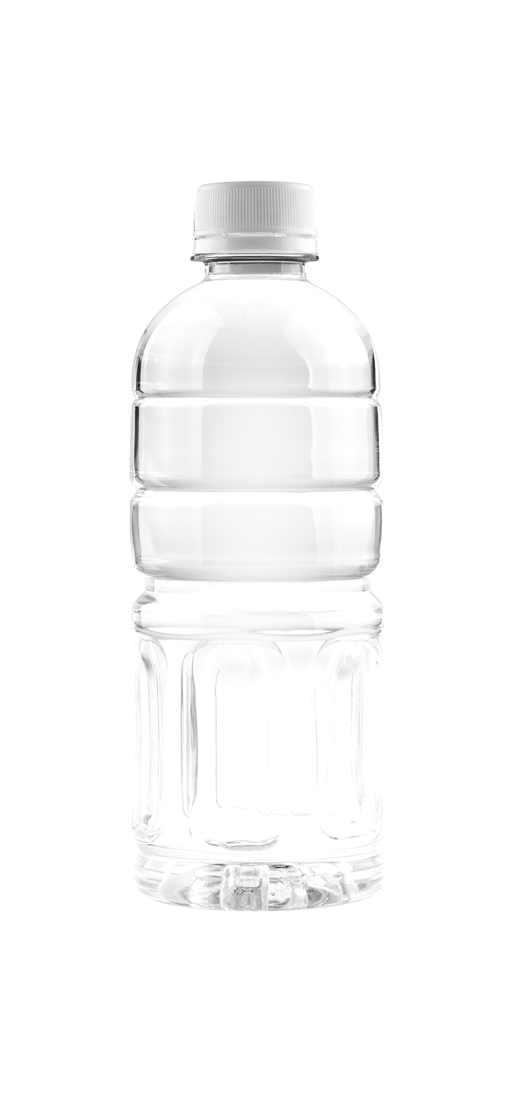
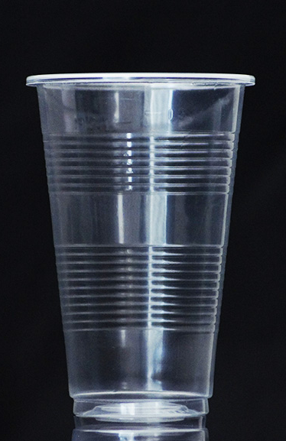
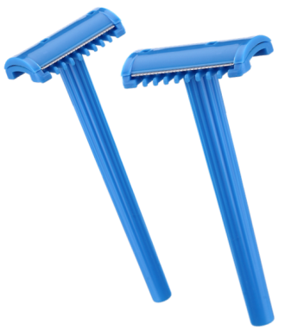
Polymers
Plastic cup
plastic razor
plastic bottle
Developing Experts All rights reserved © 2021
Developing Experts All rights reserved © 2021

Slide 5
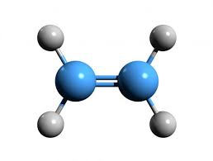
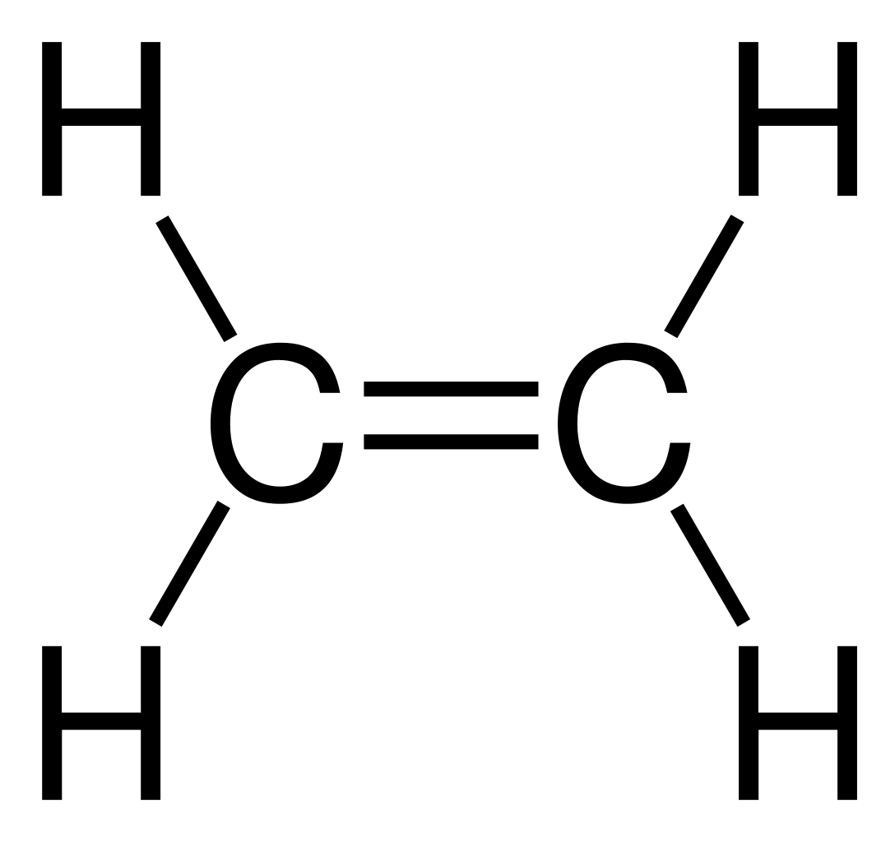
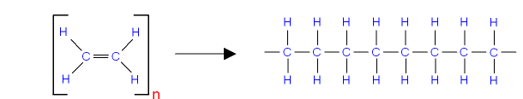
Ethene
Many (ethene) molecules
Poly (ethene)
Developing Experts All rights reserved © 2021
Developing Experts All rights reserved © 2021

Slide 6
Ethene monomers
Many (ethene) molecules
Poly (ethene)
Developing Experts All rights reserved © 2021
Developing Experts All rights reserved © 2021

Slide 7
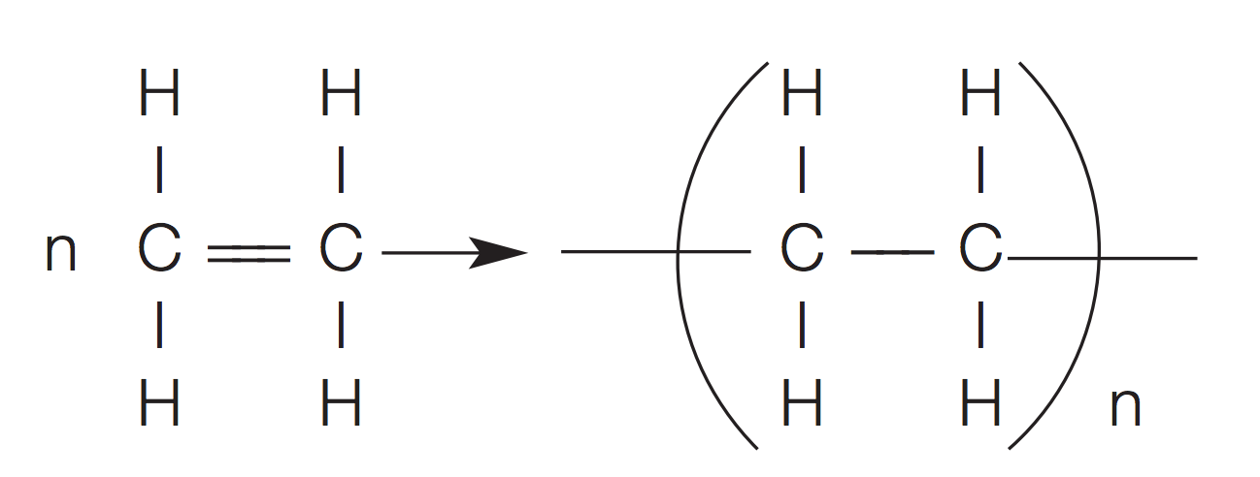
ethene
poly(ethene)
Developing Experts All rights reserved © 2021
Developing Experts All rights reserved © 2021

Slide 8
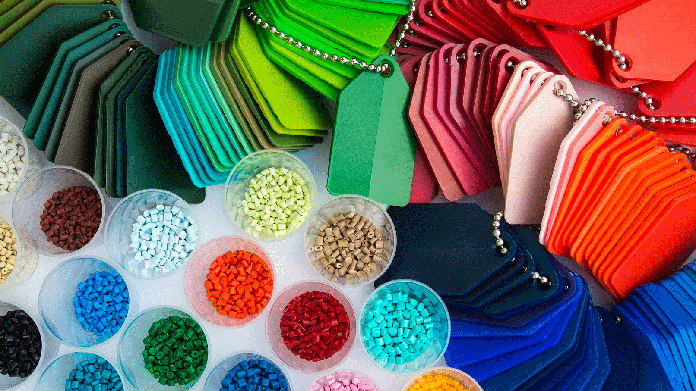
Developing Experts All rights reserved © 2021

Slide 9
ethene
poly(ethene)
Many repeating units are joined together.
Developing Experts All rights reserved © 2021

Slide 10
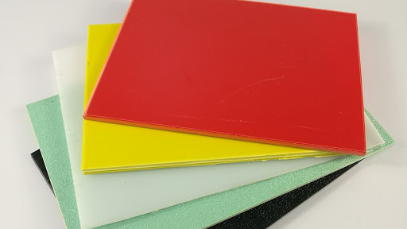
Most polymers are solids at room temperature.
Developing Experts All rights reserved © 2021

Slide 11
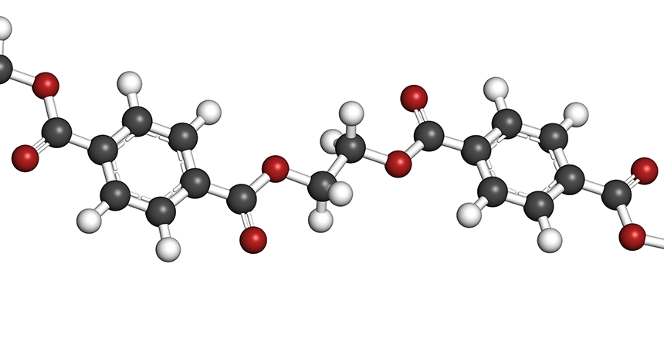
Developing Experts All rights reserved © 2021

