Slide 1
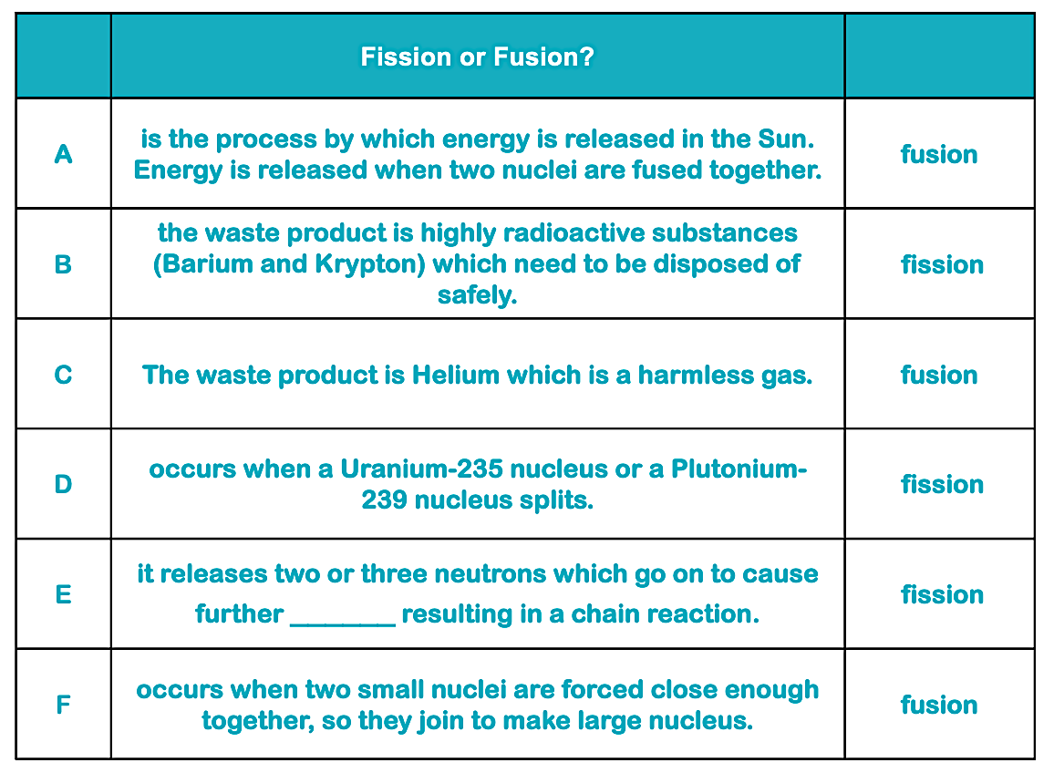
When a uranium-235 nucleus absorbs an extra neutron, its mass number increases by one and it becomes unstable. It breaks into two smaller parts. This process is known as fission. Each time a uranium-235 nucleus splits, it releases three neutrons, which creates a chain reaction.
In nuclear fusion, two nuclei of lighter elements combine to create a nucleus of a larger element, whereas in nuclear fission, a larger nucleus splits into two smaller nuclei. Both release energy; however, fusion releases a lot more. Nuclear power uses fission to produce energy.
In the core of the sun, hydrogen atoms are joined together to make helium in a fusion reaction. Lots of energy is released in this process
If fission is left uncontrolled, it will quickly escalate. Each fission releases 3 neutrons so the number of fissions increases rapidly. Huge amounts of energy can be released and this can be cause damage if not controlled.
a) the control rods are raised and lowered as needed. This controls the neutrons moving between fuel rods.
b) To slow the neutrons
Teacher answers

