Slide 1

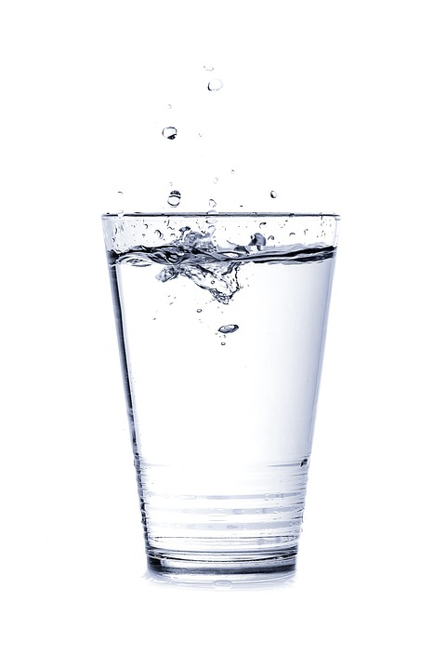
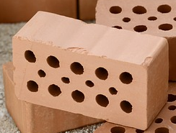
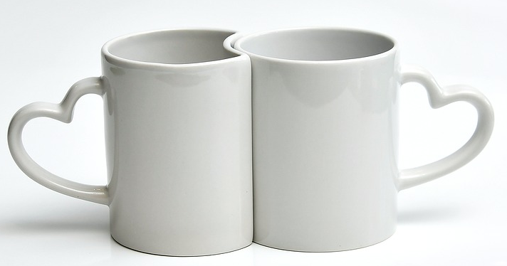
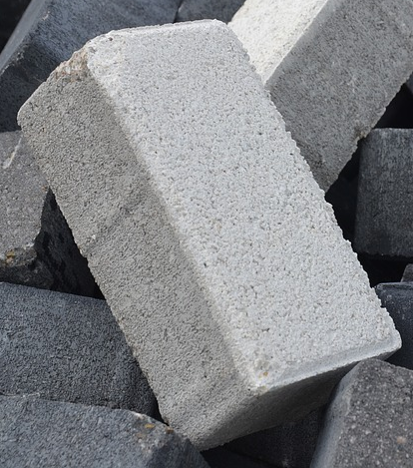
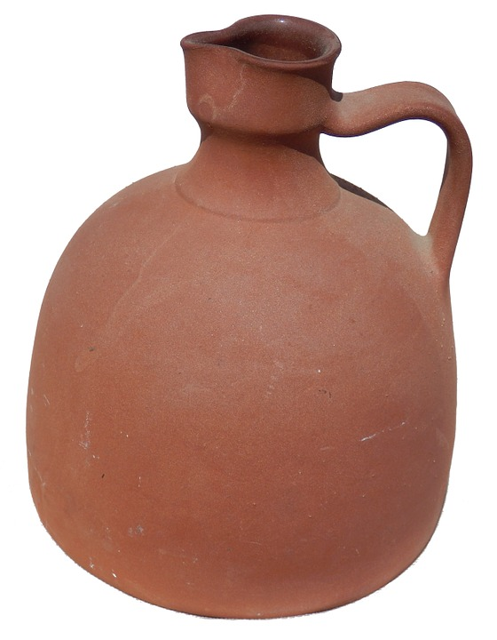
Mission Assignment: Describe the properties of ceramics
KS3-17-03
Properties of Ceramics
Complete the table with the following information.
Raw material – the starting substance(s) obtained from the Earth needed to make the ceramic, e.g. wood, sand, oil, clay, ore.
How is it made – what happens to the raw materials to convert them into the ceramic.
Properties - these are observable or can be measured. Examples are:
Colour
Hard / Soft
Strong / Weak
Heat resistant
Electrical conductors / insulators
Heat conductors / insulators
Low density / High density
Flexible / Stiff
Malleable (can be made into different shapes)
Brittle (shatter when struck)
Porous / non-porous (a substance is porous if water/liquid can soak into it)
Chemical resistant (inert) does not react with other chemicals
Unique properties for its use – which of the properties you have looked at means that the ceramic has a particular use?
Developing Experts Copyright 2023 All Rights Reserved

Slide 2
Mission Assignment: Describe the properties of ceramics
KS3-17-03
Properties of ceramics
Examine samples of different ceramics and complete the table below with your research and observations. Include a description about what makes each ceramic unique.
Unique properties for its use
Properties
How is it made
Raw material
Ceramic | Concrete | Earthenware | Brick | Glass | Porcelain
Developing Experts Copyright 2023 All Rights Reserved

Slide 3
Mission Assignment: Describe the properties of ceramics
KS3-17-03
What is meant by the term ‘ceramic’?
__________________________________________________________________________________________________________________________________________________________________
List three properties all ceramics have in common.
___________________________________________________________________________________________________________________________________________________________________________________________________________________________________________________
Describe how ceramics are processed to transform them from their raw materials into their final product.
____________________________________________________________________________________________________________________________________________________________________________________________________________________________________________________________________________________________________________________________________
Bricks are a ceramic made by baking moulded clay. Suggest two advantages and two disadvantages of using bricks as a building material
advantages _____________________________________________________________________
__________________________________________________________________________________________________________________________________________________________________
disadvantages __________________________________________________________________
__________________________________________________________________________________________________________________________________________________________________
Challenge: Suggest why ceramics are commonly found in kitchens and bathrooms.
_____________________________________________________________________________________________________________________________________________________________________________________________________________________________________________________________________________________________________________________________________________________________________________________________________________________
Developing Experts Copyright 2023 All Rights Reserved

Slide 4
Mission Assignment: Describe the properties of ceramics
ANSWERS
KS3-17-03
Properties of ceramics
Examine samples of different ceramics and complete the table below with your research and observations. Include a description about what makes each ceramic unique.
Unique properties for its use | Very strong and durable (long lasting) used in bridges, houses | Porous if unglazed used in plant pots | Fixed regular shape which allows to be fitted together to build walls | Borosilicate glass has higher melting point than soda-lime glass | Stronger and white in colour, high resistance to chemicals
Properties | Combining crushed rock and sand with water and cement | Clay is mixed with water shaped and then fired at around 1000 °C. | Clay mixed with water, shaped and fired in a kiln. | Heating raw materials until melts and then allowing molten liquid to cool. | Shaping the kaolin and then firing between 1,200-1,400 °C.
How is it made | Brittle, grey, strong, | Brittle, heat resistant, porous if unglazed | Brittle, heat resistant, porous | Brittle, translucent, non-porous, heat resistant | Brittle, hard, heat resistant white,
Raw material | Cement , sand and stones | Clay | Clay | Soda-lime - sand, sodium carbonate and limestone. Borosilicate – sand and boron trioxide | China clay (kaolin)
Ceramic | Concrete | Earthenware | Brick | Glass | Porcelain
Developing Experts Copyright 2023 All Rights Reserved

Slide 5
Mission Assignment: Describe the properties of ceramics
ANSWERS
KS3-17-03
What is meant by the term ‘ceramic’?
__________________________________________________________________________________________________________________________________________________________________
List three properties all ceramics have in common.
___________________________________________________________________________________________________________________________________________________________________________________________________________________________________________________
Describe how ceramics are processed to transform them from their raw materials into their final product.
____________________________________________________________________________________________________________________________________________________________________________________________________________________________________________________________________________________________________________________________________
Bricks are a ceramic made by baking moulded clay. Suggest two advantages and two disadvantages of using bricks as a building material
advantages _____________________________________________________________________
__________________________________________________________________________________________________________________________________________________________________
disadvantages __________________________________________________________________
__________________________________________________________________________________________________________________________________________________________________
Challenge: Suggest why ceramics are commonly found in kitchens and bathrooms.
_____________________________________________________________________________________________________________________________________________________________________________________________________________________________________________________________________________________________________________________________________________________________________________________________________________________
Substance made from non-metallic inorganic material
Brittle, inert, strong under compression
The clay is shaped and then baked in a kiln
Hard so not easily damaged
Strong under compression
Brittle so can break easily
Can crack with extreme changes in temperature
Liquids cannot soak into the ceramic, if glazed, as non-porous.
The clay is malleable so can be made into different shapes.
Ceramics are heat resistant so can be put in the oven and will not break.
Developing Experts Copyright 2023 All Rights Reserved

