Slide 1
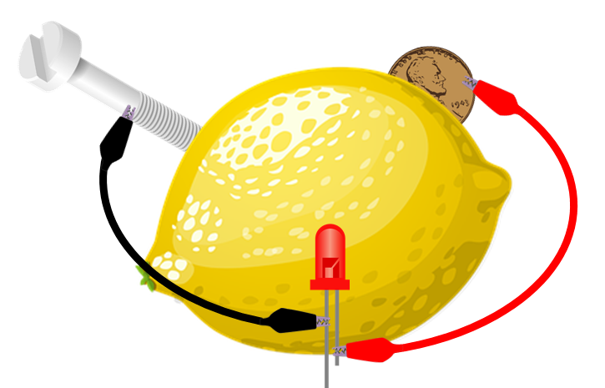
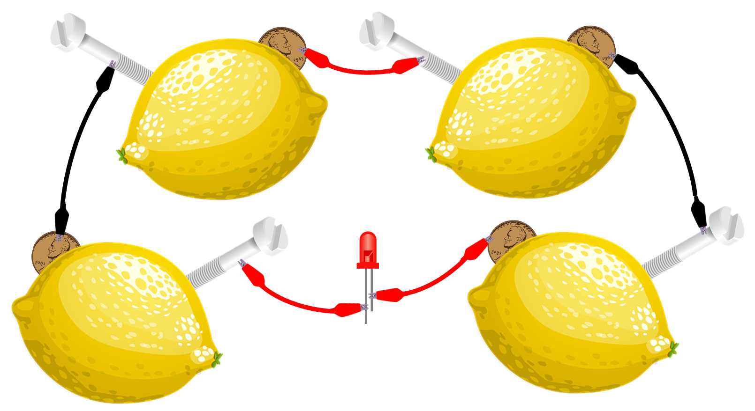
You are going to build a lemon battery. Then answer questions about the battery you have built
Build your battery
Push your zinc nail/screw and copper penny into the side of the lemon, so that they make contact with the juice inside.
Connect one end of a wire to the penny and the other end to the short wire of the LED.
Connect one end of another wire to the nail/screw and the other end to the long wire of the LED.
This will probably not be enough to power the LED, so you will have to make 3 more lemon batteries and connect them up in your circuit.
Explain why you need 4 lemons to make the LED light up.
_______________________________________________________________________________________________________________________________________
Explain why the lemons need to be arranged with the screw of one lemon wired to the penny of another.
__________________________________________________________________________________________
Explain why the metal parts need to be in contact with the lemon juice.
__________________________________________________________________________________________
What do you think would happen if you build the circuit with eight lemons?
__________________________________________________________________________________________
Stretch:
What do you think would happen if you changed the metal? Explain your ideas.
Challenge:
What other fruit do you think you could use to make a battery? Explain your ideas.

