Slide 1


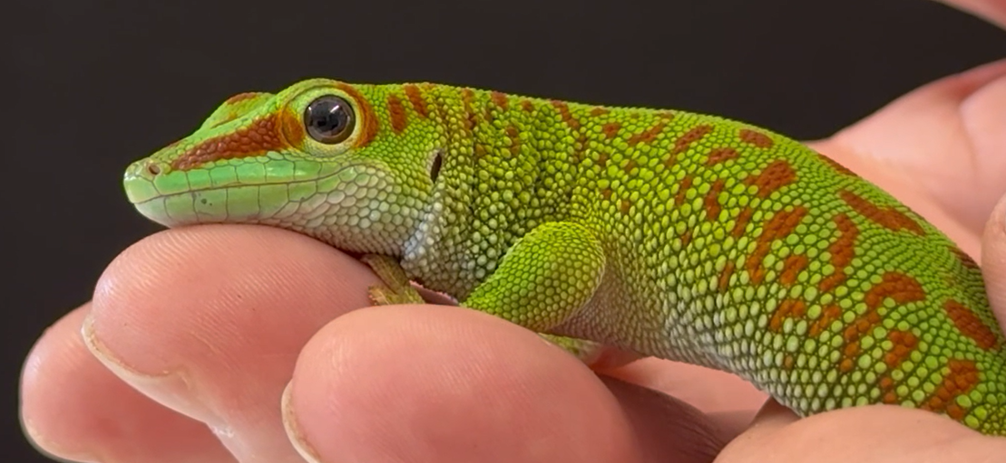
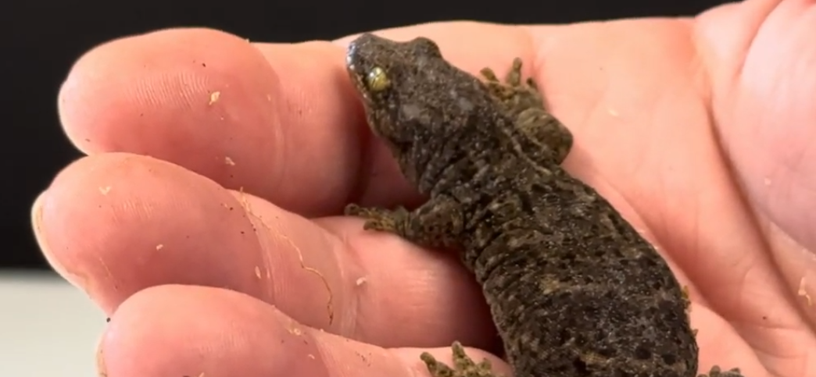
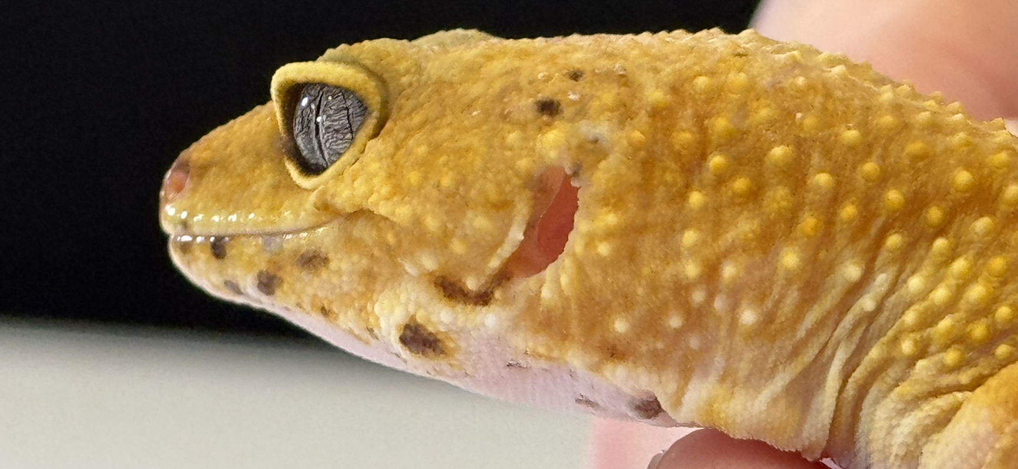
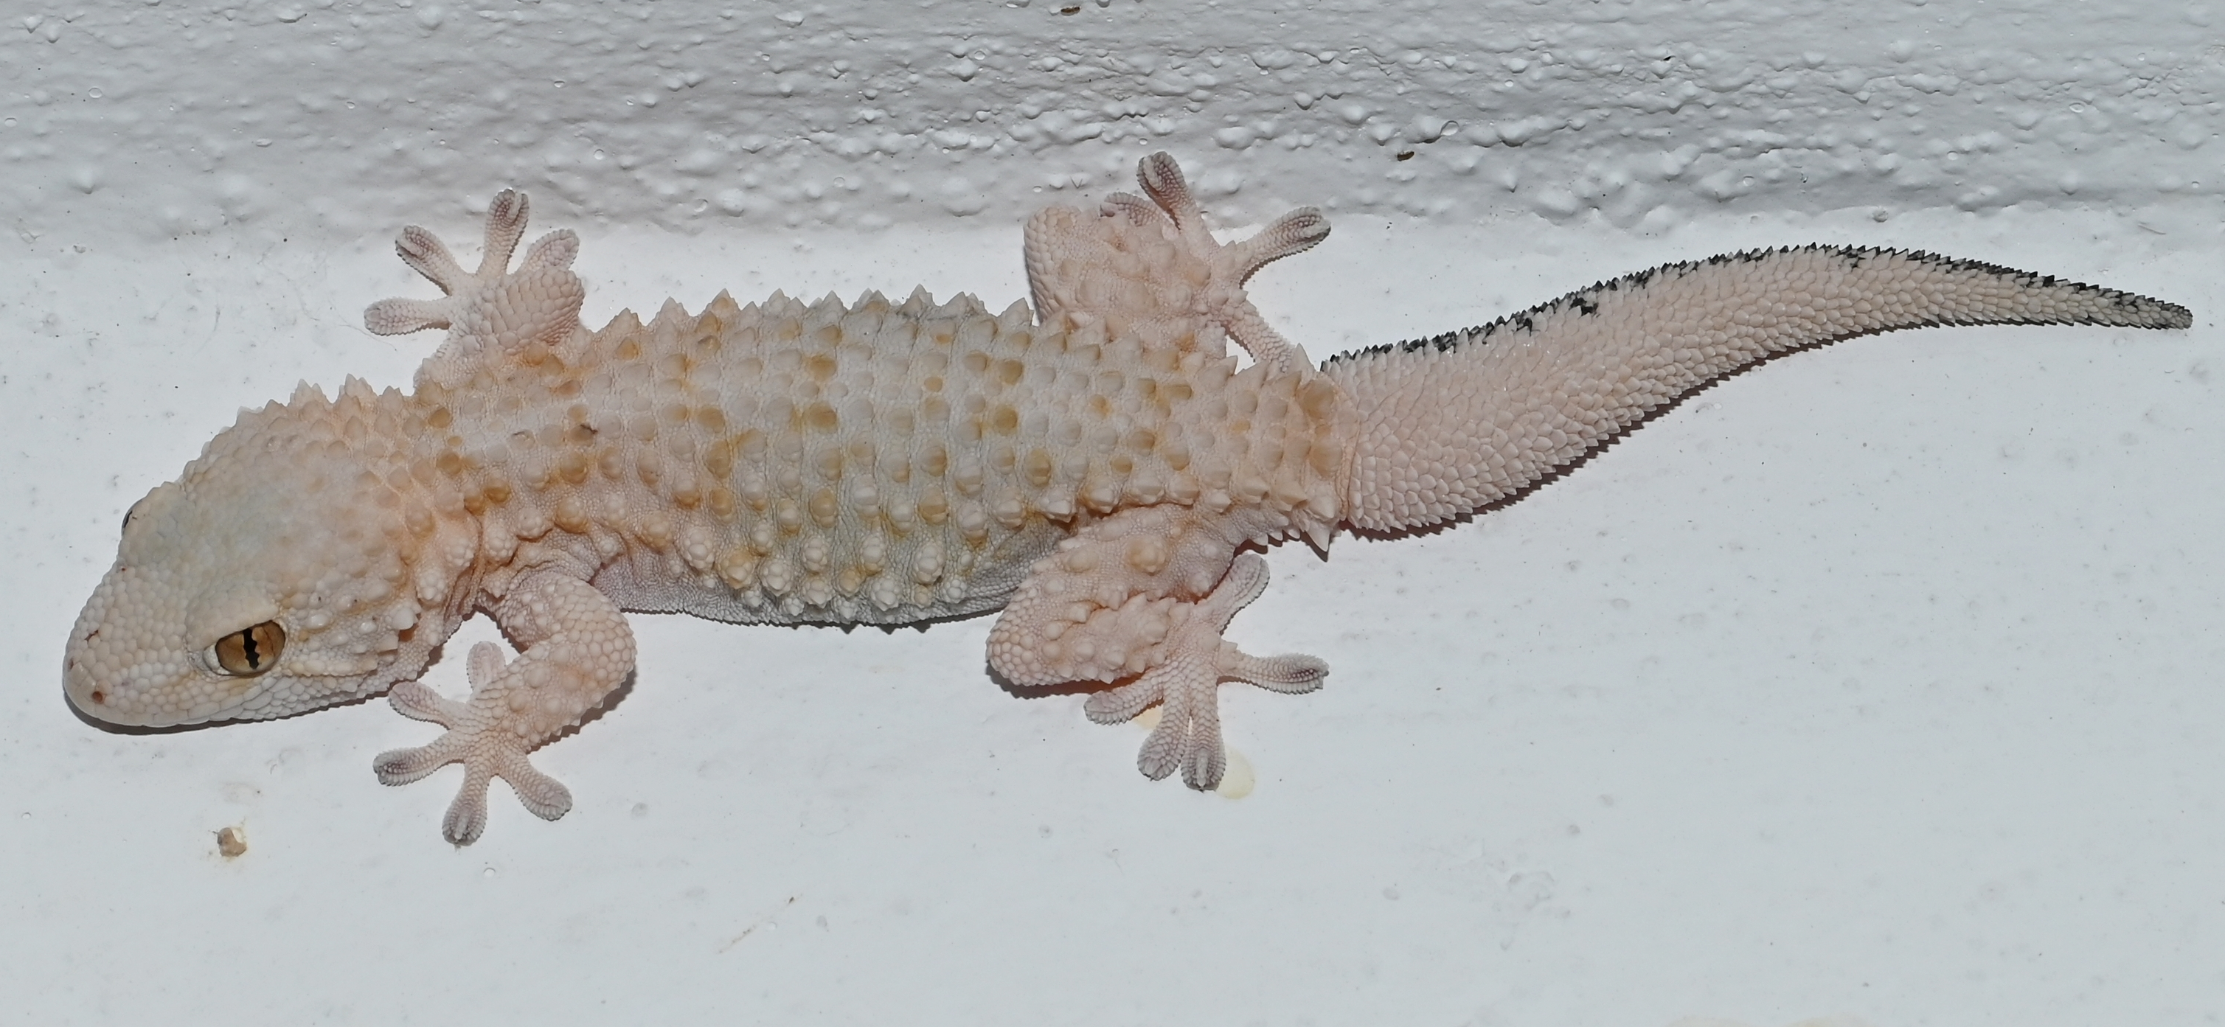
Science Week 2025
UKS2: Reptiles Uncovered: Adaptations, Habitats and Survival
Session 2
Activity 1: Write down the reptiles you know.
✓
________________________________________________________________________________________________________________________________________________________________________________________________________________________
What is a reptile? List their key features. ________________________________________________________________________________________________________________________________________________________________________________________________________________________
Activity 2: Write the habitat underneath each gecko. Include some facts for each one. ✓
Madagascar day gecko
New Zealand gecko
______________________________________________________________________________
______________________________________________________________________________
leopard gecko
house gecko
______________________________________________________________________________
______________________________________________________________________________
1
Developing Experts Copyright 2025 All Rights Reserved

Slide 2
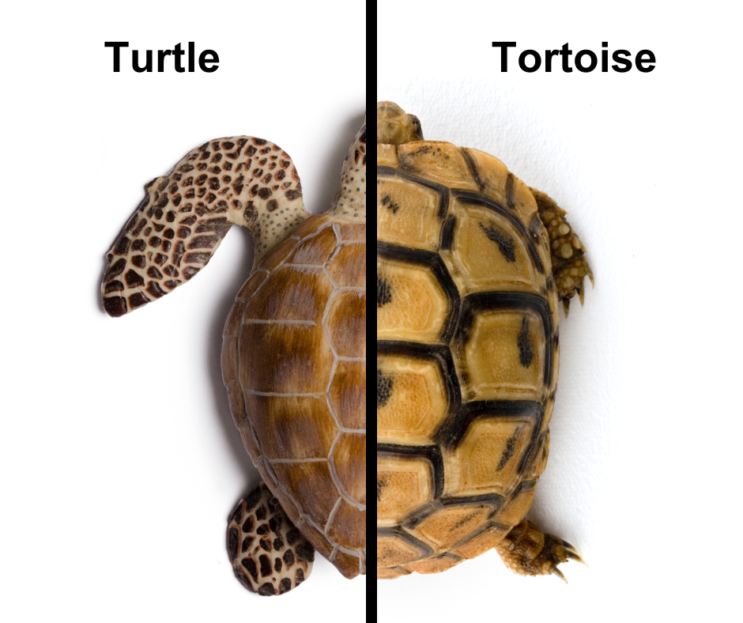
Science Week 2025
UKS2: Reptiles Uncovered: Adaptations, Habitats and Survival
Session 2
Activity 3: Label the features of a turtle and a tortoise. Label the adaptations each one has.
✓
What are the key differences between a tortoise and a turtle?
What adaptations do they have to thrive in their habitat? __________________________________________________________________________________________________________________________________________________________________
Challenge: Can you write a fact about the terrapin? ____________________________________________________________________________________________________________
2
Developing Experts Copyright 2025 All Rights Reserved

Slide 3
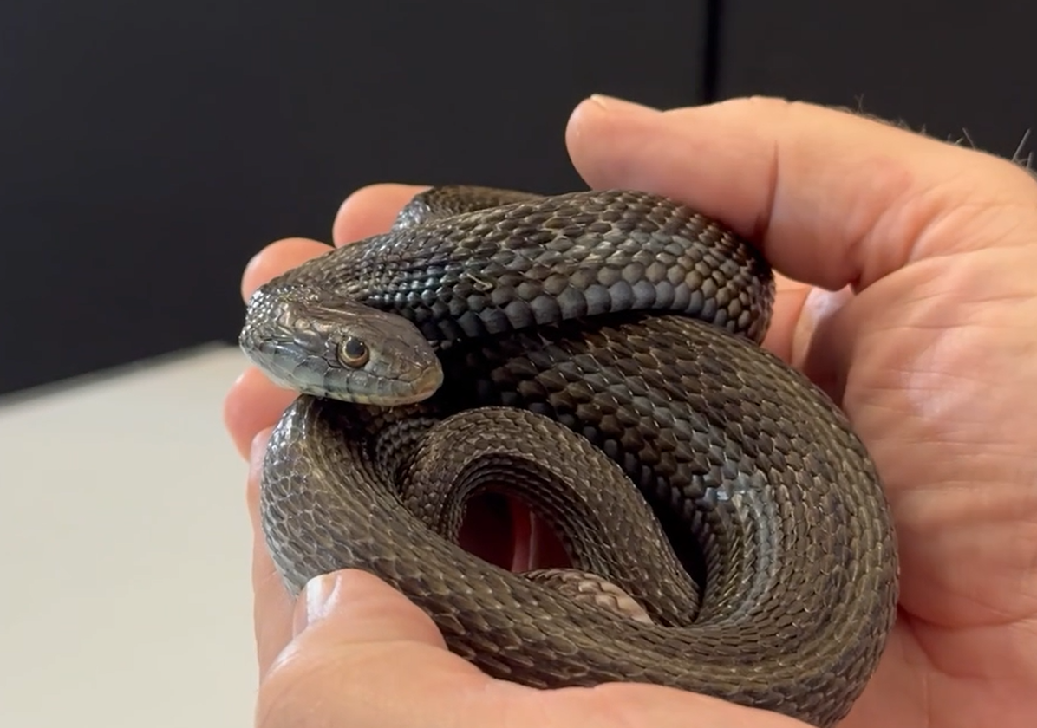
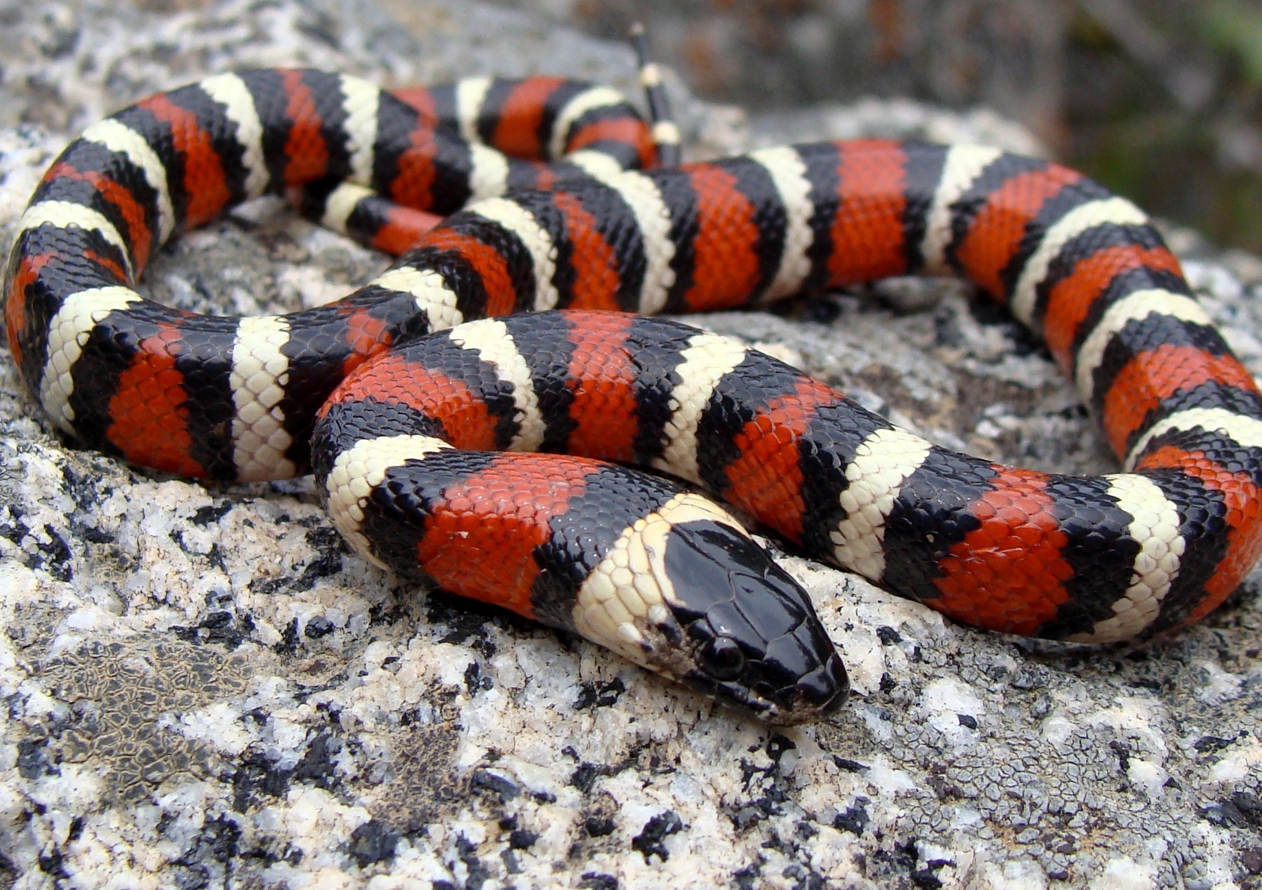
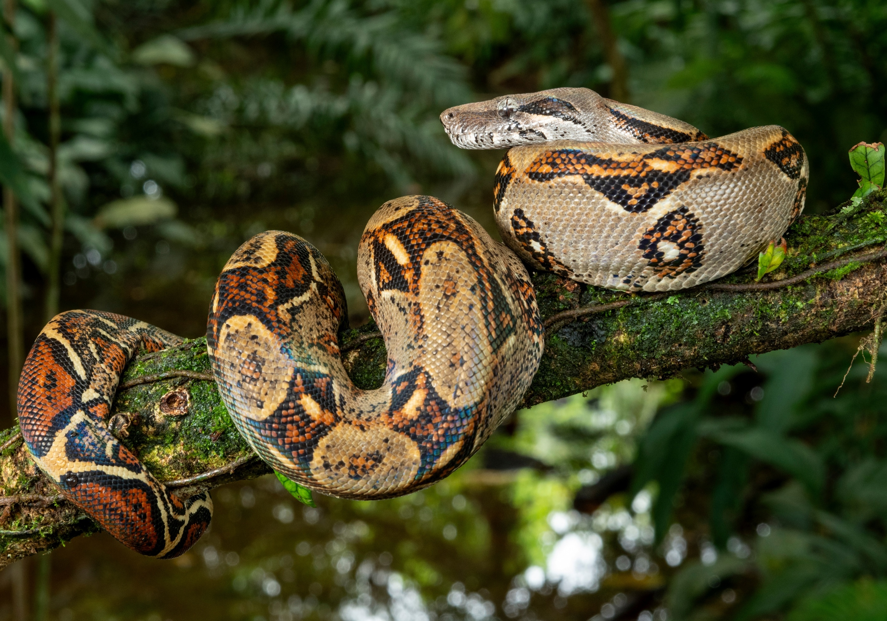
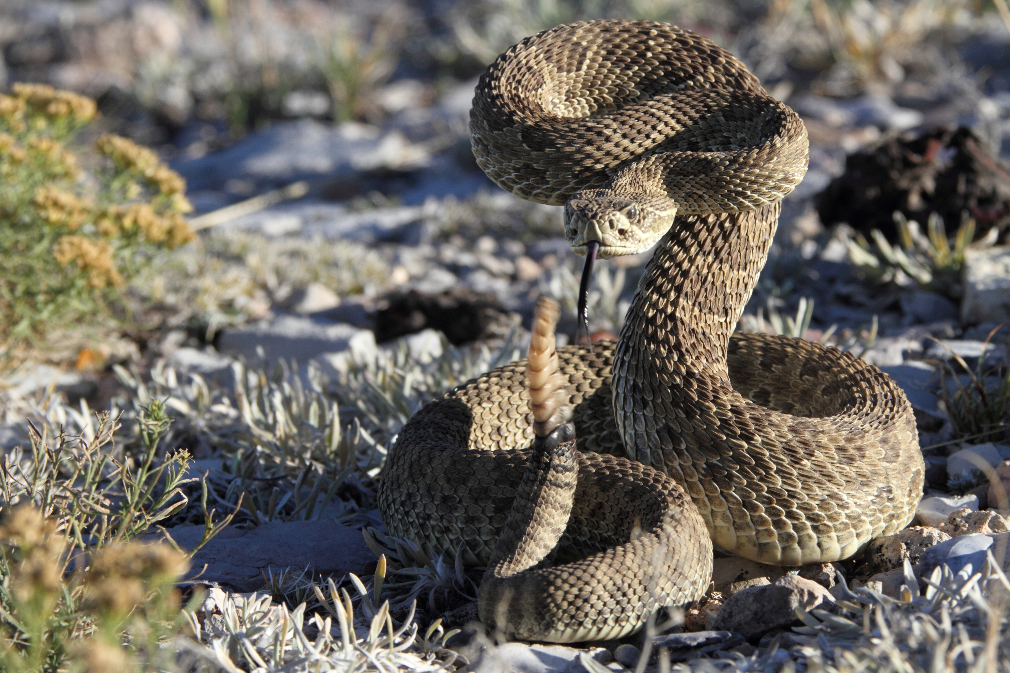
Science Week 2025
UKS2: Reptiles Uncovered: Adaptations, Habitats and Survival
Session 2
Activity 4: For each snake, write the following: 1. Its habitat; 2. What it eats; 3. How it kills prey (constrictor/venomous); 4. Other facts.
✓
garter snake
king snake
_______________________
_______________________
_______________________
___________________________________________________________________________________________________________________
_______________________
_______________________
_______________________
___________________________________________________________________________________________________________________
boa constrictor
rattlesnake
_______________________
_______________________
_______________________
___________________________________________________________________________________________________________________
_______________________
_______________________
_______________________
___________________________________________________________________________________________________________________
3
Developing Experts Copyright 2025 All Rights Reserved

