Slide 1
Teacher answers
Besides plutonium that can be used as an alternative uranium 235, thorium can be used as an alternative for nuclear power generation. It is more abundant on earth than uranium 235 and the technology to use it as nuclear fuel has been available for over 50 years.
Nuclear energy is described as a low carbon source because it is the surrounding infrastructure of mining and processing the fuel that creates the carbon footprint. Additionally, to build and commission a nuclear power station takes 17 years - before any energy is produced. However, over a long lifetime that nuclear power station will produce clean fuel. That means that the high carbon content is offset throughout the lifetime of the production of energy.
(a) When comparing the consistency of energy produced from nuclear sources and wind sources, nuclear energy has consistent power generation, as wind energy depends on the weather to use the kinetic energy from the wind. (b) Technically, all energy demands are responded to by increasing capacity in the national grid itself; however, that is dependent upon which of those sources are generating energy. Obviously, wind and solar are weather dependent and only reliable at certain times. Biomass has low energy density and is slower to react to demand. Within the UK, there is very little energy generated from hydro. CCGT has been the preferred option, but with the changes to renewable energy because of the effects on climate change from using fossil fuels, CCGT is now being decommissioned. Nuclear energy produces the most stable form of consistent supply, although more capacity to generate nuclear energy needs to be created.
The main nuclear fuels are uranium and plutonium. In a nuclear power station, a nuclear reaction (chain reaction) takes place in the reactor pool using fuel rods with small uranium pellets. The reaction is controlled by deploying control rods to reduce the speed of the neutrons. The process generates extremes of of heat and nuclear energy is converted to heat energy:
heat is used to change water into steam in the boiler at a very high temperature
the steam drives the turbine (heat to kinetic energy) the higher the temp of the steam the more kinetic energy is produced
this drives the generator to produce electricity – kinetic to electrical energy

Slide 2
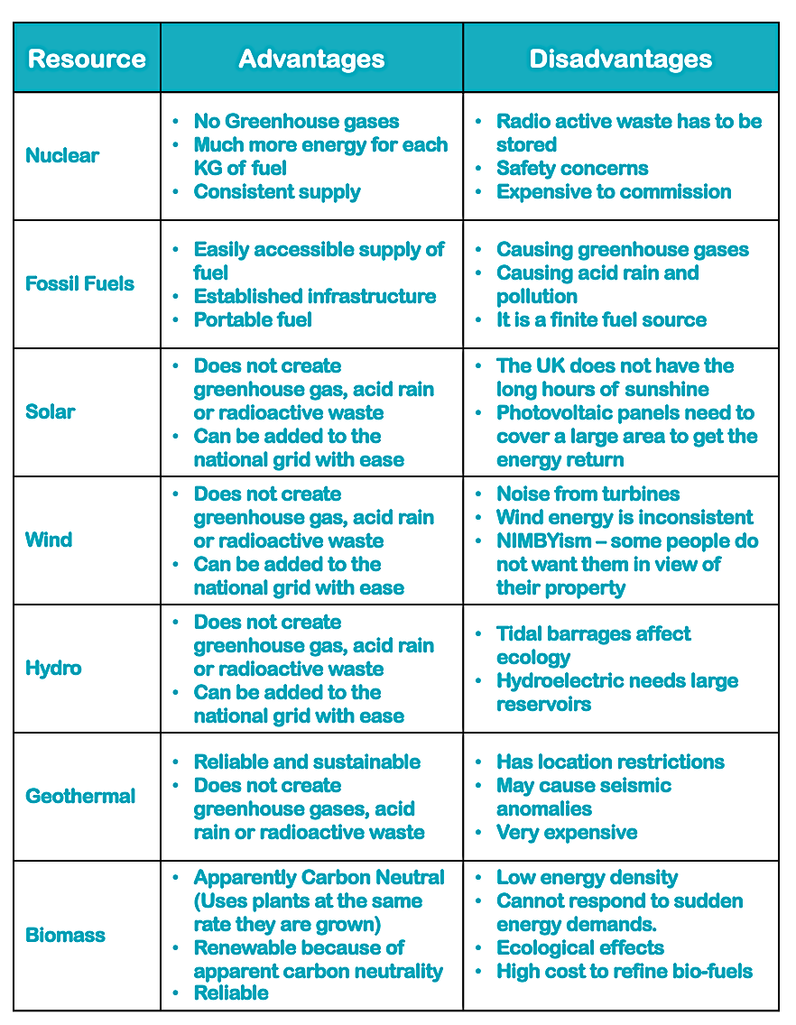
Teacher answers
(cont.)
that electrical energy is then stepped-up to a higher voltage for ease of transportation around the national grid

